Slide 1
Studio 2. Guidelines for Good Presentations
GE105
Introduction to Engineering Design College of Engineering
King Saud University
FALL 2017

Slide 2
Part I: Preparing Slides
Preparing slides is an important part of presentations
Badly prepared slides will make delivering good presentations difficult
Follow the necessary set of guidelines in order to prepare good slides

Slide 3
Know your audience
Know the technical levels in your audience
Do not target one level and ignore the others
Start with basic and careful introduction
Leave the highly technical material to the end

Slide 4
Time your talk
It is a “crime” to exceed the allotted time
Virtually any subject can be presented in any amount of time
Time limit does not mean present only generalities
A figure, table, or equation that does not specifically serve the point MUST go
Make sure that the content you include can be presented in the given time without having to speak too quickly

Slide 5
Minimize complex math
Include math ONLY if necessary
Equations slow the pace of the talk
They often create confusion
Focus instead on assumptions, techniques, and solutions

Slide 6
Be sensible about slides
Allow 1 or 2 minutes per transparency*
Avoid slides with one or two lines **
Avoid slides that are packed with too much information
No need to write full sentences
Use six to seven lines per slide whenever possible
Notes:
* Transparencies have been replaced, of course, with computer presentations, 1-2 min is maximum; recommended max. 30 sec / slide
** Enough lines to fill the slide and read comfortably from a distance

Slide 7
Organize your slides
First slide for title
Second slide for your outline
Have a good introduction (importance of the topic, motivation, etc.)
Avoid putting two different headings in one slide
One heading can span more than one slide

Slide 8
Try to make an attractive design
Choose a good slide background
Choose font colors to provide a good contrast
Choose a good font size and font type*
Try to use graphics, figures, block diagrams
Use animation whenever needed
Notes:
* Try to be simple, professional, and yet attractive and entertaining

Slide 9
Part II: Delivering a Speech
Public Speaking is a necessity of professional life
Your oral presentation is a presentation of yourself
Your ability to do your job may be questioned by your colleagues if you seem nervous or confused
Clarity, self-assurance, and skill get you the respect of the audience

Slide 10
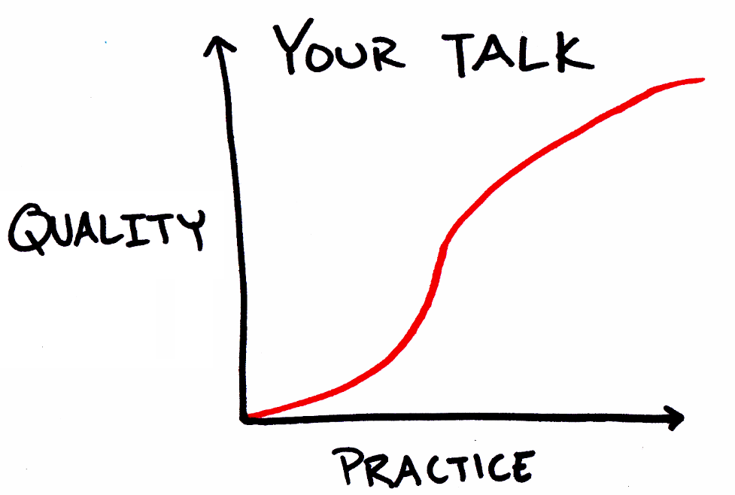
Before The Presentation
Practice & practice your talk
Unless you are a specially gifted speaker, REHEARSE
Rehearse in front of friends, spouse, colleagues, or alone (loudly)
Avoid writing your talk and reciting it

Slide 11
Before the Presentation (contn’d)
Pay attention to your appearance; people DO form an impression of you based in part of your appearance
Learn where the light switch and the pointer are BEFORE your talk
Think of where you will stand

Slide 12
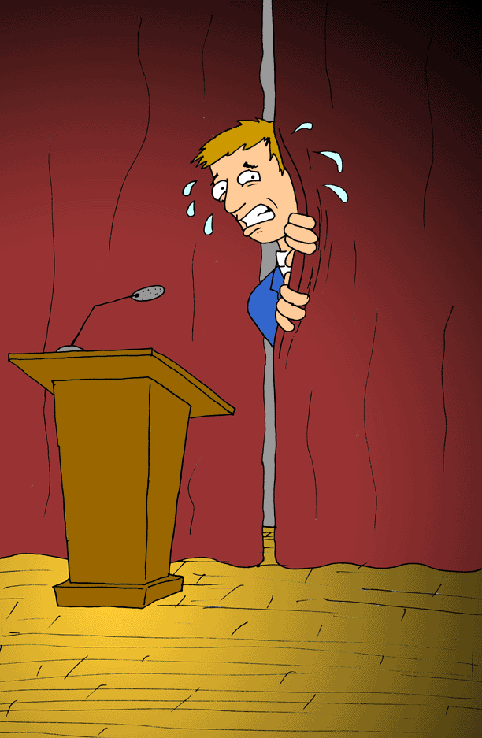
During the Presentation
Most people feel nervous during the talk
Usually the audience does not notice
Hide any nervous mannerism by leaning a little bit towards a table or podium
Resist the temptation to speak too quickly
Speak up (most people tend to start with a soft voice)

Slide 13
During the Presentation (contn’d)
Show some enthusiasm and energy to keep the audience attracted
Try to move around a bit to give some action
Do not block the view while moving
Use the pointer and not your hand to point to any part of the slide

Slide 14
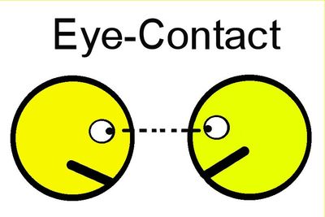
During the Presentation (contn’d)
Communicate with the audience (EYE CONTACT!)
Do NOT stare into the space above your audience, the floor or the slides
Pick out several friendly faces and establish eye contact (read the feedback)
Do NOT ignore any section in the room

Slide 15
Team Dynamics
Each member of the team should know where to stand what to present and when
Exchanging roles during presentation should be smooth (practice roles)
Show team spirit, harmony, and impressive attitude: “One for all and All for one”
The team leader should introduce the team-members and introducing himself last (before starting the presentation)

Slide 16
Team Dynamics (contn’d)
Avoid any sort of distraction when your team member is presenting
Focus on the audience and analyze feedbacks
Do not argue in front of the audience or contradict each other
Follow the team leader’s requests and respond to them professionally

Slide 17
The Questions Session
Let your questioner finish the question
Try to rephrase the question
Keep your answer short
Never argue with your questioner
Confess your ignorance

