Slide 1
E-Marketing/7E Chapter 13
E-Marketing Communication: Paid Media

Slide 2
Chapter 13 Objectives
After reading Chapter 13, you will be able to:
Outline the characteristics, benefits, and limitations of paid media.
List the most important paid media techniques and discuss how and when advertisers use each.
Explain the 3 unique aspects of social networks that attract advertisers to paid social media.
Describe some of the advertising tactics offered by the most popular social media sites, virtual worlds, and online video sites.

Slide 3
Chapter 13 Objectives, cont.
Discuss the various ways in which marketers can reach target audiences through mobile advertising and paid search.
Highlight how paid media can move B2B prospects through the marketing purchase funnel.
Identify some key metrics used by advertisers to determine the effectiveness and efficiency of paid media.

Slide 4
Lenovo Wins Big with Paid Media
Lenovo is a Chinese company that sells computers to both business and individual consumers.
In 2008 Lenovo began a successful remarketing campaign using specifically tailored Google ads for 3 different shopping behaviors:
General visitors.
Those who abandoned shopping carts.
Purchasers.
They continue to use this strategy for maximum effectiveness and efficiency.

Slide 5
Paid Media
The terms “paid media” and “advertising” are often used interchangeably.
Paid media can engage target markets and move them to owned media and social media conversation (earned media).
The most trusted digital media include branded Web sites, opt-in emails, coupons and recommendations from peers and contacts.

Slide 6
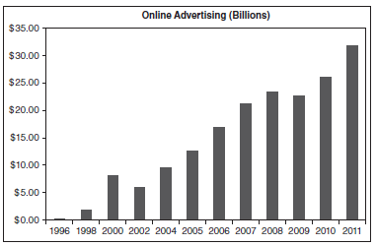
Internet Advertising Trends
Only 16% of internet users click on ads today and 8% of users account for 85% of all clicks.
U.S. online advertising grew to $31 billion in 2011, approximately 23% of all advertising dollars spent and more than the amount spent on traditional print advertising.

Slide 7
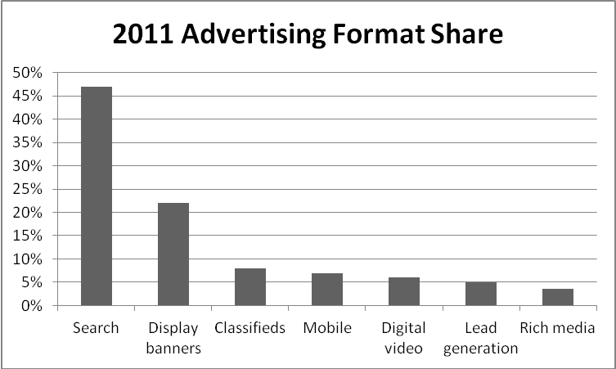
Paid Media Formats

Slide 8
Display Ads
22% of all online ad revenue is for display ads, which can contain text, graphics, and animation and allow users to click through.
The Interactive Advertising Bureau (IAB) claims that 80% of online marketers follow their standard dimensions for display ads, which can include:
Billboards
Filmstrips
Portraits
Sidekicks
Sliders

Slide 9
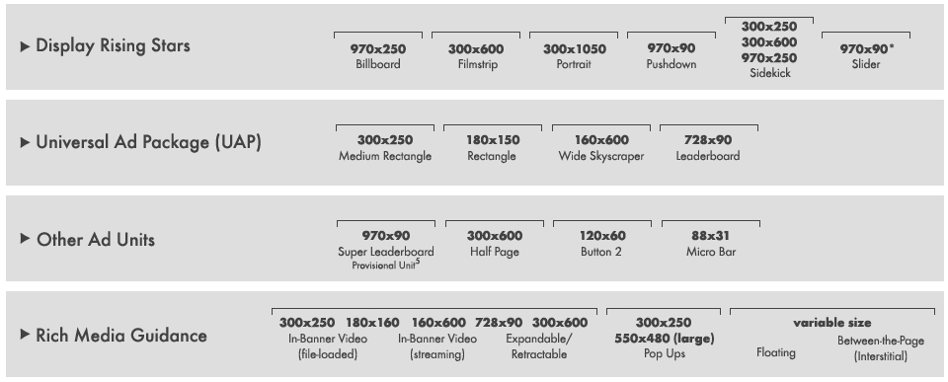
IAB Display Advertising Guidelines

Slide 10
Rich Media Ads
There are numerous formats for highly interactive rich media ads. Some can sense mouse movement, while others have built-in games or videos.
In-banner video ad
Expandable ad
Pop-up and Pop-under
Floating ad
Interstitial ad
Wallpaper ad
Trick banner ad
Map ad

Slide 11
Contextual Advertising
Contextual advertising occurs when an ad system scans a Web page for content and serves an appropriate ad.
Google’s AdSense and Microsoft’s adCenter offer this service.
Behavioral advertising is a form of contextual advertising, but follows user behavior instead of page content.
Remarketing is a tactic for communicating with users who previously visited a Web site.

Slide 12
Social Media Advertising
In 2011, two-thirds of marketers conducted social media advertising and 18% said they intended to do so in 2012.
Four main objectives for paid branded content on social media sites:
Build brand awareness.
Engage existing customers.
Increase size of community.
Drive traffic to an online destination.
Advertising on social media is predicted to grow 15-34% faster than search ads over the next 5 years.

Slide 13
Paid Media on Facebook
Advertisers on Facebook can potentially reach over 1 billion members.
Facebook ads offer narrow targeting, 70 different languages, interactive features, ease of creation, and excellent metrics.
In 2011 Facebook introduced sponsored stories that integrate social endorsement into ads.

Slide 14
Twitter and LinkedIn Ads
Twitter launched promoted tweets, ads that appear as content at the top of a page or timeline, in 2010.
Advertisers can target Twitter users by 350 narrow interests.
Advertisers can use LinkedIn Direct Ads to target by:
Job title and function.
Industry or company size.
Seniority or age.
LinkedIn Group membership.

Slide 15
Paid media in Online Videos
Marketers can place ads before, during or after videos on sites such as YouTube and Vimeo.
In-stream videos are 15-30 seconds and can be pre-roll, mid-roll and video takeovers.
Interactive banners and buttons.
Branded player skins.
In-text video ads.
In October 2012 there were nearly 11 billion streaming video ads.

Slide 16
Mobile Advertising
E-marketer predicted that mobile ads would reach $2.61 billion in 2012.
Mobile advertising formats available to marketers include:
Paid search
Display ads
Full screen takeovers
Messaging
Location-based ads
Video
Voice
Apps

Slide 17
Mobile Advertising, cont.
Several issues affect the future of mobile ads.
Wireless bandwidth is currently small which affects downloads.
Limited ad-size due to small screens.
Advertising tracking requires different techniques.
Many mobile users are opposed to paying for ad time.
Despite the issues, content-sponsored ads on mobile device are likely to increase in the future.

Slide 18
Consumer Time Spent with Each Medium in 2012

Slide 19
Paid Search
Paid search occurs when an advertiser pays a search engine a fee:
to display its ad when users type in related keywords.
for directory submission.
for inclusion in a search engine index.
Paid search captured nearly half of all online advertising dollars in 2011.

Slide 20
Google AdWords Copy Design
A 25 character headline
70 character
lines for
description
Short Headline Goes Here
A short two-line description follows
and it completes the ad copy
www.displayurl.com/here
35 character display URL

Slide 21
Effective & Efficient Internet Buys
It is difficult to generalize about the most effective media because it varies widely based on many factors.
Efficiency is easier to determine by using 3 important metrics:
CPM (cost per thousand impressions)
CPA (cost per action)
CPC (cost per click)
Exhibit 13.13 displays many popular paid media metrics and the percentage of advertisers using them.

Slide 22
All rights reserved. No part of this publication may be reproduced, stored in a retrieval system, or transmitted, in any form or by any means, electronic, mechanical, photocopying, recording, or otherwise, without the prior written permission of the publisher. Printed in the United States of America.
Copyright © 2014 Pearson Education, Inc.
Publishing as Prentice Hall

