Slide 1
E-Marketing/7E Chapter 9
Product: The Online Offer

Slide 2
Chapter 9 Objectives
After reading Chapter 9, you will be able to:
Define product and describe how it contributes to customer value.
Discuss how attributes, branding, support services, and labeling apply to online products.
Outline some of the key factors in e-marketing enhanced product development.

Slide 3
The Google Story
In 1998, co-founders Brin and Page delivered an innovative new search strategy that ranked results on popularity as well as keywords.
Today, Google performs over a billion searches a day in 181 countries, speaks 146 languages and is the most-visited U.S. Web site.
Had revenues of $37.9B and 25.7% in net income in 2011 and continues to grow in sales, new markets, and new products offered.

Slide 4
The Google Story, cont.
Uses a media e-business model to generate revenue, 96% of its revenues from advertising.
Google’s product mix includes 24 search products, 3 advertising products, 20 applications, and many enterprise products.
Pays close attention to user value, keeps costs low, and delivers eyeballs to advertisers.
What types of products do you think Google will launch next?

Slide 5
Many Products Capitalize On Internet Properties
A product is a bundle of benefits that satisfies needs of organizations or consumers.
Includes goods, services, ideas, people, and places.
Products such as search engines are unique to the internet while others simply use the internet as a new distribution channel.
Organizations use research to determine what is important to customers when creating new products.
The marketing mix 4 Ps and CRM work together to produce relational and transactional outcomes with consumers.

Slide 6
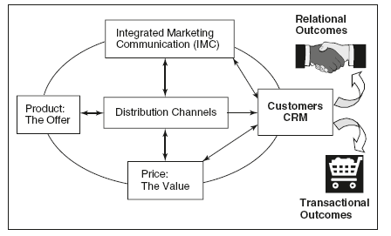
Marketing Mix & CRM Strategies & Tactics

Slide 7
Creating Customer Value Online
Customer Value = Benefits - Costs
Product decisions must be made that deliver benefits to customers.
Attributes
Branding
Support Services
Labeling
Packaging

Slide 8
Product Benefits: Attributes
Attributes include quality and specific features.
Benefits are the same features from a user perspective.
The internet increases customer benefits in ways that have revolutionized marketing.
Media, music, software, and other digital products can be presented on the Web.
Mass customization is possible.
User personalization of the shopping experience can be achieved.

Slide 9
Product Benefits: Branding
A brand includes a name, symbol, or other identifying information.
When a firm registers the information with the U.S. Patent Office, it becomes a trademark and is legally protected.
A brand represents a promise or value proposition to its customers.
Delivering on this promise builds trust, lowers risk, and helps customers by reducing stress of making product switching decisions.

Slide 10
Brand Equity
Brand equity is the intangible value of a brand, measured in dollars.
A great brand taps into popular culture and touches consumers.
Exhibit 9.3 displays rankings for some of the top brands.

Slide 11
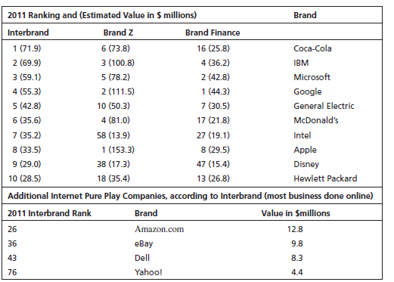
Highest Value Global Brands

Slide 12
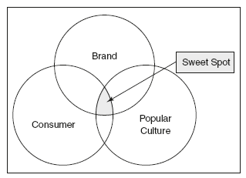
A Great Brand Intersects with Popular Culture and Touches Consumers

Slide 13
Brand Relationships and Social Media
The explosion of social media sites escalates the brand relationship process with peer-to-peer communication about brands.
Ernst & Young found that 63% of entertainment and media CEOs used social media to build brands.
Forrester Research identified 3 roles for social media in branding:
Build trust.
Differentiate the brand.
Nurture consumers to build brand loyalty.

Slide 14
5 Levels of Brand Relationship Intensity

Slide 15
Branding Decisions for Web Products
Firms can use existing brand names or create new brands on the internet.
Some firms may use different names offline and online to avoid risk if the new product or channel should fail.
Sports Illustrated created thriveonline.com.
Wired originally changed its online version name to Hotwired.

Slide 16
Creating New Brands for Internet Marketing
Good brand names should:
Suggest something about the product.
Differentiate the product from competitors.
Be suitable for legal protection.
On the internet, a good brand name should be short, memorable, easy to spell, and translate well into other languages.

Slide 17
Co-Branding
Co-branding occurs when two companies form an alliance and put their brand names on a product:
Sports Illustrated co-brands with CNN as CNNSI.
Yahoo! Has joined with TV Guide and Gist to provide TV listings.
EarthLink joined with Sprint in 1998 to provide ISP services.

Slide 18
Internet Domain Names
A URL (Uniform Resource Locator) is a Web site address.
Also called IP address and domain name.
http:// indicates that the browser should expect data using the hypertext protocol.
The top-level may be .com or a country name, such as .mx for Mexico or .uk for the United Kingdom.
“www” is no longer necessary and most sites register their name with and without it.

Slide 19
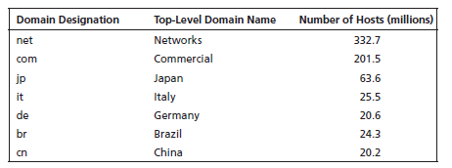
Largest Top-Level Domain Names

Slide 20
Internet Domain Names, cont.
The Internet Corporation for Assigned Names and Numbers (ICANN) is a non-profit corporation that makes decisions about protocol and names
.xxx and .post are two recently-approved extensions.
GoDaddy and other sites provide domain registration services at low cost.
More than 97% of words in the dictionary have already been registered as domain names.

Slide 21
Internet Domain Names, cont.
Organizations should purchase alternative or related names and spellings.
Coca-Cola owns cocacola.com, coca-cola.com and coke.com, among others.
Picking the right domain name can make a huge difference in:
Directing people correctly to a site.
Building consistency in marketing communications.

Slide 22
Support Services
Customer support is a critical component in the value proposition.
Customer service reps help customers with installation, maintenance, product guarantees, service warranties, etc. to increase customer satisfaction.
CompUSA combines online and offline channels to increase customer support.

Slide 23
Product Benefits: Labeling
Labeling has digital equivalents in the online world.
Online labels provide information about product usage and features.
Online labels also provide extensive legal information about the software product.
Online firms may add the Better Business Bureau logo or TRUSTe privacy shield.

Slide 24
FTC’s “Label” Page Discusses Its Privacy Policy

Slide 25
Customer Codesign via Crowdsourcing
Internet technology allows collaboration to occur electronically among consumers and across international borders.
Software developers often seek customer input about new products.
They often allow users to download beta version products, test them, and provide feedback.
Good marketers look for customer feedback to improve products.
Some set up sites to gather customer ideas and input: mystarbucksidea.com.

Slide 26
New-Product Strategies for E-Marketing
Many new products, such as YouTube, Yahoo!, and Twitter, were introduced by “one-pony” firms built around the company’s first successful product.
Other firms have added internet products to an already successful product mix.
Product mix strategies can help marketers integrate offline and online strategies.

Slide 27
Product Mix Strategies
Firms will select one or more of the following strategies, based on marketing objectives, risk tolerance, resource availability, etc.
Discontinuous innovations are new-to-the-world products.
New-product lines are new products in a different category for an existing brand name.
Additions to existing product lines.

Slide 28
Product Mix Strategies, cont.
Improvements or revisions of existing products.
Repositioned products can be targeted to different markets or promoted for new uses.
Me-too lower-cost products.

Slide 29
All rights reserved. No part of this publication may be reproduced, stored in a retrieval system, or transmitted, in any form or by any means, electronic, mechanical, photocopying, recording, or otherwise, without the prior written permission of the publisher. Printed in the United States of America.
Copyright © 2014 Pearson Education, Inc.
Publishing as Prentice Hall

