Slide 1
E-Marketing/7E Chapter 6
E-Marketing Research

Slide 2
Chapter 6 Objectives
After reading Chapter 6, you will be able to:
Identify the three main sources of data that e-marketers use to address research problems.
Discuss how and why e-marketers need to check the quality of research data gathered online.
Explain why the internet is used as a contact method for primary research and describe the main internet-based approaches to primary research.

Slide 3
Chapter 6 Objectives, cont.
Describe several ways to monitor the Web for gathering desired information.
Contrast client-side, server-side, and real-space approaches to data collection.
Explain the concepts of big data and cloud computing.
Highlight four important methods of analysis that e-marketers can apply to information in the data warehouse.

Slide 4
The Purina Story
Nestlé Purina PetCare wanted to know whether their Web sites and online advertising increased off-line behavior.
Nestlé Purina developed 3 research questions:
Are our buyers using our branded Web sites?
Should we invest beyond these branded Web sites in online advertising?
If so, where do we place the advertising?

Slide 5
The Purina Story, cont.
Online and offline shopping panel data revealed:
Banner click-through rate was low (0.06%).
31% of subjects exposed to Purina ads mentioned the Purina brand compared with 22% of the no-exposure subjects.
Home/health and living sites received the most visits from their customers.
The information helped the firm decide where to place banner ads.

Slide 6
Data Drive Strategy
U.S. marketers spend $6.7B annually on marketing research; global spend is $18.9B.
E-marketers can generate a great deal of data by using surveys, Web analytics, secondary data, social media conversations, etc.
Marketing insight occurs somewhere between information and knowledge.
Data without insight or application to inform marketing strategy are worthless.

Slide 7
Big Data
Big data refers to huge data sets that are difficult to manage and analyze.
31% of marketers would like to collect Web data daily.
74% collect demographic data; 64% collect transaction data; 35% monitor social media.
Purina, for example, sorts through hundreds of millions of pieces of data from about 21.5 million consumers to make marketing decisions.

Slide 8
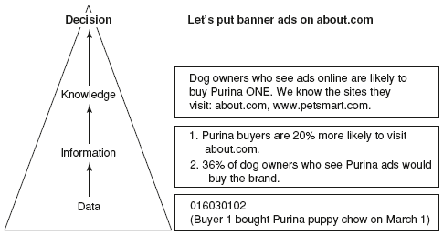
From Data to Decision: Nestlé Purina

Slide 9
Marketing Knowledge Management
Knowledge management is the process of managing the creation, use, and dissemination of knowledge.
Data, information, and knowledge are shared with internal decision makers, partners, channel members, and sometimes customers.
A marketing knowledge database includes data about customers, prospects and competitors.

Slide 10
The Electronic Marketing Information System
A marketing information system (MIS) is the process by which marketers manage knowledge.
Many firms store data in databases and data warehouses, available 24/7 to e-marketers.
The internet and other technologies facilitate data collection.
Secondary data provide information about competitors, consumers, the economic environment, technology, etc.
Marketers use the internet and other technologies to collect primary data about consumers.

Slide 11
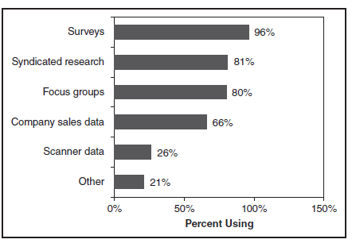
Most Common Data-Collection Methods

Slide 12
Source 1: Internal Records
Accounting, finance, production, and marketing personnel collect and analyze data for marketing planning.
Sales data.
Customer characteristics and behavior.
Universal product codes.
Tracking of user movements through Web pages.
Web sites visited before and after the firm’s Web site.

Slide 13
Source 2: Secondary Data
Can be collected more quickly and less expensively than primary data.
Secondary data may not meet e-marketer’s information needs.
Data was gathered for a different purpose.
Quality of secondary data may be unknown and data may be old.
Marketers continually scan the macroenvironment for threats and opportunities (business intelligence).

Slide 14
Public & Private Data Sources
Publicly generated data
U.S. Patent Office
International Monetary Fund
The World Factbook
American Marketing Association
Wikipedia
Privately generated data
comScore
Forrester Research
Nielsen/NetRatings
Interactive Advertising Bureau
Commercial online databases

Slide 15
Source 3: Primary Data
When secondary data are not available, marketers may collect their own information.
Primary data are information gathered for the first time to solve a particular problem.
Primary data collection can be enhanced by the internet:
Online experiments
Online focus groups
Online observation
Content analysis
Online survey research

Slide 16
Primary Research Steps

Slide 17
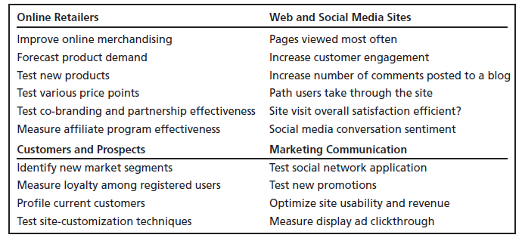
Typical Research problems for E-Marketers

Slide 18
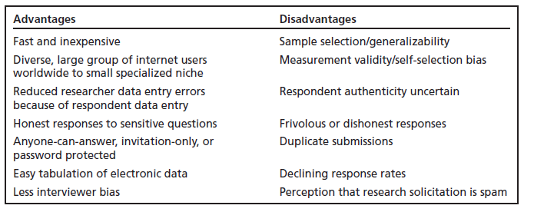
Advantages & Disadvantages of Online Survey Research

Slide 19
Online Panels
Online panels include people who have agreed to be subjects of marketing research.
Participants are usually paid and often receive free products.
Panels can help combat sampling and response problems, but can be more expensive than traditional methods of sample generation.

Slide 20
Ethics of Online Research
Companies conducting research on the Web often give respondents a gift or fee for participating.
Other ethical concerns include:
Respondents are increasingly upset at getting unsolicited e-mail requests for survey participation.
“Harvesting” of e-mail addresses from forums and groups without permission.
“Surveys” used to build a database.
Privacy of user data.

Slide 21
Other Technology-Enabled Approaches
Client-side Data Collection
Cookies.
PC meter with panel of users to track the user clickstream.
Server-side Data Collection
Site log software can generate reports on number of users who view each page, location of prior site visited, purchases, etc.
Real-time profiling tracks users’ movements through a Web site.

Slide 22
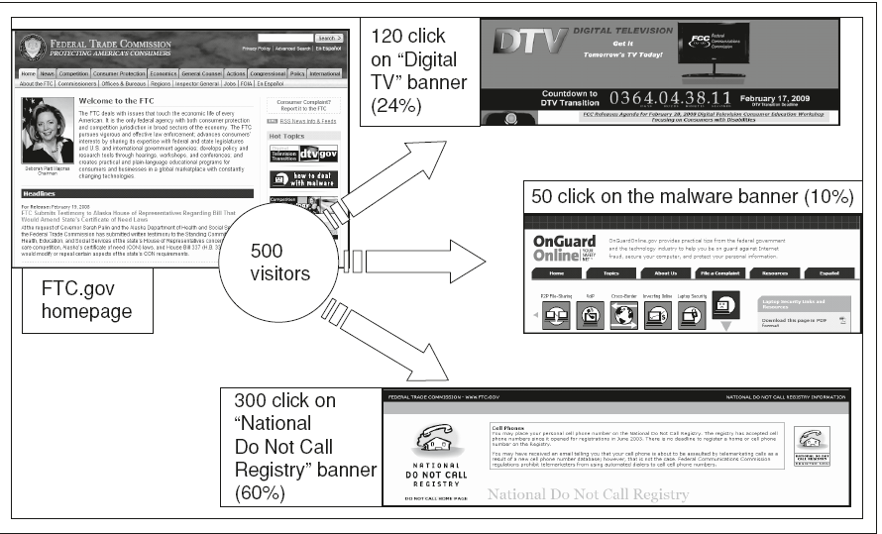
Following the Clickstream at FTC.gov

Slide 23
Real-Space Approaches
Data collection occurs at off-line points of purchase and information is stored and used in marketing databases.
Real-space techniques include bar code scanners and credit card terminals.
Catalina Marketing uses the UPC for promotional purposes at grocery stores.

Slide 24
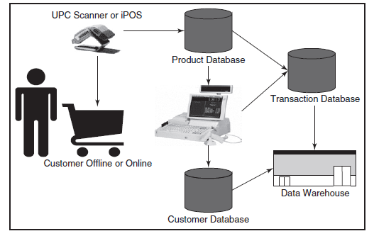
Real-space Data Collection & Storage Example

Slide 25
Marketing Databases & Data Warehouses
Product databases hold information about product features, prices, and inventory levels; customer databases hold information about customer characteristics and behaviors.
Data warehouses are repositories for the entire organization’s historical data, not just for marketing data.
The current trend in data storage is toward cloud computing: a network of online Web servers used to store and manage data.

Slide 26
Cloud Computing
Mobile phone
Data
content
Tablet
computer
Remote
servers
Company Web
server
Computer

Slide 27
Data Analysis and Distribution
Four important types of analysis for marketing decision making include:
Data mining
Customer profiling
RFM (recency, frequency, monetary value) analysis
Report generating

Slide 28
Knowledge Management Metrics
Two metrics are currently in widespread use for online data storage:
ROI: total cost savings divided by total cost of the installation.
Total Cost of Ownership (TCO): includes cost of hardware, software, labor, and cost savings.

Slide 29
All rights reserved. No part of this publication may be reproduced, stored in a retrieval system, or transmitted, in any form or by any means, electronic, mechanical, photocopying, recording, or otherwise, without the prior written permission of the publisher. Printed in the United States of America.
Copyright © 2014 Pearson Education, Inc.
Publishing as Prentice Hall

