Slide 1
E-Marketing/7E Chapter 3
The E-Marketing Plan

Slide 2
Chapter 3 Objectives
After reading Chapter 3, you will be able to:
Discuss the nature and importance of an e-marketing plan and outline its 7 steps.
Show the form of an e-marketing objective and explain the use of an objective-strategy matrix.
Describe the tasks that marketers complete in tiers 1 and 2 as they create e-marketing strategies.
List some key revenues and costs identified during the budgeting step of the planning process.

Slide 3
The Twitter Story
Started as a concept in a brainstorming meeting in 2006 to become the second most popular social network six years later.
Twitter took off after attendees sent text messages on 60-inch TV screens at the South by Southwest festival in 2007.
340 billion tweets/day and 140 million registered users in 2012.
Monetizes traffic by selling ad products: promoted Tweets, promoted trends and promoted accounts.

Slide 4
The E-Marketing Planning Process
The e-marketing plan is a blueprint for e-marketing strategy formulation and implementation.
Links the firm’s e-business strategy with technology-driven marketing strategies.
The plan serves as a road map to guide the firm, allocate resources, and make adjustments.

Slide 5
E-Marketing Plan
Legal – Ethical
Technology
Competition
Other Factors
E
internet
Markets
SWOT
E-Marketing Plan
S
E-Business
Strategy
E-Marketing Strategy
E-Marketing Mix
CRM
P
Performance Metrics

Slide 6
Two Common Types Of Plans
Napkin Plan
Entrepreneurs may jot down ideas on a napkin or pad of paper.
Large companies might create a just-do-it, activity-based, bottom-up plan.
These ad hoc plans may work and are sometimes necessary, but not recommended.
The Venture Capital E-Marketing Plan is a more comprehensive plan for those seeking start-up capital and long-term success.

Slide 7
Sources Of Funding
Where does an entrepreneur go for capital?
Bank loans
Private funds
Angel investors
Venture capitalists (VCs)
Venture capital investment in internet companies increased by 68% from 2010 to 2011.

Slide 8
Seven-Step E-Marketing Plan
Situation analysis
E-marketing strategic planning
Objectives
E-marketing strategy
Implementation plan
Budget
Evaluation plan

Slide 9
Step 1: Situation Analysis
Review the firm’s environmental factors and SWOT analysis.
Three key environmental factors are legal, technological and market-related factors, which are covered in Chapters 4, 5, and 7.
SWOT examines the company’s internal strengths and weaknesses and looks at external opportunities and threats.

Slide 10
SWOT Analysis Leading To E-Marketing Objective
Opportunities | Threats
Hispanic markets growing and untapped in our industry. Save postage costs through Facebook marketing. | Pending security law means costly software upgrades. Competitor X is aggressively using Facebook e-commerce.
Strengths | Weaknesses
Strong customer service department. Excellent Web/social media sites and database system. | Low-tech corporate culture. Seasonal business: Peaks during summer months.
E-Marketing Objective: $500,000 in revenues from e-commerce in one year.

Slide 11
Step 2: E-marketing Strategic Planning
Marketers uncover opportunities that help formulate the e-marketing objectives.
Marketers conduct analyses to determine strategies, such as Market Opportunity Analysis (MOA)
Demand & supply analysis for segmenting and targeting.
Segment analysis such as demographics.
Supply analysis to assist in forecasting. segment profitability and to find competitive advantages.

Slide 12
Step 3: Objectives
An objective in an e-marketing plan may include the following aspects:
Task (what is to be accomplished).
Measurable quantity (how much).
Time frame (by when).
Most e-marketing plans have multiple objectives:
Increase market share.
Increase the number of comments left on a blog.

Slide 13
Step 3: Objectives, cont.
Increase positive comments .
Increase sales revenue.
Reduce costs.
Achieve branding goals.
Increase database size.
Achieve customer relationship management goals.
Improve supply chain management.

Slide 14
Step 4: E-Marketing Strategies
Strategies related to the 4 Ps and relationship management to achieve objectives.
Product strategies: merchandise, content, services or advertising on its Web site.
Pricing strategies: dynamic pricing and online bidding.
Distribution strategies: direct marketing and agent e-business models.
Marketing communication strategies.
Relationship management strategies.

Slide 15
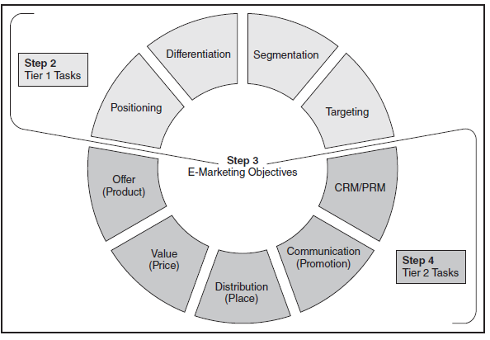
Steps 2, 3, and 4 of the E-Marketing Plan

Slide 16
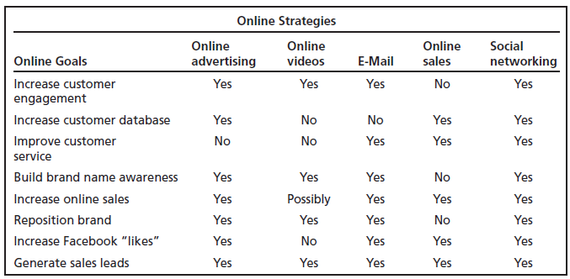
E-Marketing Objective- Strategy Matrix

Slide 17
Step 5: Implementation Plan
Tactics are used to achieve plan objectives.
Marketing mix (4 Ps) tactics.
Relationship management tactics.
Marketing organization tactics.
Staff, department structure.
Information-gathering tactics.
Website forms, cookies, feedback e-mail, social media comments and likes, etc.
Web site log analysis, business intelligence and secondary research.

Slide 18
Step 6: Budget
The plan must identify the expected returns from marketing investments, in order to develop:
Cost/benefit analysis
ROI calculation
Internal rate of return (IRR) calculation
Return on marketing investment (ROMI)

Slide 19
Revenues and Costs
Revenue forecast
Intangible benefits, such as brand equity
Cost savings
E-Marketing costs
Technology costs
Site design
Salaries
Other site development expenses
Marketing communication
Social media communication
Miscellaneous

Slide 20
Step 7: Evaluation Plan
Marketing plan success depends on continuous evaluation.
E-marketers must have tracking systems in place to measure results.
Various metrics relate to specific plan goals.
Today’s firms are ROI driven.
E-marketers must show how intangible goals will lead to higher revenue.
Accurate and timely metrics can help justify expenditures.

Slide 21
All rights reserved. No part of this publication may be reproduced, stored in a retrieval system, or transmitted, in any form or by any means, electronic, mechanical, photocopying, recording, or otherwise, without the prior written permission of the publisher. Printed in the United States of America.
Copyright © 2014 Pearson Education, Inc.
Publishing as Prentice Hall

