Slide 1
Stat 337
Design and Analysis of Experiments
Ruba alyafi

Slide 2
Instructor: Ruba Alyafi
Office: 3rd f-66 Building #5,
E-mail: ralyafi@ksu.edu.sa
Recommended Books:
Design and Analysis of Experiments, D. C. Montgomery, Wiley and Sons,
Course Scope Contents:
مقدمة، استعراض أساسيات االستدالل اإلحصائي. المبادئ الرئيسية للتصميم التجريبي )التكرار – العشوائية - القطاعات(، مقارنات التجارب البسيطة ، اختبار تي واالختبارات المماثلة.
تجارب عامل واحد: التصميم تام العشوائية - فحص كفاية ومالءمة النموذج - التضادات والتضادات المتعامدة - مقارنة أزواج من متوسطات المعالجات.
تصاميم القطاعات العشوائية: تصميم القطاع العشوائي التام - تصميم المربع الالتيني - تصميم المربع الالتيني األغريقي.
التصاميم العاملية. التصاميم العانملية بعاملين.
التصاميم العاملية ثالثية العوامل. التصاميم العاملية العامة.

Slide 3
Assignments and Tests:
Will be given during the classes
10 marks
Midterm test I
25 marks
Midterm test II
25 marks
Final Exam
As scheduled
40 marks
Attendance:
Student missing more than 25% of the total class hours won't be allowed to write the final exam.

Slide 4
Introduction
Investigators perform experiments in virtually all fields of inquiry, usually to discover something about a particular process or system.
This book is about planning and conducting experiments and about analyzing the resulting data so that valid and objective conclusions are obtained.
The three basic principles of experimental design are randomization, replication, and blocking.
Please read page 12 and 13

Slide 5
Chapter 1:Basic Statistical Method
In this chapter, we consider experiments to compare two conditions (sometimes called treatments). These are often called simple comparative experiments.
We will refer to the two different formulations as two treatments or as two levels of the factor.
The concepts of expected value and variance:
Please see page 29 – 30

Slide 6
If y1 and y2 are independent, we have

Slide 7
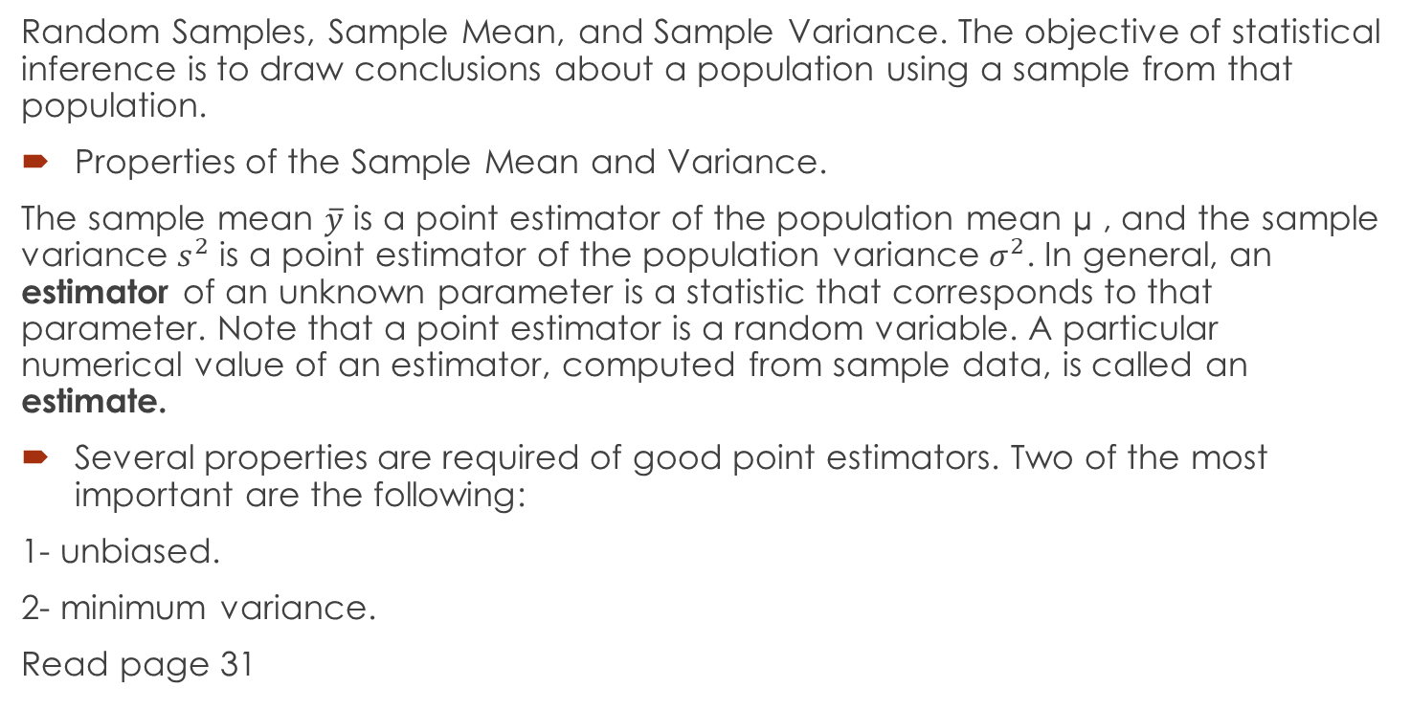
1.1Sampling and Sampling Distributions
Random Samples, Sample Mean, and Sample Variance. The objective of statistical inference is to draw conclusions about a population using a sample from that population.
Properties of the Sample Mean and Variance.
The sample mean $\overline{y}$ is a point estimator of the population mean µ , and the sample variance $s^{2}$ is a point estimator of the population variance $σ^{2}$. In general, an estimator of an unknown parameter is a statistic that corresponds to that parameter. Note that a point estimator is a random variable. A particular numerical value of an estimator, computed from sample data, is called an estimate.
Several properties are required of good point estimators. Two of the most important are the following:
1- unbiased.
2- minimum variance.
Read page 31

Slide 8
The Normal and Other Sampling Distributions. Often we are able to determine
the probability distribution of a particular statistic if we know the probability distribution of
the population from which the sample was drawn. The probability distribution of a statistic is called a sampling distribution. We will now briefly discuss several useful sampling distributions.
One of the most important sampling distributions is the normal distribution

Slide 10
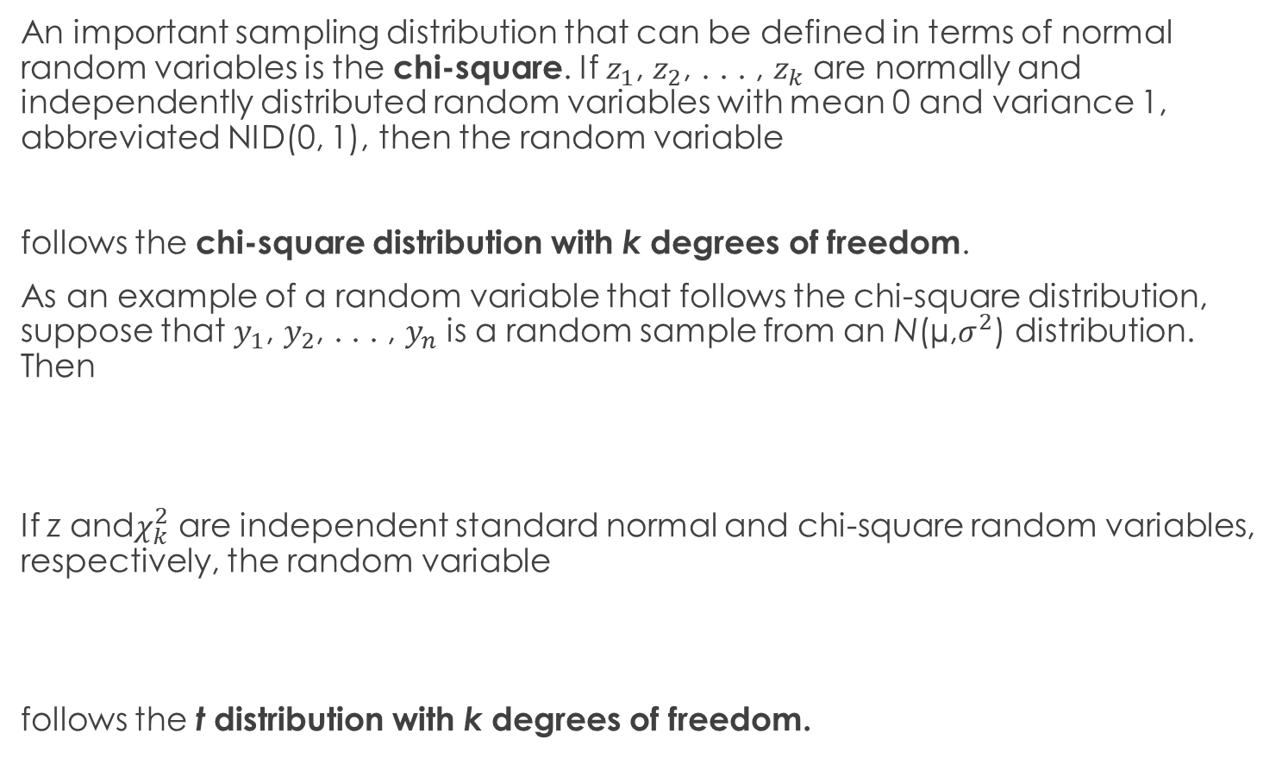
An important sampling distribution that can be defined in terms of normal random variables is the chi-square. If $z_{1}$, $z_{2}$, . . . , $z_{k}$ are normally and independently distributed random variables with mean 0 and variance 1, abbreviated NID(0, 1), then the random variable
follows the chi-square distribution with k degrees of freedom.
As an example of a random variable that follows the chi-square distribution, suppose that $y_{1}$, $y_{2}$, . . . , $y_{n}$ is a random sample from an N(µ,$σ^{2}$) distribution. Then
If z and$χ_{k}^{2}$ are independent standard normal and chi-square random variables, respectively, the random variable
follows the t distribution with k degrees of freedom.

Slide 11
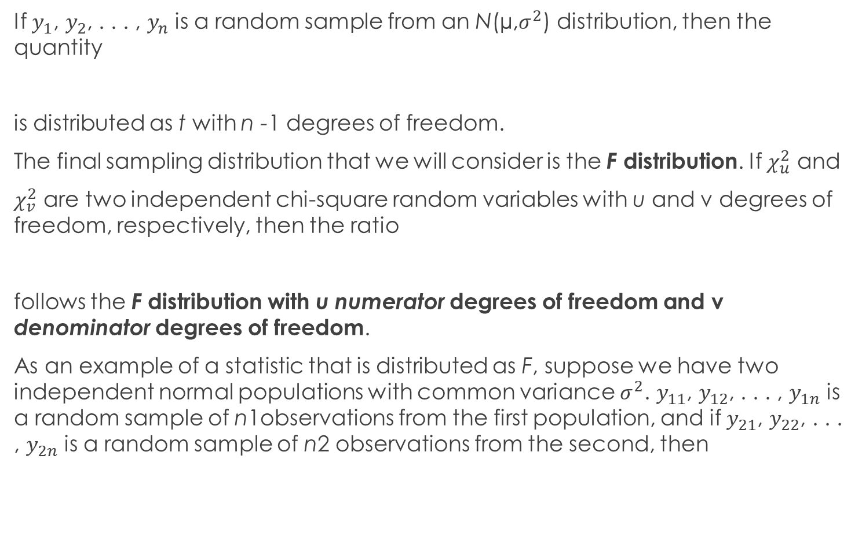
If $y_{1}$, $y_{2}$, . . . , $y_{n}$ is a random sample from an N(µ,$σ^{2}$) distribution, then the quantity
is distributed as t with n -1 degrees of freedom.
The final sampling distribution that we will consider is the F distribution. If $χ_{u}^{2}$ and
$χ_{v}^{2}$ are two independent chi-square random variables with u and v degrees of freedom, respectively, then the ratio
follows the F distribution with u numerator degrees of freedom and v denominator degrees of freedom.
As an example of a statistic that is distributed as F, suppose we have two independent normal populations with common variance $σ^{2}$. $y_{11}$, $y_{12}$, . . . , $y_{1n}$ is a random sample of n1observations from the first population, and if $y_{21}$, $y_{22}$, . . . , $y_{2n}$ is a random sample of n2 observations from the second, then

Slide 12
1.2 Inferences About the Differences in
Means, Randomized Designs

Slide 14
Hypothesis Testing
Please read pages 36-40
Two kinds of errors may be committed when testing hypotheses. If the null hypothesis is rejected when it is true, a type I error has occurred. If the null hypothesis is not rejected when it is false, a type II error has been made. The probabilities of these two errors are given special symbols

Slide 15
The Two-Sample t-Test
Example 1.1:
An engineer is studying the formulation of a Portland cement mortar. He has added a polymer latex emulsion during mixing to determine if this impacts the curing time and tension bond strength of the mortar. The experimenter prepared 10 samples of the original formulation and 10 samples of the modified formulation. We will refer to the two different formulations as two treatments or as two levels of the factor formulations. When the cure process was completed, the experimenter did find a very large reduction in the cure time for the modified mortar formulation. Then he began to address the tension bond strength of the mortar. If the new mortar formulation has an adverse effect on bond strength, this could impact its usefulness. The tension bond strength data from this experiment are shown in the Table

Slide 16
test the hypotheses:

Slide 17
The Use of P-Values in Hypothesis Testing: see page 40 output:

Slide 18
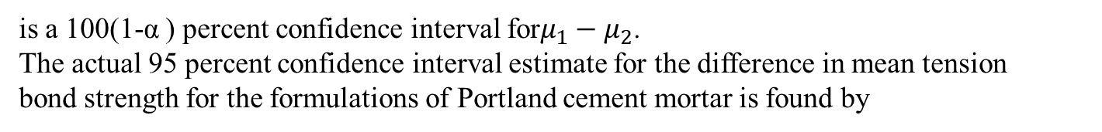
Confidence Intervals
is a 100(1-α ) percent confidence interval for$μ_{1}−μ_{2}$.
The actual 95 percent confidence interval estimate for the difference in mean tension
bond strength for the formulations of Portland cement mortar is found by

Slide 19
The Case Where${ σ}_{1}^{2}$ and $σ_{2}^{2}$ Are Known

Slide 20

The Case Where${ σ}_{1}^{2}$ ≠ $σ_{2}^{2}$ lets say we have the following data

Slide 21
Because the equal variance assumption is not appropriate here, we will use the two sample t-test described in this section to test the hypothesis of equal means.
The number of degrees of freedom are calculated
output

Slide 22
Comparing a Single Mean to a Specified Value
Please read page 51

Slide 23
How to calculate p-value

Slide 24
The Paired Comparison Problem page 53-57
We may write a statistical model that describes the data from this experiment as
Example:

Slide 25

Testing $H_{0}:μ_{1}=μ_{2}$ is equivalent to testing
This is a single-sample t-test. The test statistic for this hypothesis is
is the sample mean of the differences and
is the sample standard deviation of the differences.

Slide 26
For the data in Table we find
Where

Slide 27

Decision:
and because t-calculated 0.26 is less than t-table 2.262, we cannot reject the hypothesis $H_{0}$ that is, there is no evidence to indicate that the two tips produce different hardness readings.
Output:

Slide 28

Confidence interval:
We may also express the results of this experiment in terms of a confidence interval on $μ_{1}−μ_{2}$Using the paired data, a 95 percent confidence interval on $μ_{1}−μ_{2}$is

Slide 29
Inferences About the Variances of Normal Distributions page 57-59 note that:

Slide 30
Confidence interval:
Example:

Slide 31
Chapter 2: E x p e r i m e n t s w i t h a S i n g l e
F a c t o r : T h e A n a l y s i s o f Va r i a n c e
2.1 analysis of variance: page 68-69
Suppose we have a treatments or different levels of a single factor that we wish to compare. The observed response from each of the a treatments is a random variable. The data would appear as in Table 3.2. An entry in Table 3.2 (e.g., yij) represents the jth observation taken under factor level or treatment i. There will be, in general, n observations under the ith treatment.

Slide 32
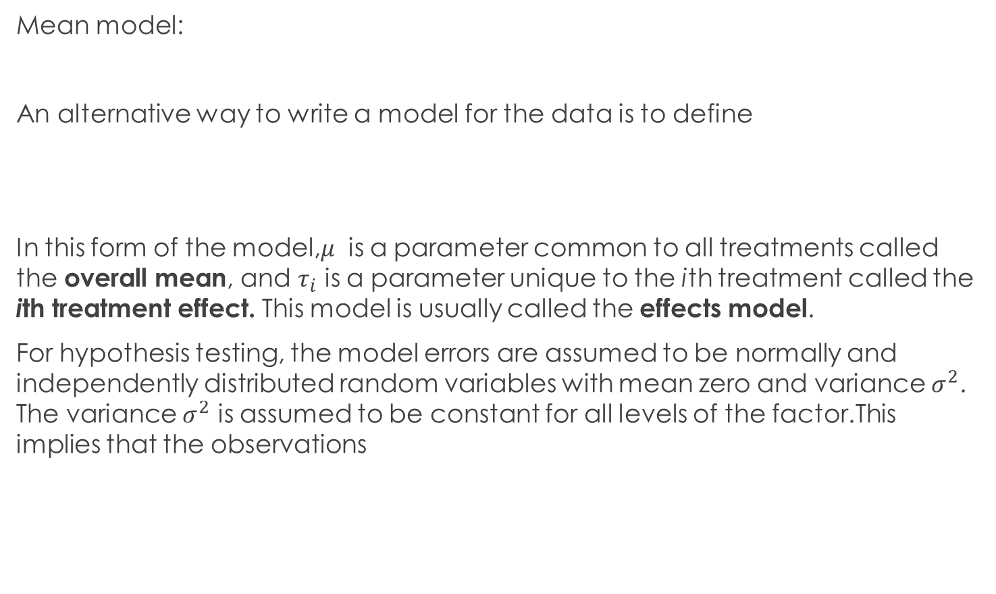
Models for the Data. We will find it useful to describe the observations from an experiment with a model. One way to write this model is
Mean model:
An alternative way to write a model for the data is to define
In this form of the model,$μ$ is a parameter common to all treatments called the overall mean, and $τ_{i}$ is a parameter unique to the ith treatment called the ith treatment effect. This model is usually called the effects model.
For hypothesis testing, the model errors are assumed to be normally and independently distributed random variables with mean zero and variance $σ^{2}$. The variance $σ^{2}$ is assumed to be constant for all levels of the factor.This implies that the observations

Slide 33
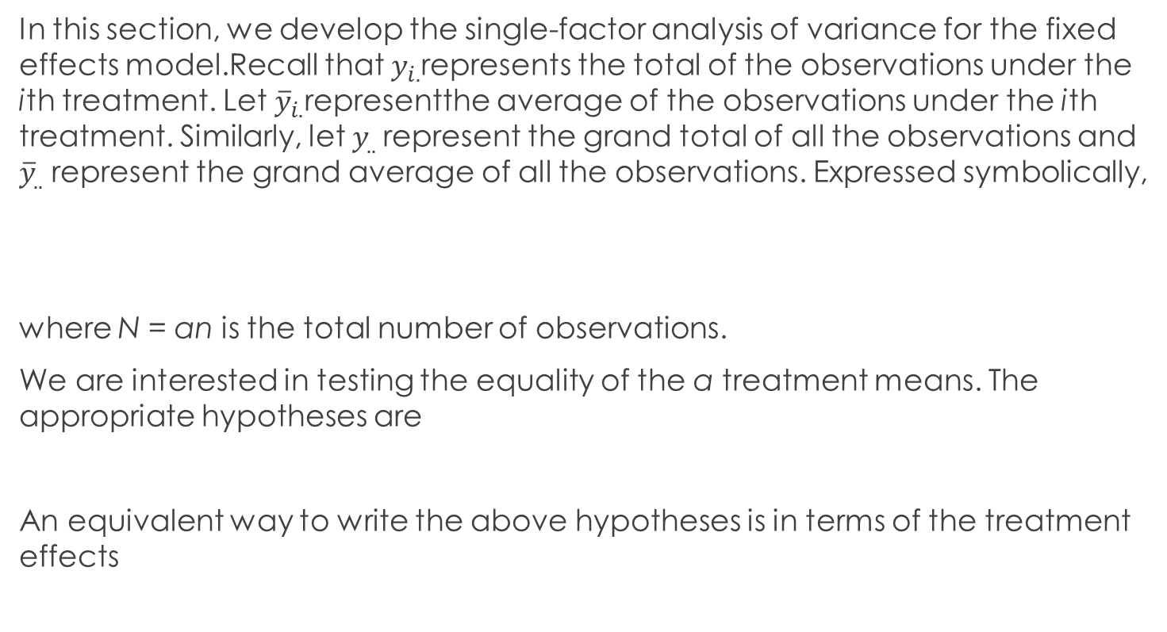
2.2 Analysis of the Fixed Effects Model page 70-
In this section, we develop the single-factor analysis of variance for the fixed effects model.Recall that $y_{i.}$represents the total of the observations under the ith treatment. Let ${\overline{y}}_{i.}$representthe average of the observations under the ith treatment. Similarly, let $y_{..}$represent the grand total of all the observations and ${\overline{y}}_{..}$ represent the grand average of all the observations. Expressed symbolically,
where N = an is the total number of observations.
We are interested in testing the equality of the a treatment means. The appropriate hypotheses are
An equivalent way to write the above hypotheses is in terms of the treatment effects

Slide 34
Decomposition of the Total Sum of Squares

Slide 35
Statistical Analysis page 73-77
Where
We reject the null hypothesis and conclude that there are differences in the treatment means if

Slide 36
Another approach used in calculations:

Slide 37
Example 1

Slide 38
Coding the observations

Slide 39

Estimation of the Model Parameters page 78
We now present estimators for the parameters in the single-factor model
Therefore, a 100(1-$α$ ) percent confidence interval on the ith treatment mean $μ_{i}$ and the difference in any two treatments means $μ_{i}−μ_{j }$, respectively are

Slide 40
Example:

Slide 41
Model Adequacy Checking page 80-84
reading

Slide 42
Comparison test page 94-100
Standardized Contrast
Scheffé’s Method for Comparing All Contrasts
Comparing Pairs of Treatment Means
Tukey’s Test.
Note: please bring book this part will be illustrated from the book directly.

Slide 43
C H A P T E R 4
Randomized Blocks ,Latin Squares , and Related Designs
4.1 The Randomized Complete Block Design page 139-146
Estimating Missing Values. Page 154-155
Estimating Model Parameters and the General Regression Significance Test
(only rules no proves) page 156

