Slide 1
Outline Stat 332
Regression Analysis

Slide 2
Instructor: Yusra A. Tashkandy
Office: 3rd f-66 Building #5,
E-mail: ytashkandi@ksu.edu.sa
Recommended Books:
Applied Linear Regression Models, John Neter, William Wasserman, Michael Kutner.
نماذج إحصائية خطية تطبيقية ( الجزء الأول)
المؤلف: نيتر واخرون.ترجمة: د. انيس كنجو – د. عبد الحميد الزيد – د. الحسيني عبد البر
Course Scope Contents:
Simple linear regression model - Multiple linear regression - Analysis of residuals and predictions. - Stepwise regression - Some nonlinear regression models and data transformations - Student will use statistical computer packages such as SAS, SPSS, Minitab

Slide 3
Assignments and Tests:
Attendance:
Student missing more than 25% of the total class hours won't be allowed to write the final exam.
Assignments and projects | Will be given during the classes | 10 marks
Midterm test I |  | 25 marks
Midterm test II |  | 25 marks
Final Exam | As scheduled | 40 marks

Slide 4
Chapter 1: Linear Regression with One
Predictor Variable
Regression analysis is a statistical methodology that utilizes the relation between two or more quantitative variables so that a response or outcome variable can be predicted from the other, or others. This methodology is widely used in business, the social and behavioural sciences, the biological sciences, and many other disciplines. A few examples of applications are:
1-Sales of a product can be predicted by utilizing the relationship between sales and amount of advertising expenditures.
(مبيعات منتج يمكن التنبؤ من خلال الاستفادة من العلاقة بين المبيعات وقيمة نفقات الدعاية)
2- The performance of an employee on a job can be predicted by utilizing the relationship between performance and a battery of aptitude tests.
)أداء موظف على وظيفة يمكن التنبؤ من خلال الاستفادة من العلاقة بين الأداء ونتيجة اختبارات الكفاءة(

Slide 5
3- The size of the vocabulary of a child can be predicted by utilizing the relationship between size of vocabulary and age of the child and amount of education of the parents.
(حجم المفردات للطفل يمكن التنبؤ بها من خلال الاستفادة من العلاقة بين حجم المفردات وعمر الطفل ودرجة تعليم الوالدين)
4-The length of hospital stay of a surgical patient can be predicted by utilizing the relationship between the time in the hospital and the severity of the operation.
(طول الإقامة في المستشفى للمريض الجراحي يمكن التنبؤ بها من خلال الاستفادة من العلاقة بين الوقت في المستشفى وشدة العملية.)

Slide 6
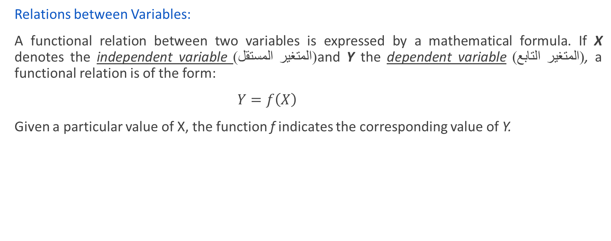
Relations between Variables:
A functional relation between two variables is expressed by a mathematical formula. If X denotes the independent variable (المتغير المستقل)and Y the dependent variable(المتغير التابع) , a functional relation is of the form:
$Y=f\left(X\right)$
Given a particular value of X, the function f indicates the corresponding value of Y.

Slide 7
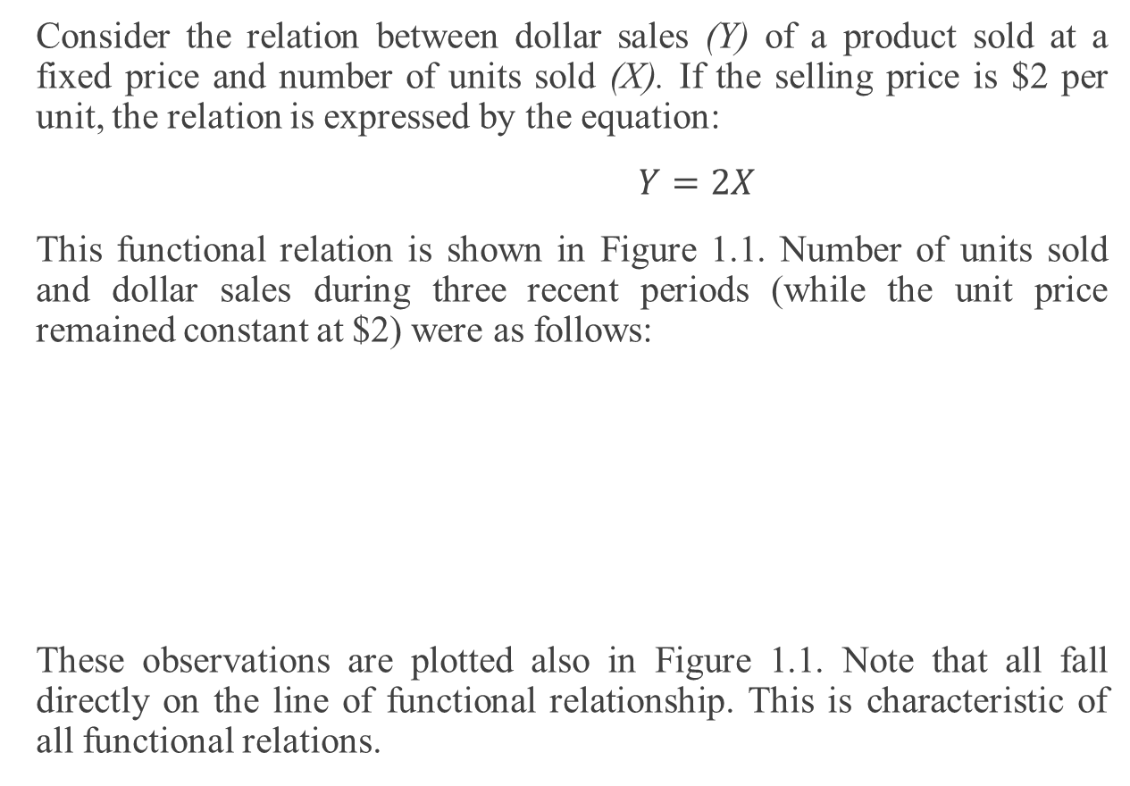
Example: Page 3
Consider the relation between dollar sales (Y) of a product sold at a fixed price and number of units sold (X). If the selling price is $2 per unit, the relation is expressed by the equation:
$Y=2X$
This functional relation is shown in Figure 1.1. Number of units sold and dollar sales during three recent periods (while the unit price remained constant at $2) were as follows:
These observations are plotted also in Figure 1.1. Note that all fall directly on the line of functional relationship. This is characteristic of all functional relations.
Period | Number of Units Sold | Dollar Sales
1 | 75 | $ 150
2 | 25 | $ 50
3 | 130 | $ 260

Slide 8
Statistical Relation between Two Variables
A statistical relation, unlike a functional relation, is not a perfect one. In general, the observations for a statistical relation do not fall directly on-the curve of relationship.
Example 1: Page 3
Performance evaluations for 10 employees were obtained at midyear and at year-end. These data are plotted in Figure 1.2a. Year-end evaluations are taken as the dependent or response variable Y, and midyear evaluations as the independent, explanatory, or predictor variable X. The plotting is done as before. For instance, the midyear and year-end performance evaluations for the first employee are plotted at X = 90, Y = 94. Figure l.2a clearly suggests that there is a relation between midyear and year-end evaluations, in the sense that the higher the midyear evaluation, the higher tends to be the year-end evaluation. However, the relation is not a perfect one. There is a scattering of points, suggesting that some of the variation in year-end evaluations is not accounted for by midyear performance assessments. For instance, two employees had midyear evaluations of X = 80, yet they received somewhat different year-end evaluations. Because of the scattering of points in a statistical relation, Figure 1.2a is called a scatter diagram or scatter plot. In statistical terminology, each point in the scatter diagram represents a trial or a case. In Figure 1.2b, we have plotted a line of relationship that describes the statistical relation between midyear and year-end evaluations. It indicates the general tendency by which yearend evaluations vary with the level of midyear performance evaluation.

Slide 9
Note that most of the points do not fall directly on the line of statistical relationship. This scattering of points around the line represents variation in year-end evaluations that is not associated with midyear performance evaluation and that is usually considered to be of a random nature. Statistical relations can be highly useful, even though they do not have the exactitude of a functional relation.
(الحصول على تقييم الأداء عن 10 موظفا في منتصف العام وحتى نهاية العام
Y تؤخذ تقييمات نهاية العام كمتغير تابع أو استجابة
X والتقييمات في منتصف العام باسم، توضيحي، أو متغير توقع المستقلة
من الرسم يشير بوضوح إلى أن هناك علاقة بين منتصف العام والتقييمات نهاية العام، بمعنى أنه كلما ارتفع تقييم منتصف العام، يميل أعلى ليكون التقييم في نهاية العام.
لاحظ أن معظم النقاط لا تقع مباشرة على خط العلاقة الإحصائية. هذا التشتت من النقاط حول خط يمثل الاختلاف في تقييم نهاية السنة التي لا ترتبط مع تقييم الأداء في منتصف العام والتي تعتبر عادة أن تكون ذات طبيعة عشوائية. يمكن أن العلاقات الإحصائية أن يكون مفيدا للغاية، على الرغم من أنها لا تملك الدقة من وجود علاقة وظيفية.)

Slide 11

Example of Mathematical relation:
$Y=2X+3$
At X=2 then Y=4+3=7
Statistical relation:
$Y_{i}=β_{0}+β_{1}X_{i}+ε_{i}$“ Simple linear regression model”
$Y_{i}=β_{0}+β_{1}X_{i1}+β_{2}X_{i2}+ε_{i}$“ Multiple regression model”
$Y_{i}=β_{0}+β_{1}X_{i}+β_{2}X_{i}^{2}+ε_{i}$“ Polynomial regression model”
$Y_{i}=\frac{1}{β_{0}+β_{1}X_{i}+ε_{i}}$ “ Nonlinear regression model”

Slide 12
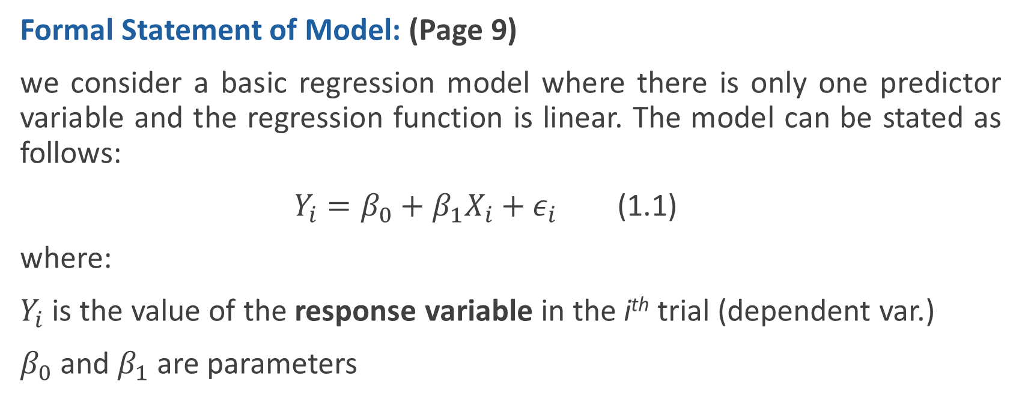
Simple Linear Regression Model with Distribution of Error Terms Unspecified
Formal Statement of Model: (Page 9)
we consider a basic regression model where there is only one predictor variable and the regression function is linear. The model can be stated as follows:
$Y_{i}=β_{0}+β_{1}X_{i}+ε_{i}$ (1.1)
where:
$Y_{i}$ is the value of the response variable in the i^{th} trial (dependent var.)
$β_{0}$ and $β_{1}$ are parameters

Slide 13
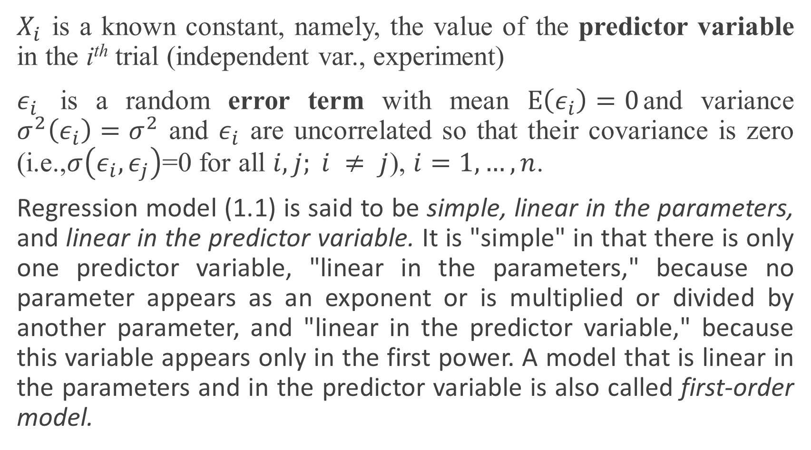
$X_{i}$ is a known constant, namely, the value of the predictor variable in the i^{th} trial (independent var., experiment)
$ε_{i}$ is a random error term with mean $E\left(ε_{i}\right)=0$and variance $σ^{2}\left(ε_{i}\right)=σ^{2}$ and $ε_{i}$ are uncorrelated so that their covariance is zero (i.e.,$σ\left(ε_{i},ε_{j}\right)$=0 for all $i, j; i ≠ j$), $i=1, …,n$.
Regression model (1.1) is said to be simple, linear in the parameters, and linear in the predictor variable. It is "simple" in that there is only one predictor variable, "linear in the parameters," because no parameter appears as an exponent or is multiplied or divided by another parameter, and "linear in the predictor variable," because this variable appears only in the first power. A model that is linear in the parameters and in the predictor variable is also called first-order model.

Slide 14
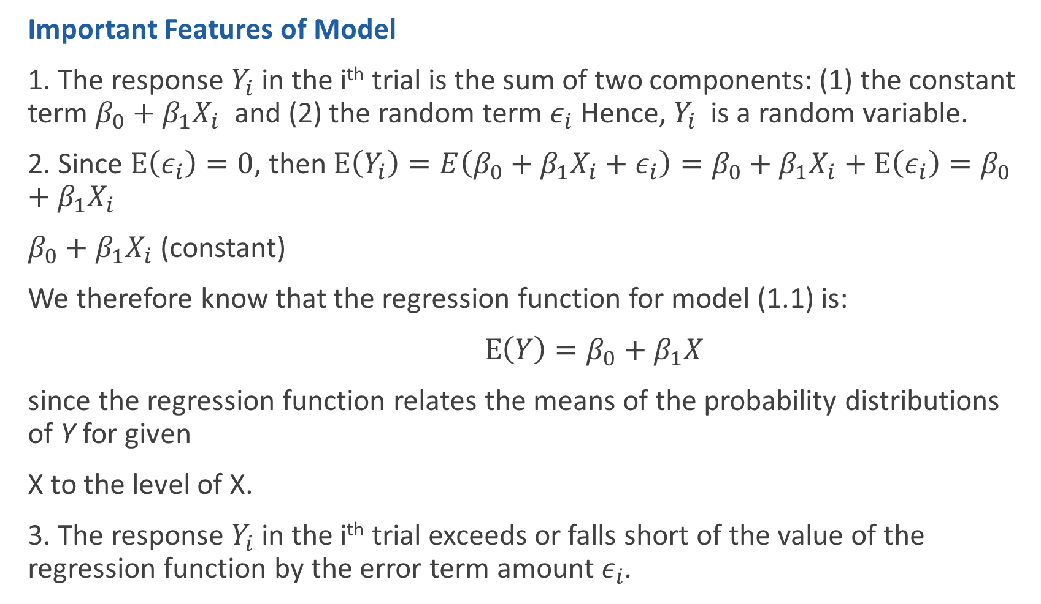
Important Features of Model
1. The response $Y_{i}$ in the i^{th} trial is the sum of two components: (1) the constant term $β_{0}+β_{1}X_{i}$ and (2) the random term $ε_{i}$ Hence, $Y_{i}$ is a random variable.
2. Since $E\left(ε_{i}\right)=0$, then $E\left(Y_{i}\right)=E\left(β_{0}+β_{1}X_{i}+ε_{i}\right)=β_{0}+β_{1}X_{i}+E\left(ε_{i}\right)=β_{0}+β_{1}X_{i}$
$β_{0}+β_{1}X_{i}$ (constant)
We therefore know that the regression function for model (1.1) is:
$E\left(Y\right)=β_{0}+β_{1}X$
since the regression function relates the means of the probability distributions of Y for given
X to the level of X.
3. The response $Y_{i}$ in the i^{th} trial exceeds or falls short of the value of the regression function by the error term amount $ε_{i}$.

Slide 15
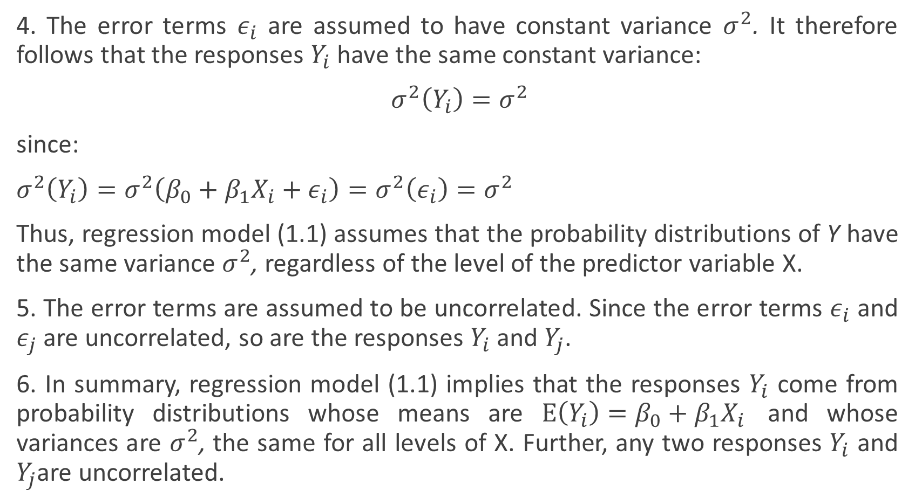
4. The error terms $ε_{i}$ are assumed to have constant variance $σ^{2}$. It therefore follows that the responses $Y_{i}$ have the same constant variance:
$σ^{2}\left(Y_{i}\right)=σ^{2}$
since:
$σ^{2}\left(Y_{i}\right)=σ^{2}\left(β_{0}+β_{1}X_{i}+ε_{i}\right)=σ^{2}\left(ε_{i}\right)=σ^{2}$
Thus, regression model (1.1) assumes that the probability distributions of Y have the same variance $σ^{2}$, regardless of the level of the predictor variable X.
5. The error terms are assumed to be uncorrelated. Since the error terms $ε_{i}$ and $ε_{j}$ are uncorrelated, so are the responses $Y_{i}$ and $Y_{j}$.
6. In summary, regression model (1.1) implies that the responses $Y_{i}$ come from probability distributions whose means are $E\left(Y_{i}\right)=β_{0}+β_{1}X_{i}$ and whose variances are $σ^{2}$, the same for all levels of X. Further, any two responses $Y_{i}$ and $Y_{j}$are uncorrelated.

Slide 16
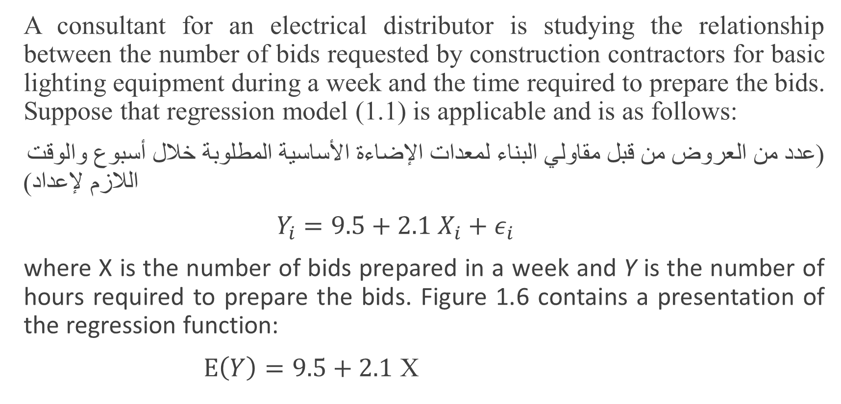
Example:
A consultant for an electrical distributor is studying the relationship between the number of bids requested by construction contractors for basic lighting equipment during a week and the time required to prepare the bids. Suppose that regression model (1.1) is applicable and is as follows:
(عدد من العروض من قبل مقاولي البناء لمعدات الإضاءة الأساسية المطلوبة خلال أسبوع والوقت اللازم لإعداد)
$Y_{i}=9.5+2.1 X_{i}+ε_{i}$
where X is the number of bids prepared in a week and Y is the number of hours required to prepare the bids. Figure 1.6 contains a presentation of the regression function:
$E\left(Y\right)=9.5+2.1$ X

Slide 17

Suppose that in the ith week, $X_{i}$=45 bids are prepared and the actual number of hours required is $Y_{i}=108$. In that case, the error term value is $ε_{i}=4$, for we have
$E\left(Y_{i}\right)=9.5+2.1\left(45\right)=104$
and
$Y_{i}=108$=104+4.
Figure 1.6 displays the probability distribution of Y when X = 45 and indicates from where in this distribution the observation $Y_{i}=108$ came. Note again that the error term $ε_{i}$ is simply the deviation of $Y_{i}$ from its mean value $E\left(Y_{i}\right)$.

Slide 18
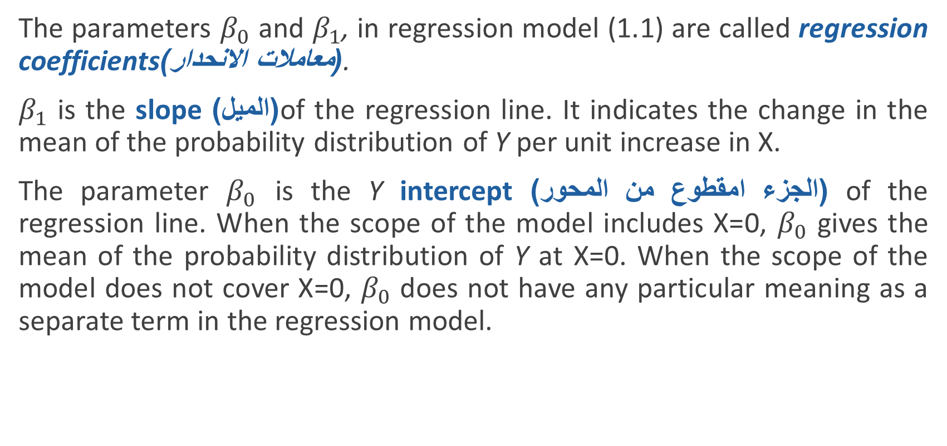
Meaning of Regression Parameters
The parameters $β_{0}$ and $β_{1}$, in regression model (1.1) are called regression coefficients(معاملات الانحدار).
$β_{1}$ is the slope (الميل)of the regression line. It indicates the change in the mean of the probability distribution of Y per unit increase in X.
The parameter $β_{0}$ is the Y intercept(الجزء امقطوع من المحور) of the regression line. When the scope of the model includes X=0, $β_{0}$ gives the mean of the probability distribution of Y at X=0. When the scope of the model does not cover X=0, $β_{0}$ does not have any particular meaning as a separate term in the regression model.

Slide 19
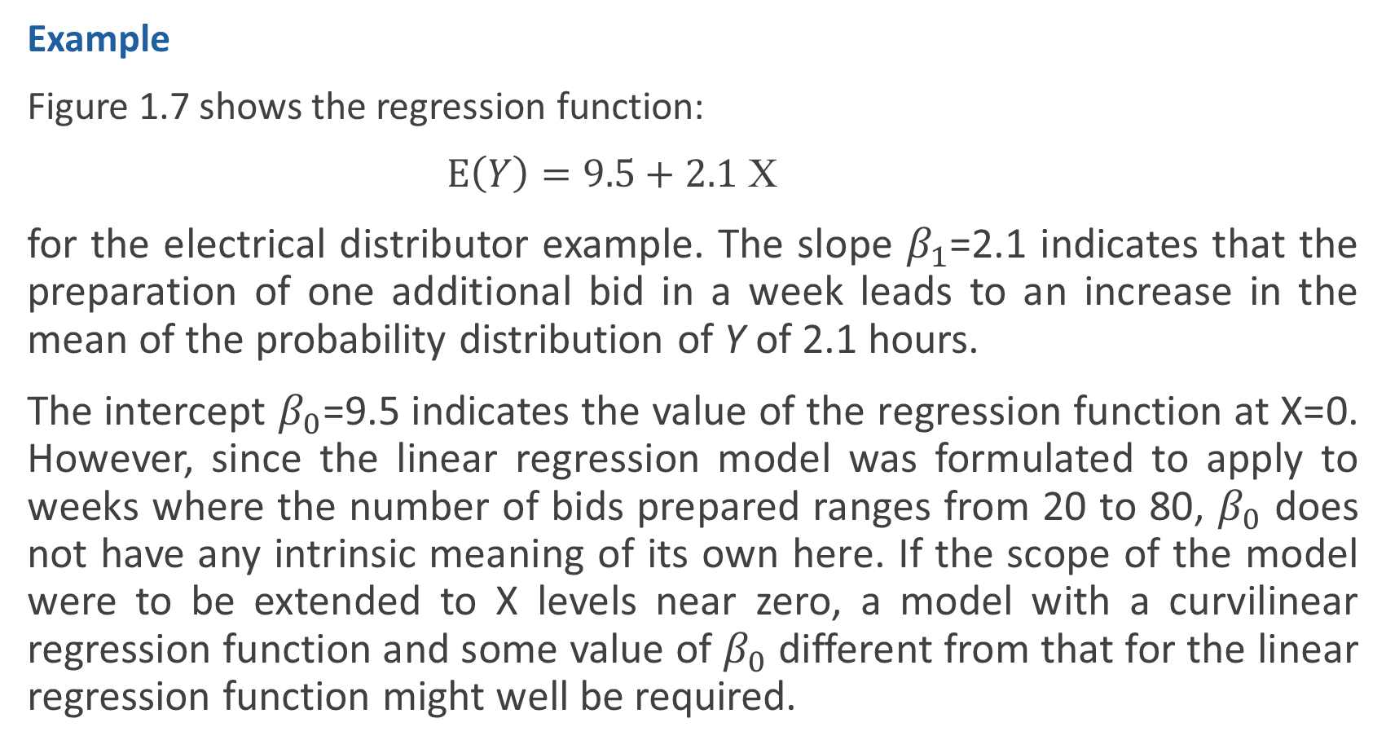
Example
Figure 1.7 shows the regression function:
$E\left(Y\right)=9.5+2.1$ X
for the electrical distributor example. The slope $β_{1}$=2.1 indicates that the preparation of one additional bid in a week leads to an increase in the mean of the probability distribution of Y of 2.1 hours.
The intercept $β_{0}$=9.5 indicates the value of the regression function at X=0. However, since the linear regression model was formulated to apply to weeks where the number of bids prepared ranges from 20 to 80, $β_{0}$ does not have any intrinsic meaning of its own here. If the scope of the model were to be extended to X levels near zero, a model with a curvilinear regression function and some value of $β_{0}$ different from that for the linear regression function might well be required.

Slide 21
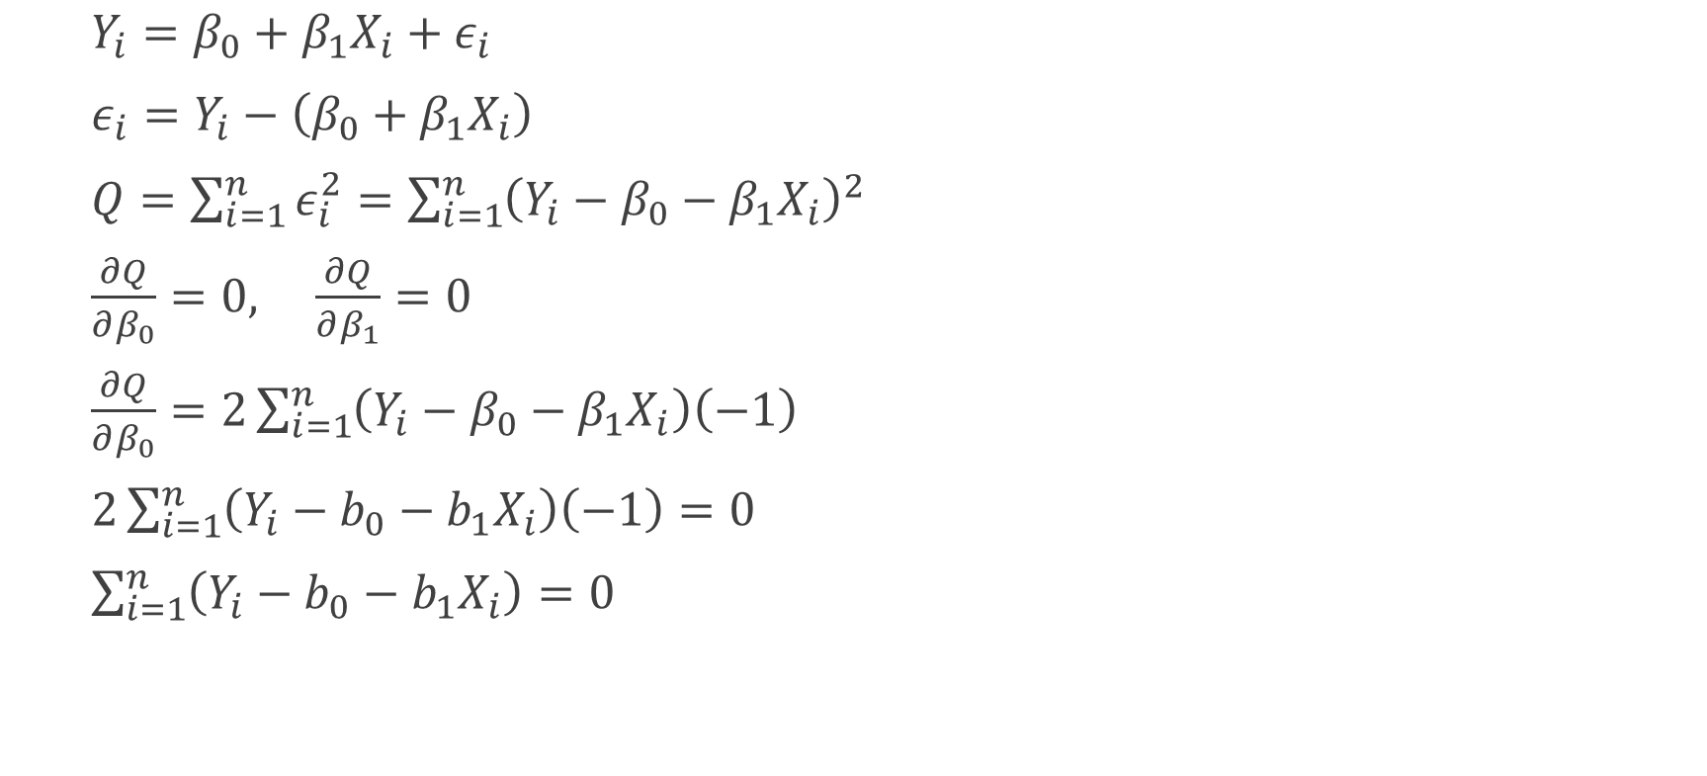
Estimation of Regression Function
Method of least -Squares
$Y_{i}=β_{0}+β_{1}X_{i}+ε_{i}$
$ε_{i}=Y_{i}−\left(β_{0}+β_{1}X_{i}\right)$
$Q=\sum_{i=1}^{n}{ε_{i}^{2}}=\sum_{i=1}^{n}{{\left(Y_{i}−β_{0}−β_{1}X_{i}\right)}^{2}}$
$\frac{∂Q}{∂β_{0}}=0, \frac{∂Q}{∂β_{1}}=0$
$\frac{∂Q}{∂β_{0}}=2\sum_{i=1}^{n}{\left(Y_{i}−β_{0}−β_{1}X_{i}\right)\left(−1\right)}$
$2\sum_{i=1}^{n}{\left(Y_{i}−b_{0}−b_{1}X_{i}\right)\left(−1\right)=0}$
$\sum_{i=1}^{n}{\left(Y_{i}−b_{0}−b_{1}X_{i}\right)=0}$

Slide 22
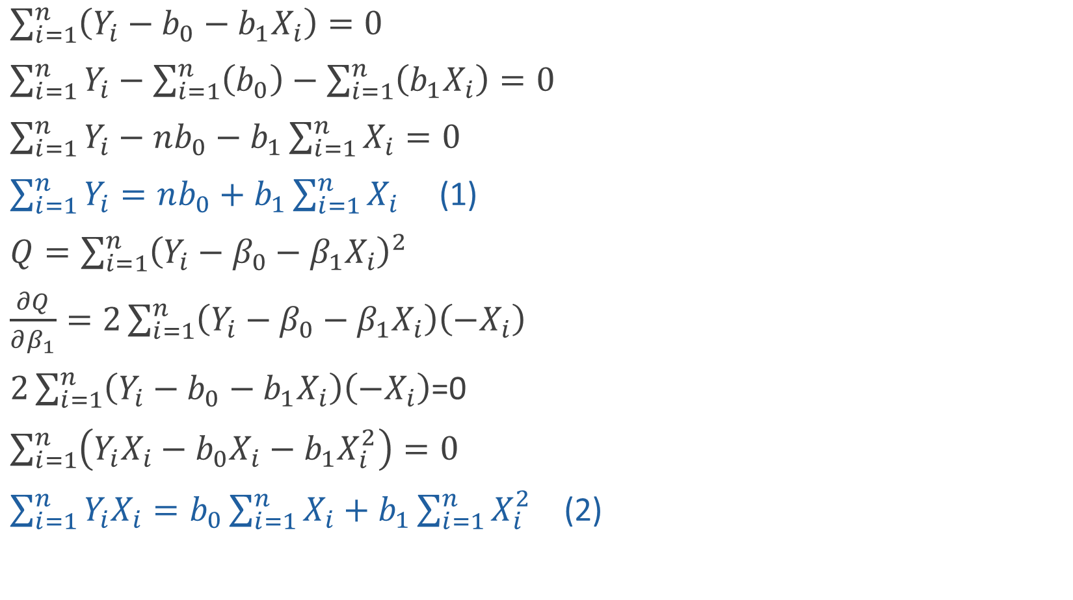
$\sum_{i=1}^{n}{\left(Y_{i}−b_{0}−b_{1}X_{i}\right)=0}$
$\sum_{i=1}^{n}{Y_{i}}−\sum_{i=1}^{n}{\left(b_{0}\right)}−\sum_{i=1}^{n}{\left(b_{1}X_{i}\right)}=0$
$\sum_{i=1}^{n}{Y_{i}}−nb_{0}−b_{1}\sum_{i=1}^{n}{X_{i}}=0$
$\sum_{i=1}^{n}{Y_{i}}=nb_{0}+b_{1}\sum_{i=1}^{n}{X_{i}}$ (1)
$Q=\sum_{i=1}^{n}{{\left(Y_{i}−β_{0}−β_{1}X_{i}\right)}^{2}}$
$\frac{∂Q}{∂β_{1}}=2\sum_{i=1}^{n}{\left(Y_{i}−β_{0}−β_{1}X_{i}\right)\left(−X_{i}\right)}$
$2\sum_{i=1}^{n}{\left(Y_{i}−b_{0}−b_{1}X_{i}\right)\left(−X_{i}\right)}$=0
$\sum_{i=1}^{n}{\left(Y_{i}X_{i}−b_{0}X_{i}−b_{1}X_{i}^{2}\right)=0}$
$\sum_{i=1}^{n}{Y_{i}X_{i}=b_{0}\sum_{i=1}^{n}{X_{i}}+b_{1}\sum_{i=1}^{n}{X_{i}^{2}}}$ (2)

Slide 23
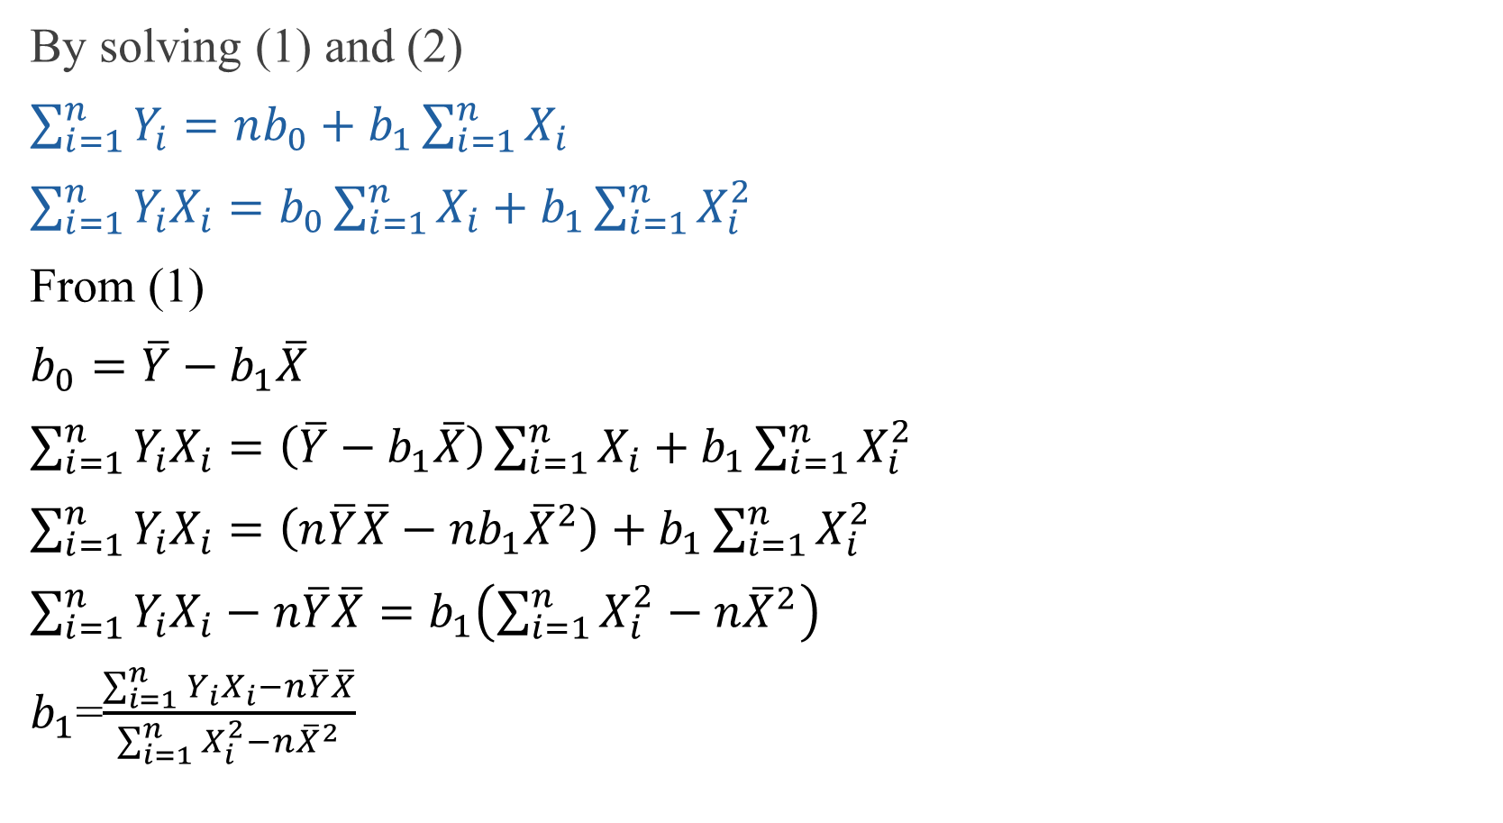
By solving (1) and (2)
$\sum_{i=1}^{n}{Y_{i}}=nb_{0}+b_{1}\sum_{i=1}^{n}{X_{i}}$
$\sum_{i=1}^{n}{Y_{i}X_{i}=b_{0}\sum_{i=1}^{n}{X_{i}}+b_{1}\sum_{i=1}^{n}{X_{i}^{2}}}$
From (1)
$b_{0}=\overline{Y}−b_{1}\overline{X}$
$\sum_{i=1}^{n}{Y_{i}X_{i}}=\left(\overline{Y}−b_{1}\overline{X}\right)\sum_{i=1}^{n}{X_{i}}+b_{1}\sum_{i=1}^{n}{X_{i}^{2}}$
$\sum_{i=1}^{n}{Y_{i}X_{i}}=\left(n\overline{Y}\overline{X}−nb_{1}{\overline{X}}^{2}\right)+b_{1}\sum_{i=1}^{n}{X_{i}^{2}}$
$\sum_{i=1}^{n}{Y_{i}X_{i}}−n\overline{Y}\overline{X}=b_{1}\left(\sum_{i=1}^{n}{X_{i}^{2}}−n{\overline{X}}^{2}\right)$
$b_{1}$=$\frac{\sum_{i=1}^{n}{Y_{i}X_{i}}−n\overline{Y}\overline{X}}{\sum_{i=1}^{n}{X_{i}^{2}}−n{\overline{X}}^{2}}$

Slide 24

$b_{0}=\overline{Y}−b_{1}\overline{X}$
$b_{1}$=$\frac{\sum_{i=1}^{n}{\left(X_{i}−\overline{X}\right)\left(Y_{i}−\overline{Y}\right)}}{\sum_{i=1}^{n}{{\left(X_{i}−\overline{X}\right)}^{2}}}$

Slide 25
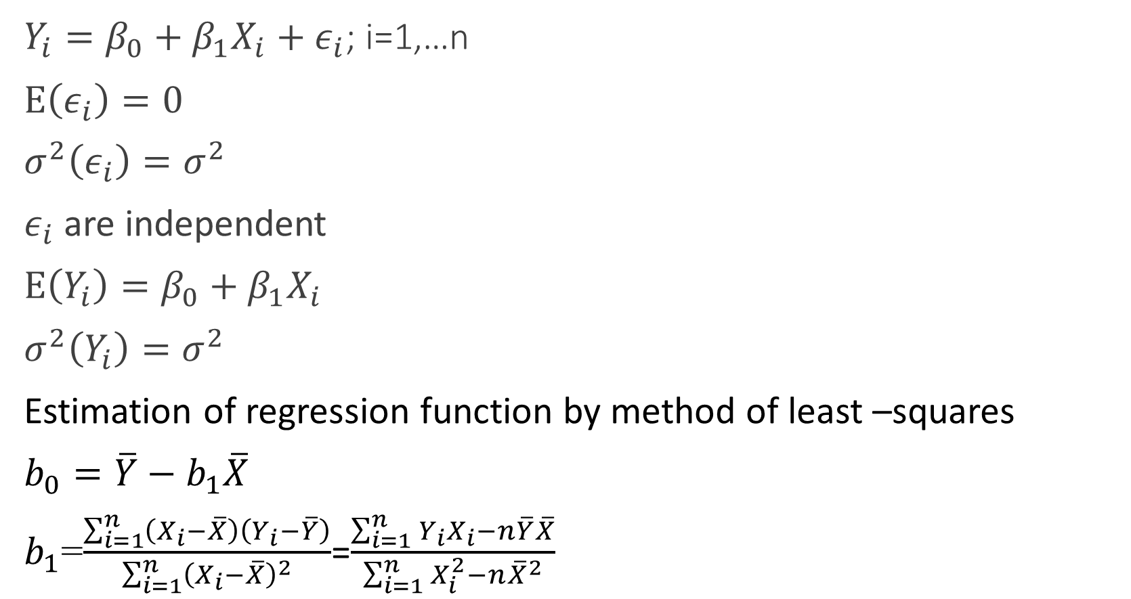
Simple Linear Regression Model
$Y_{i}=β_{0}+β_{1}X_{i}+ε_{i}$; i=1,…n
$E\left(ε_{i}\right)=0$
$σ^{2}\left(ε_{i}\right)=σ^{2}$
$ε_{i}$ are independent
$E\left(Y_{i}\right)=β_{0}+β_{1}X_{i}$
$σ^{2}\left(Y_{i}\right)=σ^{2}$
Estimation of regression function by method of least –squares
$b_{0}=\overline{Y}−b_{1}\overline{X}$
$b_{1}$=$\frac{\sum_{i=1}^{n}{\left(X_{i}−\overline{X}\right)\left(Y_{i}−\overline{Y}\right)}}{\sum_{i=1}^{n}{{\left(X_{i}−\overline{X}\right)}^{2}}}$=$\frac{\sum_{i=1}^{n}{Y_{i}X_{i}}−n\overline{Y}\overline{X}}{\sum_{i=1}^{n}{X_{i}^{2}}−n{\overline{X}}^{2}}$

Slide 26
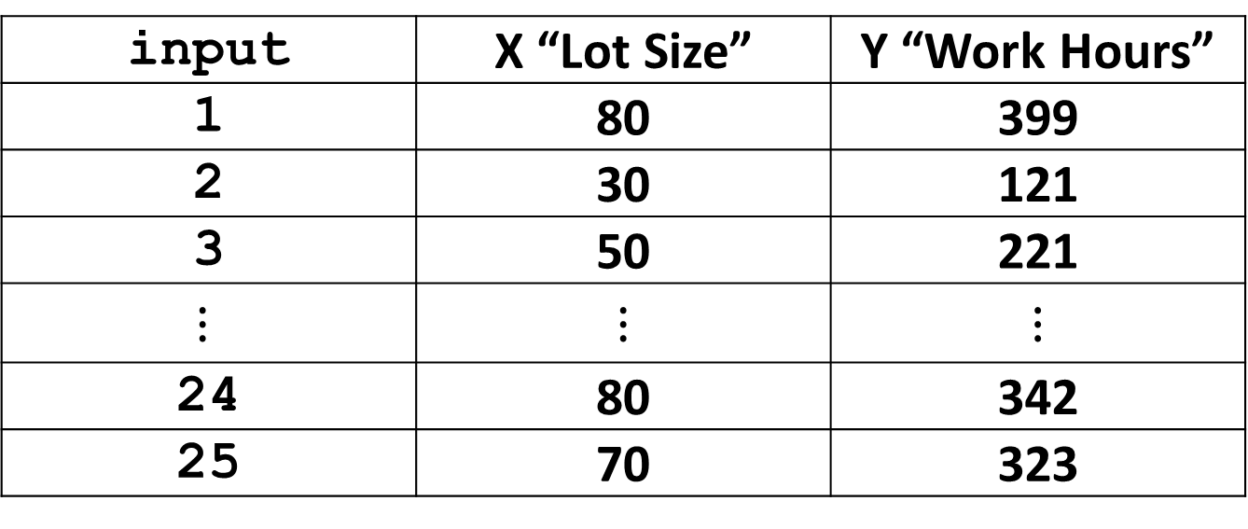
Example “Page 19”
The Toluca Company manufactures refrigeration equipment as well as many replacement parts…the relationship between lot size and labor hours required to produce the lot…
input | X “Lot Size” | Y “Work Hours”
1 | 80 | 399
2 | 30 | 121
3 | 50 | 221
$$⋮$$ | $$⋮$$ | $$⋮$$
24 | 80 | 342
25 | 70 | 323

Slide 27
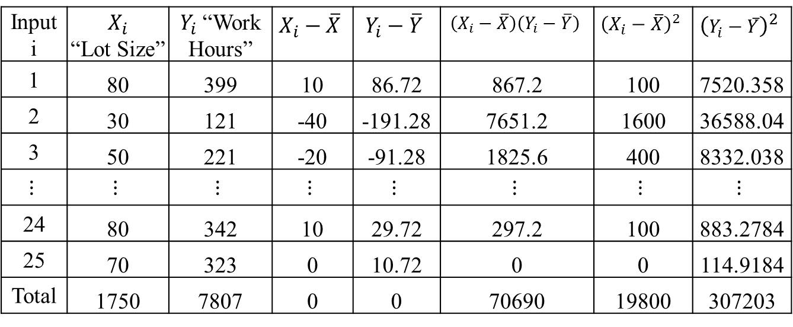
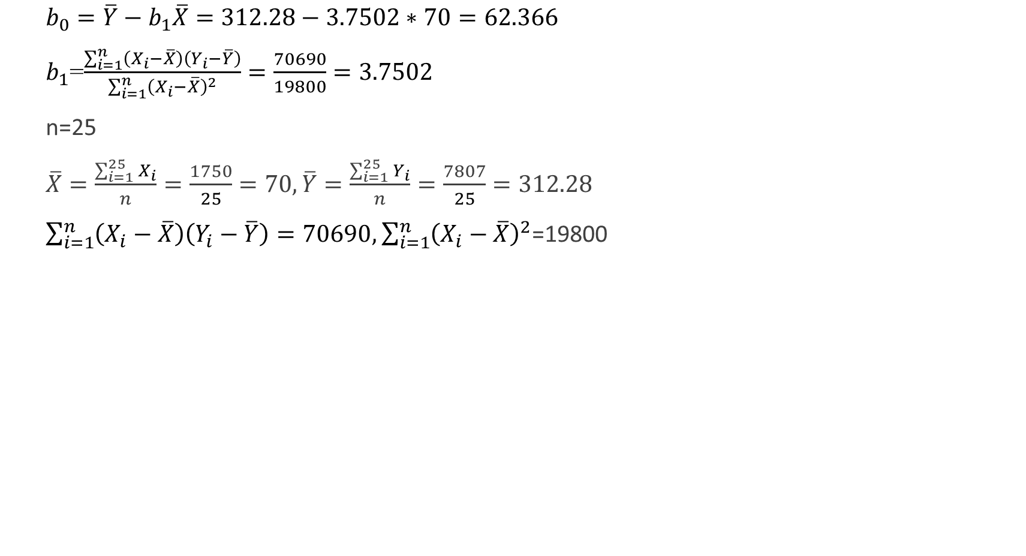
$b_{0}=\overline{Y}−b_{1}\overline{X}=312.28−3.7502∗70=62.366$
$b_{1}$=$\frac{\sum_{i=1}^{n}{\left(X_{i}−\overline{X}\right)\left(Y_{i}−\overline{Y}\right)}}{\sum_{i=1}^{n}{{\left(X_{i}−\overline{X}\right)}^{2}}}=\frac{70690}{19800}=3.7502$
n=25
$\overline{X}=\frac{\sum_{i=1}^{25}{X_{i}}}{n}=\frac{1750}{25}=70,\overline{Y}=\frac{\sum_{i=1}^{25}{Y_{i}}}{n}=\frac{7807}{25}=312.28$
$\sum_{i=1}^{n}{\left(X_{i}−\overline{X}\right)\left(Y_{i}−\overline{Y}\right)}=70690, \sum_{i=1}^{n}{{\left(X_{i}−\overline{X}\right)}^{2}}$=19800
Input i | $$X_{i}$$ “Lot Size” | $Y_{i}$ “Work Hours” | $$X_{i}−\overline{X}$$ | $$Y_{i}−\overline{Y}$$ | $$\left(X_{i}−\overline{X}\right)\left(Y_{i}−\overline{Y}\right)$$ | $${\left(X_{i}−\overline{X}\right)}^{2}$$ | $${\left(Y_{i}−\overline{Y}\right)}^{2}$$
1 | 80 | 399 | 10 | 86.72 | 867.2 | 100 | 7520.358
2 | 30 | 121 | -40 | -191.28 | 7651.2 | 1600 | 36588.04
3 | 50 | 221 | -20 | -91.28 | 1825.6 | 400 | 8332.038
$$⋮$$ | $$⋮$$ | $$⋮$$ | $$⋮$$ | $$⋮$$ | $$⋮$$ | $$⋮$$ | $$⋮$$
24 | 80 | 342 | 10 | 29.72 | 297.2 | 100 | 883.2784
25 | 70 | 323 | 0 | 10.72 | 0 | 0 | 114.9184
Total | 1750 | 7807 | 0 | 0 | 70690 | 19800 | 307203

Slide 28
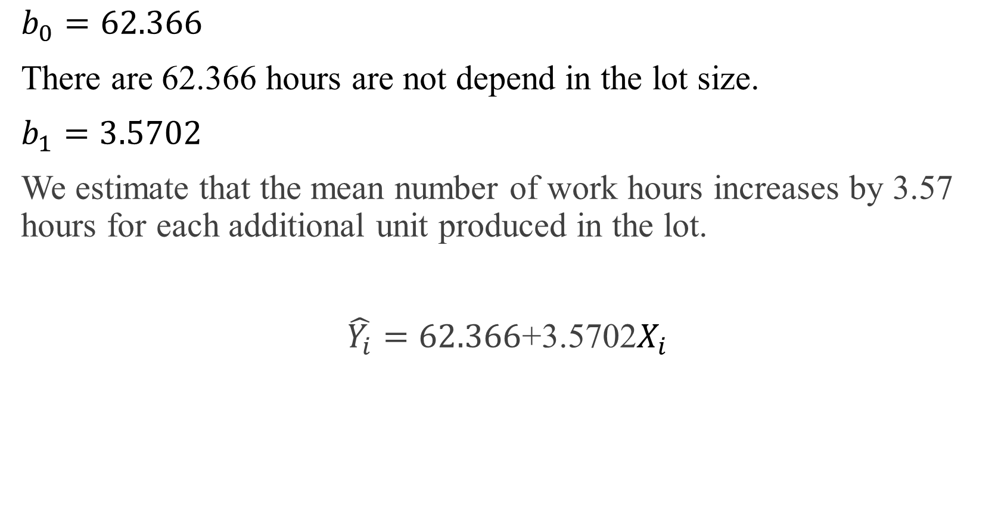
$b_{0}=62.366$
There are 62.366 hours are not depend in the lot size.
$b_{1}=3.5702$
We estimate that the mean number of work hours increases by 3.57 hours for each additional unit produced in the lot.
$\hat{Y_{i}}=62.366$+3.5702$X_{i}$

Slide 29
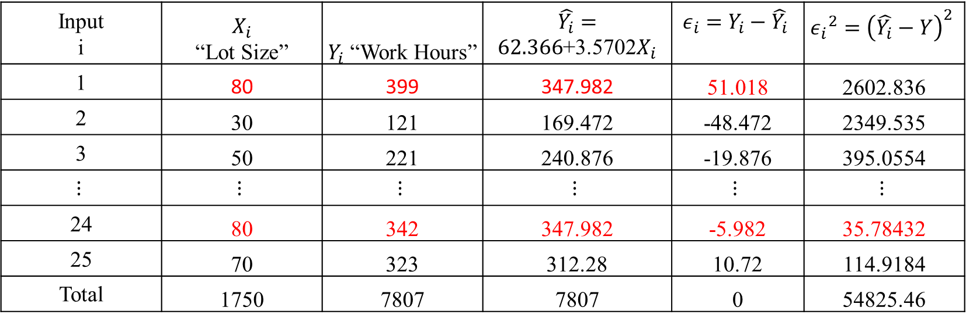
Input i | $$X_{i}$$ “Lot Size” | $Y_{i}$ “Work Hours” | $\hat{Y_{i}}=62.366$+3.5702$X_{i}$ | $${ε_{i}=Y}_{i}−\hat{Y_{i}}$$ | $${ε_{i}}^{2}={\left(\hat{Y_{i}}−Y\right)}^{2}$$
1 | 80 | 399 | 347.982 | 51.018 | 2602.836
2 | 30 | 121 | 169.472 | -48.472 | 2349.535
3 | 50 | 221 | 240.876 | -19.876 | 395.0554
$$⋮$$ | $$⋮$$ | $$⋮$$ | $$⋮$$ | $$⋮$$ | $$⋮$$
24 | 80 | 342 | 347.982 | -5.982 | 35.78432
25 | 70 | 323 | 312.28 | 10.72 | 114.9184
Total | 1750 | 7807 | 7807 | 0 | 54825.46

Slide 30

$\hat{Y}=62.366$+3.5702$X$
Let the lot size is X=65
$\hat{Y}=62.366$+3.5702$\left(65\right)$=294.43
we estimate that the mean number of work hours required for production runs of X = 65 units is 294.4 hours.

Slide 31
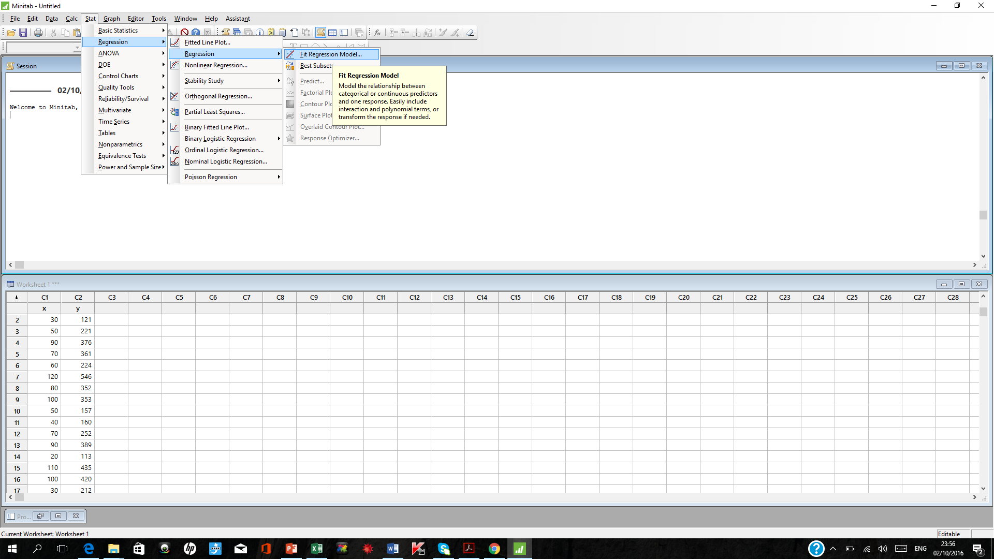

Slide 32
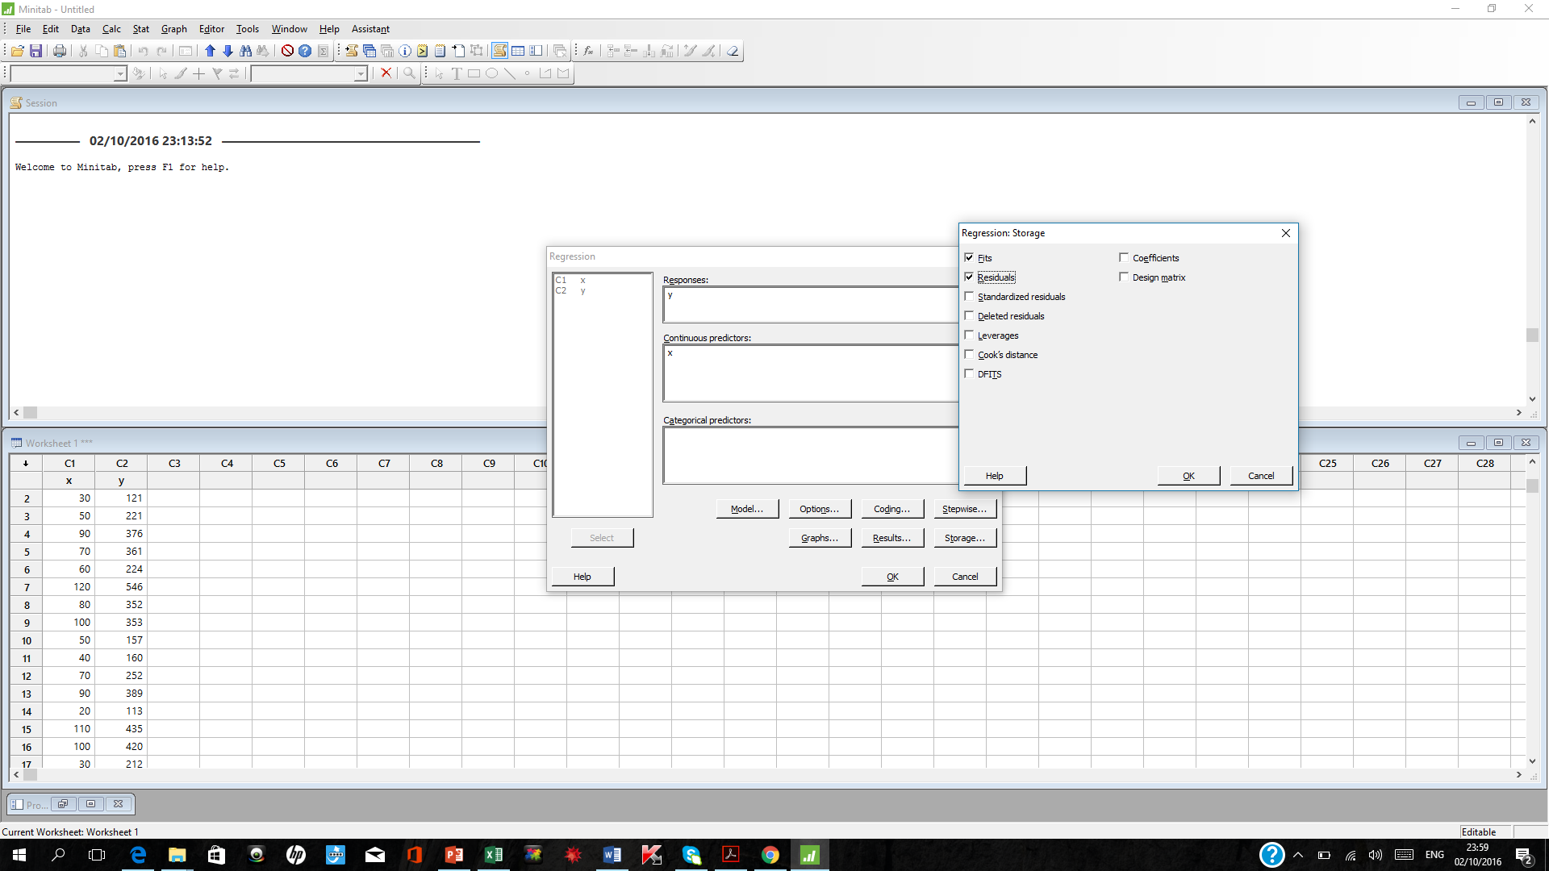

Slide 33
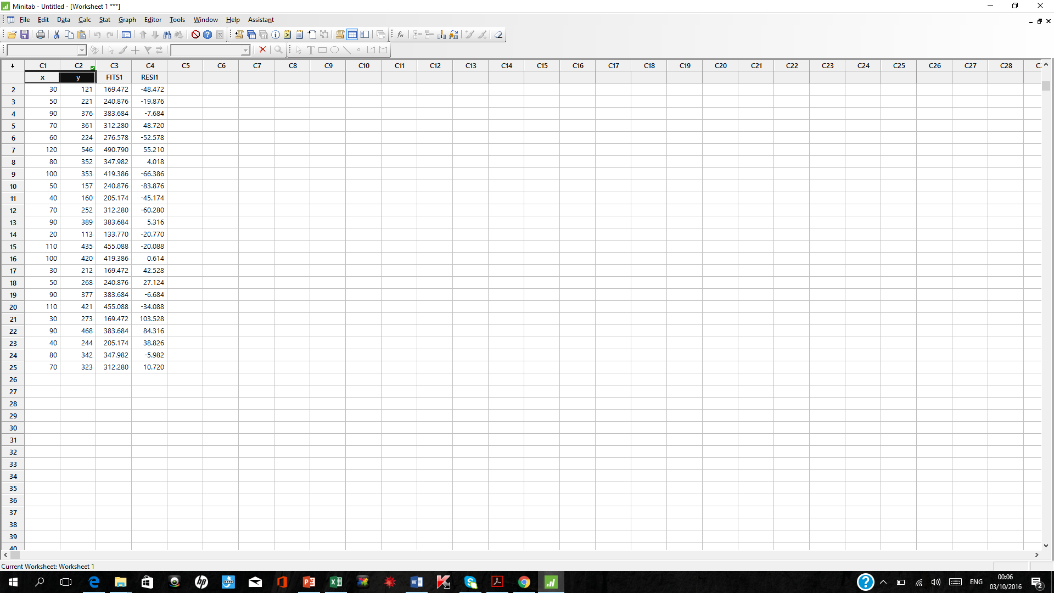

Slide 34
Stat->Regression->Regression->Fit Regression Model
Responses: Y
Continuous predictors: X
Storage: Fits
Residuals
To plot: Stat->Regression->Fitted line plot
Coefficients
Term Coef SE Coef T-Value P-Value VIF
Constant 62.4 26.2 2.38 0.026
x 3.570 0.347 10.29 0.000 1.00
Regression Equation
y = 62.4 + 3.570 x

Slide 36
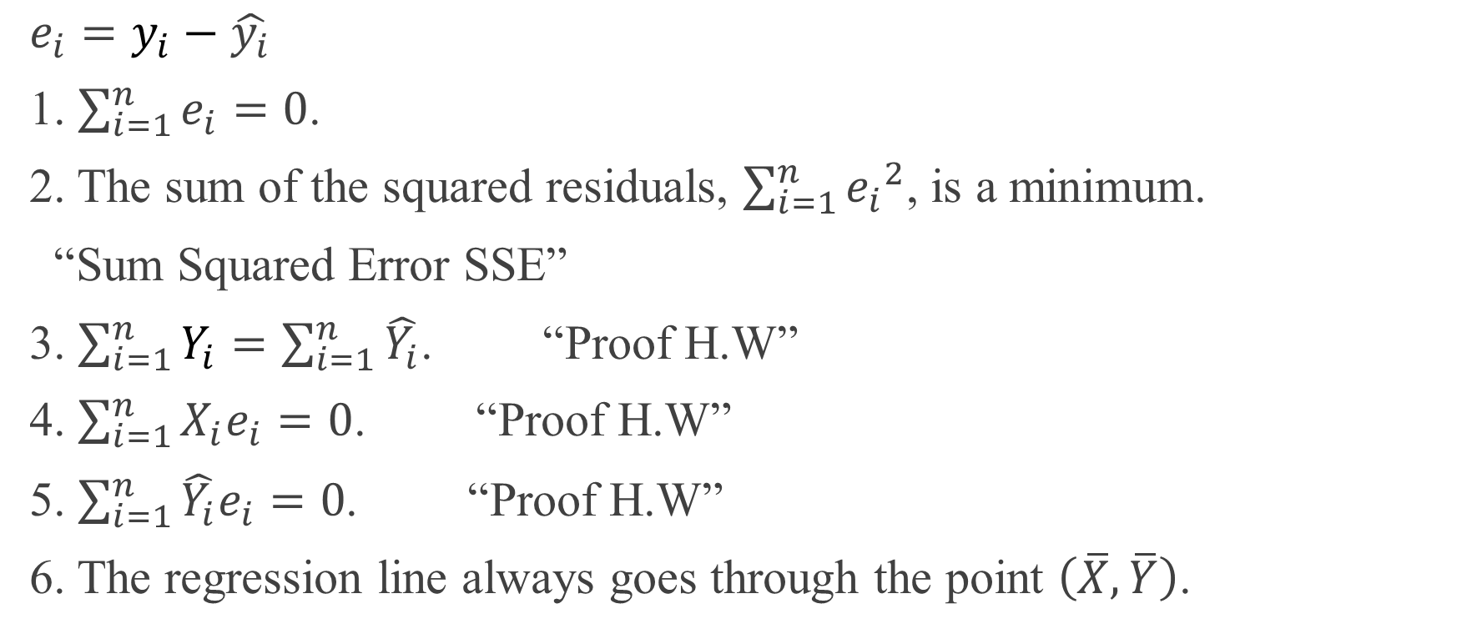
Residuals
Properties of Fitted Regression line
${e_{i}=y}_{i}−\hat{y_{i}}$
1. $\sum_{i=1}^{n}{e_{i}}=0$.
2. The sum of the squared residuals, $\sum_{i=1}^{n}{{e_{i}}^{2}}$, is a minimum.
“Sum Squared Error SSE”
3. $\sum_{i=1}^{n}{Y_{i}}=\sum_{i=1}^{n}{\hat{Y_{i}}}$. “Proof H.W”
4. $\sum_{i=1}^{n}{X_{i}e_{i}}=0$. “Proof H.W”
5. $\sum_{i=1}^{n}{{\hat{Y_{i}}e}_{i}}=0$. “Proof H.W”
6. The regression line always goes through the point $\left(\overline{X},\overline{Y}\right)$.

Slide 37
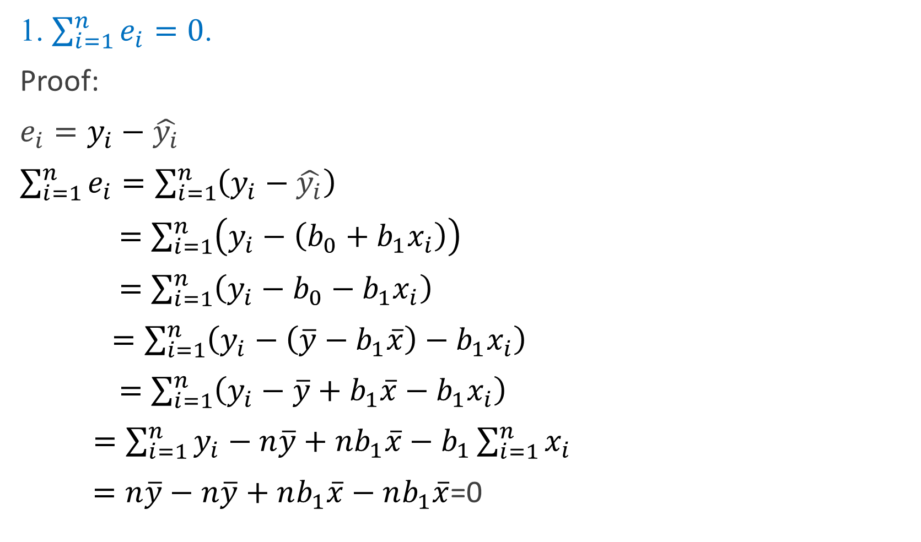
1. $\sum_{i=1}^{n}{e_{i}}=0$.
Proof:
${e_{i}=y}_{i}−\hat{y_{i}}$
$\sum_{i=1}^{n}{e_{i}}=\sum_{i=1}^{n}{\left(y_{i}−\hat{y_{i}}\right)}$
$=\sum_{i=1}^{n}{\left(y_{i}−\left(b_{0}+b_{1}x_{i}\right)\right)}$
$=\sum_{i=1}^{n}{\left(y_{i}−b_{0}−b_{1}x_{i}\right)}$
$=\sum_{i=1}^{n}{\left(y_{i}−\left(\overline{y}−b_{1}\overline{x}\right)−b_{1}x_{i}\right)}$
$=\sum_{i=1}^{n}{\left(y_{i}−\overline{y}+b_{1}\overline{x}−b_{1}x_{i}\right)}$
$=\sum_{i=1}^{n}{y_{i}}−n\overline{y}+nb_{1}\overline{x}−b_{1}\sum_{i=1}^{n}{x_{i}}$
$=n\overline{y}−n\overline{y}+nb_{1}\overline{x}−nb_{1}\overline{x}$=0

Slide 38

6. The regression line always goes through the point $\left(\overline{X},\overline{Y}\right)$.
$\hat{y_{i}}=b_{0}+b_{1}x_{i}$
If $x_{i}=\overline{x}$
$\hat{y_{i}}=b_{0}+b_{1}\overline{x}$
$b_{0}=\overline{y}−b_{1}\overline{x}$
$\hat{y_{i}}=\overline{y}−b_{1}\overline{x}+b_{1}\overline{x}=\overline{y}$
$\hat{y_{i}}=\overline{y}$

Slide 39

Estimation of Error Terms Variance $σ^{2}$
$Var\left(ε_{i}\right)=σ^{2}\left(ε_{i}\right)=σ^{2}$
${\hat{σ}}^{2}=MSE=\frac{SSE}{n−2}$
$SSE$=$\sum_{i=1}^{n}{{e_{i}}^{2}}$
From our example
SSE=$\sum_{i=1}^{n}{{e_{i}}^{2}}$=54825.46
$MSE=\frac{54825.46}{23}=2383.716$

Slide 40
Regression Analysis: y versus x
The regression equation is
y = 62.37 + 3.570 x
S = 48.8233 R-Sq = 82.2% R-Sq(adj) = 81.4%
Analysis of Variance
Source DF SS MS F P
Regression 1 252378 252378 105.88 0.000
Error 23 54825 2384
Total 24 307203

Slide 41
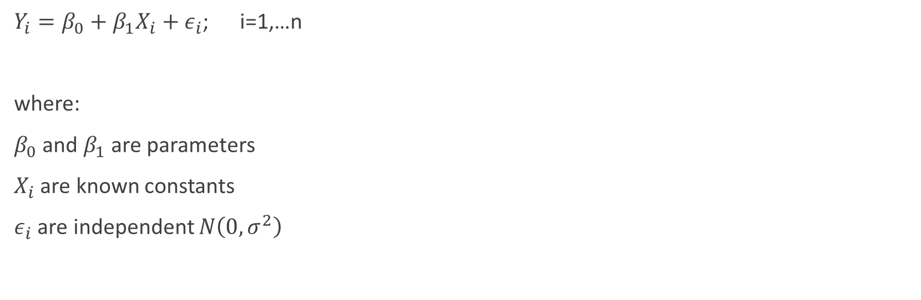
Chapter 2
Inferences in Regression and Correlation Analysis
$Y_{i}=β_{0}+β_{1}X_{i}+ε_{i}$; i=1,…n
where:
$β_{0}$ and $β_{1}$ are parameters
$X_{i}$ are known constants
$ε_{i}$ are independent $N\left(0,σ^{2}\right)$

Slide 42
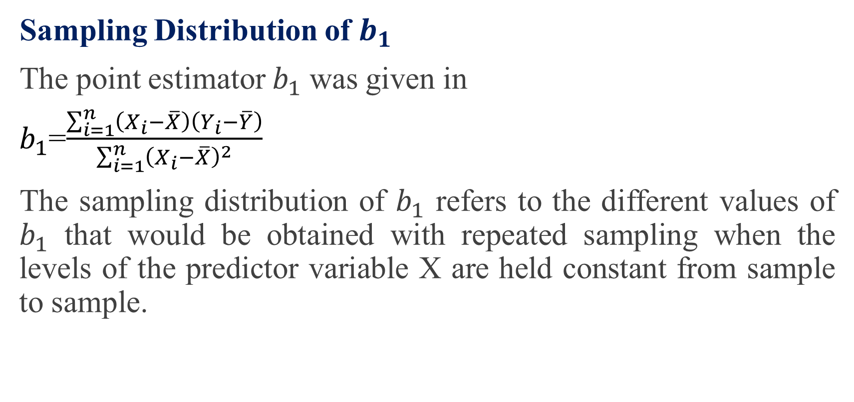
Inferences Concerning $β_{1}$
Sampling Distribution of $b_{1}$
The point estimator $b_{1}$ was given in
$b_{1}$=$\frac{\sum_{i=1}^{n}{\left(X_{i}−\overline{X}\right)\left(Y_{i}−\overline{Y}\right)}}{\sum_{i=1}^{n}{{\left(X_{i}−\overline{X}\right)}^{2}}}$
The sampling distribution of $b_{1}$ refers to the different values of $b_{1}$ that would be obtained with repeated sampling when the levels of the predictor variable X are held constant from sample to sample.

Slide 43
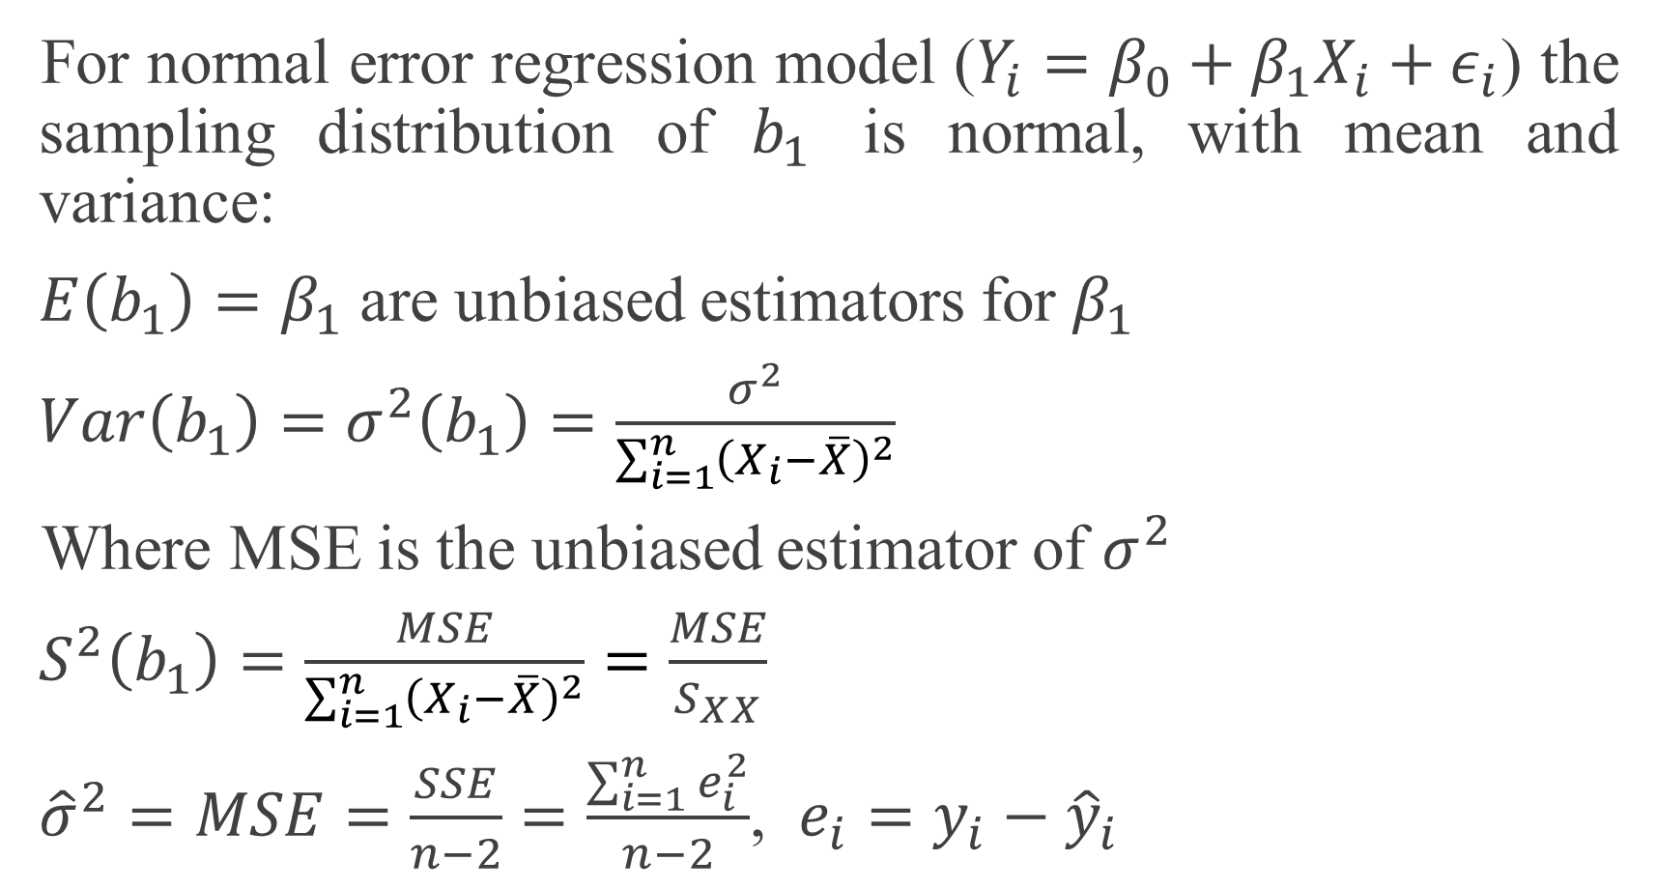
For normal error regression model ($Y_{i}=β_{0}+β_{1}X_{i}+ε_{i}$) the sampling distribution of $b_{1}$ is normal, with mean and variance:
$E\left(b_{1}\right)=β_{1}$ are unbiased estimators for $β_{1}$
$Var\left(b_{1}\right)=σ^{2}\left(b_{1}\right)=\frac{σ^{2}}{\sum_{i=1}^{n}{{\left(X_{i}−\overline{X}\right)}^{2}}}$
Where MSE is the unbiased estimator of $σ^{2}$
$S^{2}\left(b_{1}\right)=\frac{MSE}{\sum_{i=1}^{n}{{\left(X_{i}−\overline{X}\right)}^{2}}}=\frac{MSE}{S_{XX}}$
${\hat{σ}}^{2}=MSE=\frac{SSE}{n−2}=\frac{\sum_{i=1}^{n}{e_{i}^{2}}}{n−2}$, $e_{i}=y_{i}−{\hat{y}}_{i}$

Slide 44
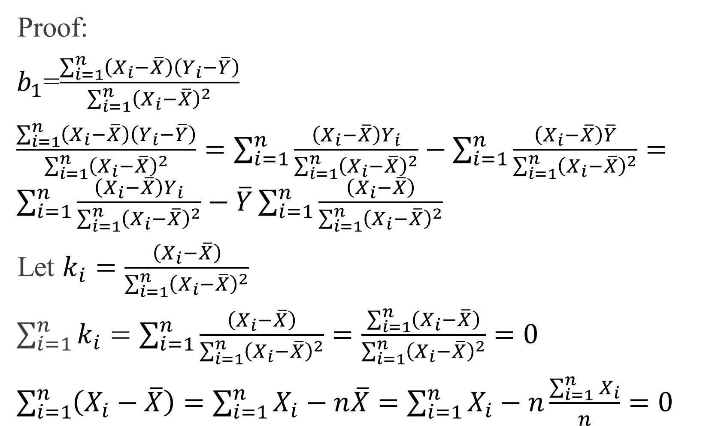
Proof:
$b_{1}$=$\frac{\sum_{i=1}^{n}{\left(X_{i}−\overline{X}\right)\left(Y_{i}−\overline{Y}\right)}}{\sum_{i=1}^{n}{{\left(X_{i}−\overline{X}\right)}^{2}}}$
$\frac{\sum_{i=1}^{n}{\left(X_{i}−\overline{X}\right)\left(Y_{i}−\overline{Y}\right)}}{\sum_{i=1}^{n}{{\left(X_{i}−\overline{X}\right)}^{2}}}=\sum_{i=1}^{n}{\frac{\left(X_{i}−\overline{X}\right)Y_{i}}{\sum_{i=1}^{n}{{\left(X_{i}−\overline{X}\right)}^{2}}}}−\sum_{i=1}^{n}{\frac{\left(X_{i}−\overline{X}\right)\overline{Y}}{\sum_{i=1}^{n}{{\left(X_{i}−\overline{X}\right)}^{2}}}}=\sum_{i=1}^{n}{\frac{\left(X_{i}−\overline{X}\right)Y_{i}}{\sum_{i=1}^{n}{{\left(X_{i}−\overline{X}\right)}^{2}}}}−\overline{Y}\sum_{i=1}^{n}{\frac{\left(X_{i}−\overline{X}\right)}{\sum_{i=1}^{n}{{\left(X_{i}−\overline{X}\right)}^{2}}}}$
Let $k_{i}=\frac{\left(X_{i}−\overline{X}\right)}{\sum_{i=1}^{n}{{\left(X_{i}−\overline{X}\right)}^{2}}}$
$\sum_{i=1}^{n}{k_{i}}=\sum_{i=1}^{n}{\frac{\left(X_{i}−\overline{X}\right)}{\sum_{i=1}^{n}{{\left(X_{i}−\overline{X}\right)}^{2}}}=\frac{\sum_{i=1}^{n}{\left(X_{i}−\overline{X}\right)}}{\sum_{i=1}^{n}{{\left(X_{i}−\overline{X}\right)}^{2}}}=0}$
$\sum_{i=1}^{n}{\left(X_{i}−\overline{X}\right)}=\sum_{i=1}^{n}{X_{i}}−n\overline{X}=\sum_{i=1}^{n}{X_{i}}−n\frac{\sum_{i=1}^{n}{X_{i}}}{n}=0$

Slide 45
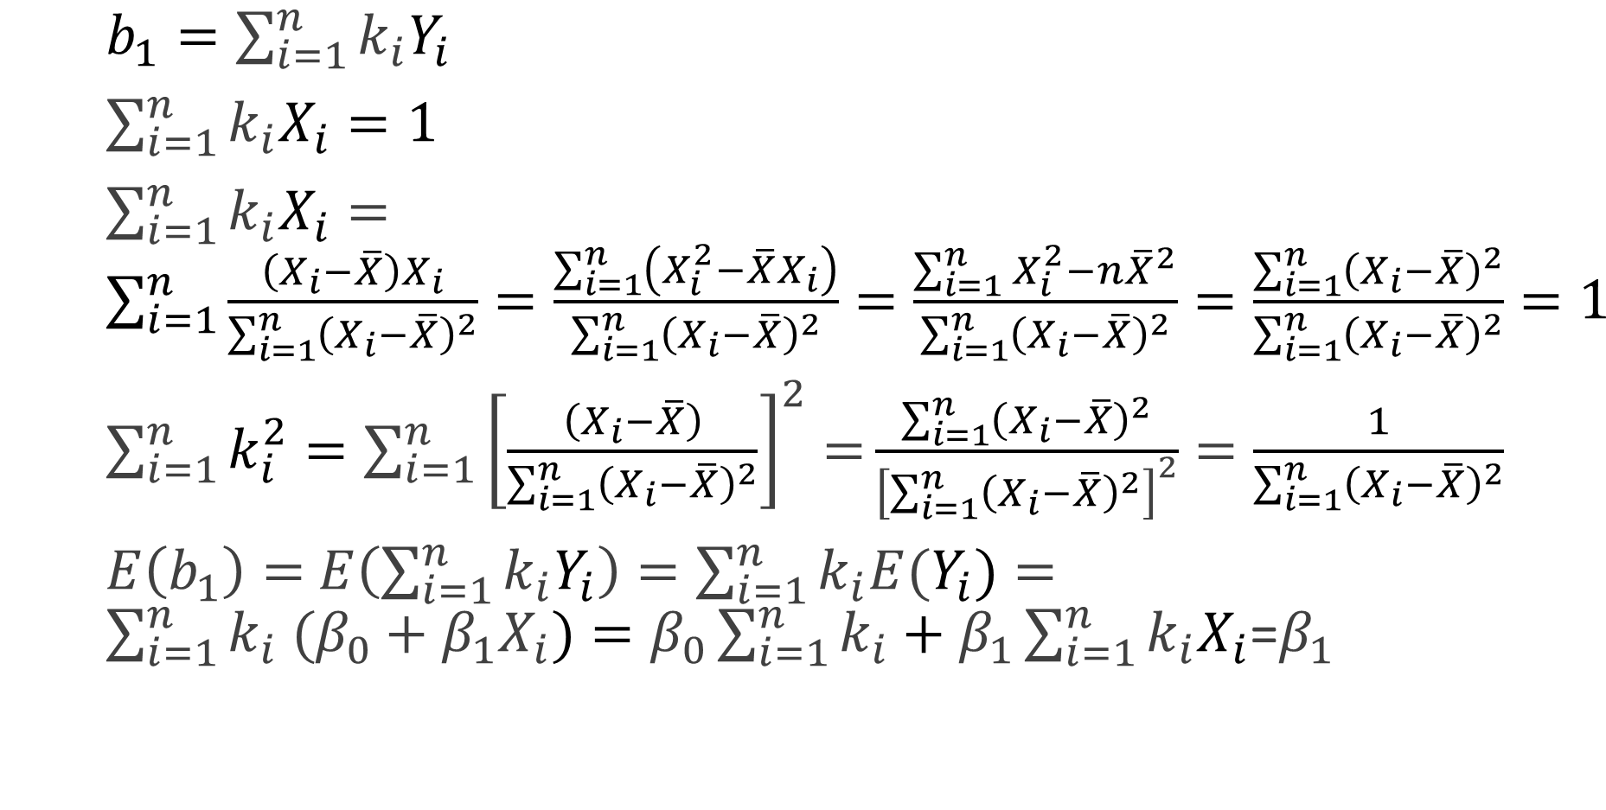
$b_{1}=\sum_{i=1}^{n}{k_{i}Y_{i}}$
$\sum_{i=1}^{n}{k_{i}X_{i}}=1$
$\sum_{i=1}^{n}{k_{i}X_{i}}=\sum_{i=1}^{n}{\frac{\left(X_{i}−\overline{X}\right)X_{i}}{\sum_{i=1}^{n}{{\left(X_{i}−\overline{X}\right)}^{2}}}=\frac{\sum_{i=1}^{n}{\left(X_{i}^{2}−\overline{X}X_{i}\right)}}{\sum_{i=1}^{n}{{\left(X_{i}−\overline{X}\right)}^{2}}}=\frac{\sum_{i=1}^{n}{X_{i}^{2}}−n{\overline{X}}^{2}}{\sum_{i=1}^{n}{{\left(X_{i}−\overline{X}\right)}^{2}}}=\frac{\sum_{i=1}^{n}{{\left(X_{i}−\overline{X}\right)}^{2}}}{\sum_{i=1}^{n}{{\left(X_{i}−\overline{X}\right)}^{2}}}=1}$
$\sum_{i=1}^{n}{k_{i}^{2}}=\sum_{i=1}^{n}{{\left[\frac{\left(X_{i}−\overline{X}\right)}{\sum_{i=1}^{n}{{\left(X_{i}−\overline{X}\right)}^{2}}}\right]}^{2}=}\frac{\sum_{i=1}^{n}{{\left(X_{i}−\overline{X}\right)}^{2}}}{{\left[\sum_{i=1}^{n}{{\left(X_{i}−\overline{X}\right)}^{2}}\right]}^{2}}=\frac{1}{\sum_{i=1}^{n}{{\left(X_{i}−\overline{X}\right)}^{2}}}$
$E\left(b_{1}\right)=$ $E\left(\sum_{i=1}^{n}{k_{i}Y_{i}}\right)=\sum_{i=1}^{n}{k_{i}E(Y_{i})}=\sum_{i=1}^{n}{k_{i} (β_{0}+β_{1}X_{i})}=β_{0}\sum_{i=1}^{n}{k_{i}}+β_{1}\sum_{i=1}^{n}{k_{i}X_{i}}$=$β_{1}$

Slide 46
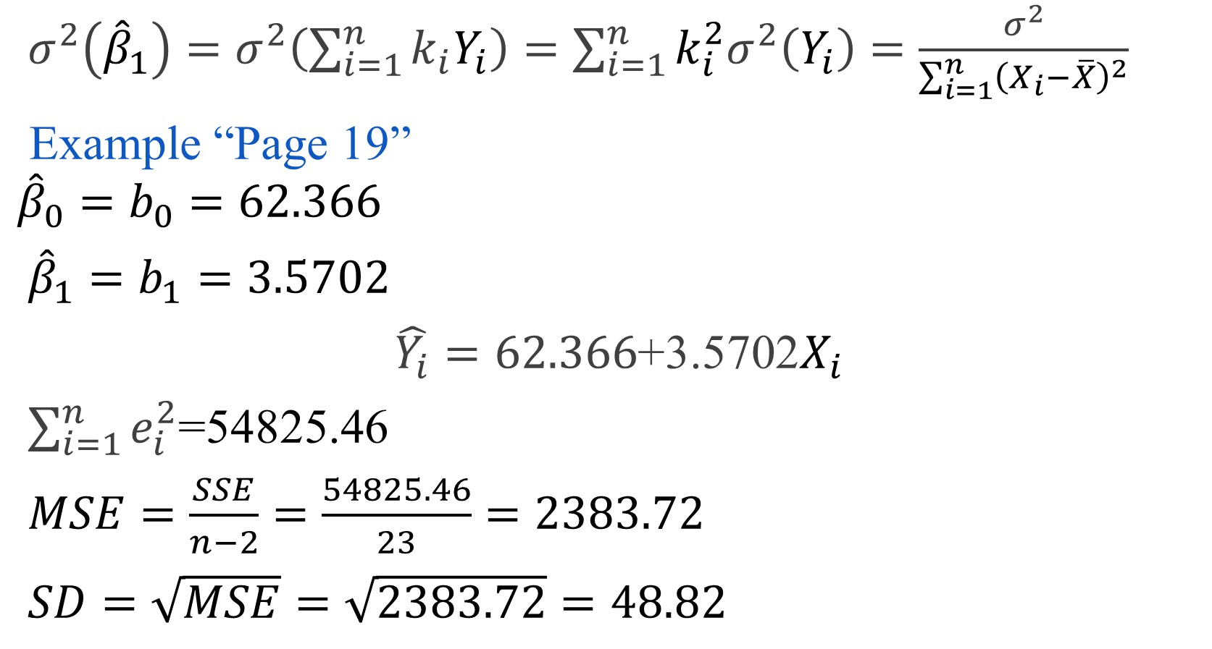
$σ^{2}\left({\hat{β}}_{1}\right)=σ^{2}\left(\sum_{i=1}^{n}{k_{i}Y_{i}}\right)=\sum_{i=1}^{n}{k_{i}^{2}σ^{2}\left(Y_{i}\right)}=\frac{σ^{2}}{\sum_{i=1}^{n}{{\left(X_{i}−\overline{X}\right)}^{2}}}$
Example “Page 19”
$${\hat{β}}_{0}=b_{0}=62.366$$
${\hat{β}}_{1}=b_{1}=3.5702$
$\hat{Y_{i}}=62.366$+3.5702$X_{i}$
$\sum_{i=1}^{n}{e_{i}^{2}}$=54825.46
$MSE=\frac{SSE}{n−2}=\frac{54825.46}{23}=2383.72$
$SD=\sqrt{MSE}=\sqrt{2383.72}=48.82$

Slide 47

$S^{2}\left({\hat{β}}_{1}\right)=\frac{MSE}{\sum_{i=1}^{n}{{\left(X_{i}−\overline{X}\right)}^{2}}}=\frac{2383.72 }{19800}=0.12039$
$S.E\left({\hat{β}}_{1}\right)=S\left({\hat{β}}_{1}\right)=\sqrt{S^{2}\left({\hat{β}}_{1}\right)}=\sqrt{0.12039}=0.3469$

Slide 48
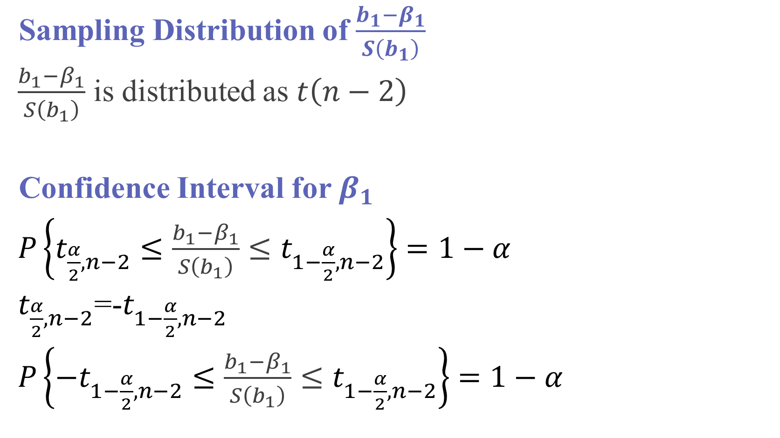
Sampling Distribution of $\frac{b_{1}−β_{1}}{S\left(b_{1}\right)}$
$\frac{b_{1}−β_{1}}{S\left(b_{1}\right)}$ is distributed as $t\left(n−2\right)$
Confidence Interval for $β_{1}$
$P\left\{t_{\frac{α}{2},n−2}≤\frac{b_{1}−β_{1}}{S\left(b_{1}\right)}≤t_{1−\frac{α}{2},n−2}\right\}=1−α$
$t_{\frac{α}{2},n−2}$=-$t_{1−\frac{α}{2},n−2}$
$P\left\{−t_{1−\frac{α}{2},n−2}≤\frac{b_{1}−β_{1}}{S\left(b_{1}\right)}≤t_{1−\frac{α}{2},n−2}\right\}=1−α$

Slide 49
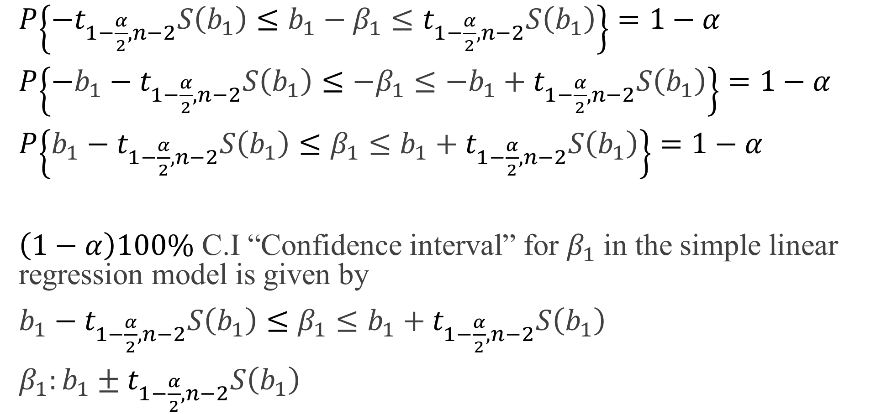
$P\left\{−t_{1−\frac{α}{2},n−2}S\left(b_{1}\right)≤b_{1}−β_{1}≤t_{1−\frac{α}{2},n−2}S\left(b_{1}\right)\right\}=1−α$
$P\left\{−b_{1}−t_{1−\frac{α}{2},n−2}S\left(b_{1}\right)≤−β_{1}≤−b_{1}+t_{1−\frac{α}{2},n−2}S\left(b_{1}\right)\right\}=1−α$
$P\left\{b_{1}−t_{1−\frac{α}{2},n−2}S\left(b_{1}\right)≤β_{1}≤b_{1}+t_{1−\frac{α}{2},n−2}S\left(b_{1}\right)\right\}=1−α$
$\left(1−α\right)100\%$ C.I “Confidence interval” for $β_{1}$ in the simple linear regression model is given by
$b_{1}−t_{1−\frac{α}{2},n−2}S\left(b_{1}\right)≤β_{1}≤b_{1}+t_{1−\frac{α}{2},n−2}S\left(b_{1}\right)$
$β_{1}:b_{1}±t_{1−\frac{α}{2},n−2}S\left(b_{1}\right)$

Slide 50
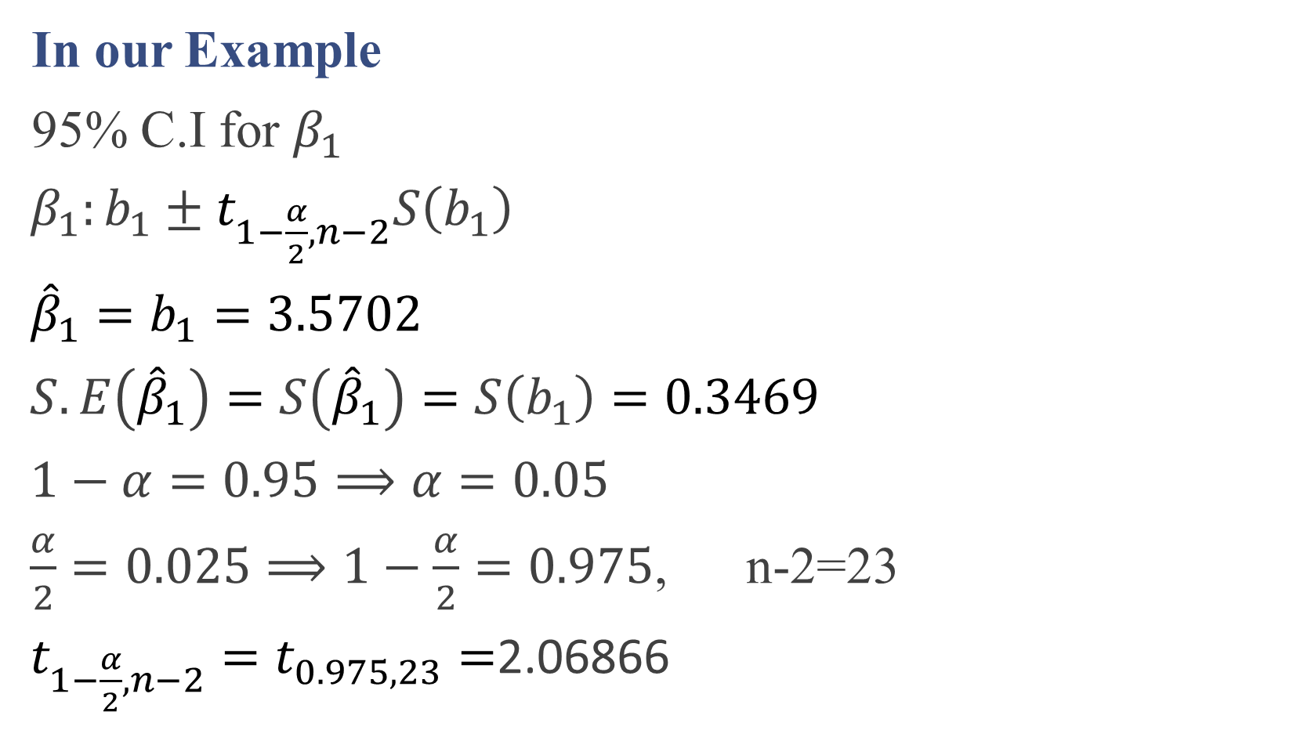
In our Example
95% C.I for $β_{1}$
$β_{1}:b_{1}±t_{1−\frac{α}{2},n−2}S\left(b_{1}\right)$
${\hat{β}}_{1}=b_{1}=3.5702$
$S.E\left({\hat{β}}_{1}\right)=S\left({\hat{β}}_{1}\right)=S\left(b_{1}\right)=0.3469$
$1−α=0.95⟹α=0.05$
$\frac{α}{2}=0.025⟹1−\frac{α}{2}=0.975$, n-2=23
$t_{1−\frac{α}{2},n−2}=t_{0.975,23}=$2.06866

Slide 51
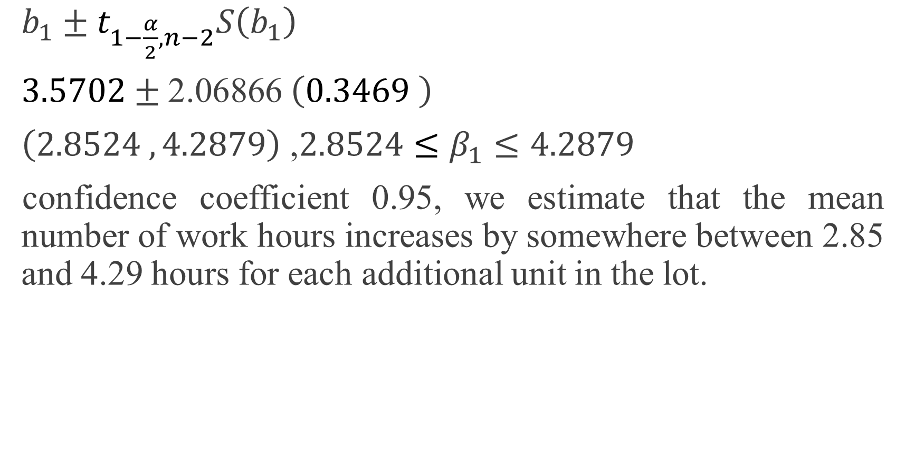
$b_{1}±t_{1−\frac{α}{2},n−2}S\left(b_{1}\right)$
$3.5702±\text{2.06866} \left(0.3469 \right)$
$\left(2.8524 , 4.2879\right)$ ,$2.8524≤β_{1}≤4.2879$
confidence coefficient 0.95, we estimate that the mean number of work hours increases by somewhere between 2.85 and 4.29 hours for each additional unit in the lot.

Slide 52
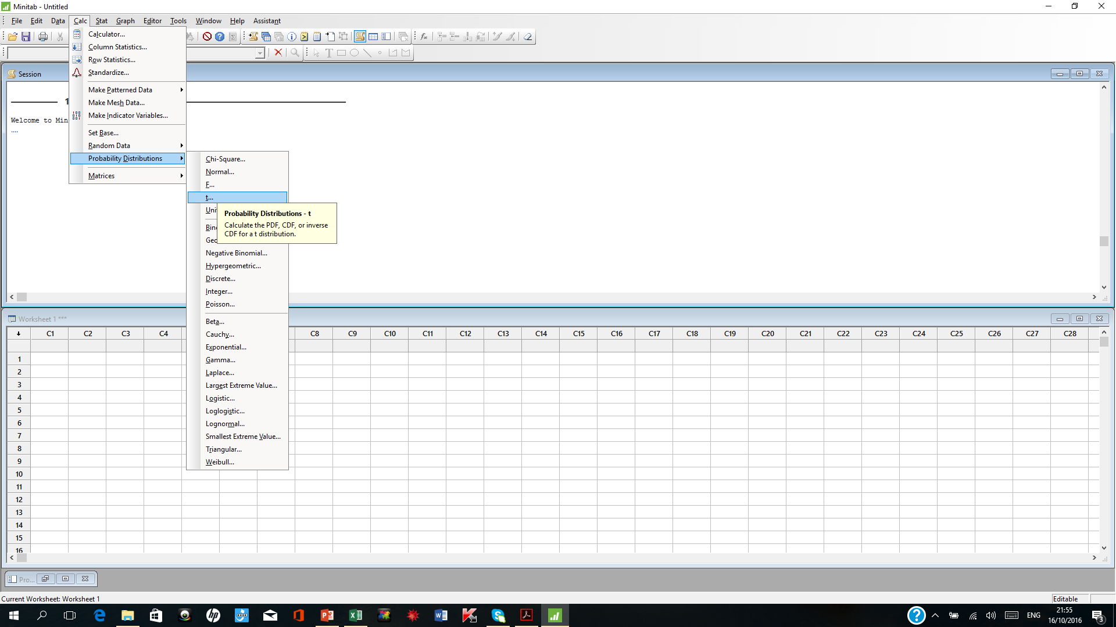

Slide 53
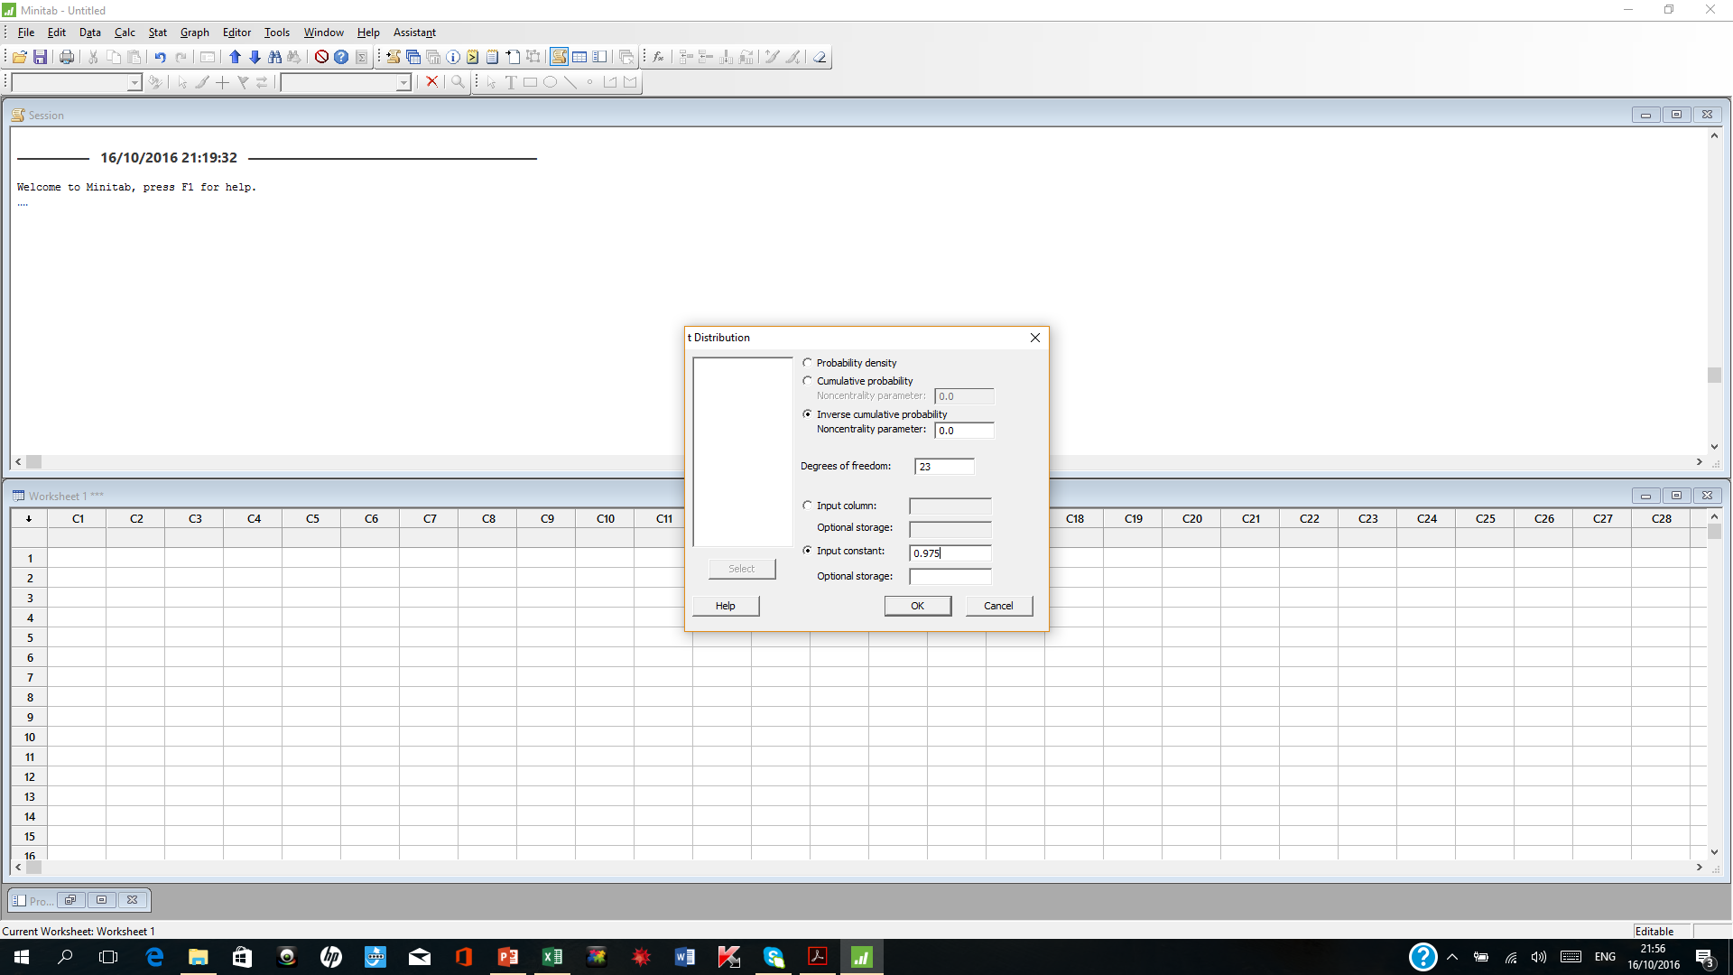

Slide 54
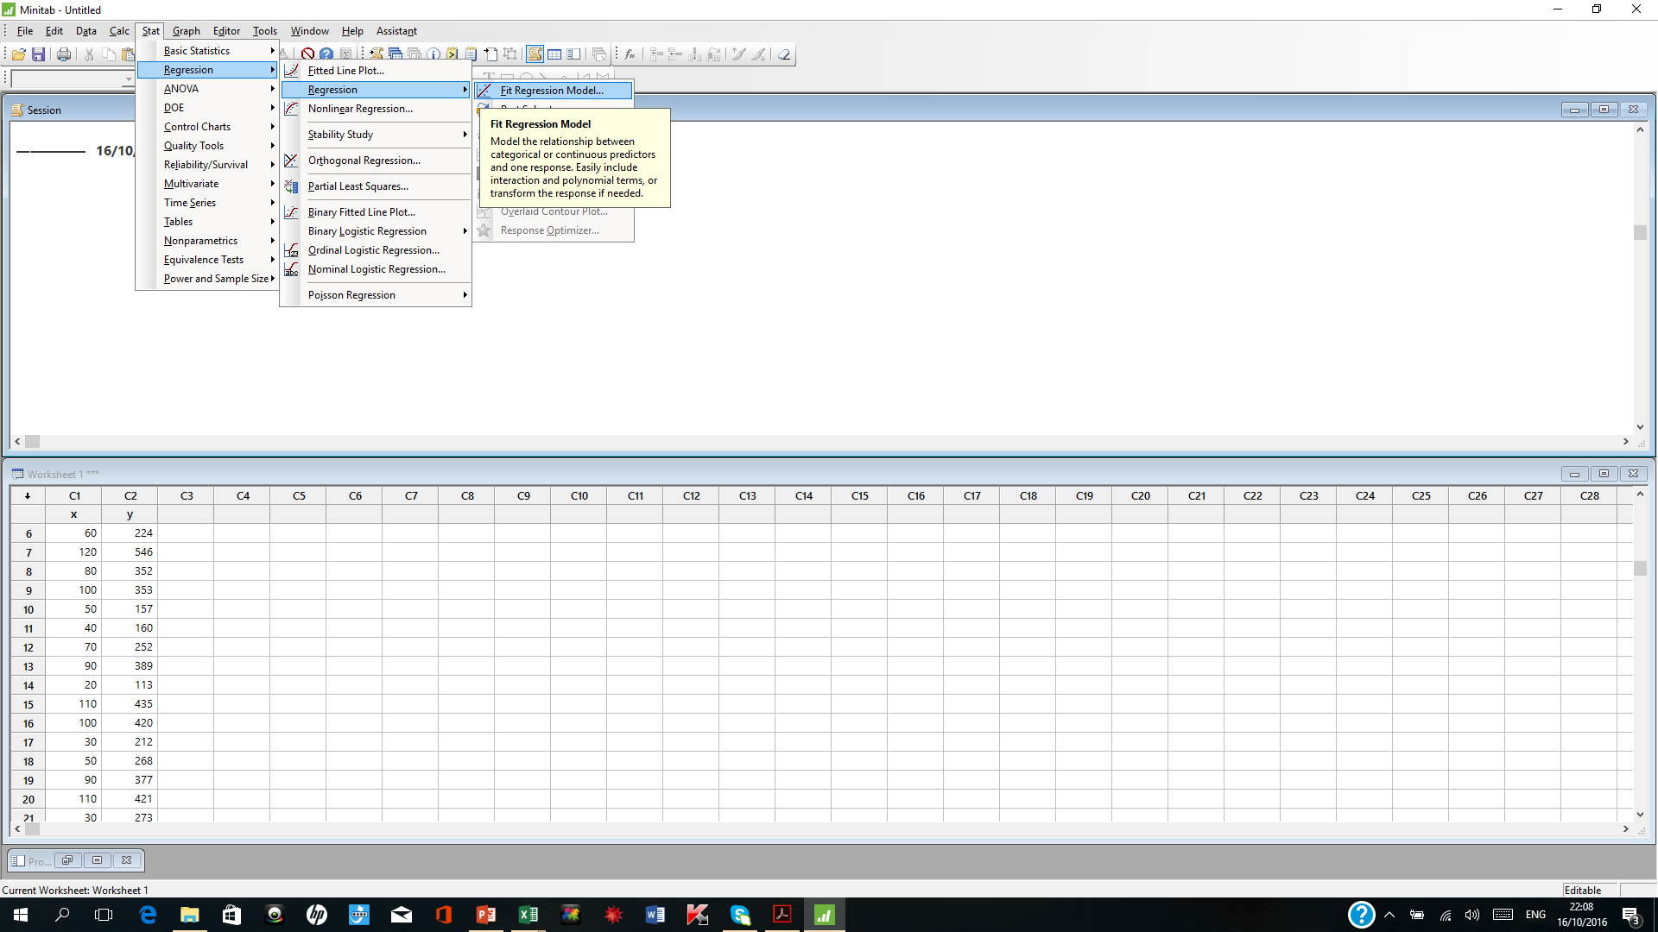

Slide 55
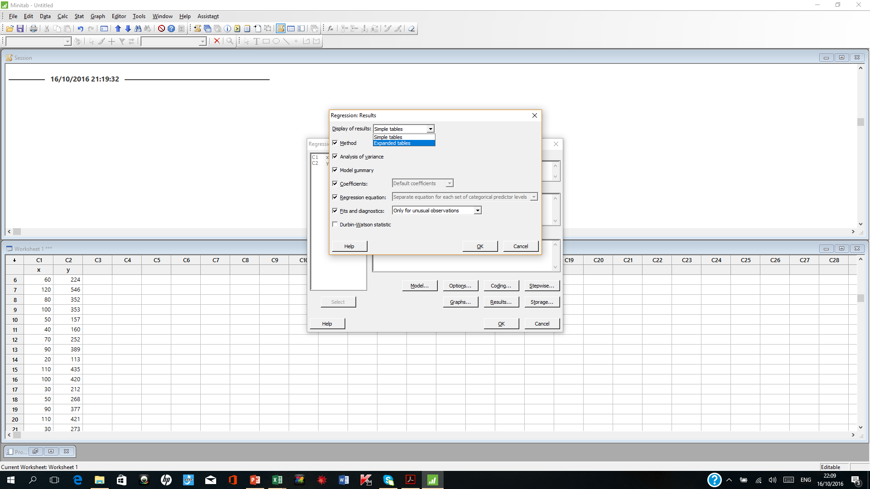

Slide 56
Coefficients
Term Coef SE Coef 95% CI T-Value P-Value VIF
Constant 62.4 26.2 ( 8.2, 116.5) 2.38 0.026
x 3.570 0.347 (2.852, 4.288) 10.29 0.000 1.00

Slide 57


Hypotheses Testing for $β_{1}$
Two-Sided Test
1. Hypotheses
$H_{0}:β_{1}=A$
$H_{1}:β_{1}≠A$
2.Test statistic
$T=\frac{b_{1}−A}{S\left(b_{1}\right)}\sim t_{n−2}$

Slide 58

3.Critical Region
Reject $H_{0}$ if T>$t_{1−\frac{α}{2},n−2}$ or T<-$t_{1−\frac{α}{2},n−2}$
4-Decision
By p-value : Reject $H_{0}$ if $p−value<α$
P-value=$2 P$($t_{n−2}>\left|T\right|$)

Slide 59
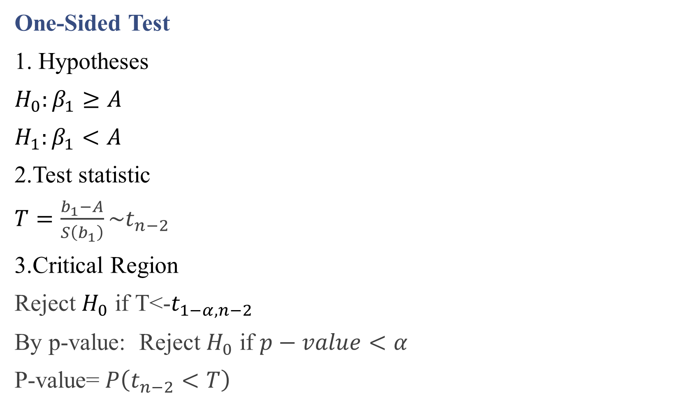
One-Sided Test
1. Hypotheses
$H_{0}:β_{1}≥A$
$H_{1}:β_{1}<A$
2.Test statistic
$T=\frac{b_{1}−A}{S\left(b_{1}\right)}\sim t_{n−2}$
3.Critical Region
Reject $H_{0}$ if T<-$t_{1−α,n−2}$
By p-value: Reject $H_{0}$ if $p−value<α$
P-value=$P\left(t_{n−2}<T\right)$

Slide 60

One-Sided Test
1. Hypotheses
$H_{0}:β_{1}≤A$
$H_{1}:β_{1}>A$
2.Test statistic
$T=\frac{b_{1}−A}{S\left(b_{1}\right)}\sim t_{n−2}$
3.Critical Region
Reject $H_{0}$ if T>$t_{1−α,n−2}$
By p-value : Reject $H_{0}$ if $p−value<α$
P-value=$P\left(t_{n−2}>T\right)$

Slide 62
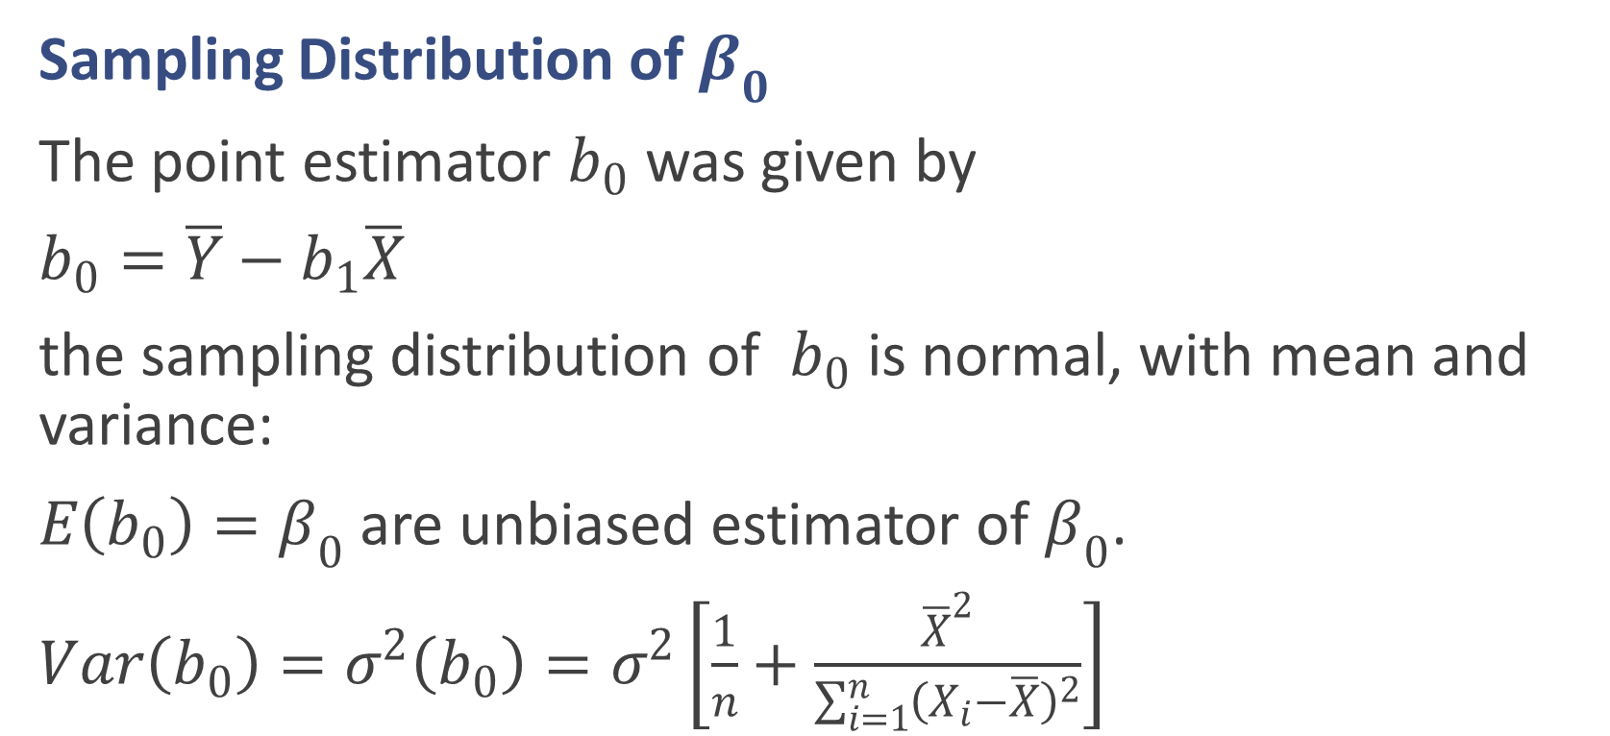

Inferences Concerning $β_{0}$
Sampling Distribution of $β_{0}$
The point estimator $b_{0}$ was given by
$b_{0}=\overline{Y}−b_{1}\overline{X}$
the sampling distribution of $b_{0}$ is normal, with mean and variance:
$E\left(b_{0}\right)=β_{0}$ are unbiased estimator of $β_{0}$.
$Var\left(b_{0}\right)=σ^{2}\left(b_{0}\right)=σ^{2}\left[\frac{1}{n}+\frac{{\overline{X}}^{2}}{\sum_{i=1}^{n}{{\left(X_{i}−\overline{X}\right)}^{2}}}\right]$

Slide 63
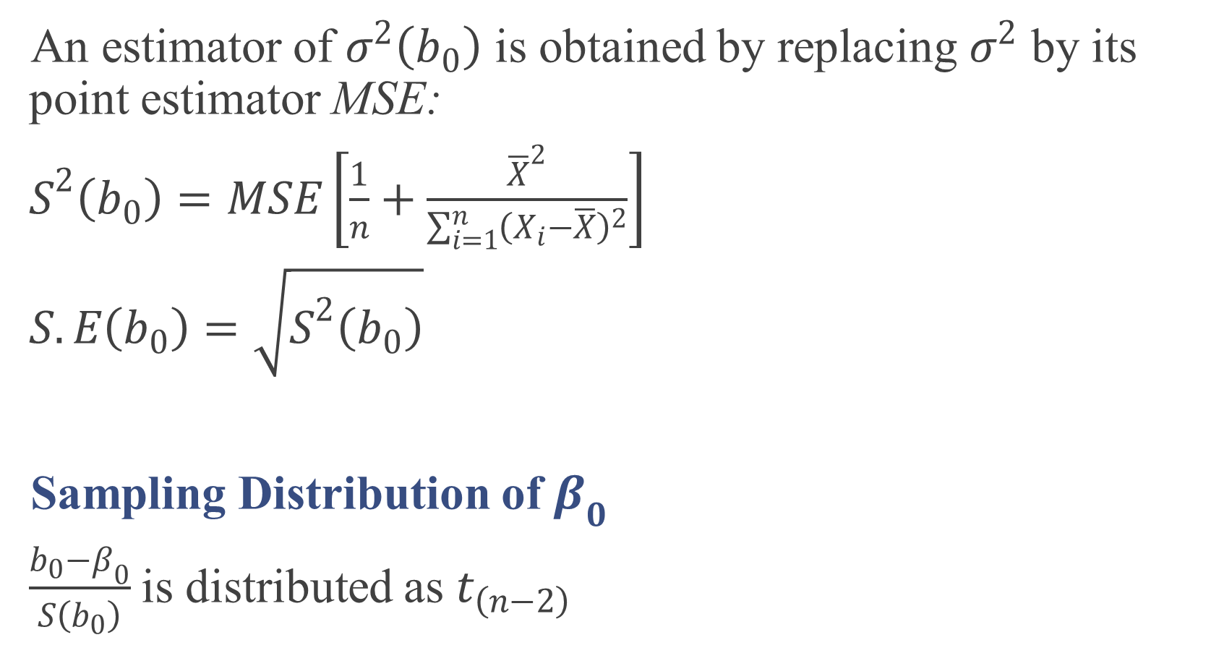
An estimator of $σ^{2}\left(b_{0}\right)$ is obtained by replacing $σ^{2}$ by its point estimator MSE:
$S^{2}\left(b_{0}\right)=MSE\left[\frac{1}{n}+\frac{{\overline{X}}^{2}}{\sum_{i=1}^{n}{{\left(X_{i}−\overline{X}\right)}^{2}}}\right]$
$S.E\left(b_{0}\right)=\sqrt{S^{2}\left(b_{0}\right)}$
Sampling Distribution of $β_{0}$
$\frac{b_{0}−β_{0}}{S\left(b_{0}\right)}$is distributed as $t_{\left(n−2\right)}$

Slide 64
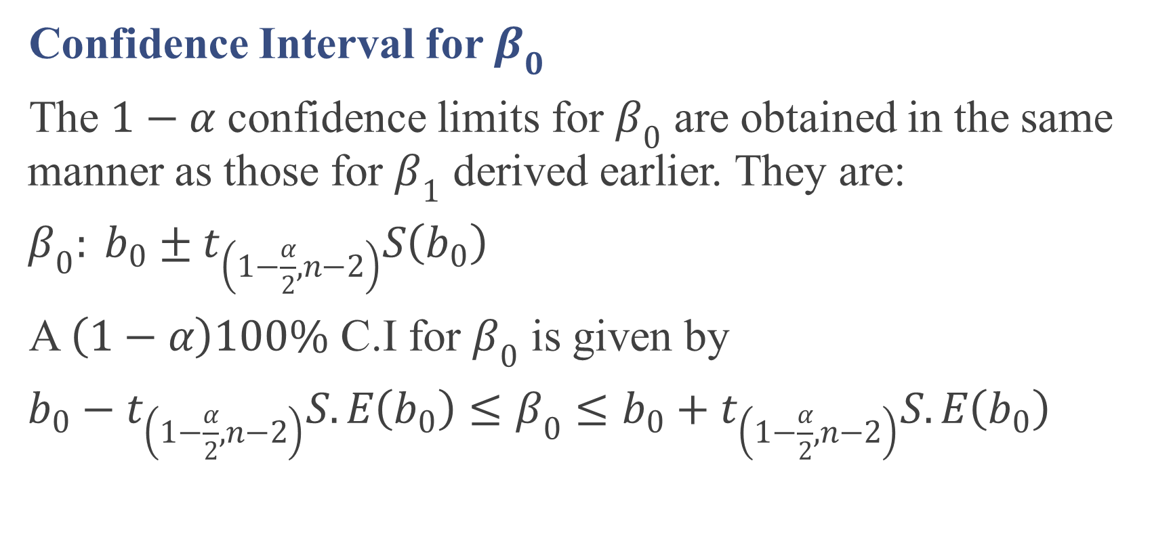
Confidence Interval for $β_{0}$
The $1−α$ confidence limits for $β_{0}$ are obtained in the same manner as those for $β_{1}$ derived earlier. They are:
$β_{0}: b_{0}±t_{\left(1−\frac{α}{2},n−2\right)}S\left(b_{0}\right)$
A $\left(1−α\right)100\%$ C.I for $β_{0}$ is given by
$b_{0}−t_{\left(1−\frac{α}{2},n−2\right)}S.E\left(b_{0}\right)≤β_{0}≤b_{0}+t_{\left(1−\frac{α}{2},n−2\right)}S.E\left(b_{0}\right)$

Slide 65

In Our Example:
90% C.I for $β_{0}$?
${\hat{Y}}_{i}=62.366+3.35702 X_{i}$
MSE=2383.72, $n=25$
$b_{0}=62.366$.
$S.E\left(b_{0}\right)=\sqrt{S^{2}\left(b_{0}\right)}$
$S^{2}\left(b_{0}\right)=MSE\left[\frac{1}{n}+\frac{{\overline{X}}^{2}}{\sum_{i=1}^{n}{{\left(X_{i}−\overline{X}\right)}^{2}}}\right]$
$\overline{X}=70,$ $S_{XX}=\sum_{i=1}^{n}{{\left(X_{i}−\overline{X}\right)}^{2}}=19800$
$S^{2}\left(b_{0}\right)=2383.72\left[\frac{1}{25}+\frac{{\left(70\right)}^{2}}{19800}\right]=685.2593$

Slide 66

$S.E\left(b_{0}\right)=\sqrt{S^{2}\left(b_{0}\right)}=\sqrt{685.2593}=26.1775$
$1−α=0.9⟹α=0.10⟹\frac{α}{2}=0.05⟹1−\frac{α}{2}=0.95$
$t_{\left(1−\frac{α}{2},n−2\right)}=t_{\left(0.95,23\right)}=1.7139$
then 90% C.I for $β_{0}$ is given by
$62.366±1.7139 \left(26.1775\right)$
$\left(17.5004,107.2316\right)$
The 90 percent confidence interval for $β_{0}$ is:
$17.5004≤β_{0}≤107.231$

Slide 67

Hypotheses Testing for $β_{0}$
Two-Sided Test
1. Hypothesis
$H_{0}:β_{0}=A$
$H_{1}:β_{0}≠A$
2. Test statistic
$T=\frac{b_{0}−A}{s\left(b_{0}\right)}$
3. Decision:
Reject $H_{0}$ if $T>t_{\left(1−\frac{α}{2},n−2\right)}$ or $T<−t_{\left(1−\frac{α}{2},n−2\right)}$
P-value: Reject $H_{0}$ if $p−value<α$
p-value=$2P\left(t_{\left(n−2\right)}>\left|T\right|\right)$

Slide 69

In Our Example:
whether or not there is a linear association between work hours and lot size “Test $β_{1}=0$”
Two-Sided Test
1. Hypotheses
$H_{0}:β_{1}=0 vs. H_{1}:β_{1}≠0$
2.Test statistic
$T=\frac{b_{1}}{S\left(b_{1}\right)}=\frac{3.5702}{0.3469}=10.2917$
3.Critical Region
Reject $H_{0}$ if T>$t_{1−\frac{α}{2},n−2}$ or T<-$t_{1−\frac{α}{2},n−2}$

Slide 70

$1−α=0.95⟹α=0.05$
$\frac{α}{2}=0.025⟹1−\frac{α}{2}=0.975\text{, }\text{n}\text{-2=23}$
$t_{1−\frac{α}{2},n−2}=t_{0.975,23}=\text{2.06866}$
$10.2917$>$\text{2.06866}$ or $10.2917$<$-\text{2.06866}$? “ Yes $10.2917$>$\text{2.06866}$“
4-Decision
Reject $H_{0}$ then $β_{1}≠0$
By p-value : Reject $H_{0}$ if $p−value<α$
P-value=$2 P$($t_{n−2}>\left|T\right|$)=2 $P$($t_{23}>10.2917$)
=2(1- $P$($t_{23}<10.2917$))=2(1-1)=0.00

Slide 71


Slide 72

$p−value=0<α=0.05$
$⟹$Reject $H_{0}$ then $β_{1}≠0$
whether or not there are work hours does not depend on lot size “Test $β_{0}=0$”
Two-Sided Test
1. Hypothesis
$H_{0}:β_{0}=0 vs. H_{1}:β_{0}≠0$
2. Test statistic
$T=\frac{b_{0}}{s\left(b_{0}\right)}=\frac{62.366}{26.1775}=2.3824$

Slide 73

3. Decision:
Reject $H_{0}$ if $T>t_{\left(1−\frac{α}{2},n−2\right)}$ or $T<−t_{\left(1−\frac{α}{2},n−2\right)}$
$t_{1−\frac{α}{2},n−2}=t_{0.975,23}=\text{2.06866}$
$2.3824>\text{2.06866} \text{or} 2.3824<\text{-}\text{2.06866} \text{ ??}$ “Yes $2.3824>\text{2.06866}“$
Then Reject $H_{0}⟹$ $β_{0}≠0$
P-value: Reject $H_{0}$ if $p−value<α$
p-value=$2P\left(t_{\left(n−2\right)}>\left|T\right|\right)$=2$P\left(t_{23}>2.3824\right)$
$=2(1−P\left(t_{23}<2.3824\right)$)=2(1-0.9871)=2*0.0129=0.0258<0.05
Then Reject $H_{0}⟹$ $β_{0}≠0$

Slide 74
Cumulative Distribution Function
Student’s t distribution with 23 DF
x P( X ≤ x )
2.3824 0.987074

Slide 75

Analysis of Variance Approach to Regression Analysis (Page 64)
Fitted value: ${\hat{y}}_{i}$
Experimenter value: $y_{i}$
Mean of responses: $\overline{y}$

Slide 76

1- total sum of squares SSTo
$SSTo=\sum_{i=1}^{n}{{\left(Y_{i}−\overline{Y}\right)}^{2}}$
2- error sum of squares SSE
$SSE=\sum_{i=1}^{n}{{\left(Y_{i}−{\hat{Y}}_{i}\right)}^{2}}$
3- Regression sum of squares SSR
$SSR=\sum_{i=1}^{n}{{\left({\hat{Y}}_{i}−\overline{Y}\right)}^{2}}$
$SSTo=SSR+SSE$

Slide 78


Analysis of Variance Table
$SSTo=\sum_{i=1}^{n}{{Y_{i}}^{2}}−n{\overline{Y}}^{2}$
$SSR=\sum_{i=1}^{n}{{\left({\hat{Y}}_{i}−\overline{Y}\right)}^{2}}={b_{1}}^{2}\sum_{i=1}^{n}{{\left(X_{i}−\overline{X}\right)}^{2}}$ “Proof H.W”
Source of Variation | df | SS | MS | F | P-Value
Regression model | 1 | $$SSR=\sum_{i=1}^{n}{{\left({\hat{Y}}_{i}−\overline{Y}\right)}^{2}}$$ | $$MSR=\frac{SSR}{1}$$ | $$F=\frac{MSR}{MSE}$$ | ?
Error | n-2 | $$SSE=\sum_{i=1}^{n}{{\left(Y_{i}−{\hat{Y}}_{i}\right)}^{2}}$$ | $$MSE=\frac{SSE}{n−2}$$
Total | n-1 | $$SSTo=\sum_{i=1}^{n}{{\left(Y_{i}−\overline{Y}\right)}^{2}}$$

Slide 79

In Simple Linear Regression Model
1. Hypotheses
$H_{0}:β_{1}=0 vs. H_{1}:β_{1}≠0$
2.Test statistic
$F=\frac{MSR}{MSE}\sim F_{1,n−2}$
3.Critical Region
Reject $H_{0}$ if F>$F_{1−α,1, n−2}$
4-Decision
By p-value : Reject $H_{0}$ if $p−value<α$

Slide 80

Then to test $β_{1}=0$ “the linearity” , we have two methods
In our example
Method I:
1. Hypotheses
$H_{0}:β_{1}=0 vs. H_{1}:β_{1}≠0$
2.Test statistic
$T=\frac{b_{1}}{S\left(b_{1}\right)}=\frac{3.5702}{0.3469}=10.2917$
3.Critical Region
$10.2917$>$\text{2.06866}$“
P-value=2(1- $P$($t_{23}<10.2917$))=2(1-1)=0.00$<α$
4-Decision
Reject $H_{0}$ then $β_{1}≠0$

Slide 81


Method II:
$\sum_{i=1}^{n}{{\left(Y_{i}−\overline{Y}\right)}^{2}}=\text{307203} ,\sum_{i=1}^{n}{{\left(Y_{i}−{\hat{Y}}_{i}\right)}^{2}}=\text{54825.46}$
Source of Variation | df | SS | MS | F
Regression model | 1 | $$SSR=307203−54825.46$$ =252377.54 | $$MSR=252377.54$$ | $$F=\frac{252377.54}{2383.72}=105.876$$
Error | 23 | $$SSE=54825.46$$ | $$MSE=\frac{54825.46}{23}=2383.72$$
Total | 24 | $$SSTo=307203$$
81

Slide 82

1. Hypotheses
$H_{0}:β_{1}=0 vs. H_{1}:β_{1}≠0$
2.Test statistic
$F=\frac{MSR}{MSE}=\frac{252377.54}{2383.72}=105.876$
3.Critical Region
Reject $H_{0}$ if F>$F_{1−α,1, n−2}$
$F_{1−α,1, n−2}$=$F_{0.95,1, 23}=4.2793$
$105.876>4.2793$
4-Decision
$⟹\text{Reject} H_{0}$, then $β_{1}≠0$
There are linear association between work hours and lot size

Slide 84

Analysis of Variance
Source DF SS MS F P
Regression 1 252378 252378 105.88 0.000
Error 23 54825 2384
Total 24 307203
By p-value : Reject $H_{0}$ if $p−value<α$
$p−value=0.00<0.05$
$⟹\text{Reject} H_{0}$, then $β_{1}≠0$
There are linear association between work hours and lot size

Slide 86

Coefficient of Determination
$R^{2}=\frac{SSR}{SSTo}=1−\frac{SSE}{SSTo}; 0≤R^{2}≤1$
We may interpret $R^{2}$ as the proportionate reduction of total variation associated with the use of the predictor variable X. Thus, the larger $R^{2}$ is, the more the total variation of Y is reduced by introducing the predictor variable X.

Slide 87

Coefficient of Correlation
A measure of linear association between Y and X when both Y and X are random is the coefficient of correlation. This measure is the signed square root of $R^{2}$:
$r=±\sqrt{R^{2}}$
A plus or minus sign is attached to this measure according to whether the slope of the fitted regression line is positive or negative. Thus, the range of r is: $−1≤r≤1$.

Slide 88

In our example
$R^{2}=\frac{SSR}{SSTo}=\frac{252377.54}{307203}=0.8215$
Thus, the variation in work hours is reduced by 82.2 percent when lot size is considered.
$r=±\sqrt{0.8215}=+0.9064$
These are simply descriptive measures of the degree of linear association between X and Y.
The regression equation is
y = 62.37 + 3.570 x
S = 48.8233 R-Sq = 82.2% R-Sq(adj) = 81.4%

