Slide 1
Stat 223
Introduction to the Theory of Statistics

Slide 2
Chapter 1
1.1 Sampling Distribution from notes
1.2 Central Limit Theorem from notes

Slide 3

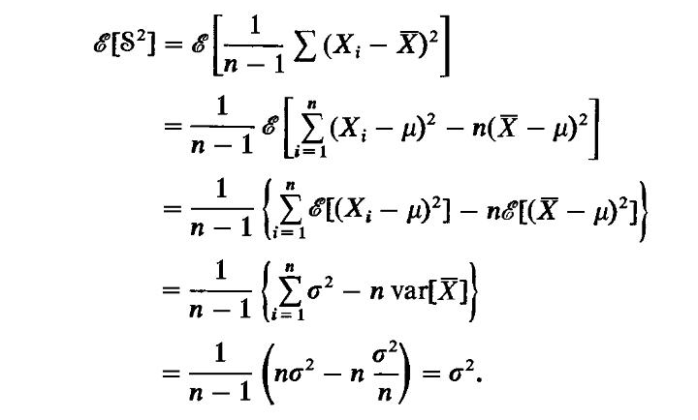
Proof:

Slide 4
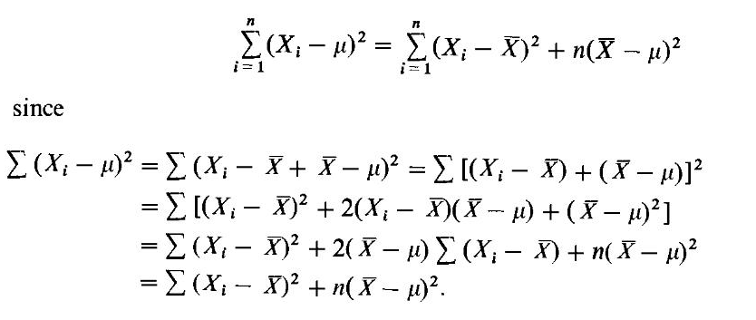

Slide 5
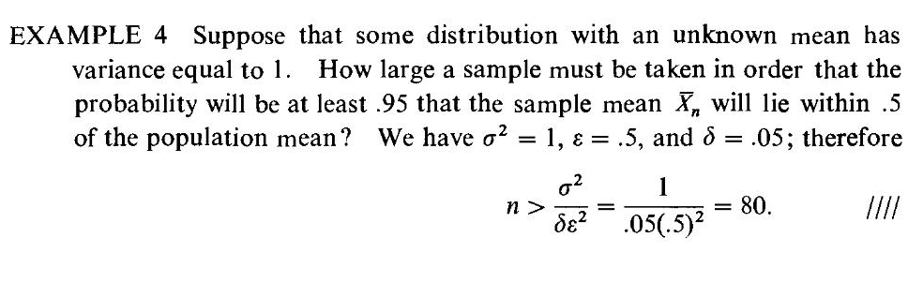
Examples on the weak low of large number

Slide 6
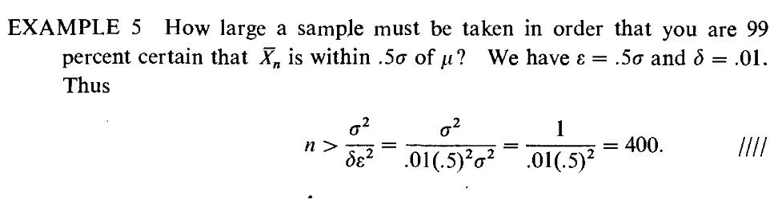

Slide 7
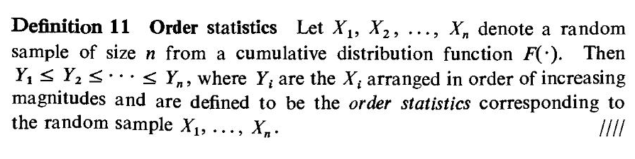
1.3 Order Statistic (p251-p254)

Slide 8
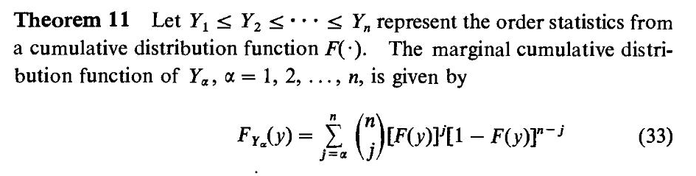
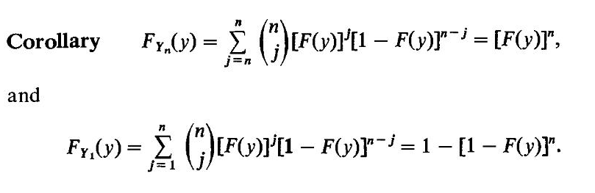

Slide 9
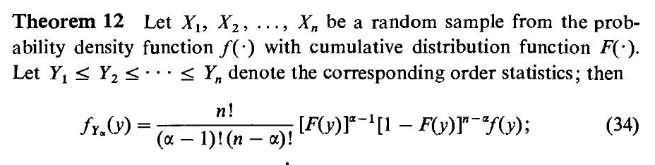

Slide 10

1.4 Exponential Family (p312-p314) one parameter exponential family:

Slide 11
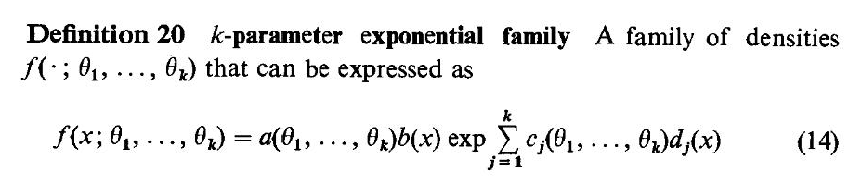
k parameter exponential family:

Slide 12
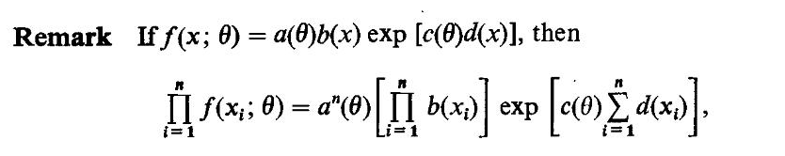
The joint distribution of the exponential family

Slide 13

Exponential Family (p312-p314)
Example 1:
Example 2:

Slide 14


Example 3:

Slide 15
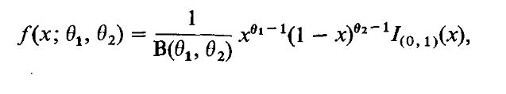
Homework: Does the following density function belong to the exponential family?

Slide 16
Chapter 2
Point Estimation

Slide 17
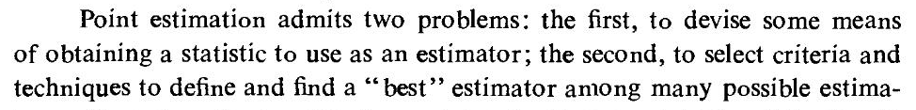
2. 1 Introduction
Statistical inference
estimation
Tests of hypotheses
Point estimation
Interval istimation

Slide 18
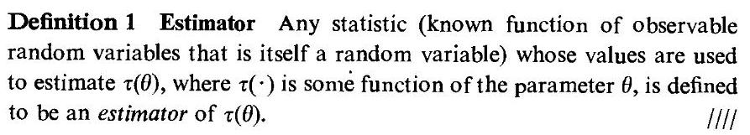
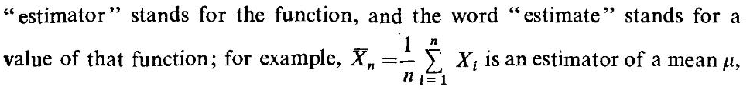
2.2 METHOD OF FINDING ESTIMATORS

Slide 19



Notes:

Slide 20
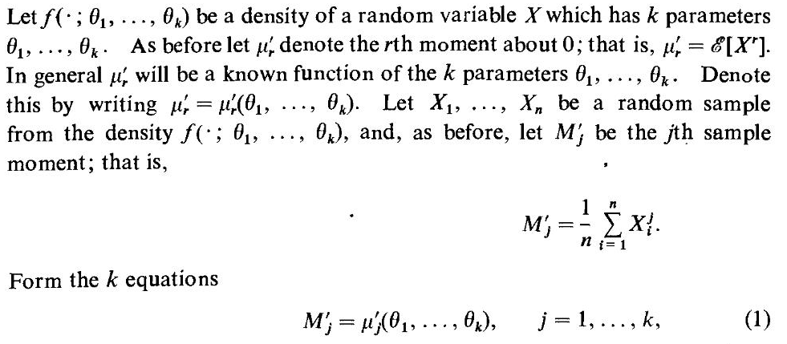
2.2.1 Method of Moments

Slide 21
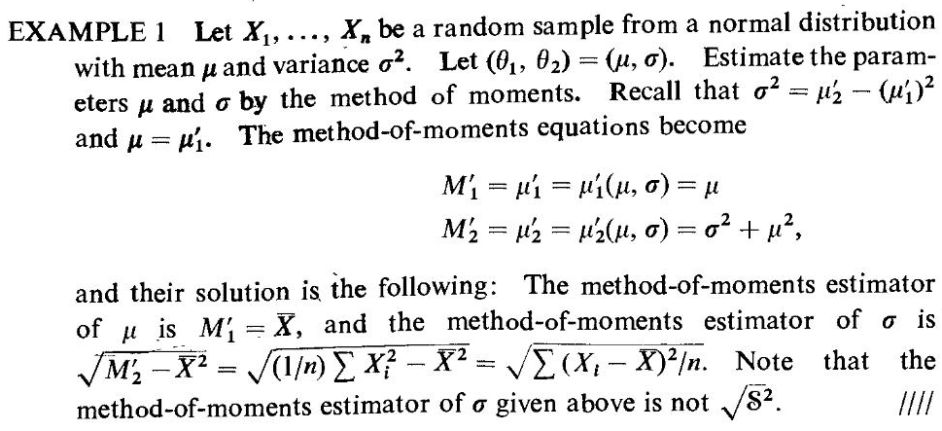

Slide 22






Slide 23
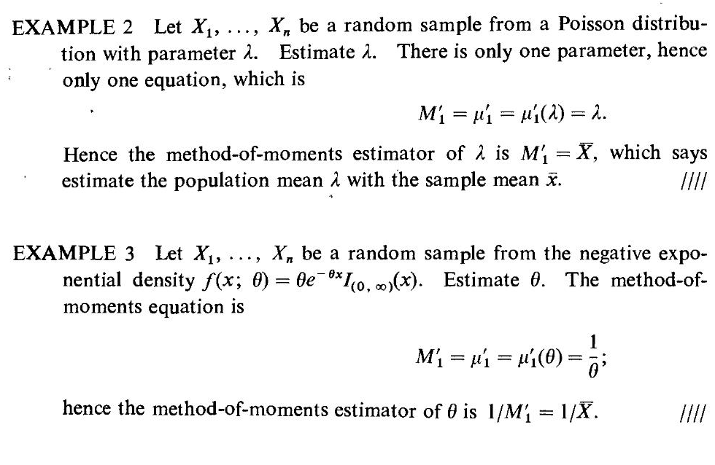

Slide 24
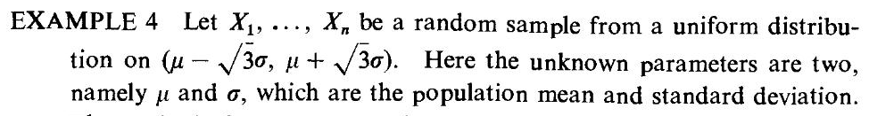
Homework

Slide 25
Note:

Slide 26
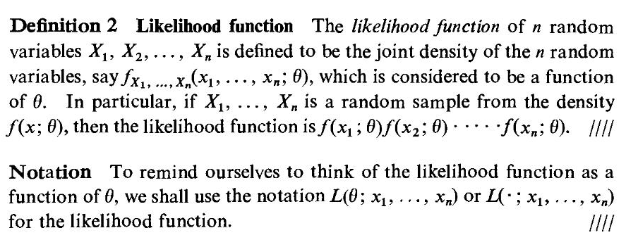
2.2.2 Maximum Likelihood

Slide 27
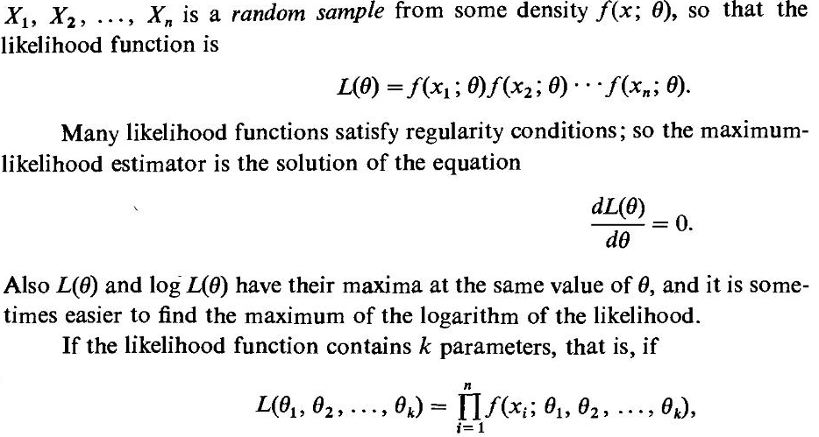

Slide 28
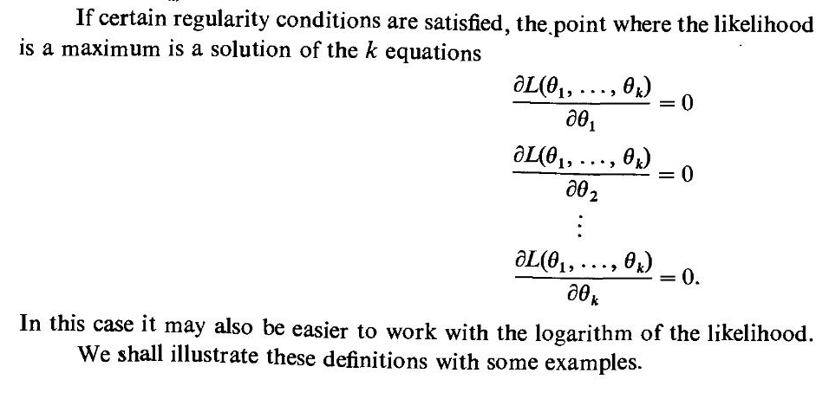

Slide 29
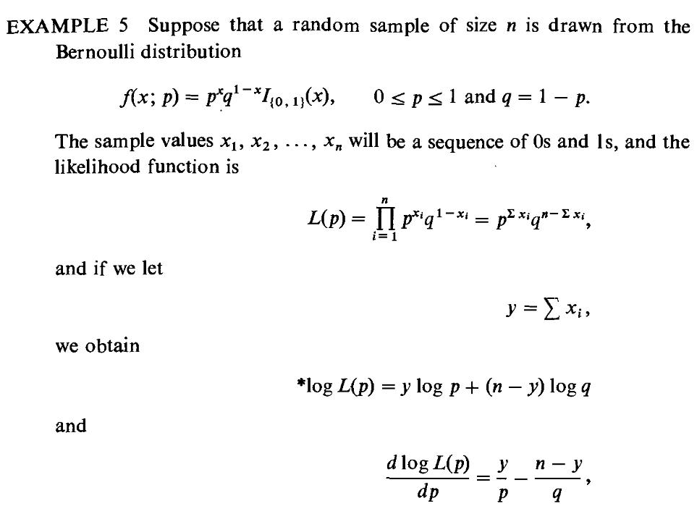

Slide 30




Slide 31
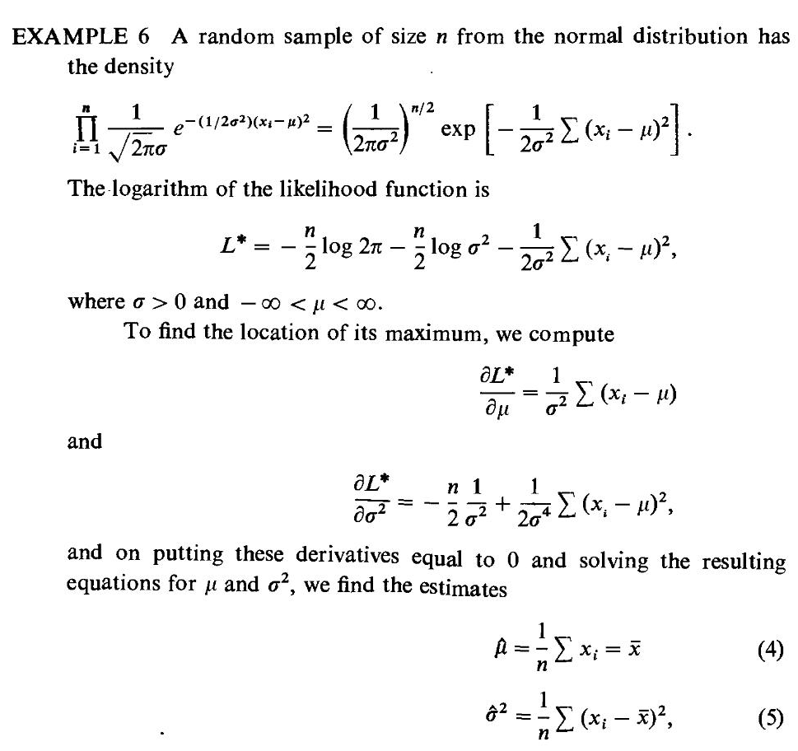
Note: ln = log

Slide 32
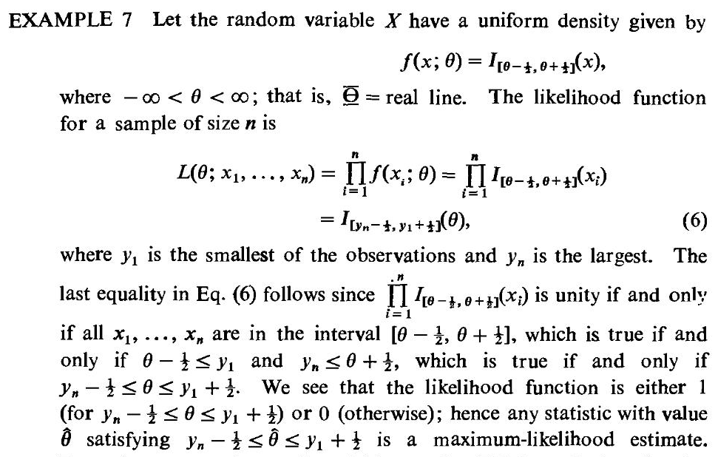

Slide 33
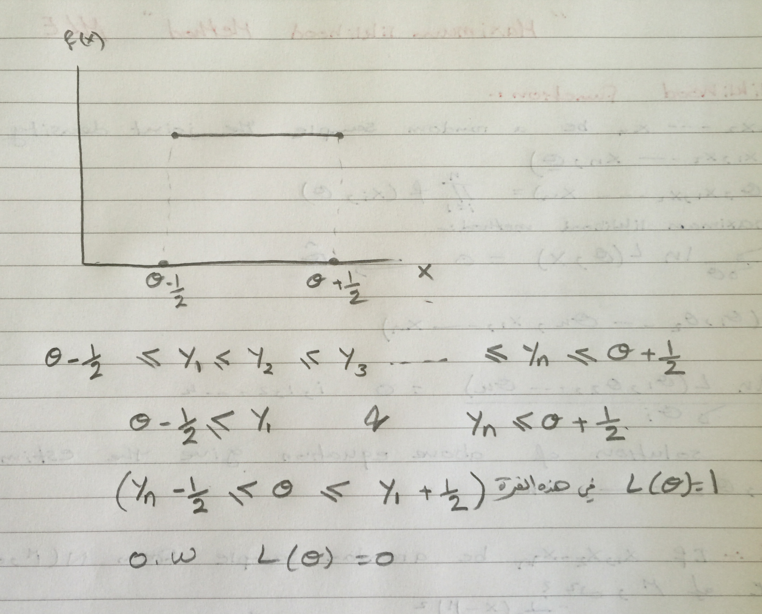
Clarification of the above example

Slide 34
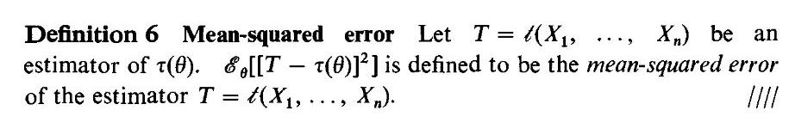
2.3 Properties of Point Estimator
2.3.1mean Squared Error

Slide 35
