Slide 1
Sourcing HR for Global Markets: STAFFING, RECRUITMENT & SELECTION
Chapter 5

Slide 2
Staffing attitudes of internationalizing firms
Ethnocentric – PCNs are favored
Polycentric – HCNs manage subsidiaries
Geocentric – Ability is more important than nationality
Regiocentric – Similar to geocentric, but limited to a given region

Slide 3
Global Expansion & Orientations
Four Strategic Orientations:
1. Ethnocentric:
- The key positions in the organization are filled with the employees of the parent country.
- All the managerial decisions viz. Mission, vision, objectives are formulated by the MNC’s at their headquarters, and the same is to be followed by the host company. - The staff of the parent country is best over the others, and also, they can better represent the interest of the headquarters. 2. Polycentric: The nationals of the host country are recruited at the managerial positions to carry out the operations of the subsidiary company.
3. Regiocentric: Firm accepts a regional marketing policy covering a group of countries which have comparable market characteristics. Operational strategies are formulated on the basis of the entire region rather than individual countries.
4. Geocentric: A company with offices in multiple nations that operates to achieve global objectives as well as local objectives.
Ch 5 -3
Copyright © 2011 Pearson Education

Slide 4
Table 5.1a
Advantages & disadvantages of using PCNs

Slide 5
Table 5.1b
Advantages & disadvantages of using TCNs

Slide 6
Table 5.1c
Advantages & disadvantages of using HCNs

Slide 7
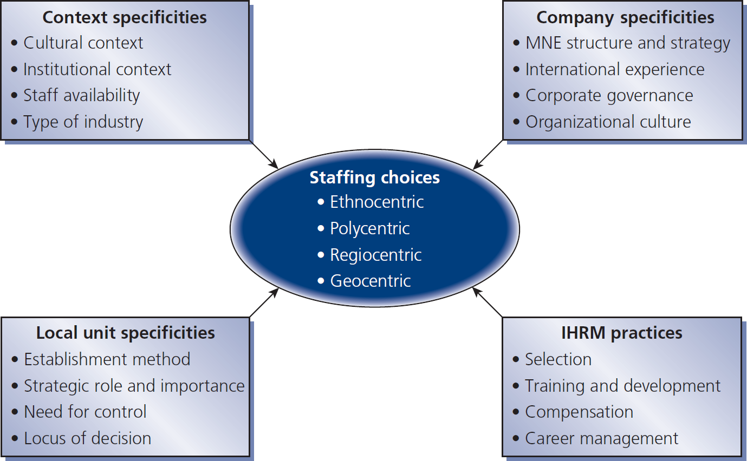
Figure 5.1
Determinants of staffing choices

Slide 8
Transferring staff for international activities

Slide 9
Reasons for international assignments
Position filling lack of available skills → PCN works abroad
Management development - training, development, common corp. values
Organization development - transfer of knowledge, competence, practices - exploit global market opportunities

Slide 10
Types of international assignments
Short term up to 3 months
Extended up to 1year
Long term 1 to 5 years (traditional expatriate assignment)
Some non-standard assignments:
Commuter go home every one to two weeks
Rotational commute for set period followed by break in home country
Contractual specific skills employees hired for 6-12 months on specific projects
Virtual employee manages international responsibilities from base in home country

Slide 11
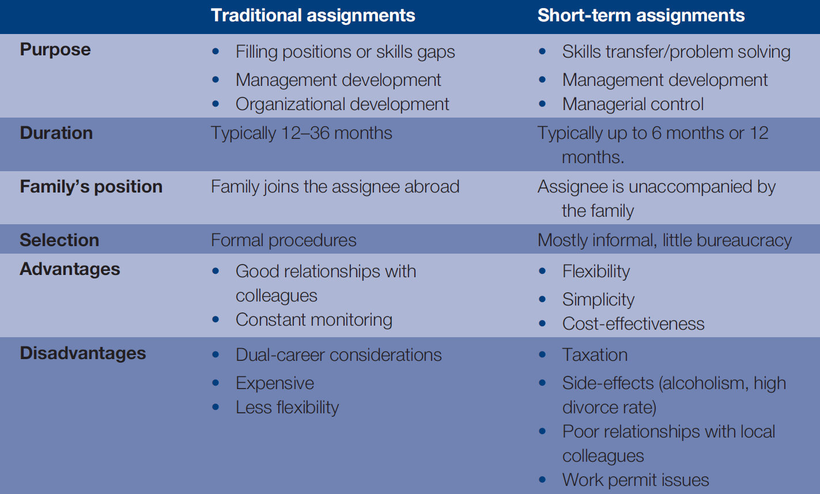
Table 5.2
Differences between traditional & short-term assignments
Chapter 5

Slide 12
Roles of an expatriate

Slide 13
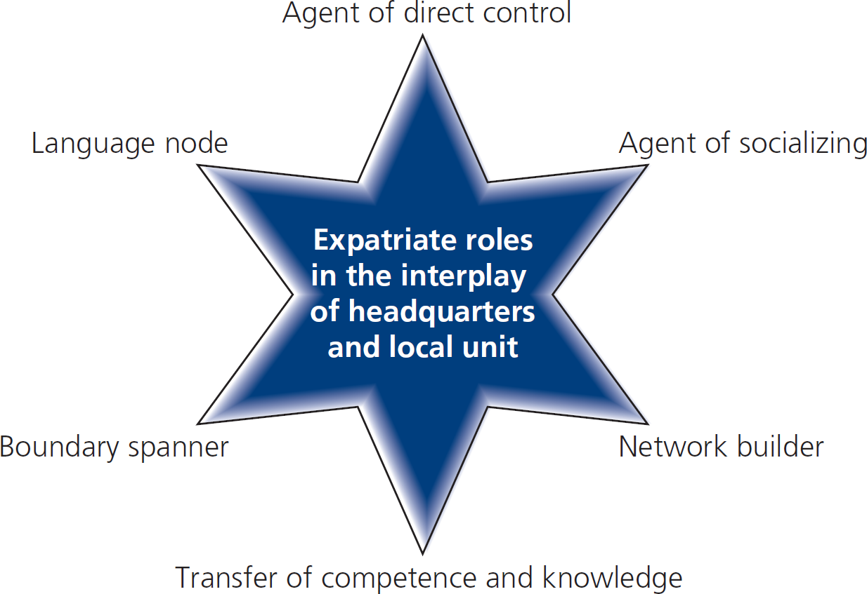
Figure 5.2
Determinants of staffing choices

Slide 14
Factors that influence effectiveness of international assignments
Open environment
Support for cross-fertilization of ideas
Implementation of best practice
Knowledge/info travels freely between expatriate, host country, & parent country
Consideration for personal networks
Some knowledge transfer requires longer assignments (e.g., where there is much tacitness)
Expatriate’s ability & motivation to act as an agent of knowledge transfer
Abilities, motivations, relationships of locals

Slide 15
Role of non-expatriates

Slide 16
Issues with international business travelers
Home & family issues
Work arrangements
Travel logistics
Health concerns
Host culture issues

Slide 17
Role of inpatriates
An employee of a multinational company who is from a foreign country, but is transferred from a foreign subsidiary to the corporation's headquarters.

Slide 18
Drivers for recruiting & transferring inpatriate mgrs.
Desire to create global core competency & cultural diversity of strategic perspectives
Desire to provide career opportunities in HCs
The emergence of developing markets which often are difficult locations for expatriates:
Quality of life adjustment
Cultural adjustment

Slide 19
Recruitment & selection of international managers

Slide 20
International vs. domestic recruitment & selection
Smaller number of external recruits
Preference for internal recruitment
To reduce selection risk
To secure present & past human capital investments

Slide 21
Selection criteria

Slide 22
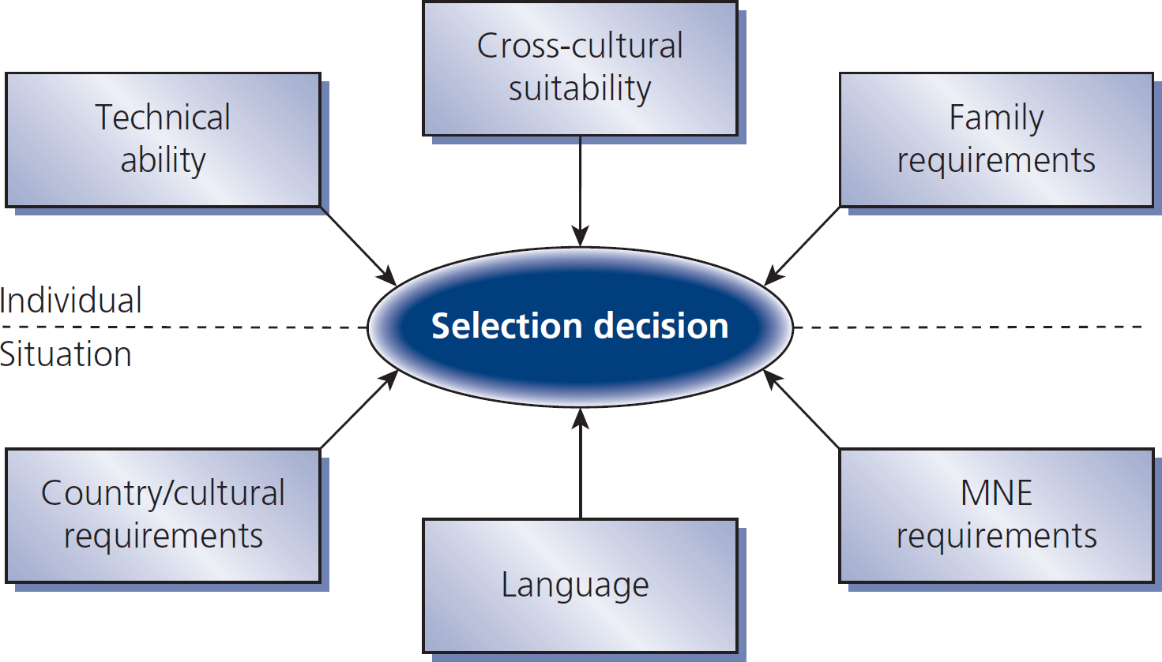
Figure 5.3
Factors in expatriate selection

Slide 23
Dual career couples

Slide 24
IHRM solutions for dual career couples
Inter-firm networking
Job-hunting assistance
Intra-firm employment
Language training, educational assistance
Employer-sponsored work permits
Career planning assistance

Slide 25
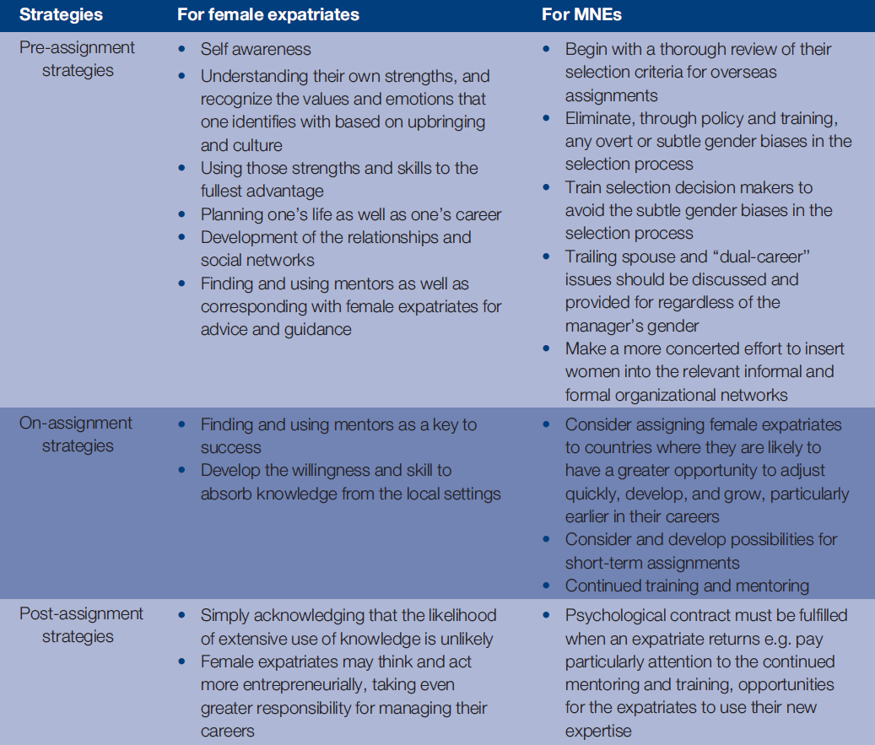
Table 5.6
Strategies for breaking the expatriate glass ceiling

