Slide 1
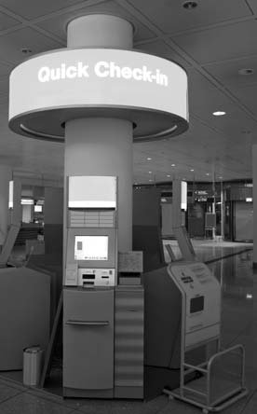
Chapter 9:
Balancing Demand
and Productive
Capacity

Slide 2
Overview of Chapter 9
Fluctuations in Demand Threaten Service Productivity
Managing Capacity
Analyze Patterns of Demand
Managing Demand
Inventory Demand Through Waiting Lines and Queuing Systems
Customer Perceptions of Waiting Time
Inventory Demand Through Reservation Systems

Slide 3
Fluctuations in Demand Threaten Service Productivity

Slide 4
Defining Productive Capacity?
Productive capacity can take several forms in services
Physical facilities designed to contain customers
Physical facilities designed for storing or processing goods
Physical equipment used to process people, possessions, or information
Labor
Infrastructure
Financial success in capacity-constrained business is a function of management’s ability to use productive capacity as efficiently and profitably as possible.

Slide 5
From Excess Demand to Excess Capacity
Excess demand
Too much demand relative to maximum capacity
Demand exceeds optimum capacity
Service quality is perceived to have deteriorated
Optimum capacity
Staff is not overworked and customers receive good service
Excess capacity
Too much capacity relative to demand

Slide 6
Variations in Demand Relative to Capacity
VOLUME DEMANDED
Demand > Capacity
(business is lost)
CAPACITY UTILIZED
Maximum Available
Demand >
Capacity
optimum capacity
(quality declines)
Optimum Capacity
(Demand ≈ Supply)
Excess capacity
Low Utilization
(wasted resources)
(may send bad signals)
TIME CYCLE 1
TIME CYCLE 2

Slide 7
Addressing Problem of Fluctuating Demand
Two basic approaches of which most firms use a mix of:
Adjust level of capacity to meet demand
Need to understand productive capacity and how it varies on an incremental basis
Manage level of demand
Use marketing strategies to smooth out peaks, fill in valleys
Inventorying demand until capacity becomes available

Slide 8
Managing Capacity

Slide 9
Managing Capacity
Enables more people to be served at same level of capacity
Stretch and shrink:
Offer inferior extra capacity at peaks (e.g., bus/train standees)
Use facilities for longer/shorter periods
Reduce amount of time spent in process by minimizing slack time
Adjusting capacity to match demand
Rest during low demand
Cross-train employees
Use part-time employees
Customers perform self-service
Ask customers to share
Create flexible capacity
Rent/share facilities and equipment

Slide 10
Analyze Patterns of Demand

Slide 11
Demand Varies by Market Segment
Understand why customers from specific market segments select this service
Keep good records of transactions to analyze demand patterns
Sophisticated software can help to track customer consumption patterns
Record weather conditions and other special factors that might influence demand

Slide 12
Predictable Demand Patterns and Their Underlying Causes
Predictable Cycles of Demand Levels
Underlying Causes of
Cyclical Variations
employment
billing or tax payments/refunds
pay days
school hours/holidays
seasonal climate changes
public/religious holidays
natural cycles
(e.g., coastal tides)
day
week
month
year
other

Slide 13
Causes of Seemingly Random Changes in Demand Levels
Question: Which of these events can be predicted?
Weather
Health problems
Accidents, Fires, Crime
Natural disasters

Slide 14
Managing Demand

Slide 15
Managing Demand
Take no action
Let demand find its own levels
Interventionist approach
Reduce demand in peak periods
Increase demand when there is excess capacity
Inventorying demand until capacity becomes available
Formal wait and queuing system
Reservation system

Slide 16
Marketing Mix Elements to Shape Demand Patterns
Use price and other nonmonetary costs to manage demand
Change product elements
Modify place and time of delivery
No change
Vary times when service is available
Offer service to customers at a new location
Promotion and Education

Slide 17
Hotel Room Demand Curves by Segment and Season
Price per
room night
B_{l}
B_{h}
T_{h}
B_{h} = business travelers in high season
B_{l} = business travelers in low season
T_{h} = tourist in high season
T_{l} = tourist in low season
T_{l}
T_{h}
B_{h}
B_{l}
T_{l}
Quantity of rooms demanded at each price
by travelers in each segment in each season
Note: hypothetical example

Slide 18
Inventory Demand Through Waiting Lines and Queuing Systems

Slide 19
Waiting Is a Universal Phenomenon!
An average person may spend up to 30 minutes/day waiting in line—equivalent to over one week per year!
Nobody likes to wait
It's boring, time-wasting, and sometimes physically uncomfortable

Slide 20
Why Do Waiting Lines Occur?
Because number of arrivals at a facility exceeds capacity of system to process them at a specific point in the process
Queues are basically a symptom of unresolved capacity management problems
Not all queues take form of a physical waiting line in a single location
Queues may be physical but geographically dispersed
Some are virtual (e.g., phone)

Slide 21
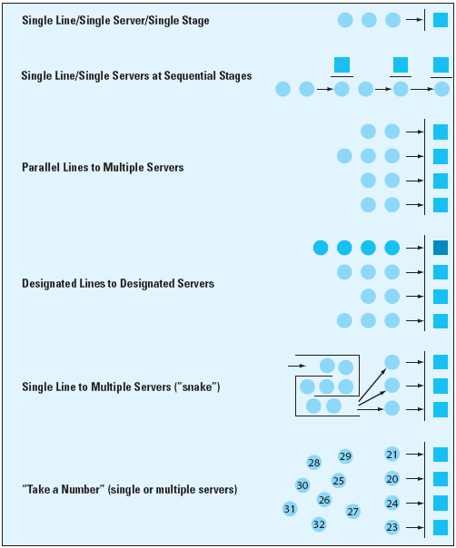
Managing Waiting Lines
Rethink design of queuing system
Install a reservations system
Tailoring the queuing system to different market segments
Manage customer behavior and perceptions of wait
Redesign processes to shorten transaction time

Slide 22
Queuing Systems can be Tailored to Market Segments
Urgency of job
Emergencies vs. non-emergencies
Duration of service transaction
Number of items to transact
Complexity of task
Payment of premium price
Importance of customer
Frequent users/high volume purchasers vs. others

Slide 23
Customer Perceptions of Waiting Time

Slide 24
Ten Propositions on Psychology of Waiting Lines
Feels longer than
Unoccupied time | Occupied time
Solo waits | Group waits
Physically uncomfortable waits | Comfortable waits
Pre- and post-process waits | In-process waits
Unexplained waits | Explained waits
Unfamiliar waits | Known, finite waits
Unfair waits | Fair waits
Anxious waits | Calm waits
Monotonous waits | Valued waits
Sources: Maister; Davis & Heineke; Jones & Peppiatt

Slide 25
Inventory Demand Through Reservations System

Slide 26
Benefits of Reservations
Saves customers from having to wait in line
Helps to control and manage the demand (e.g., leave time for emergency jobs)
Pre-sells the service and can be used to prepare and educate the customer for the service encounter
Data captured helps organizations to understand their demand patterns and to plan their operations and staffing levels

Slide 27
Characteristics of Well-Designed Reservations System
Fast and user-friendly for customers and staff
Responsive to customer queries and needs
Offers options for self service (e.g., through an online reservations system)
Accommodates preferences (e.g., room with a view)
Deflects demand from unavailable first choices to alternative times and locations

Slide 28
Reservations Strategies Should Focus on Yield
Yield analysis helps managers recognize opportunity cost of allocating capacity to one customer/segment when another segment might yield a higher rate later
Decisions need to be based on good information
Detailed records of past usage
Current market intelligence and good marketing sense
Realistic estimate of the chances of obtaining higher rated business
When firms overbook to increase yield,
Victims of overbooking should be compensated to preserve the relationship

Slide 29
Setting Hotel Room Sales Targets by Segment and Time Period
Capacity
(% rooms)
Week 7
Week 36
(Low Season)
(High Season)
100%
Out of commission for renovation
Loyalty Program Members
Loyalty Program
Members
Transient guests
Weekend
package
W/E
package
50%
Transient guests
Groups and conventions
Groups (no conventions)
Airline contracts
Airline contracts
Time
Nights:
M
Tu
W
Th
F
S
Su
M
Tu
W
Th
F
S
Su

Slide 30
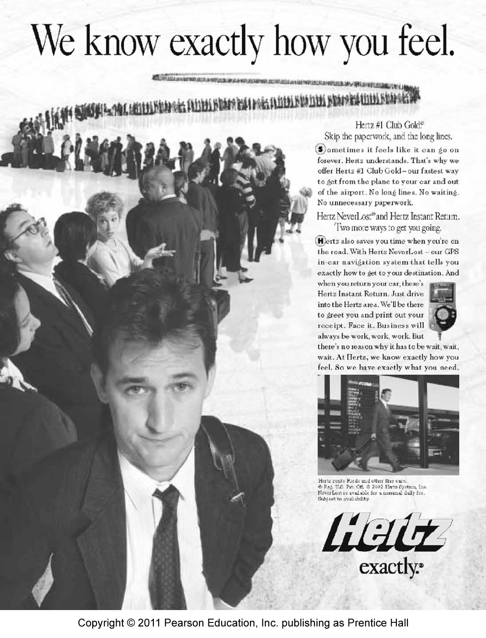
Creating Alternative Use For Otherwise Wasted Capacity
Use capacity for service differentiation
Reward your best customers and build loyalty
Customer and channel development
Reward employees
Barter free capacity

Slide 31
Information Needed for Demand and Capacity Management Strategies
Historical data on demand level and composition, marketing variables
Demand forecasts by segment under specified conditions
Segment-by-segment data
Fixed and variable cost data, profitability of incremental sales
Meaningful location-by-location demand variations
Customer attitudes towards queuing
Customer opinions of quality at different levels of capacity utilization

Slide 32
Summary
At any moment in time, a fixed-capacity service may face
Excess demand
Demand exceeding optimum capacity
Demand and supply well-balanced at the level of optimum capacity
Excess capacity
To balance demand and capacity, a firm can:
Manage capacity
Take no action and let demand find its own levels
Reduce demand in peak periods
Increase demand when there is excess capacity
Inventory demand using wait & queuing, and reservation systems
Capacity can be managed through:
Stretching or shrinking capacity levels
Adjusting capacity to match demand
Creating flexible capacity

Slide 33
Summary
Demand can be managed through
Analysis of patterns
To be reshaped by marketing strategies
Waiting is a universal phenomenon. Waits can be reduced by
Rethinking and redesigning the queuing system
Managing customers’ behavior and their perceptions of the wait
Installing an effective reservation system focused on yield

