Slide 1
Services Marketing 7e, Global Edition
Chapter 6:
Setting Prices and
Implementing
Revenue Management

Slide 2
Overview Of Chapter 6
Effective Pricing is Central to Financial Success
Pricing Strategy as Represented by the Pricing Tripod
Revenue Management: What it is and How it Works
Ethical Concerns in Service Pricing
Putting Service Pricing into Practice

Slide 3
Effective Pricing is
Central to Financial Success

Slide 4
What Makes Service Pricing Strategy Different and Difficult?
Harder to calculate financial costs of creating a service process or performance than a manufactured good
Variability of inputs and outputs:
How can firms define a “unit of service” and establish basis for pricing?
Importance of time factor – same service may have more value to customers when delivered faster
Customers find service pricing difficult to understand, risky, and sometimes even unethical

Slide 5
Pricing Strategy
As Represented by the Pricing Tripod

Slide 6
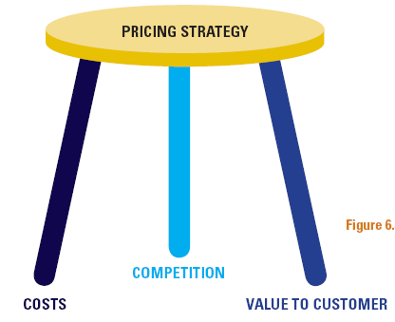
The Pricing Tripod

Slide 7
Three Main Approaches to Pricing
Cost-Based Pricing
Set prices relative to financial costs
Value-Based Pricing
Relate price to value perceived by customer
Competition-Based Pricing
Monitor competitors’ pricing strategy
Pricing implications of cost analysis
Activity-Based Costing
Dependent on the price leader

Slide 8
Cost-Based Pricing
Definition: A pricing method in which a fixed sum or a percentage of the total cost is added (as income or profit) to the cost of the product to arrive at its selling price. BUT, customers care about value to themselves, not what service production costs the firm

Slide 9
Value-Based Pricing:
The setting of a product or service's price, based on the benefits it provides to consumers. By contrast, cost-plus pricing is based on the amount of money it takes to produce the product. Companies that offer unique or highly valuable features or services are better positioned to take advantage of value-based pricing, than companies whose products are services are relatively indistinguishable from those of their competitors.
Example: A company that sells basic, white, 100% cotton athletic socks would probably use cost-plus pricing, because its product does not have any special features. However, a company that sold sweat-wicking, extra-padded athletic socks could use value-based pricing and sell its socks at a higher price, because it provides something unique and valuable to athletic consumers.

Slide 10
Competition-Based Pricing
Price competition increases due to:
Increasing competition
Increase in substituting offers
Wider distribution of competitor

Slide 11
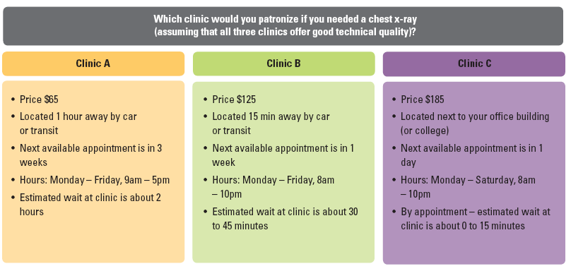
Competitive-Based Pricing

Slide 12
Ethical Concerns in Service Pricing

Slide 13
Ethical Concerns in Pricing
Many services have complex pricing schedules
hard to understand
difficult to calculate full costs in advance of service
Unfairness and misrepresentation in price promotions
misleading advertising
hidden charges
Too many rules and regulations
customers feel constrained (uncomfortable), exploited(broken)
customers unfairly penalized (punished) when plans change

Slide 14
Putting Service
Pricing into Practice

Slide 15
Pricing Issues: Putting Strategy into Practice
1. How much to charge?
2. What basis for pricing?
3. Who should collect payment?
4. Where should payment be made?
5. When should payment be made?
6. How should payment be made?
7. How to communicate prices?

Slide 16
Putting Service Pricing into Practice
How much to charge?
A specific figure must be set for the price
Need to consider the pros (favor) and cons (against), and ethical issues
What basis for pricing?
Completing a task
Admission to a service performance
Time based
Monetary value of service delivered (e.g., commission)
Consumption of physical resources(e.g., food and beverages)
1. How much to charge?
2. What basis for pricing?

Slide 17
Putting Service Pricing into Practice
Who should collect payment?
Service provider or specialist intermediaries
Direct or non-direct channels
Where should payment be made?
Conveniently located intermediaries
Mail/bank transfer
When should payment be made?
In advance
Once service delivery has been completed
3. Who should collect payment?
4. Where should payment be made?
5. When should payment be made?

Slide 18
Putting Service Pricing into Practice
How should payment be made?
Cash
Token
Stored value card
Electronic fund transfer
Charge Card (Debit/Credit)
Vouchers
How to communicate prices?
Relate the price to that of competing products
Ensure price is accurate and intelligible
6. How should payment be made?
7. How to communicate prices?

