Slide 1
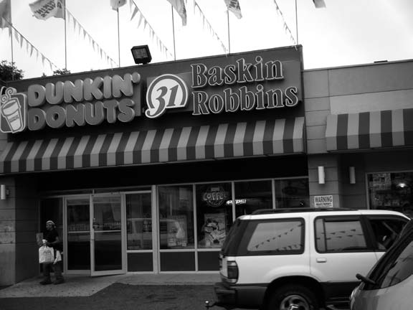
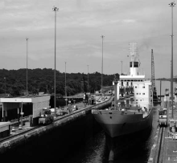
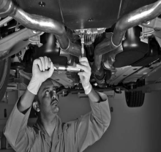
Services Marketing 7e, Global Edition
Chapter 5:
Distributing Services
Through Physical
And Electronic Channels

Slide 2
Overview Of Chapter 5
Distribution in a Services Context
Options for Service Delivery
Place and Time Decisions
Delivering Services in Cyberspace
The Role of Intermediaries
The Challenge of Distribution in Large Domestic Markets
Distributing Services Internationally

Slide 3
What is Distribution ?
Distribution: The way in which something is shared out among
a group or spread over an area.

Slide 4
Distribution in a Services Context

Slide 5
Distribution in a Services Context
In a services context, we often don’t move physical products
Experiences, performances, and solutions are not being physically shipped and stored
More and more informational transactions are conducted through electronic and not physical channels

Slide 6
Applying the Flow Model of Distribution to Services
The three interrelated elements of distribution are:
Information and promotion flow
To get customer interested in buying the service
Negotiation flow
To sell the right to use a service
Product flow
To develop a network of local sites

Slide 7
Distinguishing(unique) between Distribution of Supplementary and Core Services
Most core services require physical locations
Many supplementary services are informational; can be distributed widely and cost-effectively via other means
Telephone
Internet

Slide 8
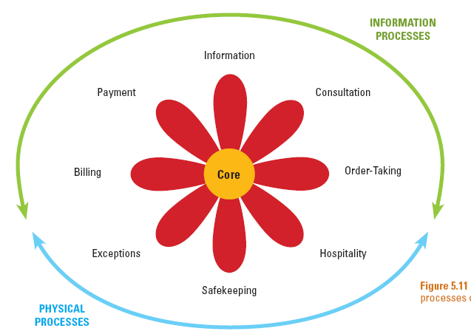
Information and Physical Processes of Augmented(increased) Service Products

Slide 9
Using Websites for Service Delivery
Information
Read brochure/FAQ; get schedules/
directions; check prices
Payment
Pay by bank card
Direct debit
Consultation
Conduct e-mail dialog
Use expert systems
Billing
Receive bill
Make auction bid
Check account status
Order-Taking
Make/confirm reservations
Submit applications
Order goods, check status
Core
Exceptions
Make special requests
Resolve problems
Hospitality
Record preferences
Safekeeping
Track package movements
Check repair status
Information Process
Physical Process

Slide 10
Options for Service Delivery

Slide 11
How should services be distributed? Distribution Options for Serving Customers
Customers visit service site
E.g. Theater and Barber shop when customer has to be physically present
Service providers go to customers
E.g House Panting and Mobile Car wash
More expensive and time-consuming for service provider
Service transaction is conducted remotely
E.g. Credit card company and TV Station

Slide 12
Channel Preferences Vary Among Customers
For complex(multifaceted) and high- perceived(supposed) risk services, people tend to rely(trust) on personal channels (e.g. mortgage dealing they will use face to face)
Individuals with greater confidence and knowledge about a service/channel tend(have a habit of) to use impersonal(easy to use) and self-service channels
Customers with social motives(reasons) tend to use personal channels
Convenience is a key driver of channel choice

Slide 13
Place and Time Decisions

Slide 14
Place Decisions of Service Delivery
Cost, productivity, and access to labor are key determinants to locating a service facility
Location constraints(limitations)
Operational requirement (e.g., airports)
Geographic factor (e.g.,ski resorts)
Need for economies of scale (e.g., hospitals)

Slide 15
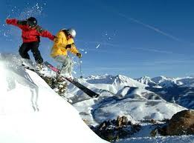

Slide 16
Place Decisions of Service Delivery
Ministores
Creating many small service factories to maximize geographic coverage (like ATM Machines, small Franchises)
Locating in Multipurpose Facilities
Proximity(nearness) to where customers live or work
Service Stations

Slide 17
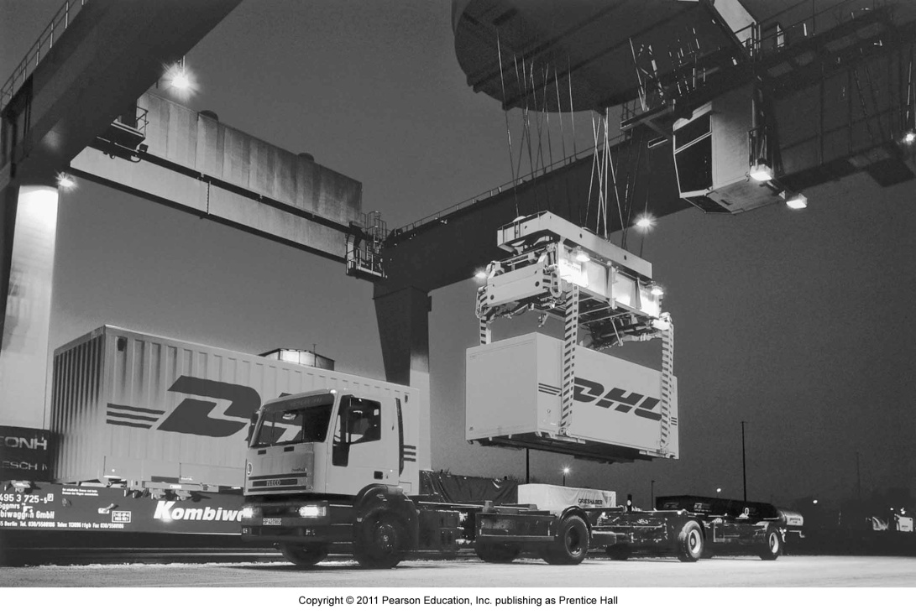
Time of Service Delivery
Traditionally, schedules were restricted
Service availability limited to daytime, 40-50 hours a week
Today
For flexible, responsive service operations: 24/7 service, 24 hours a day, 7 days a week, all around the world

Slide 18
Delivering Services in Cyberspace

Slide 19
Service Delivery Innovations Facilitated by Technology
Technological Innovations
Development of “smart” mobile telephones and PDAs, and presence of Wi-Fi
Voice-recognition technology
Websites
Smart cards
- Store detailed information about customer
- Act as electronic purse containing digital money
Electronic channels can be offered together with physical channels, or replace physical channels

Slide 20
E-Commerce: Move to Cyberspace
What are the factors that encourage you to use virtual stores?
Convenience
Ease of search
Broader selection
Potential for better prices
24-hour service with prompt (quick) delivery

Slide 21
Role of Intermediaries(Mediators)

Slide 22
Franchising
Definition: An authorization granted by a government or company to an individual or group enabling them to carry out specified commercial activities, for example acting as an agent for a company's products.
"Toyota granted the group a franchise“
“Mobily, STC & Zain telecome granted the group a franchise.

Slide 23
Franchising
Franchisor provides training, equipment, and support marketing activities.
Franchisees invest time and finance, and follow copy and media guidelines of franchisor.
Advantages:
Expand delivery of effective service concept without a high level of monetary investment
Franchisees are motivated to ensure good customer service and high-quality service operations

Slide 24
Franchising
Disadvantages of franchising
Loss of control over delivery system and how customers experience actual service
Effective quality control is difficult
Conflict between franchisees may arise especially as they gain experience

Slide 25
Challenge of Distribution in Large Domestic Markets

Slide 26
The Challenge of Distribution in Large Domestic Markets
Distributing services (i.e.,physical logistics) faces challenges due to:
Distances involved
Multiple time zones
Multiculturalism
Differences in laws and tax rates

