Slide 1




Services Marketing 7e, Global Edition
Chapter 2:
Consumer Behavior
in a Services Context

Slide 2
Definition : Consumer Behavior
Consumer Behavior :
Consumer behavior is the study of individuals, groups, or organizations and the processes they use to select, secure, and dispose of products, services, experiences, or ideas to satisfy needs and the impacts that these processes have on the consumer and society.

Slide 3
Overview Of Chapter 2
Customer Decision Making:
The Three-Stage Model of Service Consumption
Pre-purchase Stage
Service Encounter Stage
Post-encounter Stage

Slide 4
Pre-purchase Stage

Slide 5
Pre-purchase Stage - Overview
Pre-purchase Stage
Customers seek solutions to aroused needs
Evaluating a service may be difficult
Uncertainty about outcomes Increases perceived risk
What risk reduction strategies can service suppliers develop?
Understanding customers’ service expectations
Components of customer expectations
Making a service purchase decision
Service Encounter Stage
Post-encounter Stage

Slide 6
The pre- purchase process of consumers in services
Need Arousal
Information Search
Evaluation of predicted quality performance
Service Expectations
Evaluation of alternatives
Knowledge
Internal
External
Purchase Decision

Slide 7
Need Arousal
Decision to buy or use a service is triggered (caused) by need arousal
Consumers are then motivated to find a solution for their need
Courtesy of Masterfile Corporation

Slide 8
Information Search
Need arousal leads to attempts to find a solution
Evoked(suggested) set – a set of products and brands that a consumer considers during the decision-making process – that is derived from past experiences or external sources
Alternatives then need to be evaluated before a final decision is made

Slide 9
Evaluating Alternatives –
Service Attributes
High in Search Attributes(quality) help customers evaluate a product before purchase
  E.g., type of food, location, type of restaurant and price
High in Experience Attributes cannot be evaluated before purchase
  The consumer will not know how much she/he will enjoy the food, the service, and the atmosphere until the actual experience
High in Credence Attributes are those that customers find impossible to evaluate confidently even after purchase and consumption
  E.g., hygiene(cleanliness) conditions of the kitchen and the healthiness of the cooking ingredients (elements)

Slide 10
How Product Attributes Affect
Ease of Evaluation
Most Goods
Most Services
Easy
To Evaluate
Difficult
To evaluate
Clothing
Chair
Motor Vehicle
Foods
Restaurant Meals
Lawn Fertilizer
Haircut
Entertainment
Computer Repair
Education
Legal Services
Complex Surgery
High In Search
Attributes
High In Experience
Attributes
High In Credence
Attributes
Source: Adapted from Valarie A. Zeithaml , “How Consumer Evaluation Processes Differ Between Goods & Services,” in J.H. Donelly and W. R. George, Marketing of Services (Chicago: American Marketing Association, 1981)

Slide 11
Components of Customer Expectations
Desired Service Level
wished-for level of service quality that customer believes can and should be delivered
Adequate(acceptable) Service Level
minimum acceptable level of service without being dissatisfaction
Predicted Service Level
service level that customer believes firm will actually deliver
Zone of Tolerance
Acceptable range of variations in service delivery. “The zone of tolerance is usually defined as the range of customer perceptions of a service between desired and minimum acceptable standards ( Zeithaml, Berry, and Parasuraman, 1993 ).

Slide 12
Purchase Decision
Purchase Decision: Possible alternatives are compared and evaluated, whereby the best option is selected
  Simple if perceived(suppose) risks are low and alternatives are clear
  Complex when trade-offs increase
Trade- offs are often involved: “A balance achieved between two desirable but incompatible features”; a compromise.
After making a decision, the consumer moves into the service encounter stage

Slide 13
Service Encounter Stage

Slide 14
Service Encounter Stage - Overview
Pre-purchase Stage
Service encounters range from high- to low-contact
Understanding the servuction system
Theater as a metaphor for service delivery: An integrative perspective
  Service facilities
  Personnel
  Role and script theories
Service Encounter Stage
Post-encounter Stage

Slide 15
Service Encounter Stage
Service encounter – a period of time during which a customer interacts directly with the service provider
  Might be brief or extend over a period of time
Models and frameworks:
  “Moments of Truth” – importance of managing touchpoints
  High/low contact model – extent and nature of contact points
  Servuction model – variations of interactions
  Theater metaphor (symbol) – “staging” service performances

Slide 16
Moments of Truth
“We could say that the perceived quality is realized at the moment of truth, when the service provider and the service customer confront one another in the arena(ground, stadium). At that moment they are very much on their own… It is the skill, the motivation, and the tools employed by the firm’s representative and the expectations and behavior of the client which together will create the service delivery process.” Richard Normann
Web Define: A time when a person or thing is tested, a decision has to be made, or a crisis has to be faced.

Slide 17
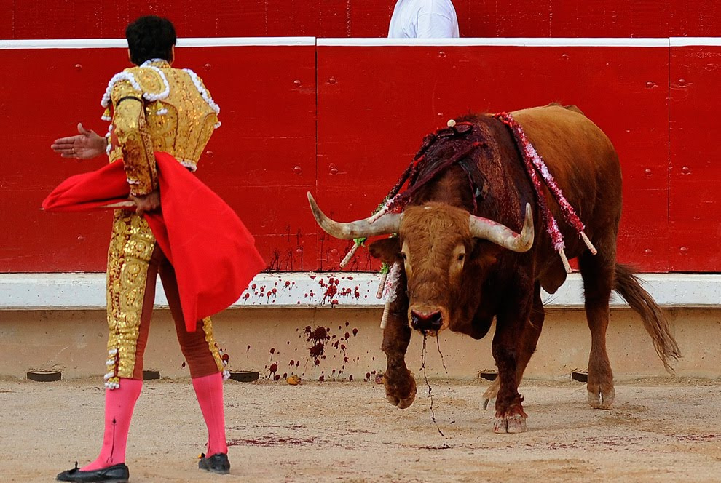
Moments of Truth :

Slide 18
Distinctions between High-Contact and Low-Contact Services
High-Contact Services
  Customers visit service facility and remain throughout service delivery
  Active contact
  Includes most people-processing services
Low-Contact Services
  Little or no physical contact
  Contact usually at arm’s length through electronic or physical distribution channels
  Facilitated by new technologies

Slide 19
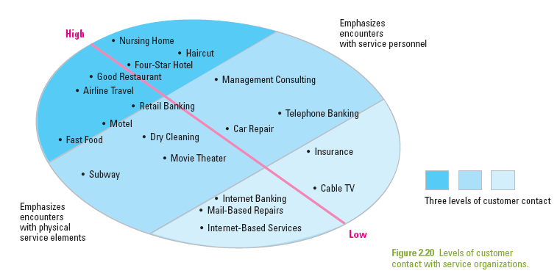
Service Encounters Range from
High-Contact to Low-Contact

Slide 20
The Servuction System:
Service Production and Delivery
Servuction System: visible front stage and invisible backstage
Service Operations
  Technical core where inputs are processed and service elements created
  Contact people
  Inanimate environment
Service Delivery
  Where “final assembly” of service elements takes place and service is delivered
  Includes customer interactions with operations and other customers

Slide 21
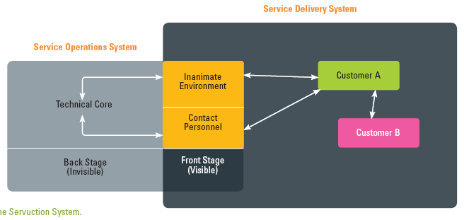
The Servuction System
Source: Adapted and expanded from an original concept by Eric Langeard and Pierre Eiglier

Slide 22
Theater(Hall) as a Metaphor(symbol) for Service Delivery
“All the world’s a stage and all the men and women only players. They have their exits and their entrances and each man in his time plays many parts.”
William Shakespeare
As You Like It

Slide 23
Theatrical Metaphor: an Integrative Perspective
Good metaphor(symbol) as service delivery is a series of events that customers experience as a performance
Service facilities
Stage on which drama unfolds(explain)
This may change from one act to another
Personnel (staff)
Front stage personnel are like members of a cast
Backstage personnel are support production team
Roles
Like actors, employees have roles to play and behave in specific ways
Scripts
Specifies the sequences of behavior for customers and employees

Slide 24
Implications(not expressed) of Customer Participation in Service Delivery
Greater need for information/training
  Help customers to perform well, get desired results
Customers should be given a realistic service preview in advance of service delivery
  This allows them to have a clear idea of their expected role and their script in this whole experience
  Manages expectations and emotions

Slide 25
Post-Encounter Stage

Slide 26
Customer Satisfaction with
Service Experience
Satisfaction: attitude-like judgment following a service purchase or series of service interactions
  Whereby customers have expectations prior to consumption, observe service performance, compare it to expectations
Satisfaction judgments are based on the below comparison
  Positive disconfirmation: (if the service is better than expected)
  Confirmation : (if it is as expected)
  Negative disconfirmation : ( If it is worse than expectation)

Slide 27
Customer Delight(enjoyment):
Going Beyond Satisfaction
Research shows that delight is a function of three components
  Unexpectedly high levels of performance
  Arousal (e.g., surprise, excitement)
  Positive affect (e.g., pleasure, joy, or happiness)
Strategic links exist between customer satisfaction and corporate performance
  By creating more value for customers (increased satisfaction), the firm creates more value for the owners

Slide 28
Customer Delight:
Going Beyond Satisfaction
Best Practice in Action 2.1: Turkish Delight: Back-Up Company Offers Customers Surprisingly Innovative Solutions
  Provided excellent customer service whatever the time and wherever the place.

Slide 29
Summary
Key Steps
  Need arousal
  Information search
  Evaluation of alternative solutions
  Purchase decision
Customers face perceived risks which marketers should reduce with some strategic responses
Zone of tolerance: Adequate to desired. Dissatisfaction if service level falls below adequate level.
Pre-purchase Stage
Service Encounter Stage
Moments of Truth: importance of effectively managing touchpoints
High/low contact service model – understanding the extent and nature of contact points
Servuction model – variations of interactions
Theater metaphor – “staging” service performances
  In evaluating service performance, customers can have expectations positively disconfirmed, confirmed, or negatively disconfirmed
  Unexpectedly high levels of performance, arousal, and positive affect are likely to lead to delight
Post-encounterStage

