Slide 1
Chapter 2:
Consumer Behavior
in a Services Context

Slide 2
Overview Of Chapter 2
Customer Decision Making: The Three-Stage Model of Service Consumption
Pre-purchase Stage
Service Encounter Stage
Post-encounter Stage

Slide 3
Pre-purchase Stage

Slide 4
Pre-purchase Stage - Overview
Pre-purchase Stage
Customers seek solutions to aroused needs
Evaluating a service may be difficult
Uncertainty about outcomes Increases perceived risk
What risk reduction strategies can service suppliers develop?
Understanding customers’ service expectations
Components of customer expectations
Making a service purchase decision
Service Encounter Stage
Post-encounter Stage

Slide 5
Need Arousal
Decision to buy or use a service is triggered by need arousal
Triggers of need:
Unconscious minds (e.g., personal identity and aspirations)
Physical conditions (e.g., hunger )
External sources (e.g., a service firm’s marketing activities)
Consumers are then motivated to find a solution for their need
Courtesy of Masterfile Corporation

Slide 6
Information Search
Need arousal leads to attempts to find a solution
Evoked set – a set of products and brands that a consumer considers during the decision-making process – that is derived from past experiences or external sources
Alternatives then need to be evaluated before a final decision is made

Slide 7
Evaluating Alternatives – Service Attributes
Search attributes help customers evaluate a product before purchase
E.g., type of food, location, type of restaurant and price
Experience attributes cannot be evaluated before purchase
The consumer will not know how much s/he will enjoy the food, the service, and the atmosphere until the actual experience
Credence attributes are those that customers find impossible to evaluate confidently even after purchase and consumption
E.g., hygiene conditions of the kitchen and the healthiness of the cooking ingredients

Slide 8
How Product Attributes Affect Ease of Evaluation
Most Goods
Most Services
Easy
To Evaluate
Difficult
To evaluate
Clothing
Chair
Motor Vehicle
Foods
Restaurant Meals
Lawn Fertilizer
Haircut
Entertainment
Computer Repair
Education
Legal Services
Complex Surgery
High In Search
Attributes
High In Experience
Attributes
High In Credence
Attributes
Source: Adapted from Valarie A. Zeithaml , “How Consumer Evaluation Processes Differ Between Goods & Services,” in J.H. Donelly and W. R. George, Marketing of Services (Chicago: American Marketing Association, 1981)

Slide 9
Perceived Risks of Purchasing and Using Services
Functional – unsatisfactory performance outcomes
Financial – monetary loss, unexpected extra costs
Temporal – wasted time, delays leading to problems
Physical – personal injury, damage to possessions
Psychological – fears and negative emotions
Social – how others may think and react
Sensory – unwanted impact on any of five senses

Slide 10
How Might Consumers Handle Perceived Risk?
Seek information from respected personal sources
Compare service offerings and search for independent reviews and ratings via the Internet
Relying on a firm with good reputation
Looking for guarantees and warranties
Visiting service facilities or going for trials before purchase and examining tangible cues or other physical evidence
Asking knowledgeable employees about competing services

Slide 11
Strategic Responses to Managing Customer Perceptions of Risk
Free trial (for services with high experience attributes)
Advertise (helps to visualize)
Display credentials
Use evidence management (e.g., furnishing, equipment etc.)
Offer guarantees
Encourage visit to service facilities
Give customers online access about order status

Slide 12
Understanding Customers’ Service Expectations
Customers evaluate service quality by comparing what they expect against what they perceive
Situational and personal factors also considered
Expectations of good service vary from one business to another, and differently positioned service providers in same industry
Expectations change over time

Slide 13
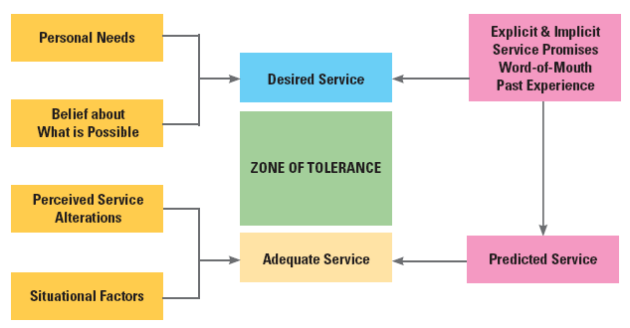
Factors Influencing Customer Expectations of Service
Source: Adapted from Valarie A. Zeithaml, Leonard A. Berry, and A. Parasuraman, “The Nature and Determinants of Customer Expectations of Service,” Journal of the Academy of Marketing Science 21, no. 1 (1993): 1-12

Slide 14
Components of Customer Expectations
Desired Service Level
wished-for level of service quality that customer believes can and should be delivered
Adequate Service Level
minimum acceptable level of service
Predicted Service Level
service level that customer believes firm will actually deliver
Zone of Tolerance
Acceptable range of variations in service delivery

Slide 15
Purchase Decision
Purchase Decision: Possible alternatives are compared and evaluated, whereby the best option is selected
Simple if perceived risks are low and alternatives are clear
Complex when trade-offs increase
Trade-offs are often involved
After making a decision, the consumer moves into the service encounter stage

Slide 16
Service Encounter Stage

Slide 17
Service Encounter Stage - Overview
Pre-purchase Stage
Service encounters range from high- to low-contact
Understanding the servuction system
Theater as a metaphor for service delivery: An integrative perspective
Service facilities
Personnel
Role and script theories
Service Encounter Stage
Post-encounter Stage

Slide 18
Service Encounter Stage
Service encounter – a period of time during which a customer interacts directly with the service provider
Might be brief or extend over a period of time (e.g., a phone call or visit to the hospital)
Models and frameworks:
“Moments of Truth” – importance of managing touchpoints
High/low contact model – extent and nature of contact points
Servuction model – variations of interactions
Theater metaphor – “staging” service performances

Slide 19
Moments of Truth
“[W]e could say that the perceived quality is realized at the moment of truth, when the service provider and the service customer confront one another in the arena. At that moment they are very much on their own… It is the skill, the motivation, and the tools employed by the firm’s representative and the expectations and behavior of the client which together will create the service delivery process.”
Richard Normann

Slide 20
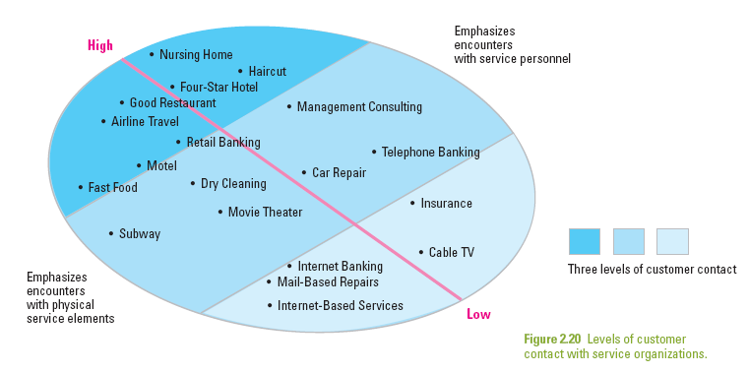
Service Encounters Range from High-Contact to Low-Contact

Slide 21
Distinctions between High-Contact and Low-Contact Services
High-Contact Services
Customers visit service facility and remain throughout service delivery
Active contact
Includes most people-processing services
Low-Contact Services
Little or no physical contact
Contact usually at arm’s length through electronic or physical distribution channels
Facilitated by new technologies

Slide 22
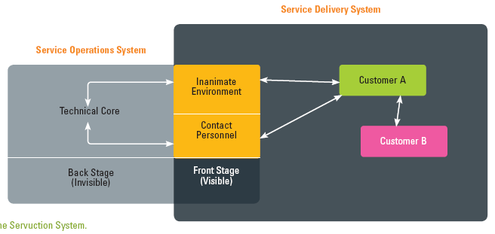
The Servuction System
Source: Adapted and expanded from an original concept by Eric Langeard and Pierre Eiglier

Slide 23
The Servuction System: Service Production and Delivery
Servuction System: visible front stage and invisible backstage
Service Operations
Technical core where inputs are processed and service elements created
Contact people
Inanimate environment
Service Delivery
Where “final assembly” of service elements takes place and service is delivered
Includes customer interactions with operations and other customers

Slide 24
Theater as a Metaphor for Service Delivery
“All the world’s a stage and all the men and women merely players. They have their exits and their entrances and each man in his time plays many parts.”
William Shakespeare
As You Like It

Slide 25
Theatrical Metaphor: an Integrative Perspective
Good metaphor as service delivery is a series of events that customers experience as a performance
Service facilities
Stage on which drama unfolds
This may change from one act to another
Personnel
Front stage personnel are like members of a cast
Backstage personnel are support production team
Roles
Like actors, employees have roles to play and behave in specific ways
Scripts
Specifies the sequences of behavior for customers and employees

Slide 26
Implications of Customer Participation in Service Delivery
Greater need for information/training
Help customers to perform well, get desired results
Customers should be given a realistic service preview in advance of service delivery
This allows them to have a clear idea of their expected role and their script in this whole experience
Manages expectations and emotions

Slide 27
Post-Encounter Stage

Slide 28
Post-purchase Stage - Overview
Pre-purchase Stage
Evaluation of service performance
Future intentions
Service Encounter Stage
Post-encounter Stage

Slide 29
Customer Satisfaction with Service Experience
Satisfaction: attitude-like judgment following a service purchase or series of service interactions
Whereby customers have expectations prior to consumption, observe service performance, compare it to expectations
Satisfaction judgments are based on this comparison
Positive disconfirmation (better)
Confirmation (same)
Negative disconfirmation (worse)

Slide 30
Customer Delight: Going Beyond Satisfaction
Research shows that delight is a function of three components
Unexpectedly high levels of performance
Arousal (e.g., surprise, excitement)
Positive affect (e.g., pleasure, joy, or happiness)
Strategic links exist between customer satisfaction and corporate performance
By creating more value for customers (increased satisfaction), the firm creates more value for the owners

Slide 31
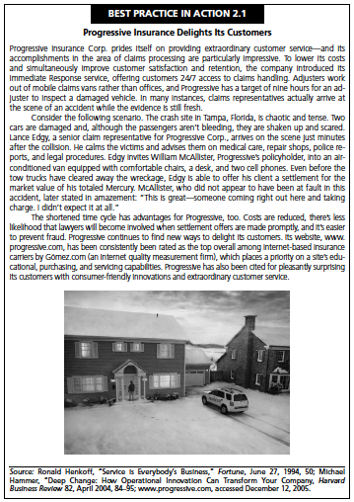
Customer Delight: Going Beyond Satisfaction
Best Practice in Action 2.1: Progressive Insurance Delights Its Customers
Provided excellent customer service which allowed them to lower costs and also increase customer satisfaction and retention

Slide 32
Summary
Key Steps
Need arousal
Information search
Evaluation of alternative solutions
Purchase decision
Customers face perceived risks which marketers should reduce with some strategic responses
Zone of tolerance: Adequate to desired. Dissatisfaction if service level falls below adequate level.
Pre-purchase Stage
Service Encounter Stage
Moments of Truth: importance of effectively managing touchpoints
High/low contact service model – understanding the extent and nature of contact points
Servuction model – variations of interactions
Theater metaphor – “staging” service performances
In evaluating service performance, customers can have expectations positively disconfirmed, confirmed, or negatively disconfirmed
Unexpectedly high levels of performance, arousal, and positive affect are likely to lead to delight
Post-encounter Stage

