Slide 1
Services Marketing 7e, Global Edition
Chapter 1:
New Perspectives(viewpoints) On
Marketing in the
Service Economy

Slide 2
Overview of Chapter 1
Why Study Services?
What are Services?
Marketing Challenges Posed(modeled) by Services
Extended Marketing Mix Required for Services
Integration (mixing) of Marketing with Other Management Functions
Developing Effective Service Marketing Strategies

Slide 3
Why Study Services?

Slide 4
Why Study Services?
Services dominate most economies and are growing rapidly:
Services account for more than 60% of GDP worldwide
Almost all economies have a substantial (worth) service sector
Most new employment is provided by services
Strongest growth area for marketing

Slide 5
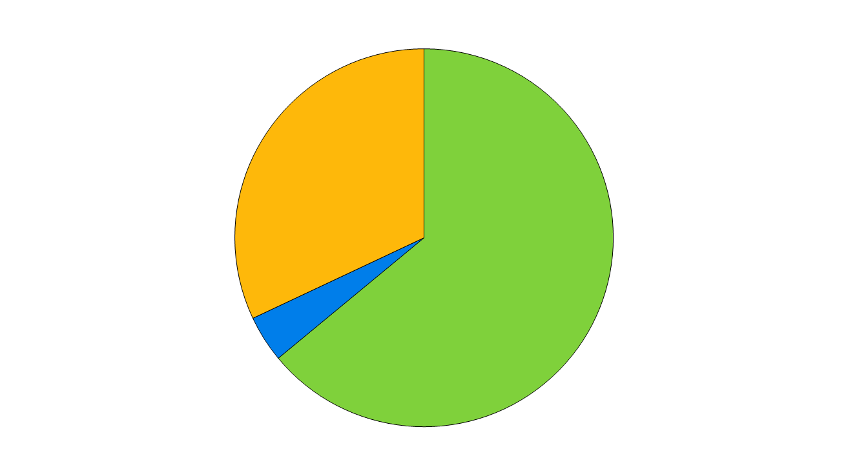
Services Dominate the Global Economy
Contribution of Service Industries to GDP Globally
Manufacturing 32%
Services 64%
Agriculture 4%
Source: The World Factbook 2008, Central Intelligence Agency

Slide 6
Estimated Size of Service Sector in Selected Countries
Jersey (97%), Cayman Islands (95%), Hong Kong (92%)
Bahamas (90%), Bermuda ( 89%), Luxembourg (86%)
USA (79%), Fiji (78%), Barbados (78%), France (77%), U.K. (76%)
Japan (72%), Taiwan (71%), Australia (71%), Italy (71%)
Canada (70%), Germany (69%), Israel (67%)
South Africa (65%), Brazil (66%), Poland (66%)
Turkey (63%), Mexico (62%)
Argentina (57%), Russia (55%)
Malaysia (46%), Chile (45%)
Indonesia (41%), China (40%)
Saudi Arabia (35%)
Services as Percent of GDP
10
20
30
40
50
60
70
80
90
Source: The World Factbook 2008, Central Intelligence Agency

Slide 7
Why Study Services?
Most new jobs are generated by services
Fastest growth expected in knowledge-based industries
Significant training and educational qualifications required, but employees will be more highly compensated

Slide 8
Why Study Services?
Powerful forces are transforming service markets
Government policies, social changes, business trends, advances in IT, internationalization
Forces that reshape:
Demand
Supply
The competitive landscape (site)
Customers’ choices, power, and decision making

Slide 9
Transformation of the Service Economy
Social
Changes
Business
Trends
Advances
In IT
Government
Policies
Globalization
New markets and product categories
Increase in demand for services
More intense(strong) competition
Innovation in service products & delivery systems, stimulated(move) by better technology
Customers have more choices and exercise more power
Success hinges (axes) on:
Understanding customers and competitors
Viable (feasible) business models
Creation of value for customers and firm
Increased focus on services marketing and management

Slide 10
Factors Stimulating Transformation of the Service Economy
Social
Changes
Business
Trends
Advances
In IT
Government
Policies
Globalization
Changes in regulations
Privatization
New rules to protect customers, employees, and the environment
New agreement on trade in services

Slide 11
Factors Stimulating Transformation of the Service Economy
Social
Changes
Business
Trends
Advances
In IT
Government
Policies
Globalization
Rising consumer expectations
More affluence (wealth)
More people short of time
Rising consumer ownership of high tech equipment
Easier access to information
Immigration

Slide 12
Factors Stimulating Transformation of the Service Economy
Social
Changes
Business
Trends
Advances
In IT
Government
Policies
Globalization
Push to increase shareholder value
Emphasis(stress) on productivity and cost savings
Manufacturers add value through service and sell services
More strategic alliances and outsourcing
Focus on quality and customer satisfaction
Growth of franchising

Slide 13
Factors Stimulating Transformation of the Service Economy
Social
Changes
Business
Trends
Advances
In IT
Government
Policies
Globalization
Growth of Internet
Greater bandwidth
Compact mobile equipment
Wireless networking
Faster, more powerful software
Digitization of text, graphics, audio, video

Slide 14
Factors Stimulating Transformation of the Service Economy
Social
Changes
Business
Trends
Advances
In IT
Government
Policies
Globalization
More companies operating on transnational(international) basis
Increased international travel
International mergers and alliances
“Offshoring”(far from) of customer service
Foreign competitors invade domestic markets

Slide 15
What are Services?

Slide 16
What Are Services?
The historical view
Smith (1776): Services are different from goods because they are perishable
Say (1803): As services are immaterial, consumption cannot be separated from production
A fresh perspective: Benefits without Ownership
Rental of goods:
(a) Payment made for using or accessing something – usually for a defined period of time – instead of buying it outright and
(b) Allows participation in network systems that individuals and organizations could not afford

Slide 17
What Are Services?
Five broad categories within non-ownership framework of which two or more may be combined
Rented goods services
Defined space and place rentals
Labor and expertise rentals
Access to shared physical environments
Access to and usage of systems and networks

Slide 18
Definition of Services
Services
are economic activities offered by one party to another
most commonly employ time-based performances to bring about desired results
In exchange for their money, time, and effort, service customers expect to obtain value from
access to goods, labor, facilities, environments, professional skills, networks, and systems;
normally do not take ownership of any of the physical elements involved.

Slide 19
Value Creation is Dominated by Intangible Elements
Physical Elements
High
Salt
Detergents
CD Player
Wine
Golf Clubs
New Car
Tailored clothing
Plumbing Repair
Fast-Food Restaurant
Health Club
Airline Flight
Landscape Maintenance
Consulting
Life Insurance
Internet Banking
Low
High
Intangible Elements
Source; Adapted from Lynn Shostack

Slide 20
Service Products vs. Customer Service & After-Sales Service
A firm’s market offerings are divided into core product elements and supplementary service elements
Need to distinguish between:
Marketing of services – when service is the core product
Marketing through service – when good service increases the value of a core physical good
Manufacturing firms are reformulating and enhancing existing added-value services to market them as stand-alone core products

Slide 21
Service – A Process Perspective
Differences exist amongst services depending on what is being processed
Classification of services into
People processing
Possession processing
Mental stimulus processing
Information processing

Slide 22
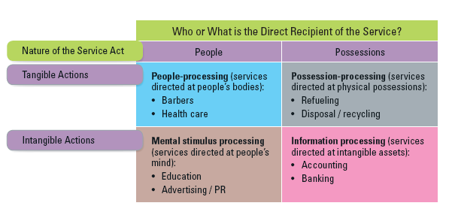
4 Categories of Services

Slide 23
People Processing
Customers must:
physically enter the service factory
cooperate actively with the service operation
Managers should think about process and output from the customer’s perspective
to identify benefits created and non-financial costs: Time, mental and physical effort

Slide 24
Possession Processing
Involvement is limited
Less physical involvement
Production and consumption are separable

Slide 25
Mental Stimulus Processing
Ethical standards required:
Customers might be manipulated(operated)
Physical presence of recipients not required
Core content of services is information-based

Slide 26
Information Processing
Most intangible form of service
May be transformed:
Into enduring(durable) forms of service output
Line between information processing and mental stimulus processing may be unclear

Slide 27
Extended Marketing Mix for Services

Slide 28
Services Require An Extended Marketing Mix
Marketing can be viewed as:
A strategy and competition thrust pursued by top management
A set of functional activities performed by line managers (low level managers).
A customer-driven orientation(direction) for the entire organization
Marketing is only function to bring revenues into a business; the rest functions are cost centers
The “7 Ps” of services marketing are needed to create practical strategies for meeting customer needs profitably

Slide 29
The 7Ps of Services Marketing
Traditional Marketing Mix Applied to Services
Product (Chapter 4)
Place and Time (Chapter 5)
Price (Chapter 6)
Promotion and Education (Chapter 7)
Extended Marketing Mix for Services
Process (Chapter 8 & 9)
Physical Environment (Chapter 10)
People (Chapter 11)

Slide 30
Integration (mixing) of Marketing with Other Management Functions

Slide 31
Marketing to be Integrated with Other Management Functions
Three management functions play central and interrelated roles in meeting needs of service customers
Operations
Management
Marketing
Management
Customers
Human Resources
Management

