Slide 1


قسم الصيدلانيات
كلية الصيدلة
جامعة الملك سعود
PHT 432)) Industrial Pharmacy
Dr. Fars Alanazi
AA91

Slide 2
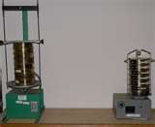
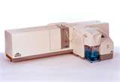
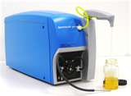
4-5
Lectures
Particle size analysis of powders and granules

Slide 3
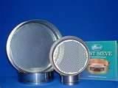
Outline of the lecture:
Particle size analysis
Kinds of particle diameters
Importance of particle size in pharmacy
Steps of particle size analysis
Tabular and graphical representation of analysis data
Methods of measuring the particle size
    Microscopy
    Sieve analysis
    Sedimentation
    Electronic determination of Particle size

Slide 4
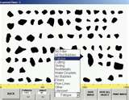
Particle size analysis particle and size distribution:
In a collection of particles of more than one size, two properties are important:
The shape and the surface area of the individual particle.
The size range and number of weight of particles present and hence, the total surface area.

Slide 5
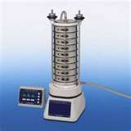
The size of a sphere is readily expressed in terms of its diameter. As the degree of asymmetry of particles increases, there is a difficulty to express the size in terms of a meaningful diameter.
Under these conditions, there is no one diameter for a particle. Therefore, one uses equivalent spherical diameter which relates the size of the particle to the diameter of sphere having the same surface area, volume or sedimentation rate according to the purpose to which the particle is intended to be used.

Slide 6
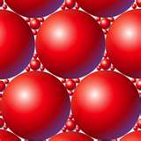
(a) Surface diameter:
It is the diameter of sphere having the same surface area as the par­ticle in question.
(b) Volume diameter:
The diameter of a sphere having the same volume as the particle in question.
(C) Stoke's diameter or sedimentation diameter:
It describes the diameter of a sphere having the same sedimentation rate as the particle in question.

Slide 7

The type of the expressed diameter used depends on:
The method used to obtain the diameter.
The purpose for which the powder is used ,e.g. , Powder used for suspension , the sedimentation rate must be determined and so one uses stoke's diameter. Powder used as adsorbent one uses surface diameter. Powders used for pharmacological action after dissolution and absorption, one uses volume diameter.

Slide 8

Importance of drugs particle size:
Respiratory tract drugs: The distance to which the particles travel in the respiratory tract depends upon their particle size. Bigger particles do not travel long distances thus doing the action in the upper respiratory tract, and vice versa the smaller particles which do their action in the lower respiratory tract.
Parentrally administered drugs with different routes of injection depends on the particle size on their action. Smaller particles dissolve faster and exert faster action. Bigger particles when injected may dissolve very slowly and may act as a sustained release depot.

Slide 9
3. Rectal absorption of drugs depends on the particle size on their dissolution and absorption.
Tablets, capsules and orally administered powders: Tablet will not
be absorbed unless it undergoes disintegration and dissolution, and this depends on the particle size. The smaller and finer the particles; the higher is the solubility. Dissolution of capsules and powders depend mainly on particle size.
5. Pharmacokinetic aspects: Absorption, distribution, metabolism
and excretion depend mainly on particle size.

Slide 10

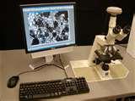
Parameters which are important in particle size determination:
(a) Average particle size, (Mean)
(b) Particle size distribution.
Steps for particle size analysis:
1- Sampling
2- Generating Data
3- Presentation of Data
4- Treatment of Data

Slide 11
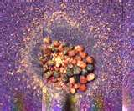
Sampling :
Which means taking the sample from the material to be analyzed.
This sample must be representative of the entire lot or batch of material .

Slide 12
Coning and quartering method:

Slide 13
Coning and quartering involve thorough premixing of the entire sample and then careful pouring of the sample into a pile, which usually forms a cone with a base angle referred to as the angle of repose of the powder.
The cone is then divided into four approximately equal quarters. Two opposite quarters are combined and mixed well while the re­maining two quarters are returned to the original container.
The procedure is repeated at least four times until the desired size sam­ple is obtained.
If four repeats cannot be made because of a small sample size, the pro­cedure is repeated using the material returned to the original container

Slide 14
2- Generating the data
In generating the data, individual particles or groups of particles from each sample are sized and counted.
The sizing and counting follow a particular pattern in order to put the data into an orderly, meaningful form that can be statistically analyzed for interpretive and comparative purposes.

Slide 15
3- Presentation of the data
a- Table form
b- Graph form:
(i) Histogram: (Bar graph)
(ii) Frequency- distribution curves:
(iii) Cumulative –distribution curve:

Slide 16
a- Table form
The Cumulative % over size is interpreted as the percent of the number of particles that are more than the stated size. ,e.g., in the table, 99.4% all the particles are more than 57.5 mm.

Slide 17
b- Graph form:

Slide 18
(ii) Frequency- distribution curves:
(a) Normal distribution curve: (symmetrical particle size distribution)

Slide 19
Most particulate material cannot be described by a normal distribu­tion curve.
The resultant curves are usually skewed.
(b)- Skewed - distribution curve: (asymmetrical particle size distri­bution curve)

Slide 20
4- Treatment of data
Average of the particles (Mean)
Standered deviation
Median
Mode

Slide 21
a- Arithmetic Mean (or average particle size)
d= Arithmetic mean
ni = Frequency or number of particle in each size range.
di = Mid point of the size range.
∑ ni = Total number of particles.

Slide 22
b- Standard deviation:
It is the deviation of sizes of individual particles from the average.
It describes the scatter or dispersion around the mean.
It may be narrow or wide (the narrow is better)
N= Total number of particles

Slide 23
C- Median:
It is the diameter (particle size) that divides the distribution curve into 2 equal parts.
d- Mode
It is the most frequent size.
In normal distribution: Mean = Mode = Median.

Slide 24
Methods of measuring the particle size
Microscopy
Sieve analysis
Sedimentation
Electronic determination of particle size

Slide 25
1– Microscopy:
Particle size range:
  Optical microscope 0.5 - 100 μm
  Electronic microscope 0.01 - 1.0 μm

Slide 26
Procedures:
  Preparing a slurry of several mg of powder in a liquid dispersion me­dium in which the sample is insoluble.
  One or two drops of the well - mixed slurry is placed on a clean mi­croscope slide, and a cover slip is applied.
  Several random fields are selected for counting. The particle sizing may be accomplished by using:
      Calibrated graticule
      Calibrated micrometer

Slide 27
(1) A calibrated graticule:
  Which is placed on the eye piece: and it consists of a series
  of graded black and open circles.
The field is scanned from one side to the other using a mechanical microscope stage and particles are sized according to the nearest equivalent circle area.

Slide 28
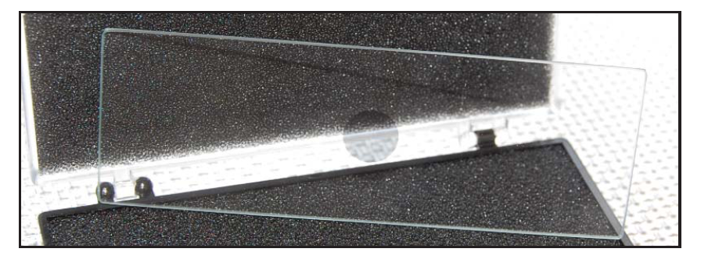
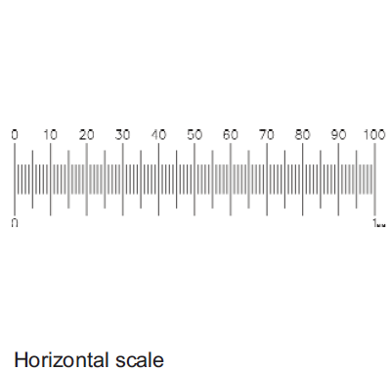
(2) A calibrated micrometer: The sample is placed over a calibrated micrometer and examined under the optical microscope.
Advantages:
    Low cost
    It is simple and direct method.
    Preparing the sample is simple.
    Give information about the shape of particles.

Slide 29
Disadvantages:
    Tedious
    Time consuming
    Aggregation of 2 or more particles together can be counted and measured as one particle so give wrong results.
    Also air bubbles may be entrapped and can be considered as particles.

Slide 30
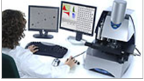
Electron microscope
Particle size range: 0.5µm to 1000µm
Dispersion Type: Wet, Dry
Technology: Image Analysis

Slide 31
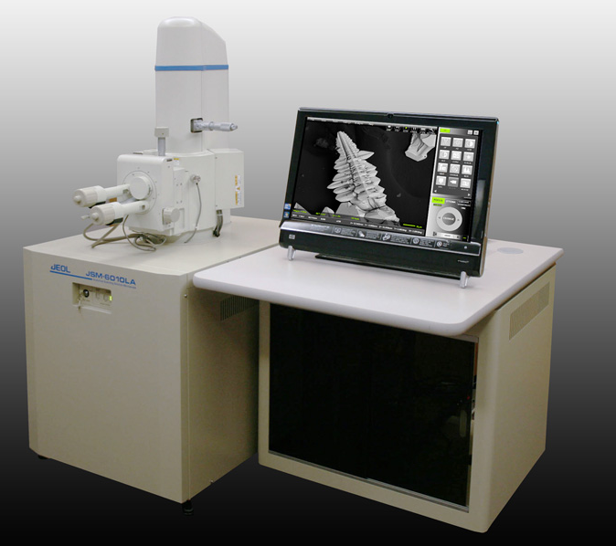
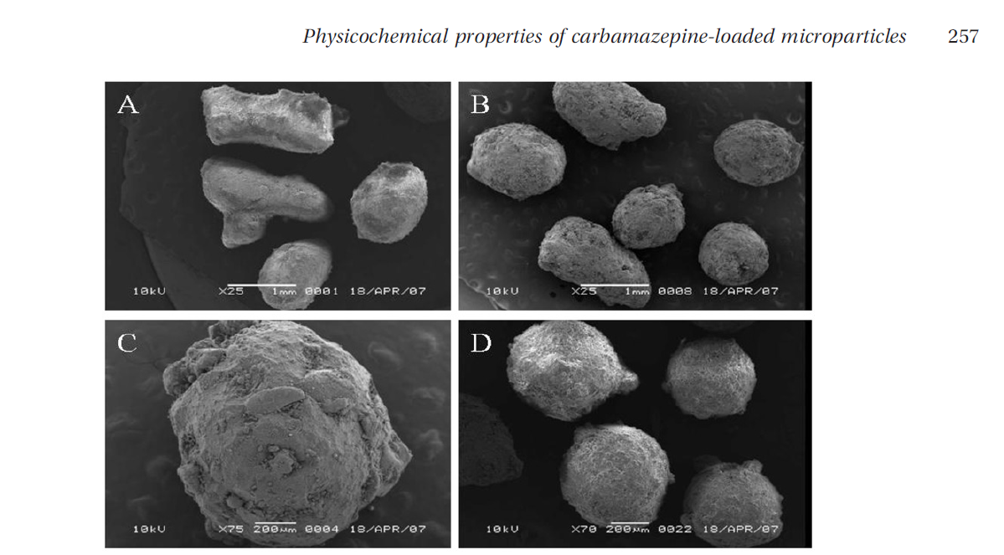
SCANNING ELECTRON MICROSCOPY (SEM):

Slide 32
2- Sieve analysis
Particle size range: 50 μm up to 10,000 μm.
Method: This is one of the simplest and the most frequently used method for deter­mining particle size distribution. The technique involves size classifica­tion followed by the determination of weight of each fraction.

Slide 33
This is carried out by passing the powder in different sieves with different mesh - size.
The screens are attached to mechanical shaker. The particles of a powder mass are placed on the first screen and apply shaking for certain time.
The particles smaller than the mesh pass through to the next screen and so on.
Each fraction remained on each sieve is then taken and weighed.

Slide 34
Advantages:
  Very simple
  Fast
  Used in most pharmaceutical preparations.
Disadvantages:
Production of electrostatic charges and so the particles may aggregate together and not pass through the sieves.
Humidity present in the atmosphere causes the particles to stick together.
The shape of the particles: ,e.g., particle present as needle shape, if it is in vertical position it will pass but if it is in the horizontal position, it will not pass.
The procedures should be standardized. ,i.e., shaking should be carried out by the same shaker with the same rate and for certain fixed time.

Slide 35
3- Sedimentation:
Range of particle size determination: 5- 500 μm
Method: Weight distribution is obtained by allowing a dispersed powder to settle in air or in a liquid in which it is insoluble and weighing the particles sedimented in each time interval, thus find a relation between the cumulative weights and time.

Slide 36
By using stocke’s equation:
d = particle diameter (cm)
h= Viscosity of fluid (poise = g/cm. see.)
h = distance of fall in cm
t = time off all.
P = density of the particles (g/ cm³)
Po = density of fluid (g/ cm³)
g = Acceleration due to gravity 981 (cm / see ²) (gravity acceleration
constant)

Slide 37
where the powder particles settle in air
where the powder particles settle in a liquid

Slide 38
By using either of these two instruments the sample is dispersed in its re­spective settling medium and the powder particle settles onto an ultrasen­sitive balance.
Weight is recorded cumulatively against time. The time being the only variable in stoke's equation creating the change in diameter (i.e. all oth­er components in the equation are constant so that the diameter change is dependent on time change).
Another method is the Andreasen Pipet. This apparatus is also based on the stoke's equation.
This apparatus in designed for a settling liquid medium that will not dissolve the sample and can be easily and completely evaporated by heat and/or vacuum.

Slide 39
Advantages:
Used for suspensions to measure their stability.
Disadvantages of measuring particle size by sedimentation methods:
There are certain requirements for stoke's law to be applied
    The particles must be spherical .If the particles are not spherical this law cannot be used.
    Defloculating agent is added to allow separation and prevent aggre­gation of particles.

Slide 40
4- Electronic determination of Particle size:
  Range of particle size determination: 0.5 - 500 microns.
  Average diameter determined: volume diameter.
  Method: The apparatus used is the coulter counter.

Slide 41
Schematic diagram of coulter counter used to determine particle.

Slide 42
The principle of this apparatus depends on, when a particle suspended in a conducting liquid passes through a small orifice, on either side of which are electrodes, a change in electric resistance occurs.
The coulter counter determines the number and size of particles suspended in an electrically conducted liquid in which the sample is not soluble.
This is accomplished by forcing a thoroughly dispersed suspension of particles through a small orifice on either side of which is an elec­trode.
A constant voltage is applied across the electrodes so as to produce a current.
As the particle travel through the orifice, it displaces its own volume of electrolyte and this result in an increased resistance between the two electrodes. This, in turn, produces a short- duration voltage pulse of a magni­tude proportional to the volume of the particle. (i.e. change in resistance a size of the particle i.e. increase in resis­tance) These pulses are sized and counted electrically.

Slide 43
Precautions that should be noted in using this equipment:
The selection of the proper size orifice for counting the sample size range.
Adjusting the particle concentration such that only single particle pass through the orifice thus preventing counting of 2 or more parti­cles at one time.
Advantages:
This equipment can count large number of particles (500/min) very rapidly.
The apparatus yields highly reproducible results.
Because of the large number of particles, statistics will be easy and yield high level of confidence in the distribution of a sample.

Slide 44
Disadvantages:
    Cost of equipment is high
    The possibility of orifice blockage by the particles specially in heavy suspensions.
    The electrolyte used must be specific and selective in which the material to be counted is insoluble and is suitable in terms of electrical resistance to the counted particles.
    Wrong results are produced if there is electrolytic back ground.

Slide 45
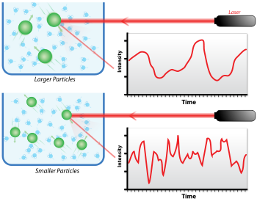
Dynamic light scattering (also known as photon correlation spectroscopy

Slide 46
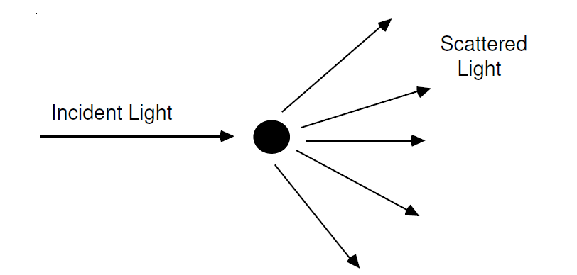

Slide 47
Conclusions of the lecture:
Particle size analysis
Kinds of particle diameters
Importance of particle size in pharmacy
Steps of particle size analysis
Tabular and graphical representation of analysis data
Methods of measuring the particle size
    Microscopy
    Sieve analysis
    Sedimentation
    Electronic determination of Particle size

