Slide 1
.
signature image

Slide 2
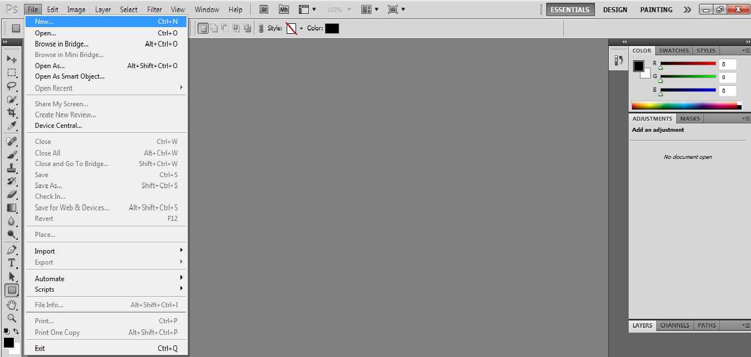
Open new file

Slide 3
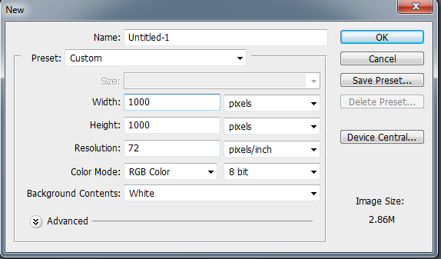
File and new so that the width and length less than a thousand so I can control it

Slide 4
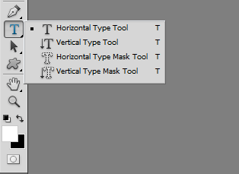
use the horizontal type tool

Slide 5
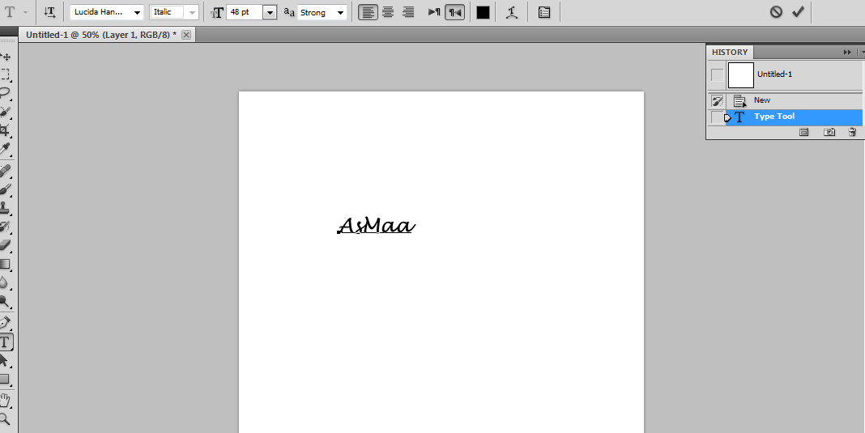
.

Slide 6
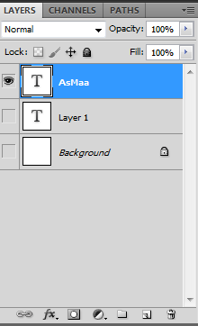
.
Using delete the background so that I can work in keeping her brush

Slide 7
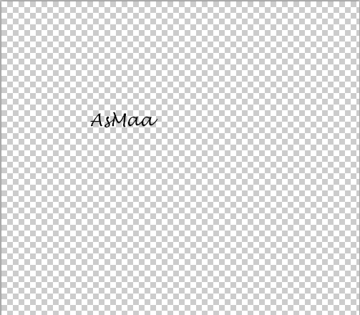
delete background

Slide 8
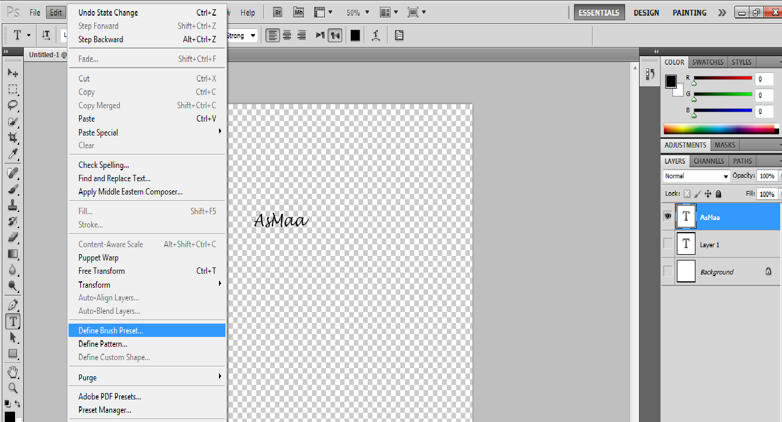
From the edit use Define Brush

Slide 9
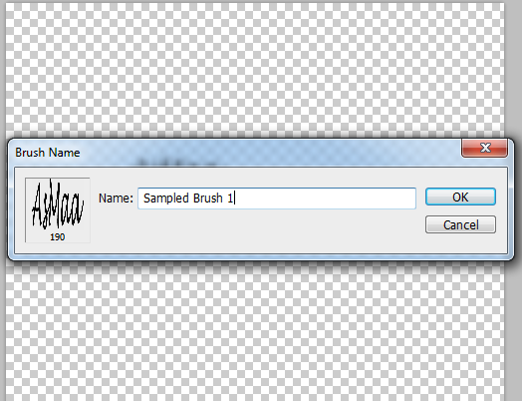
Save Brush

Slide 10
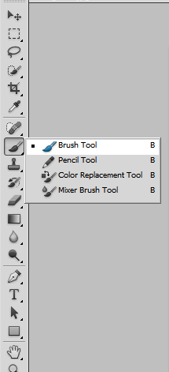
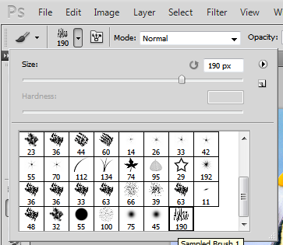
Use brush tool
.
.

Slide 11
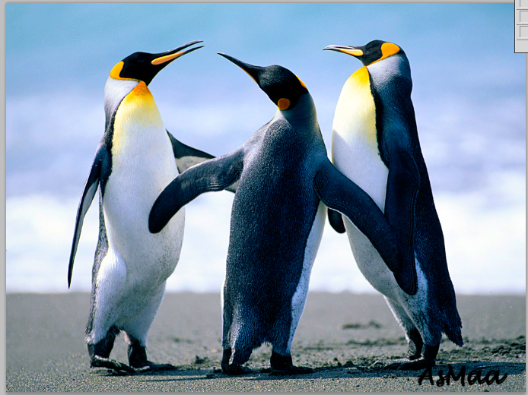
.

Slide 12
.
Asmaa jamil

