Slide 1
Separation of Plasma and Serum from Whole Blood and Separation of Main Proteins in Plasma and Serum
Practical of the First and Second Experiments

Slide 2
Objectives
Plasma Separation, and calculation of percentage
Serum Separation, and calculation of percentage
Plasma Proteins separation and detection

Slide 3
Separation of Plasma and Serum from Whole Blood 1-Plasma Separation
Centrifuge at 3000 rpm
for 10 minutes
Record the volume of the Whole Blood (V1)
Record the volume of the plasma (V2)
Record the volume of the RBC (V3) and
Calculate the percentage and compare it to normal
Plasma
Red Blood Cell

Slide 4
Results
 | Component | Total Volume | Percentage (%)
1 | Whole Blood | V1=
2 | Plasma | V2=
3 | RBCs | V3=

Slide 5
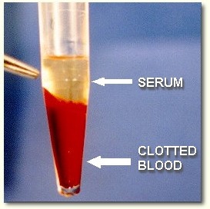
Separation of Plasma and Serum from Whole Blood 2-Serum Separation
Centrifuge at 3000 rpm
for 10 minutes
Record the volume of the Whole Blood (V1)
Record the volume of the Serum (V2)
Record the volume of the RBC (V3) and
Calculate the percentage and compare it to normal

Slide 6
Results
 | Component | Total Volume | Percentage (%)
1 | Whole Blood | V1=
2 | Serum | V2=
3 | RBCs | V3=

Slide 7
Separation of Main Proteins in Plasma and Serum
There are many method for plasma proteins separation
In this lab we will use salting out and then centrifugation
Fibrinogen need a low concentration of salt to be separated Why?
After that we will use different method for protein detection:
Clotting test (to determine the presence of Fibrinogen)
Biuret Test (purple color)
Heat Coagulation Test

Slide 8
Method
Serum
Separation of Globulin from Albumin
Albumin
Globulin
Biuret test
Heat Coagulation Test
Heat coagulation Test
Salting out
Plasma
Separation of Fibrinogen from other proteins
Albumin+ Globulin
Fibrinogen
Biuret test
Clotting Test
Detect the presence of Fibrinogen

