Slide 1
Introduction to Geomatics Engineering
SE 312
Hydrographic Survey
Prof. Ismat Elhassan

Slide 2
Introduction
Introduction:
Mapping the water floor is a specialized field of surveying, called hydrographic surveying. The maps that hydrographic surveyors produce are called nautical charts or bathymetric maps. These, in fact, are topographic maps of the water bed.
Hydrographic surveys include all underwater surveys encompassing all navigational, pipeline routing and sub marine cable installation and dredging surveys. It also provides data for flood control and water pollution control.
However, typical hydrographic surveys are carried out for the purpose of navigation.

Slide 3
Underwater Topography
Introduction
To produce a contoured bathymetric map of the sea bed, known as (Nautical Chart) in three dimensions is a hydrographic surveying operation which can be divided into two main phases in general:
  Horizontal positioning of sounding stations (X and Y co-ordinates); and
  Sounding (water depth, Z co-ordinate) determination.

Slide 4
Sounding
Introduction
Tidal Datum
To produce a contour map of the waterbed the third dimension should be determined by sounding to some datum level.
The surface of the water from which the sounding is measured cannot be used as a datum due to the continuous fluctuations of the water level caused by tidal effects.
An arbitrary datum is chosen, normally the lowest water level and each sounding reduced by the height of the tide above the selected datum level to give a reduced sounding defined as water depth from bottom to datum.
In general, a datum is a base elevation used as a reference from which to reckon heights or depths.
A tidal datum is a standard elevation defined by a certain phase of the tide.
Tidal datum is used as reference to measure local water levels.

Slide 5
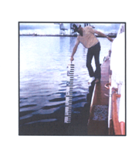
Methods of Sounding
Classical Methods:
In early days Hydrographic Surveys involve the depth measurement by sounding pole (Fig. 1) and hand lead line (Fig 2). The reading of these survey methods are analogue in nature, and it is a labor-intensive and time-consuming process. Thus, this method was not that popular.
Fig. 1
Sounding Pole

Slide 6
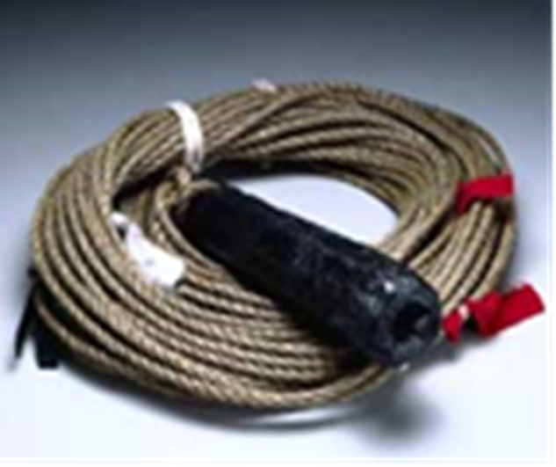
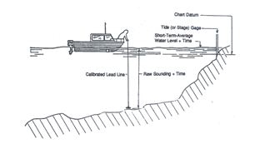
Classical Methods
Fig. 2
Fig. 2a Lead Line Fig. 2b Lead Line in
operation

Slide 7
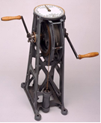
Sounding Machine
Lead line is further developed to sounding machine (Fig. 3)
Fig, 3 Sounding Machine

Slide 8
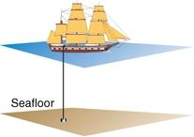
Echo sounding
Further development lead to using sounding waves to measure water depth, called acoustic sounding (fig. 4) Fig. 4
Sound pulse is transmitted
From transducer passing water
Medium to water bottom,
Reflected to transducer
Onboard ship and time lapse
Is recorded.
Water depth=(v x dt)/2
V = sound pulse speed in water
dt= time interval recorded
by transducer

Slide 9
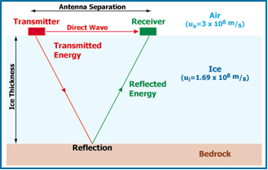
Echo sounding process
Fig. 5 shows the process of echo sounding
Fig. 5

Slide 10
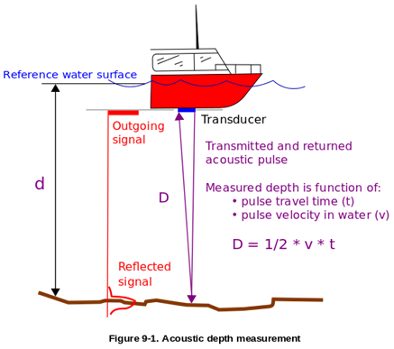
Echo sounding Process
Fig. 6 is further illustration to acoustic sounding operation.
Fig. 6.

Slide 11
Sound speed in water
Accuracy of measured water depth depends mainly on accuracy of sound speed in water.
The speed of sound depends on the temperature of the water, its salinity, and the pressure (which is equivalent to depth below the sea surface).
The speed of sound ranges between 1400 and 1570 m/sec. This is about 4 times faster than sound speed through air.

Slide 12
Correction for sound speed in water
Empirical formula were developed to compute correct speed due to effects of water temp, salinity and depth:
Mackenzie Formula (1981):
c(D,S,T) = 1448.96 + 4.591T - 5.304 x 10⁻²T² + 2.374 x 10⁻⁴T³ +
1.340 (S-35) + 1.630 x 10⁻²D + 1.675 x 10⁻⁷D² - 1.025 x 10⁻²T(S - 35) –
7.139 x 10⁻¹³TD³
Where, T = temperature in degrees Celsius
S = salinity in parts per thousand
D = depth in meters
Range of validity: temperature 2 to 30 °C, salinity 25 to 40 parts per thousand, depth 0 to 8000 m.
For a depth up to 70m the above formula can be written simply as (ignoring depth effect):
c(S,T) = 1448.96 + 4.591T - 5.304 x 10⁻²T² + 2.374 x 10⁻⁴T³ + 1.340 (S-35) m/s

Slide 13
Multi beam sounder
Echo sounder is further developed to multi beam sounder (Fig. 7), scanning across sounding line:
Fig. 7

Slide 14
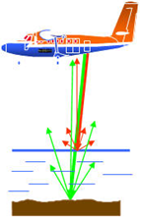
LIDAR Bathymetry
Light Detection and Ranging (LIDAR) sends two signals of different wave lengths: green and red (Fig. 8)
Green laser pulses (532 nm) reflected
from bottom, Near-IR (1064 nm)
laser pulses reflected from water
surface. Difference in arrival time
allows depth measurement.
Fig. 8

Slide 15
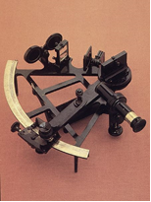
Positioning Sounding Stations
1- Classical Survey techniques:
Fig. 9
Using Sextant (Fig. 9) to measure
angles to three ground control
stations and using resection
solution to locate ship position.
Using theodolite or total station at
two ground control points to ship
position and determine ship position
using intersection method

Slide 16
Positioning Sounding Stations
2- GPS technique
A GPS can be taken onboard the ship to be used in Positioning Sounding Stations at the time of measuring water depth.
What is even remarkable about the GPS system is its accuracy; normally 10-15 meters for civilian systems, and a huge improvement on the older sextant centered methods.
Another advantage of the system is that it is an ‘all weather’ one.
Even when one cannot see a landmark 50 meters away in dense fog, the GPS will give you your position without any decrease in accuracy.

Slide 17
GPS Positioning
Development of GPS
First developed for the US Department of Defense almost forty years ago, today this global navigational satellite system uses between 24 and 32 satellites orbiting 11000 nautical miles in space, normally making two orbits around the earth every day.
Use on Board Ships
On board, the GPS receiver stores the almanac data for continuous use. It also calculates, exactly how far the satellite is from the ship at any given instant.
Three such satellites and the calculations give us an exact 2D fix on board- Latitude and Longitude.
If there are four satellites used, one can calculate altitude as well.
By keeping a record of the ship’s positions, another simpler calculation determines the ship’s speed, and the course it has made in the time between positions.
Almost all ships today carry a GPS receiver – sometimes more than one.

Slide 18
Class Problem (1)
Acoustic Sounding
Compute the corrected sound signal speed in water and water depth if water temp, T = 10ºC ±1ºC; Salinity, S = 37 ppt ±1ppt ; two way time interval recorded on echo-sounder is 0.5 sec.
Use the following empirical sound speed in water:
V(S,T) =1449.2 +4.6T − 0.055T ²+(1.34 − 0.010T)(S − 35) m/sec
Compute accuracy of determined depth, using law of propagation of errors:
Standard error = var(f)]^{1/2} = [(∂f/∂x)² var(x) + (∂f/∂y)² var(y)]^{1/2}.
Set f = V (signal speed); x = T; y = S

Slide 19
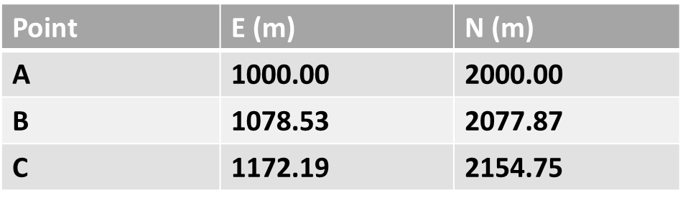
Class Problem (2)
Sounding Station Positioning
Three ground control points A, B and C were observed from a ship (P) while sounding is being carried out. Coordinates of control points and horizontal angles observed using a sextant are given below.
Compute ship position.
Coordinates of control points:
Observed angles:
BPC = 57° 36'
BPA = 40° 08'
B C
A Hint: Solve triangle ABC
(Sides AB, BC, AC, angle ABC)
SEA Form angle equation: PABCP
Form side equation using PB
Solve the two equations, apply
Ship, P intersection formula

