Slide 1
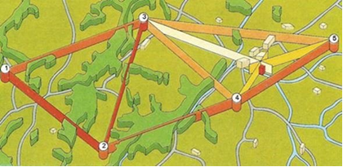
Triangulation Survey
Triangulation is a method of determining coordinates of a point fixed in the field to be used as control point for survey work.
Triangulation is preferred for hills and undulating areas, since it is easy to establish stations at reasonable distances apart, with inter-visibility. In plane and crowded areas it is not suitable as the inter-visibility of stations is affected. The difficulty is overcome by building towers which is quite expensive.
In triangulation, entire area to be surveyed is covered with a framework of triangles. For the triangle, the length of the first line, which is measured precisely is known as Base line.

Slide 2
Operation of Triangulation Survey
Steps for executing triangulation project
The field work of a triangulation project is carried out in the following well defined operations:
1. Reconnaissance
2. Erection of Signals & Towers
3. Measurement of Horizontal Angles
4. Astronomical Observations Necessary to Determine the True Meridian and the Absolute Positions of the Stations
5. Measurement of Baseline
6. Adjustment of observed Angles
7. Computations of Lengths of each side of each triangle
8. Computations of the Latitude and Longitude of ST

Slide 3
Conditions for selecting ground stations
Reconnaissance
1. Examination of the country to be surveyed.
2. Selection of most favorable sides for base lines
3. Selection of suitable positions of stations
2. Selection of Station:
The selection of station is based upon the following consideration.
1. The stations should be clearly visible from each other. For this purpose highest commanding positions such as top of hills or mountains is selected.
2. They should form well shaped triangles (angles > 30 deg)
3. They should be easily accessible
4. They should be useful for detail survey
5. Thy should be so fixed that the length of sight is not too short or too long

Slide 4
Conditions for selecting ground stations
3. Inter-visibility and Heights of Stations:
For inter-visibility of two stations they should be fixed on highest available ground. Such as mountain peaks rides or top of hills when the distance b/t the two stations is great and the difference in elevation b/t them is small then it is necessary to raise both the instrument and signal to overcome the curvature of the earth and to clear all the intervening obstruction.
The height of both the instrument and signal above the ground depends upon.
1. Distance between the stations.
2. Relative elevations of stations.
3. The profile of intervening ground.

Slide 5
Applications of Triangulation Survey
Following are some applications of triangulation survey:
* Establishing accurately located control points for plane and geodetic surveys of large areas.
* Establishing accurately located control points in connection with aerial surveying
* Accurate location of engineering projects such as Centre lines, terminal points and shafts for long tunnels, and Centre lines and abutments for long span bridges.
Triangulation Systems
A system consisting of triangulation stations connected by a chain of triangles. The complete fig is called triangulation system or triangulation figure. The most common type of figures used in a triangulation system are
Triangles
Quadrilaterals
Polygons

Slide 6
Triangulation Systems
Triangles System: simple, economical but least accurate system.

Slide 7
Triangulation Systems
Quadrilaterals System: most accurate system as the number of checks are more.

Slide 8
Triangulation Systems
Polygons: Accurate since more checks are there.

Slide 9
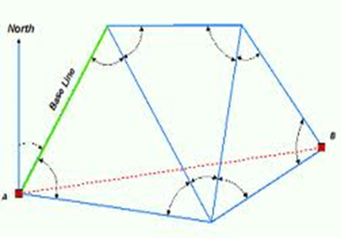
Intersection Method
The triangle is the simplest unit of the triangulation net.
We start with a Base Line with known azimuth and precise length.
All angles of the triangle are measured and should be adjusted to sum to 180.
At least on end point of the base line should have known ground coordinates: E and N or X and Y.

Slide 10
Intersection Solution
Given Coordinates of A and B; Observed angles α and ß:
To compute coordinates of point P: X_{p} and Y_{P}
Y, N P (X_{P}, Y_{P})?
B ß
α
A
X, E

Slide 11
Intersection Solution
1- Calculate departure and latitude of line AB
ΔX_{AB} = X_{B} – X_{A}; ΔY_{AB} = Y_{B} – Y_{A}, which are necessary for determining bearing AZ_{AB} (Ɵ_{AB}) and the length D_{AB} of side AB:
1.1 D_{AB} = √ (ΔX_{AB}² + ΔY_{AB}²)
1.2 Azimuth of AB = AZ_{AB} or (Ɵ_{AB}) = arctan (ΔX_{AB} /ΔY_{AB});
2-Use the Sine rule to calculate the length D_{AP} from triangle ABP:
D_{AP} / sinβ = D_{AB} / sin (α + β) ⇒ D_{AP} = D_{AB}•sinβ / sin (α + β)
3- Calculate the bearing (azimuth) of the side AP: AZ_{AP} = AZ_{AB} + α,
4- Calculate Northing and Easting differences (departure and latitudes) using the length and bearing of the side AP:
ΔX_{AP} = D_{AP} cos AZ_{AP} ; ΔY_{AP} = D_{AP} sin AZ_{AP}
5-The final coordinates of point P:
X_{P} = X_{A} + ΔX_{AP} and Y_{P} = Y_{A} + ΔY_{AP}

Slide 12
Check Intersection Solution
Calculation of coordinates of P can be carried out using length and azimuth of BP and coordinates of B to check the previous results:
1- Length of side BP:
D_{BP} / sinα = D_{AB} / sin(α + β)⇒ D_{BP} = D_{AB}•sinα / sin(α + β)
2- Bearing or Azimuth of side BP:
AZ_{BP} = AZ_{BA} – β; AZ_{BA} = AZ_{AB} – 180º
3- North and East differences using the length and bearing of the side BP:
ΔX_{BP} = D_{BP} cos AZ_{BP} ΔY_{BP} = D_{BP} sin AZ_{BP}
4- The final coordinates of point P:
X_{P} = X_{B} + ΔX_{BP} and Y_{P} = Y_{B} + ΔY_{BP}
This should be exactly equal to coordinates of P computed from station A

Slide 13
Intersection Formula
The following formulae are called intersection formula, used to calculate coordinates of P by directly substituting the given and observed data:
N_{P} = {E_{A} – E_{B} + N_{A} cot β + N_{B} cot α} / [cot α + cot β]
E_{P} = {N_{B} - N_{A} + E_{A} cot β + E_{B} cot α} / [cot α + cot β]
NOTE: Direct substitution should be done when observing A and B from P should be seen clockwise direction. This means standing at P observing A, you have to turn clockwise to observe B.
Example:
A and B are ground control points of coordinates: A(200.00, 400.00)m and B(500.00, 600.00)m. Angles observed at A and B towards station P (almost east of A) are 65º 00’ 00” and 67º 00’ 00” respectively, compute coordinates of P.

Slide 14
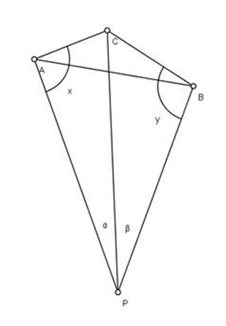
Resection Solution
When an unknown coordinates station (P) is occupied by an angle observation instrument and directions to three control points are observed from this station, the procedure to calculate coordinates of this point is known as Resection solution or three points problem.
If coordinates of A, B and C are known
Directions PA, PB and PC are observed
to determine angles α and ß
Required are coordinates of P
Many solutions are available
One solution will be discussed here.
The key for this solution is to
calculate angles x (CAP) and y (PBC)

Slide 15
Resection Solution
* First step: Using coordinates of A, B and C solve triangle ABC
(Lengths of sides and angles of the triangle: AB, BC, CA, <ABC, <BCA and <CAB)
Using Pythagoras theory for sides and cosine rule for angles
* To compute unknown angles x and y, two equations are needed:
Angle equation and side equation
First equation, Angle Equation
Denoting the (unknown) angles CAP as x and CBP as y, angle ACP = C, can be determined from given coordinates of control points. From the angles of the quadrilateral PACB,
x + y = 2π – α – β – C = k₁ ………. (1)
k₁ = 2π – α – β – C is thus a known value,
and we can write equation (1) as: y = k₁ – x

Slide 16

Resection Solution
Second Equation: Side Equation
Applying the law of sine in triangles PAC and PCB we can express PC in two different ways:
From the above relation:
sin x / sin y = BC sin α / AC sinβ = k2 (2)
K2 = BC sin α / AC sinβ is also a known value.
With this substitution the equation can be written: sin x = k2 sin y
We now need to solve these two equations in two unknowns. Once x and y are known the various triangles can be solved straight forward and intersection method can be used to determine the position of P.

Slide 17
Resection Solution
Solution of the two equations to give x and y:
1- compute constants k1 and k2
2- Substituting (1) in (2): sin x = k₂ sin (k₁ – x)
sin x = k₂ [ sin k₁ cos x - cos k₁ sin x ]
Dividing both sides by cos x, tan x = k₂ [sin k₁ - cos k₁ tan x],
hence:
tan x [1 + k₂ cos k₁] = k₂ sin k₁
tan x =k₂ sin k₁/[1 + k₂ cos k₁];
3- Substitute values of k1 and k2 to calculate x and y:
x = tan⁻¹ {k₂ sin k₁/[1 + k₂ cos k₁]}
y = k1 –x
4- Check the solution:
In ∆ ACP, <ACP = C1; In ∆ BCP, <BCP = C2; C1 + C2 = C, already calculated in ∆ABC; also 180 – (α +C1) = x and 180 – (ß + C2

Slide 18
Resection Solution
5- In ∆APC, coordinates of A and C are known; angles x and C1 are known, use intersection solution to solve for coordinates of P
6- Check:
In ∆BPC, coordinates of B and C are known; angles y and C2 are known, use intersection solution to solve for coordinates of P
Example:
A theodolite was adjusted at station P and angles APC and CPB were observed and recorded as: 109.3045º and 115.0520º respectively. Ground coordinates of stations A, B and C are respectively given as: A(1000.00, 5300.00); B(3100.00, 5000.00); C(2200.00, 6300.00)m Compute the coordinates of station P.
C
P(E, N)?
y P x
A B

Slide 19
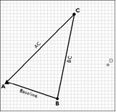
Trilateration Survey
* With the introduction of EDM it became more practical to measure lengths of sides of triangles in triangulation nets rather than angles.
* The process will be faster and give accurate results.
This is called Trilateration.
* For a triangle ABC where AB is the base line (with length and azimuth precisely known) sides BC and AC will be measured using EDM.
* Angles of triangle can be calculated using cosine
rule.
* Intersection solution can be applied to
Compute coordinates of station C.

Slide 20
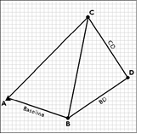
Trilateration Survey
* Having calculated coordinates of C, length of BC can be computed and used as base line for next triangle BCD.
* For a neighboring triangle BCD, sides BD and CD are measured.
* Angles of triangle BCD can be computed
using cosine rule.
* Again applying intersection solution will allow
computing coordinates of D.
Example
Trilateration was carried out to observe sides of triangulation
net ABQP, including Base line AB whose azimuth was known
to be 60º 00’ 00”. Observed sides lengths are:
AB = 360.00m; BP = 440.00m BQ = 320.00m;
QP = 480.00m; PA = 450.00m
Assuming control point A(100.00; 250.00)m, compute: coordinates of B, C and D.

