Slide 1
Horizontal Curves
- Introduction:
- Types of H Curves
- Elements of H Curve
- Data for Setting Out
- Setting Out Methods:
1- Offset from tangent
2- Offset from main chord
3- Deflection angle method

Slide 2
Introduction
What are Curves and Why are they used?
What are road curves?
The center line of a road consists of series of straight lines interconnected by curves that are used to change the alignment, direction, or slope of the road. Those curves that change the alignment or direction are known as horizontal curves, and those that change the slope are vertical curves.
Why are they used?
When a highway changes horizontal direction, making the point where it changes direction a point of intersection between two straight lines is not feasible. The change in direction would be too abrupt for the safety of modem, high-speed vehicles. It is therefore necessary to interpose a curve between the straight lines. The straight lines of a road are called tangents because the lines are tangent to the curves used to change direction.

Slide 3
Geometric Shape of Horizontal Curve
Geometric Shape:
In practically all modem highways, the curves are circular curves.
The smaller the radius of a circular curve, the sharper the curve.
For modern, high-speed highways, the curves must be flat, rather than sharp. That means they must be large-radius curves.
Some typical radii you may encounter are 5,000 m or longer on a main highway, 300m on a major through-fare in a city, 200 m on an industrial access road, and 50 m on a minor residential street. See Fig. 1, next slide:

Slide 4
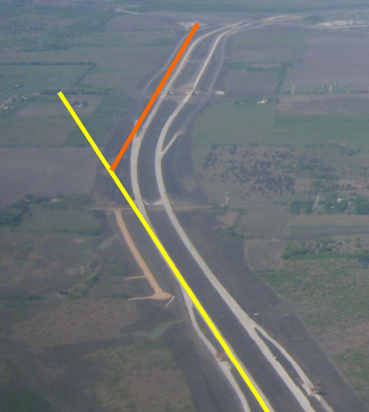
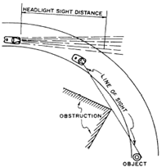
Horizontal Curves
Circular Horizontal Curve

Slide 5
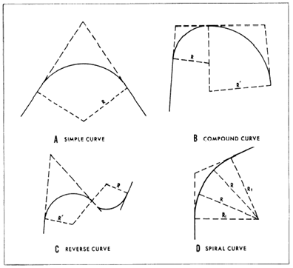
Types of H Curves
1- simple, 2- compound, 3- reverse, 4-transitional: (figure 2)
Fig. 2.

Slide 6
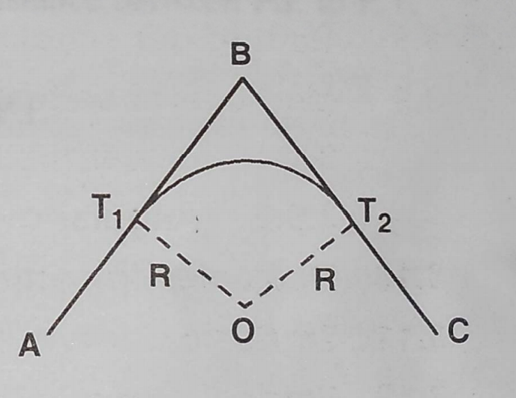
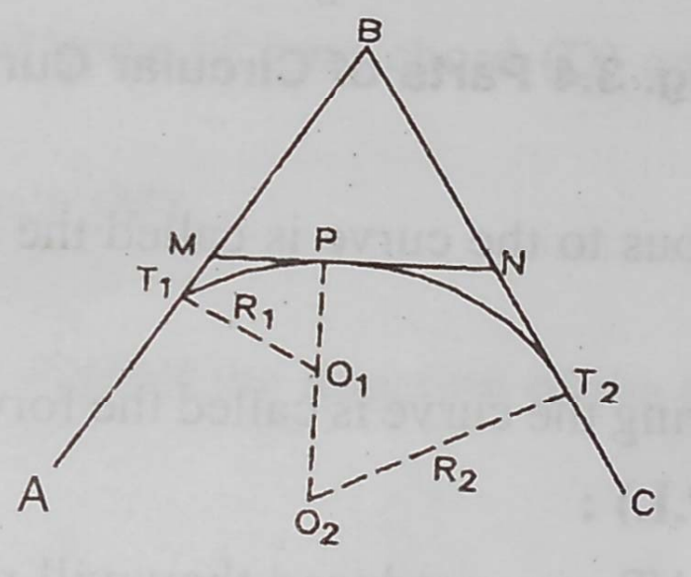
Types of Horizontal Curves
Simple Circular Compound

Slide 7
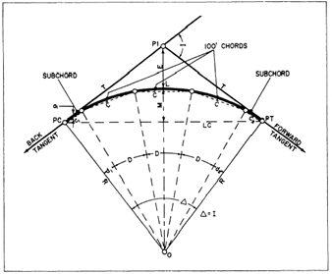
Elements of Horizontal Curve
Main elements (Figure 3): Fig. 3
PI POINT OF INTERSECTION.
PC POINT OF CURVATURE or initial
Point of curvature.
PT POINT OF TANGENCY, or Ending
Point of curve.
O Center point of curve.
R Radius of Curve.
PC-PI Tangent of curve, perpendicular
To the radius at PC or at PT
(Distance T)

Slide 8
Elements of H Curve
Continued
I INTERSECTING ANGLE. The intersecting angle is the deflection angle at the PI. Its value is either computed from the preliminary traverse angles or measured in the field.
∆ CENTRAL ANGLE. The central angle is the angle formed by two radii drawn from the center of the circle (O) to the PC and PT. The value of the central angle is equal to the I angle. Some authorities call both the intersecting angle and central angle either I or ∆.
POC POINT OF CURVE. The point of curve is any point along the curve.
L LENGTH OF CURVE. The length of curve is the distance from the PC to the PT, measured along the curve.
LC LONG CHORD. The long chord is the straight-line distance from the PC to the PT. Other types of chords are designated as follows:

Slide 9
Elements of H Curves
Continued
C The full-chord distance between adjacent stations (full, half, quarter, or one-tenth stations) along a curve.
C1 The sub-chord distance between the PC and the first station on the curve.
C2 The sub-chord distance between the last station on the curve and the PT.
E EXTERNAL DISTANCE. The external distance (also called the external secant) is the distance from the PI to the midpoint of the curve. The external distance bisects the interior angle at the PI.
M MIDDLE ORDINATE. The middle ordinate is the distance from the midpoint of the curve to the midpoint of the long chord. The extension of the middle ordinate bisects the central angle.
D DEGREE OF CURVE. The degree of curve defines the sharpness or flatness of the curve

Slide 10
Radius of Horizontal Circular Curve
Curve radius (R) is either given directly by the highway engineer or can be determined from designated curvature of the curve.
Degree of Curve (Arc Definition)
The arc definition is most frequently used in high-way design. This definition, illustrated in figure 4, states that the degree of curve is the central angle formed by two radii that extend from the center of a circle to the ends of an arc measuring 100 meters long. Therefore, if you take a sharp curve, mark off a portion so that the distance along the arc is exactly 100m, if the corresponding central angle is 12°, then you have a curve for which the degree of curvature is 12°; it is referred to as a 12° curve.
By studying figure 4, you can see that the ratio between the degree of curvature (D) and 360° is the same as the ratio between 100 m of arc and the circumference (C) of a circle having the same radius.

Slide 11
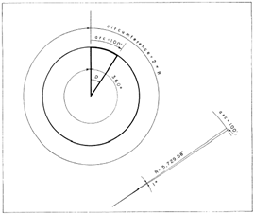
Degree of Curve – Arc Definition
Fig. 4 – Arc Definition
The ratio between the degree of
curvature (D°) and 360° is the
same as the ratio between 100m
of arc and the circumference
(C) of a circle having the same
radius. (D°/360°) = (100/C)
where C= 2πR,
R = (360x100)/(2 πD)
R = 5729.58/D° meters

Slide 12
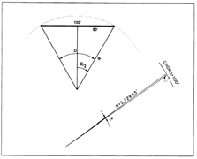


Degree of Curve - Chord Definition
The chord definition (fig. 5) is used in railway Fig. 5
practice and in some highway work.
This definition states that the degree of curve
is the central angle formed by two radii drawn
from the center of the circle to the ends of
a chord 100 m long. If you take a flat curve,
mark a 100-m chord, and determine the
central angle to be 0°30’,
then you have a 30-minute curve (chord definition).
or

Slide 13
Solved Example
Given a circular curve with degree of curvature 20°, compute the radius of the curve using: a) Arc definition, b) Chord definition
– Arc definition: R = 5729.58/D° m = 286.48m
- Chord definition: R = 50/(sin 10°) = 287.94m

Slide 14
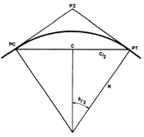
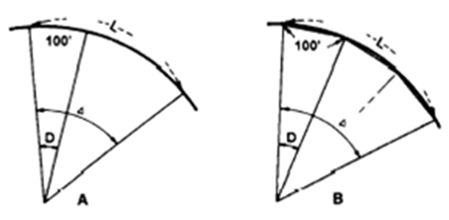
Curve Geometric Formulae
Referring to Fig. 3: Fig. 6
Tangent Length, (T); tan (Δ/2) = T/R;
Hence T = R tan (Δ/2)
Chord Length (C),; C = 2 R sin (Δ/2), fig 6.
Length of Curve (L) , fig 7
In figure 7, the relationship between D, Δ, and
L, and a 100- meters arc length may be expressed as follows:
(L/Δ = 100/D) , or L = (100 x Δ/D)
Since, D = 5729.58 / R, then Fig. 7
L = 100 x Δ° x R / 5729.58
= R * Δ (Δ in radians) = R * Δº * π / 180

Slide 15
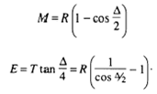
Curve Geometric Formulae
Referring to Fig. 3:
Middle Ordinate (M) and External Distance (E):
M MIDDLE ORDINATE. The middle ordinate is the distance from the midpoint of the curve to the midpoint of the long chord. The extension of the middle ordinate bisects the central angle.
E EXTERNAL DISTANCE. The external distance (also called the external secant) is the distance from the PI to the midpoint of the curve. The external distance bisects the interior angle at the PI.

Slide 16
Setting Out Curve
For setting out a simple circular curve follow the following steps:
1st step: Locate Intersection point and measure intersection angle.
2nd step: Compute tangent length and set out initial point of curvature PC,
If there is obstruction to intersection point positioning as in figure 8 below: select two points on the two straights; A and B. Measure length of AB and angles at A and B.
Solve triangle ABPI for A-PI and B-PI (Tangent length) and angle A-PI-B, for intersection angle I.
Using angle I and given curve radius compute
tangent length, T. From A set out PC by going back a distance A-PC = T - A-PI (see figure 8 on next slide)
Then:
Prepare data for one of the following setting out methods:

Slide 17
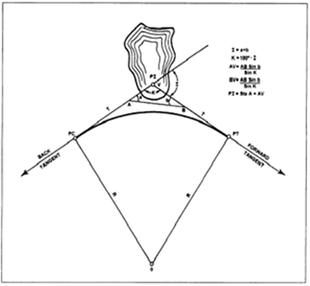
Hindrance to PI Location
To find Tangent length T if PI cannot be occupied for some reason:
Fig. 8

Slide 18
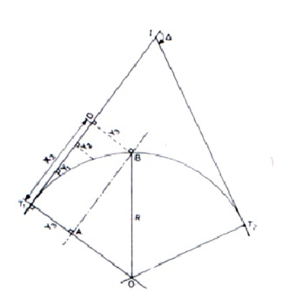
Setting Out by Offset from Tangent
The position of the curve is located by right-angled offsets Y set out from tangents along distances X (Fig 9), thereby fixing half the curve from each side. The offsets may be calculated as follows for a given distance X. Consider offset Y₃, for example.
Fig. 9
In ΔABO, AO ² = OB² - AB²,
(R-Y₃)² = R² –X ₃² and
R - Y₃ = (R²-X ₃²)^{½}
Thus for any offset Yi, at distance Xi,
along the tangent:
Yi = R - (R² - Xi²)^{½}

Slide 19
Offset from Tangent
Or, R² + Y₃² - 2RY₃ = R² – X₃²
Dividing both sides by 2R: Y₃²/2R - Y₃ = - X₃² / 2R, since Y₃² is very small compared to 2R, it can be neglected and the formula reduces to: Y₃ = X₃² / 2R
And in general: Y_{i} = X_{i}² / 2R
This equation is only accurate for large radii curves
Example
Derive the data needed to set out a circular curve of radius 50m using offsets, every 5m, from the tangent, assuming both tangent points and intersection point were fixed on ground.
Using the relation Yi = Xi2 / 2R, the following data are computed and tabulated:
Xi (m) 5 10 20 40
Yi (m) ? ? ? ?
Check this solution using the relation: Yi = R - (R2 - Xi2)½

Slide 20
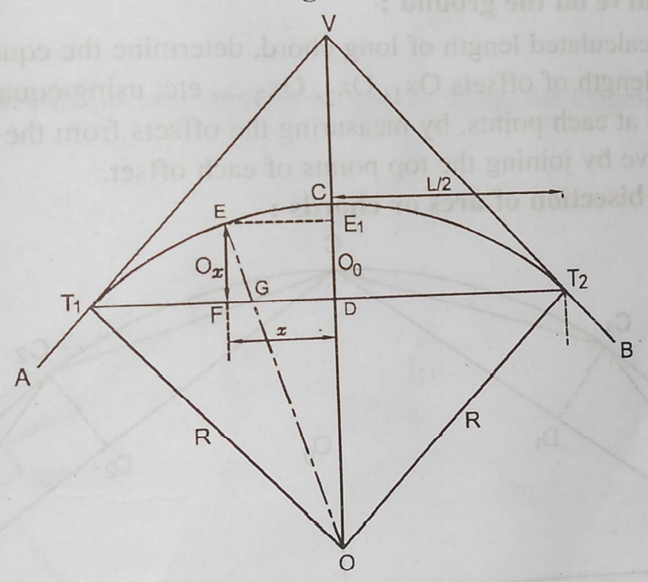
Offset from Main Chord
Main chord joins starting and ending points of curvature PC and PT,
In this case the right-angled offsets X
are set off from the long chord PC-PT,
at distances Y along the chord
Measured from mid- point F,
left and right to
each side of the center point F
Offset X_{m} at mid-point F
is given as
X_{m} = FC = OC – OF =
[R – (R² - (L/2)²)^{1/2}]

Slide 21
Offset from Main Chord
Referring to fig. 10 on previous slide:
From triangle PC O F, R² = (R – X_{m})² + (L/2)²,
(R – X_{m})² = R² - (L/2)²
From triangle ODE, (R – X_{m} + X)² + Y² = R²,
this can be written as:
R – X_{m} + X_{i} = (R² – Y_{i}²)^{1/2}; X_{i} = (R² - Y_{i}²)^{1/2} – (R - X_{m})
X_{i} = (R² - Y_{i}²)^{1/2} – [R² - (L/2)²]^{1/2}

Slide 22
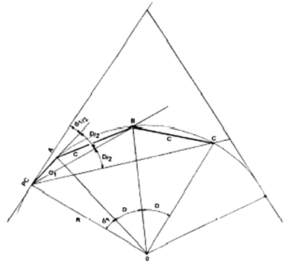
Setting out using deflection angle
In the previous two methods only linear measurement and right angle were used.
Deflection angle method would need distance (chord length) and horizontal angle from tangent to be set out.
This is illustrated in figure 11. Fig 11.
First deflection angle, d (in radians) =
arc PC-A / (2R).
Assuming arc PC-A =
Chord PC-A when chord length ≤ R/20 m,
then d (in radians) = chord PC-A / (2R).
d (in minutes) =
chord PC-A * (180 * 60 / π) / (2R)
= chord PC-A * 1718.9 / R

Slide 23
Example
Solved example:
The centerlines of two straights are projected forward to meet at I, the intersection (deflection) angle I is measured as 30º 00' 00". If these two straights are to be connected by a circular curve of radius 200m. Tabulate all setting out data, assuming 20m chords. Let chainage of I (ChI) be 2259.59m.
Solution: given data: (∆ = I = 30º, R = 200m, ChI = 2259.59m)
Tangent length (T) is calculated from: T=R tan(∆/2) = 200 tan (30/2)º = 53.59m.
Chainage of PC = Chainage of I - T = 2259.59 - 53.59 = 2206.00m
Let first sub-chord = c₁ = 14m (so that chainage of first curve point A will be a whole chainage = 14 + 2206.0 = 2220.0m)
Length of circular curve, L = R * Δº * π / 180 = 200 * 30 * π / 18 = 104.72m

Slide 24
Solution continued
From this:
If first sub-chord length is 14m, there remains 104.72- 14.00 = 90.72m, of which 80m will be the summation of four chords each 20m length.
The second sub-chord c₂ = 90.72 – 80.00 = 10.72m
To calculate deflection angle for each chord we use the relation: deflection angle (in minutes) = 1718.9*Chord length/R.
For first sub-chord (14m), d = 1718.9*14/200 = 120.3' = 2º 00' 19"
For standard chords (20m), d = 1718.9*20/200 = 171.9' =2º 51' 53"
For second sub-chord (10.72m), d=1718.9*10.72/200 = 92.1' =
1º 32' 08"

Slide 25
Table of Required Data
Results will be tabulated as follows:
Check sum of deflection angles that should be equal to
Δ/2 = (30/2) = 15º
Chord | Chord length (m) | Chainage (m) of curve point | Deflection angle ^{O ‘ “} | Setting out angle ^{O} ‘ “ | Remarks
1 | 14 | 2220.00 | 2 00 19 | 2 00 19 | Peg 1 on curve
2 | 20 | 2240.00 | 2 51 53 | 4 52 12
3 | 20 | 2260.00 | 2 51 53 | 7 44 05
4 | 20 | 2280.00 | 2 51 53 | 10 35 58
5 | 20 | 2300.00 | 2 51 53 | 13 27 51
6 | 10.72 | 2310.72 | 1 32 08 | 14 59 59 | Last peg on PT

