Slide 1
Introduction to Geomatics Engineering
SE 312
Prof. Ismat M. Elhassan
1442 H
2020/2021 G

Slide 2
General Information
Course Name: Introduction to Geomatics Engineering
Course Code and Number: SE 312
Course instructor: Ismat M. Elhassan
Office: 2A – 44
Office Tel. 4677070
E-mail: ismat@ksu.edu.sa
Mobile 0509426590

Slide 3
Course Objectives
Use of Theodolites, EDMs and Total Stations to collect field data, determine distances and coordinates (Field Work).
Observe, Compute and adjust Traverses.
Compute ground coordinates using Triangulation and Trilateration; principles of intersection & resection.
Use optical and electronic tacheometers (Total Stations) to determine distances, 3D Coordinates and compile topographic maps.
Setting out Civil Engineering Project: Calculate data necessary for setting out horizontal and vertical curves.
Use precise level and correct observed data for curvature and refraction effects
Compute water depth using sound waves.

Slide 4
Learning Outcomes
At the end of the course students will be able to :
Use survey instruments to collect field data for producing survey information such as control points coordinates, map detailing, contouring and DEM;
Adjust Traverses and triangulation nets and compute ground coordinates using traverse, triangulation and trilateration techniques to compute coordinates of tie points;
Compute 3D ground coordinates using tacheometric approach and total station;
Plan and determine data for setting out horizontal and vertical curves.

Slide 5
Course Contents
Introduction and Angle Measurements (Theodolites) (2 h)
Electromagnetic Distance Measurement (3 h)
Total Station (1 h)
Control Surveying: *Traversing (6 h)
*Triangulation and Trilateration (4 h)
Positioning & Map Compilation using:
Tacheometry & Total Station (4 h)
Precise Leveling (1 h)
Curves Setting Out; 1- Horizontal Curves (4 h)
2- Vertical Curves (3 h)
Introduction to Hydrographic Surveying (2 h)

Slide 6
Course Assessment and Textbook
Textbook: Elementary Surveying: Introduction to Geomatics, by: Charles Chailani & P. Wolf, 14th edition, 2014
Notes on Introduction to Geomatics Engineering, SE 312
Course Evaluation:
Mid Term Tests: 2x15 30%
Tutorials & HWs 10%
Field Work 20%
Final Exam 40%

Slide 7
Instrumentatsion
Surveying Instrument Required in this Course are:
Theodolites
EDM
Total Station
Tacheometer

Slide 8
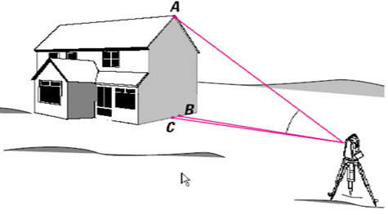
Theodolites
Functions:
To measure horizontal and vertical angles
To set out directions
To measure distances when used with a graduated staff

Slide 9
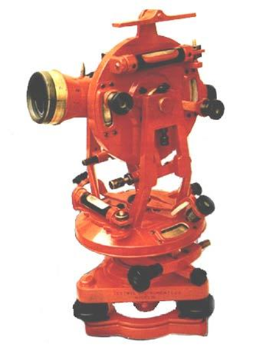
Types of Theodolites
A Vernier theodolite measures the angles up to an accuracy of 10’’, 20” (not used now).
Optical Theodolites: measure angles
up to 1” accuracy
And
Electronic theodolites: measure angles
to an accuracy of 1”

Slide 10
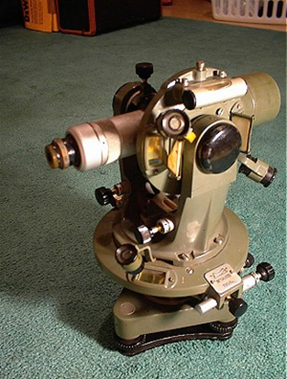
Main Parts of Theodolites
All theodolites are composed of:
Surveying Telescope
Horizontal Circle
Vertical Circle
Bubble Tube to be set vertical
Alidade to hold different parts
Tribrach (bas plate) with
Foot (levelling Screws)

Slide 11
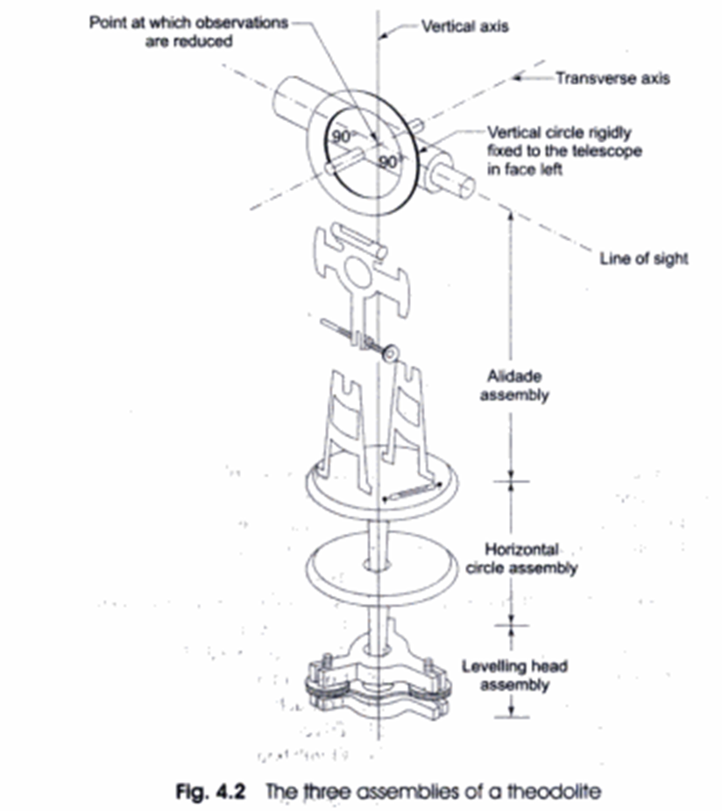
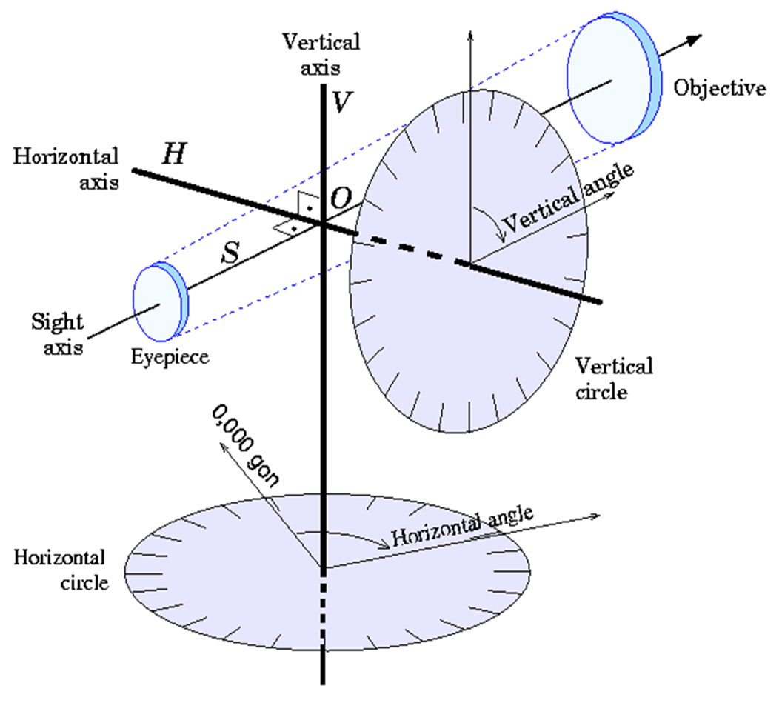
Detailed Parts of Theodolite
The basic criteria is the principal of mutual perpendicular three axis:

Slide 12
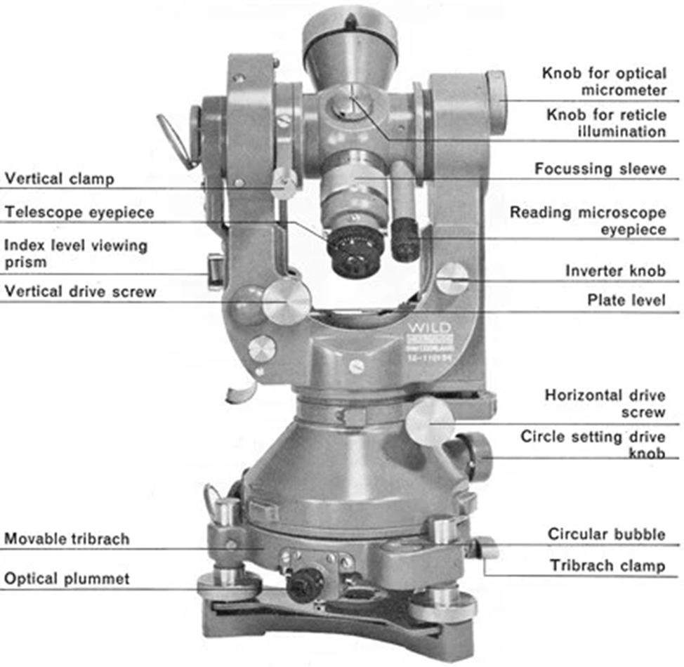
Optical Theodolites

Slide 13
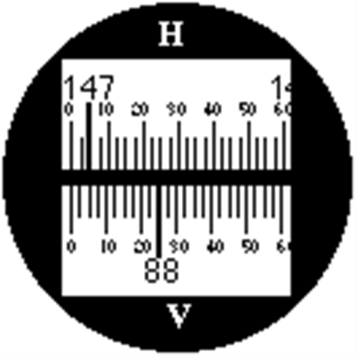
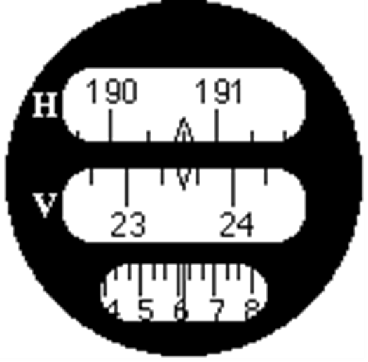
Example of Reading Circle of Optical Theodolite
Direct Scale Reading Micrometer Scale Reading

Slide 14
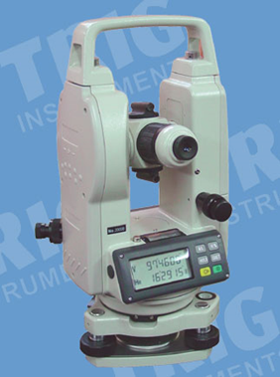
Digital or Electronic Theodolite
In addition to mentioned parts, an electronic theodolite is provided with a screen to show the circle (horizontal or vertical) readings;
In electronic theodolites, the readout
of the horizontal and vertical circles
is usually done with a rotary encoder
(an electro-mechanical device that
converts the angular position
or motion of a shaft or axle to
analog or digital output signals)

Slide 15
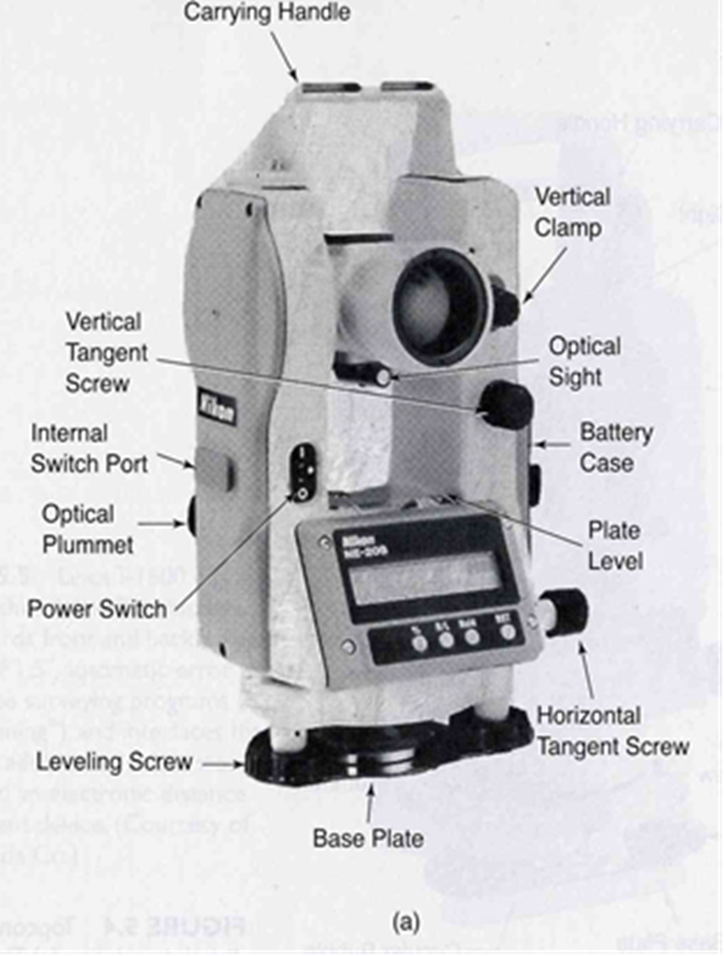
Electronic Theodolite Parts

