Slide 1
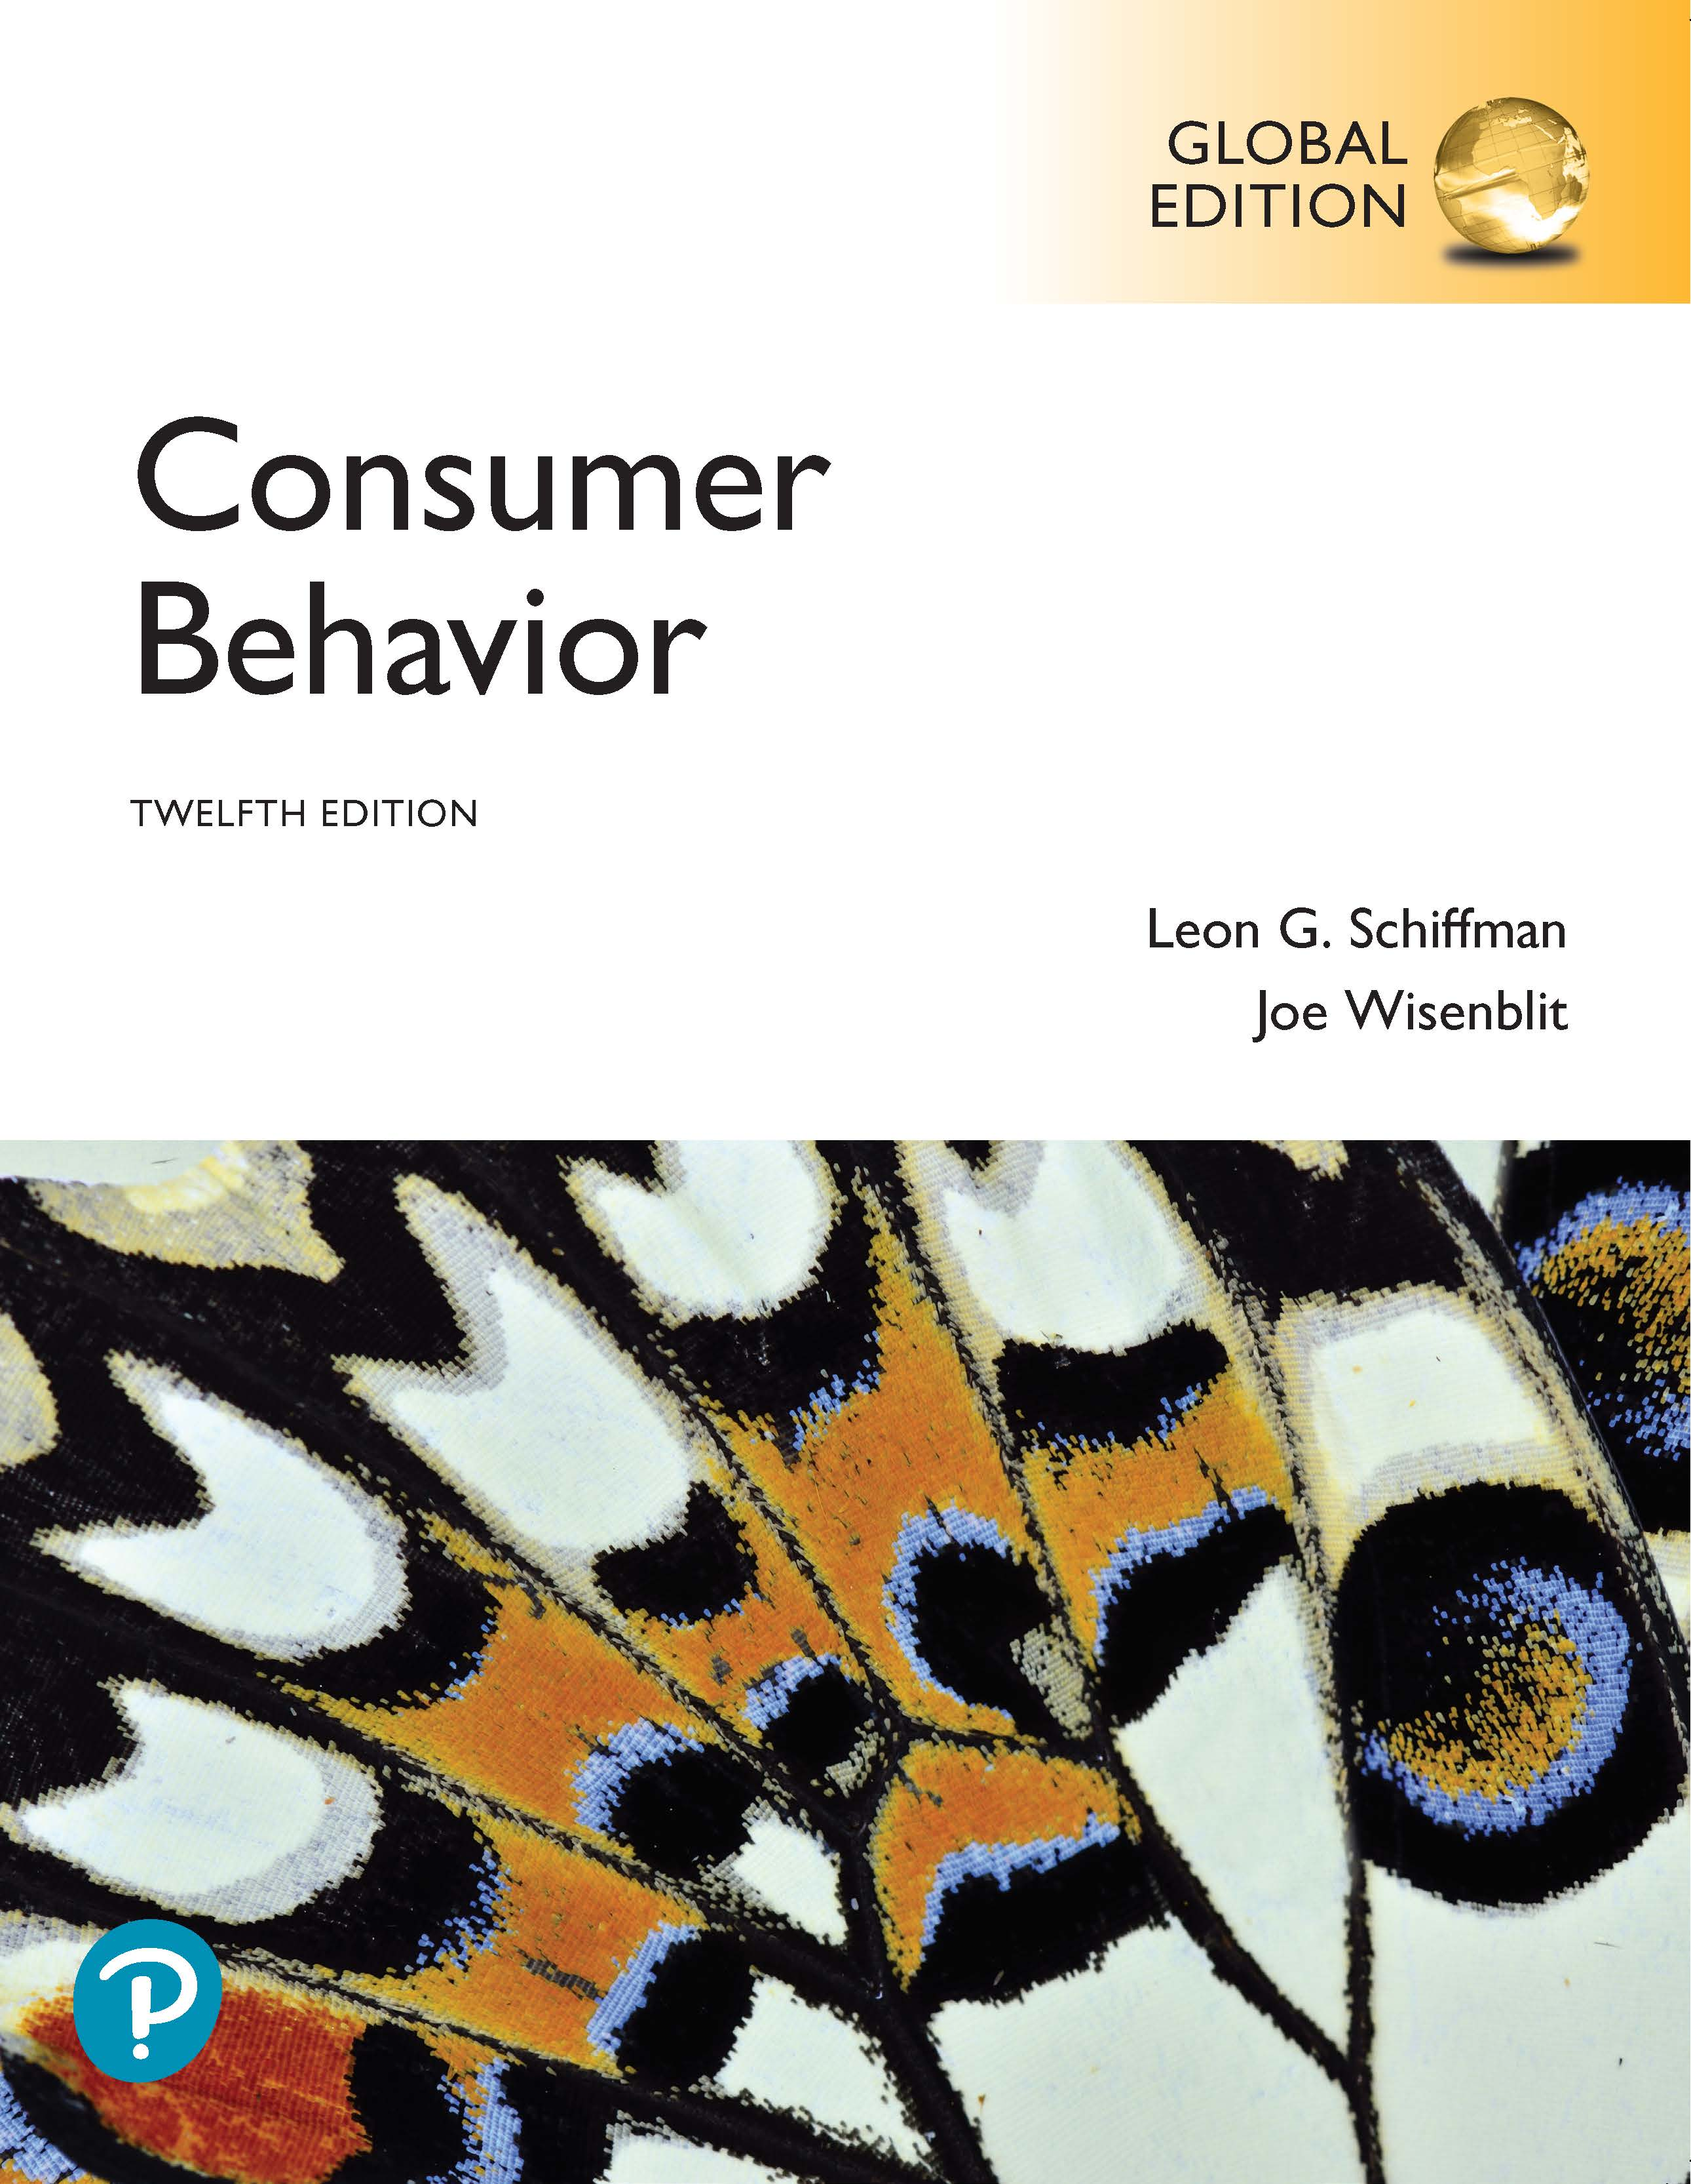
Consumer Behavior
Twelfth Edition, Global Edition
Chapter 6
Consumer Attitude Formation and Change
Slides in this presentation contain hyperlinks. JAWS users should be able to get a list of links by using INSERT+F7
Copyright © 2019 Pearson Education, Ltd. All Rights Reserved.
Notes:
If this PowerPoint presentation contains mathematical equations, you may need to check that your computer has the following installed:
1) MathType Plugin
2) Math Player (free versions available)
3) NVDA Reader (free versions available)

Slide 2
Learning Objectives (1 of 2)
6.1 To understand how consumers’ attitudes influence their decision-making.
6.2 To understand the tri-component attitude model.
6.3 To understand how to apply multiattribute models to change consumers’ attitudes.
6.4 To understand how to alter consumers’ attitudes by making particular needs prominent.
Notes:
Chapter 6 introduces attitudes, including attitude formation and attitude models, and identifies theories related to attitude change.

Slide 3
Learning Objectives (2 of 2)
6.5 To understand cognitive elaboration and the two routes to persuasion.
6.6 To understand cognitive dissonance and resolving cognitive conflicts.
6.7 To understand how people assign causality to events.
Notes:
It also discusses the roles of elaboration, dissonance, and how consumers assign causality to events.

Slide 4
Learning Objective 6.1
6.1 To understand how consumers’ attitudes influence their decision-making.
Notes:
An attitude is a learned predisposition to behave in a consistently favorable or unfavorable way toward a given object (a product, brand, service, price, package, advertisement, promotional medium, or the retailer selling the product, etc.) Attitudes reflect either favorable or unfavorable evaluations of the object and are learned from direct experience with the product, word-of-mouth, exposure to mass media, and other information sources that consumers are exposed to.

Slide 5
Attitude
Defined
A learned predisposition to behave in a consistently favorable or unfavorable manner with respect to a given object.

Slide 6

Example: Wrangler
Source: Wrangler, a V F Company
Notes:
Wrangler wants to change the attitudes of millennials, many of whom have shunned jeans in favor of sweatpants or leggings, by telling them traveler jeans are comfortable.

Slide 7
Attitude Formation
Consumers learn attitudes
Sources of attitude formation
  Experience
  Family and friends
  Media/Internet/Social Media
Notes:
Consumers learn attitudes when they try new products, product models, and different brands. If such trial purchases meet or exceed their expectations, then they develop favorable attitudes toward those objects. Generally, the more information consumers have about a product or service, the more likely they are to process information and form attitudes about it, either positive or negative. Typically, only two or three prominent beliefs about a product play a role in the formation of attitudes, and less important beliefs carry little weight.
Personal experience, family and friends, media, the Internet, and (increasingly) social media strongly affect attitudes. A primary source of attitudes toward products is the consumers’ direct experiences in trying and evaluating them.

Slide 8
Role of Personality Factors
Need for cognition
Innovativeness
Notes:
Personality traits like need for cognition (craving information and enjoyment of thinking) and innovativeness affect consumer behavior. Individuals with
a high need for cognition are likely to form positive attitudes in response to promotions that include a lot of detailed, product-related information, while consumers who are relatively low in this need are more likely to form positive attitudes in response to ads that feature attractive models or celebrities, or other peripheral cues about the products advertised. Innovativeness is relevant in the context of new product adoption.

Slide 9
Role of Attitudes
Attitudes are consistent with behavior
How do situations affect attitudes?
Table 6.1 Situations Affecting Attitudes
Product/Service | Situation | Attitude
Energizer Batteries | Hurricane is coming | “I know that the hurricane is going to knock out my electricity, so I’d better be prepared.”
Mini Cooper | Buying a new car | “With gas prices so high, I’ve got to trade in my S U V and buy a car that gets 30 m p g!”
Cheerios | High cholesterol | “They’ve been advertising how Cheerios can lower cholesterol for so long that it must be true.”
The Wall Street Journal | Extra cash on hand | “I have to decide whether to invest in stocks or just put my money in a money market fund.”
Delta Airlines | Friend’s bachelor party | “My friend’s bachelor party is in Las Vegas, and I want to be there.”
Maxwell House Coffee | Need to stay awake | “I had a late date last night, but I’ve got a lot of work to do this morning at the office.”
Stouffer’s Easy Express Meals | Want dinner at home | “I’m tired of eating out night after night.”
Notes:
Similar attitudes consistently lead to the same behaviors. However, despite their consistency, attitudes are not permanent and can change either seldom or frequently.
Attitudes occur within and are affected by situations. In this context, “situations” are events and circumstances that influence the relationships between attitudes and behaviors at particular times. Situations can cause consumers to behave in ways seemingly inconsistent with their attitudes. Examples are included in Table 6.1.

Slide 10
Learning Objective 6.2
6.2 To understand the tri-component attitude model.
Notes:
The tri-component attitude model maintains that attitudes consist of three components: cognitive, affective, and conative

Slide 11
The Cognitive Component
Table 6.2 Beliefs about Two Smart Speakers
Product Attribute | Google Home | Amazon Echo
Responds to Voice Commands | Yes | Yes
Prompt Word | “OK Google” or “Hey Google” | “Alexa,” “Echo,” “Amazon,” or “Computer”
Works with my Smart Home (Ecobee) | No | Yes
Customizable Appearance | Yes | No
Personal Assistant | Search Google, daily briefing, check traffic, calendar, flights, make shopping list, track packages | Add items to calendar, make shopping and to-do lists, check flights, track a package
Works with my Music Streaming Preference (YouTube Music) | Yes | No
Source: Adapted from: Andrew Gebhart, “Google Home versus Amazon Echo: Round 2—Google strikes back,” CNET.com, 28, 2017.
Notes:
The cognitive component consists of a person’s knowledge and perceptions of the features of an attitude object - commonly expressed as beliefs; or whether or not the consumer believes that the attitude object possesses specific attributes.

Slide 12
The Affective Component
For the past 30 days, you have been using Dapper Dan Aftershave Balm. Please tell us how your skin felt after using the product. Please indicate your level of agreement or disagreement with each of the statements listed here.
Blank | Strongly Agree | Agree | Neutral | Disagree | Strongly Disagree
Dapper Dan Balm refreshed my skin. | [1] | [2] | [3] | [4] | [5]
Dapper Dan Balm tightened my skin. | [1] | [2] | [3] | [4] | [5]
Dapper Dan Balm smoothed my skin. | [1] | [2] | [3] | [4] | [5]
Dapper Dan Balm suppled my skin. | [1] | [2] | [3] | [4] | [5]
Dapper Dan Balm revived my skin. | [1] | [2] | [3] | [4] | [5]
Notes:
The affective component represents the consumer’s emotions and feelings regarding the attitude object, or evaluations. The example shown is a Likert scale.

Slide 13
Likert Scale
Defined
The most popular form of attitude scale, where consumers are asked to check numbers corresponding to their level of “agreement” or “disagreement” with a series of statements about the studied object.
Notes:
The scale consists of an equal number of agreement/disagreement choices on either side of a neutral choice.

Slide 14
Semantic Differential Scale
For the past 30 days, you have been using H I Lipgloss. Please tell us how your lips felt after using the product. For each of the adjectives listed here, please mark an “X” in the box corresponding to how your lips felt after using H I Lipgloss.
Refreshed | [1] | [2] | [3] | [4] | [5] | Not refreshed
Refreshed | [1] | [2] | [3] | [4] | [5] | Not tight
Refreshed | [1] | [2] | [3] | [4] | [5] | Not smooth
Supple | [1] | [2] | [3] | [4] | [5] | Not supple
Revived | [1] | [2] | [3] | [4] | [5] | Not revived
Notes:
Semantic differential scales use a series of bipolar adjectives anchored at ends of an odd-numbered curriculum

Slide 15
The Conative Component
Which of the following statements best describes the chance that you would buy Dapper Dan Aftershave Balm the next time you purchase an aftershave product?
Fill in the blank I definitely will buy it.
Fill in the blank I probably will buy it.
Fill in the blank I am uncertain whether I will buy it or not.
Fill in the blank I probably will not buy it.
Fill in the blank I definitely will not buy it.
How likely are you to buy Dapper Dan Aftershave Balm during the next three months?
Fill in the blank Very likely
Fill in the blank Likely
Fill in the blank Uncertain
Fill in the blank Unlikely
Fill in the blank Very unlikely
Notes:
The conative component reflects the likelihood that an individual will undertake a specific action or behave in a particular way with regard to the attitude object - treated as an expression of the consumer’s intention to buy in consumer research. Figure 6.5 shows examples of intention-to-buy measures.

Slide 16
Discussion Questions
Explain your attitude toward your college/university based on the tricomponent attribute model.
Be sure to isolate the cognitive, affective, and conative elements.
Notes:
You probably have an overall positive or negative feeling toward your university. Try to break this affective component down a bit more – what do you like and not like? You can now look to the cognitive to determine what beliefs you have about these different parts of your university. Finally, how does this influence what you do? Will you come back for a graduate degree? Recommend your little brother or sister attend? Send your children here? Donate money as an alumnus?

Slide 17

Altering Consumer Attitudes
Changing beliefs about products
Changing brand image
Changing beliefs about competing brands
Source: Avocados From Mexico, Mexican Hass Avocado Importers Association
Notes:
Changing attitudes about products and brands is difficult because consumers frequently resist evidence that challenges strongly held attitudes or beliefs and tend to interpret any ambiguous information in ways that reinforce their preexisting attitudes. Marketers may try to change beliefs or perceptions about the brand itself (the most common form of advertising appeal); alter consumers’ overall perceptions of the brand; or change beliefs about competing brands.

Slide 18
Learning Objective 6.3
6.3 To understand how to apply multiattribute models to change consumers’ attitudes.
Notes:
Multi-attribute attitude models portray consumers’ attitudes as functions of their assessments of the objects’ prominent attributes.

Slide 19
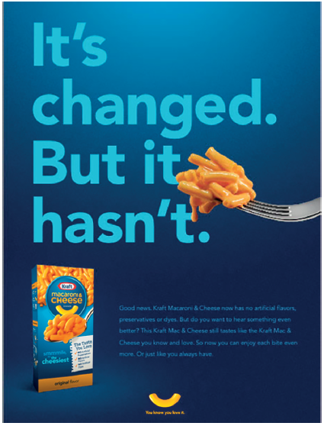
Attitude-Toward-Object Model
Used to change attitudes
Ways
  Add an attribute
  Change perceived importance of an attribute
  Develop new products
Source: The Kraft Heinz Company
Notes:
The attitude-toward-object model maintains that a consumer’s evaluation of a product is a function of: 1. The extent to which the product has (or lacks) each of a given set of attributes. 2. The importance of each of these attributes to the consumer. Consumers generally have more favorable attitudes toward those brands that they believe have better performance on the attributes that they view as important than other brands.
Marketers may add an attribute that previously was ignored or one that represents an improvement or innovation; change the perceived importance of attributes; or develop new products. Figure 6.6 shows an ad that tries to change the importance of an attribute (use of real fruit juice for packaging fruit).
Developing New Products
Marketers often use the attitude-toward-object model during the development of new products. Consider
the following hypothetical example: The Tropicana company considered adding a new item to
its product line. The company’s market researchers identified four attributes as the key determinants
in consumers’ attitudes toward orange juice: amount of pulp, degree of sweetness, strength of flavor,
and color.

Slide 20
Other Multi-Attribute Models
Theory of Reasoned Action
Theory of trying-to-consume
Attitude-toward-the-ad model
How are the models different from the attitude-toward-object model? From each other?
Notes:
Like the tri-component model, the theory of reasoned action (TRA) incorporates the cognitive, affective, and conative components. It adds the measurement of subjective norms (feelings about what relevant others would think about the action) that influence a person’s intention to act before gauging the level of intention.
The theory of trying-to-consume represents cases where the outcome of a contemplated action (e.g., a purchase), stemming from a positive attitude, is uncertain, but is still being pursued by the consumer. A person trying to consume faces two types of obstacles that may prevent the desired outcome: 1. Personal impediments and 2. Environmental impediments. Consumers who fail to try to consumer do not recognize all the consumption options available or prefer to self-sacrifice or delay gratification.
The attitude-toward-the-ad model proposes that the feelings consumers form when they see and hear ads significantly impact their attitudes towards the brands advertised.

Slide 21
Multiattribute Models
Attitude Toward the Object
Does a brand have the needed attribute?
What is the importance of that attribute?
Attitude Toward Behavior
Attitude toward the brand
How do I feel about buying this brand?
Theory of Reasoned Action
Tri-component attitude model
Normative beliefs
Motivation to comply with norms
Theory of Trying to Consume
Attitude toward the behavior
Personal impediments
Environmental impediments
Attitude Toward the Ad
Attitudes toward brands are formed based on how consumers feel about the advertisements for these brands.
Attitude-Toward-Social-Media Posts
Attitudes toward brands are formed based on how consumers feel about what they see on social media about the brands.

Slide 22
Learning Objective 6.4
6.4 To understand how to alter consumers’ attitudes by making particular needs prominent.
Notes:
Sometimes marketers must try to change negative consumer attitudes about their products, companies, or marketing practices.

Slide 23
Functional Approach
Utilitarian function
Ego-defensive function
Value-expressive function
Knowledge function
Associate brands with worthy causes and events
Notes:
Changing attitudes by appealing to consumers’ motivations/reasons or functions behind their attitudes is known as the functional approach. Attitudes are classified into four functions: the utilitarian function, ego-defensive function, value-expressive function, and knowledge function.
The utilitarian function stems from the belief that consumers’ attitudes reflect the utilities that brands provide. When a product has been useful or enabled us to perform certain tasks in the past, our attitude toward it tends to be favorable. The ego-defensive function maintains that people form attitudes in order to protect themselves from sensing doubt and to replace uncertainty with feelings of security and confidence. The value-expressive function maintains that attitudes reflect consumers’ values and beliefs. The knowledge function holds that people form attitudes because they have a strong need to understand the characters of the people, events, and objects they encounter.
Marketers may also associate brands with worthy causes or objects (social or cultural events).

Slide 24
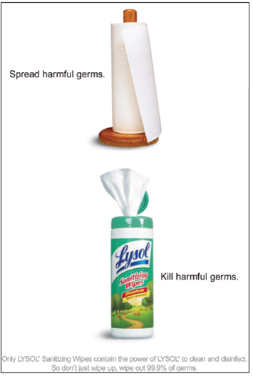
Example: Utilitarian Function
Source: LYSOL is a registered trademark of Reckitt Benckiser L L C.

Slide 25
Learning Objective 6.5
6.5 To understand cognitive elaboration and the two routes to persuasion.
Notes:
The elaboration likelihood model (ELM) proposes that attitudes can sometimes be changed by either one of two different routes to persuasion—a central route or a peripheral route—and that the cognitive elaboration related to the processing of information received via each route is different.

Slide 26
Elaboration Likelihood Model
Defined
The proposition that attitudes can be changed by either one of two different routes to persuasion – a central route or a peripheral route – and that the cognitive elaboration related to the processing of information received via each route is different
Notes:
The central and peripheral routes to problem solving reflect extensive problem solving and limited problem solving. They correspond with high-involvement purchases and low-involvement purchases.

Slide 27
Central Route
High involvement
Considered thought and cognitive processing
Learning through
  Attribute-based information
  High quality arguments
  Exertion of effort to learn, comprehend, evaluate
Comparative ads
Objective knowledge
Notes:
The premise of this model is that consumers carefully evaluate the merits and weaknesses of a given product when they consider the purchase to be very relevant. Conversely, consumers engage in very limited information search and evaluation (or cognitive elaboration) when the purchase holds little relevance or importance for them.
The central route to persuasion is a promotional approach that maintains highly involved consumers are best reached and persuaded through ads focused on the product’s attributes

Slide 28
Peripheral Route
Low involvement
Little thought and little information processing
Learning through
  Repetition
  Passive processing of visual cues
  Holistic processing
Non-comparative ads
Subjective knowledge
Notes:
The peripheral route to persuasion is a promotional approach maintaining that uninvolved consumers can be best persuaded by the ad’s visual aspects rather than its informative copy.

Slide 29
Applications (1 of 2)
Comparative ads
  Comparative ads processed centrally
  Noncomparative ads processed peripherally
Product knowledge
  Higher objective knowledge for utilitarian products than hedonic products
  Higher subjective knowledge for hedonic products than utilitarian products
Notes:
Message arguments are more likely to be processed centrally in comparative ads. Noncomparative ads are more likely to be evaluated based on other elements.
Subjective knowledge is likely to be the result of interpreting imagery presented in the ad (peripheral), which objective knowledge is the outcome of the factual information the ad provides (central).

Slide 30
Learning Objective 6.6
6.6 To understand cognitive dissonance and resolving cognitive conflicts.
Notes:
Cognitive dissonance theory provides an explanation as to why and how behavior sometimes precedes attitude formation.

Slide 31
Dissonance
Cognitive dissonance
Post-purchase dissonance
Ways to reduce post-purchase dissonance
  1. Rationalize decision
  2. Seek advertisements that support choices (avoid competitive ads).
  3. “Sell” friends on the positive features of the purchase.
  4. Seek reassurance from satisfied owners
Notes:
Cognitive dissonance occurs when a consumer holds conflicting thoughts about a belief or an attitude object. When cognitive dissonance occurs after a purchase, it is called post-purchase dissonance. Because expensive and important purchases require compromise and choice among similar alternatives (e.g., similar homes in the same community), post-purchase dissonance in such instances commonly occurs, and leaves consumers with an uneasy feeling about their behavior (the purchase decision). Thus, marketers must actively ensure that these consumers resolve conflicting cognitions by changing their attitudes to conform to their behaviors.
Ways to reduce
1. Rationalize their decisions.
2. Seek advertisements that support their choices (while avoiding dissonance-creating competitive ads).
3. Try to “sell” friends on the positive features of the purchase made (i.e., “the consumer as a sales
agent”).
4. Look to satisfied owners for reassurance (e.g., meet homeowners in the community where the
newly purchased house is located).

Slide 32
Learning Objective 6.7
6.7 To understand how people assign causality to events.
Notes:
Attribution theory attempts to explain how people assign causality (e.g., blame or credit) to events, on the basis of either their own behavior or the behavior of others.

Slide 33
Attribution Theory
Self-perception attribution
Defensive attribution
Foot-in-the-door technique
Door-in-the-face technique
Notes:
Self-perception attribution reflects the way people see themselves when they try to figure out why prior events happen. These attributions consist of internal and external attributions.
Defensive attribution suggests people generally accept or take credit for success (internal attribution), but assign failure to others for outside events (external attribution).
Foot-in-the-door technique consists of getting people to agree to large requests after convincing them to agree to a small and modest request first – the small request bonds the requester and the requestee.
Door-in-the-face technique consists of a large, costly first request that is likely to be refused followed by a second, more realistic, less costly request.

Slide 34
Defensive Attribution
Defined
People generally accept (or take) credit for success (internal attribution), but assign failure to others or outside events (external attribution)

Slide 35
Applications (2 of 2)
Why does the foot-in-the door technique increase the likelihood that the requestee will fulfill a larger request?
How is it different from the door-in-face technique?
Notes:
The foot-in-the-door technique consists of getting people to agree to large requests after convincing them to agree to a small and modest request first. The rationale behind this method is that agreeing to a small request creates a bond between the requester and the requestee. The requestee does not want to disappoint the requestor, with whom he feels he has bonded. The requestee also becomes interested in the objective of the request. People tend to develop attitudes to justify prior actions. So, when people look at their prior behavior (e.g., compliance with minor requests), they conclude that they are the kind of persons who generally agree to requests from others (i.e., an internal attributions), which increases their compliance with the larger request.
In the door-in-the-face technique, a large, costly first request that is likely to be refused is followed by a second, more realistic, and less costly request.

Slide 36
Analyzing Self-Attributions
Table 6.4 Reviewing Self-Attributions
Scenario | Distinctiveness | Consistency Over Time and Varied Situations | Consensus
An alumnus considering donating money to his M B A program | How distinctive will my contribution be? Do many others make larger donations? Will I become part of a select group if I donate? | Can I afford to donate regularly? Will I be able to contribute money if the university asks for a special donation (e.g., for building a new student center)? | If I ask my friends, would most of them agree that I should make a donation, or will their opinions vary?
An amateur photographer who sees that, when printed on the latest H P printer, her photos look much better | Am I the only one who sees this marked difference, or do others notice the same? | Will I see the same superiority of the H P printer when I take other photos? Or is the advantage I see mostly a function of what this articular photo shows? | If I ask my friends, would most of them agree that my pictures look better when printed on the H P printer, or would some notice the difference and others not?
Notes:
Self-attributions reflect the way people see themselves in the causalities they form about prior behaviors and the attitudes they develop thereafter.

