Slide 1
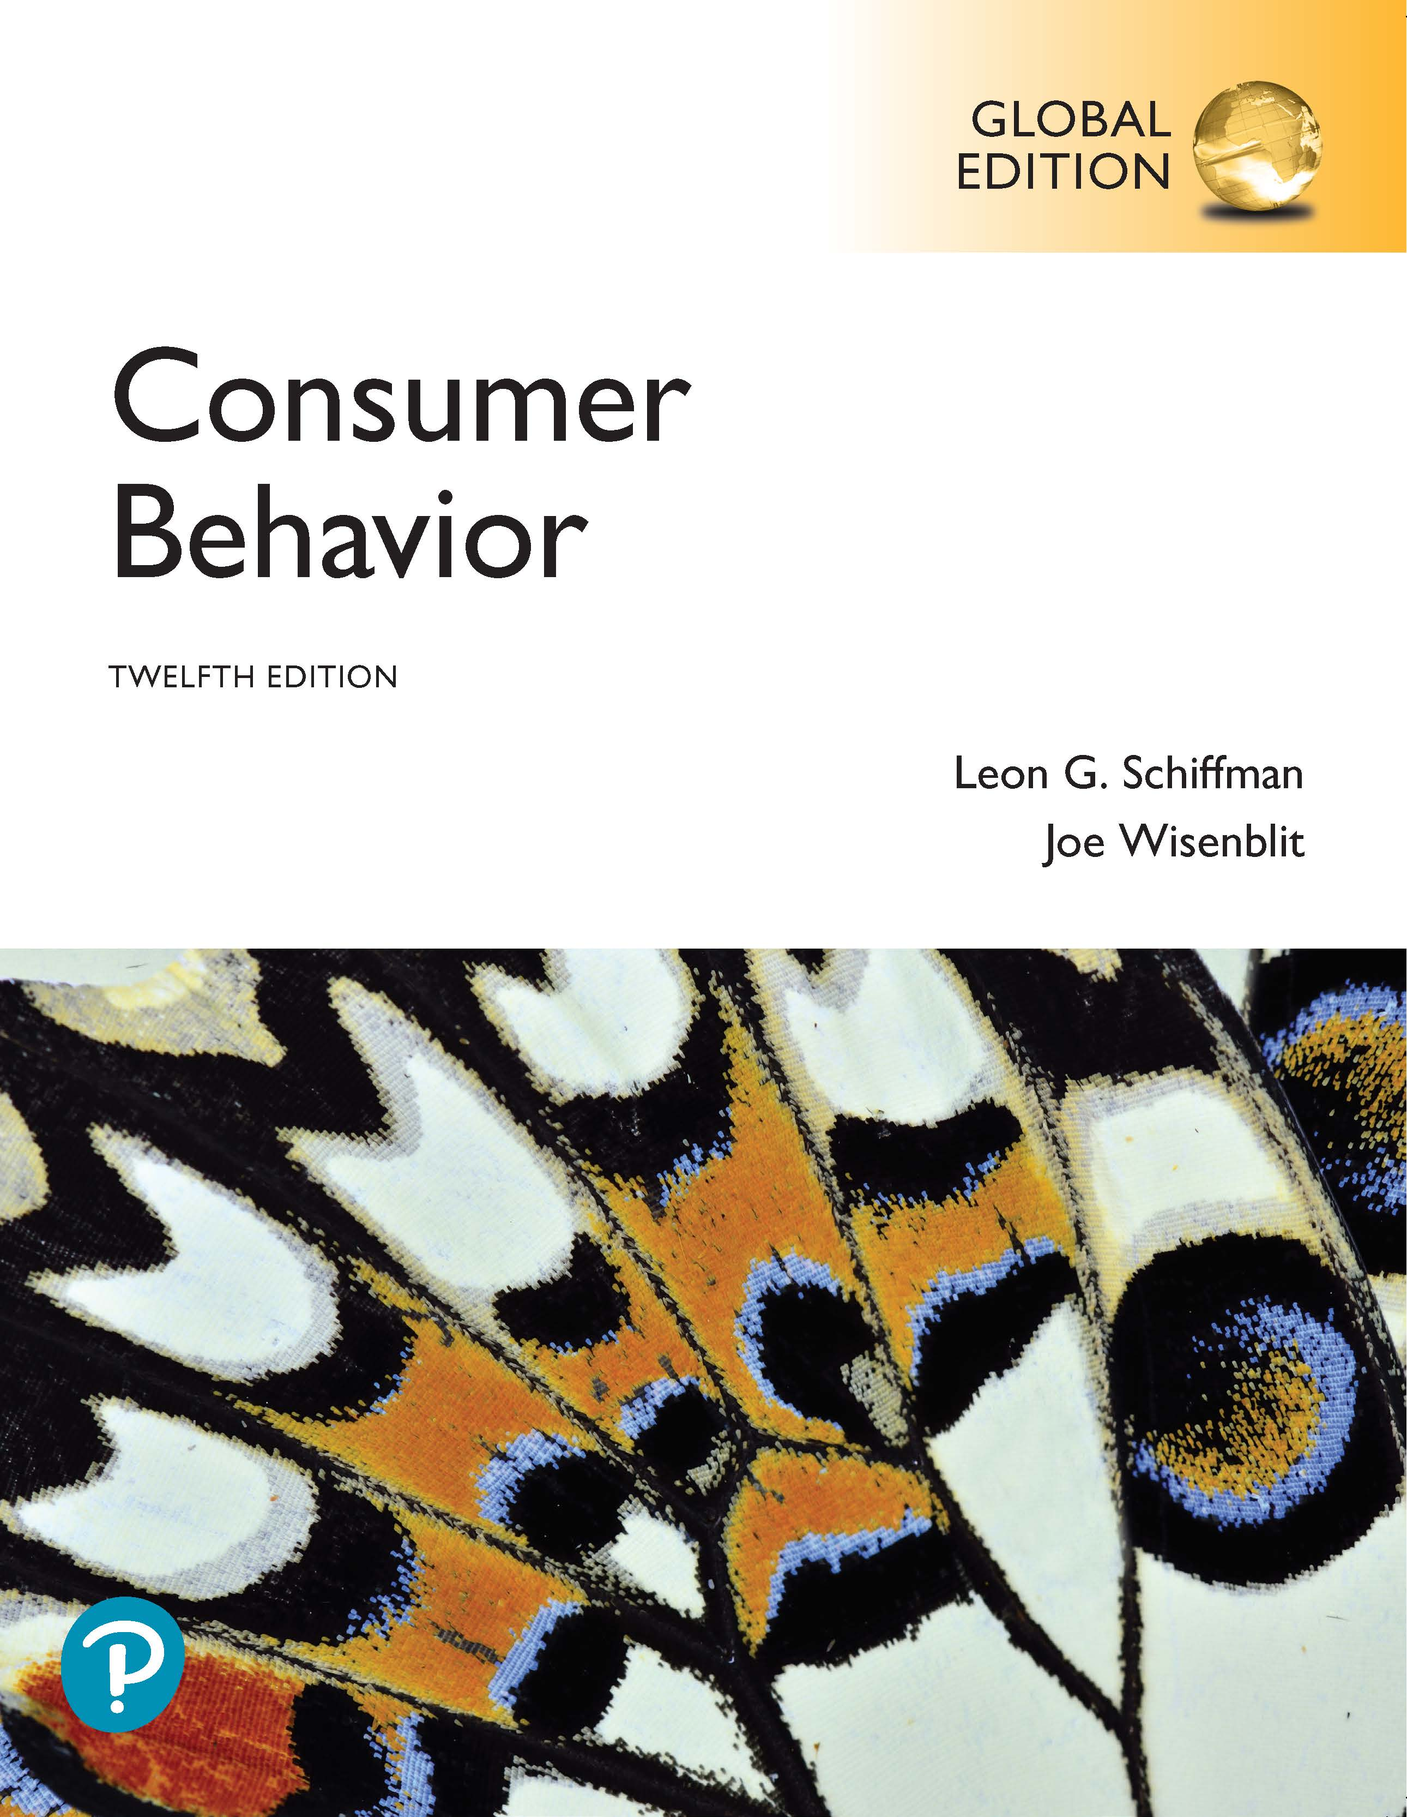
Consumer Behavior
Twelfth Edition, Global Edition
Chapter 5
Consumer Learning
Copyright © 2019 Pearson Education, Ltd. All Rights Reserved.
Notes:
If this PowerPoint presentation contains mathematical equations, you may need to check that your computer has the following installed:
1) MathType Plugin
2) Math Player (free versions available)
3) NVDA Reader (free versions available)

Slide 2
Learning Objectives (1 of 2)
5.1 To understand the elements of learning.
5.2 To understand behavioral learning, classical conditioning, and the roles of stimulus generalization and discrimination in marketing.
5.3 To understand instrumental conditioning and the objectives and methods of reinforcement.
5.4 To understand observational learning.
5.5 To understand how consumers process information.
Notes:
Learning is applying one’s past knowledge and experience to present circumstances and behavior. Students learn more enthusiastically when taught by persons whom they view as knowledgeable. Second, consumers are more likely to learn from messages that are fun and attract attention, just like students who feel motivated and learn more from teachers with good communication skills than from boring teachers. The third element of learning is repetition and the fourth element is reinforcement, which rewards behavior.

Slide 3
Learning Objectives (2 of 2)
5.6 To understand cognitive learning as a form of consumer decision-making.
5.7 To understand the impact of involvement and passive learning on purchase decisions.
5.8 To understand how to measure the outcomes of consumer learning.
Notes:
The elements of learning are applied to the development of marketing strategies. The chapter ends with an overview of methods to measure consumer learning.

Slide 4
Learning through Ads
Source: Avocados From Mexico, Mexican Hass Avocado Importers Association
Notes:
The ad is teaching consumers that avocados have good fats, are nutritious, fresh, and have no cholesterol. The marketer hopes consumers will engage in cognitive learning and retrieve the information when they food shop where avocados are sold.

Slide 5
Learning Objective 5.1
5.1 To understand the elements of learning.
Notes:
Learning is the process by which individuals acquire the purchase and consumption knowledge and experience they apply to future, related behavior. Consumer learning is a process that evolves and changes as consumers acquire knowledge from experience, observation, and interactions with others and newly acquired knowledge affects future behavior. It ranges from simple and often reflexive responses to marketing stimuli (such as packaging, product colors, and promotional messages), to learning abstract concepts and making decisions about purchasing complex and expensive products.

Slide 6
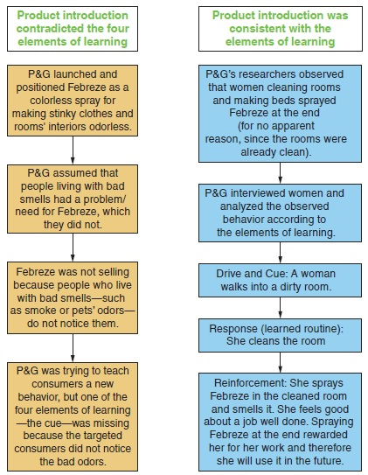
Learning
Intentional versus. incidental learning
Four elements:
  Motives
  Cues
  Responses
  Reinforcement
Compare the two introductions of Febreze.
Notes:
Intentional learning is acquired as the result of a search for information, while incidental learning is acquired by accident or without much effort.
Learning consists of four elements: motives, cues, responses, and reinforcement. Unfilled needs lead to motivation, which spurs learning. Cues are stimuli that direct motivated behavior. Response is an individual’s reaction to a drive or cue. Reinforcement is the reward—the pleasure, enjoyment, and benefits—that the consumer receives after buying and using a product or service. The figure applies the four elements to the introduction of Febreze.

Slide 7
Learning Objective 5.2
5.2 To understand behavioral learning, classical conditioning, and the roles of stimulus generalization and discrimination in developing in marketing.
Notes:
Behavioral learning (aka stimulus-response learning) is concerned with the inputs and outcomes of learning (the stimuli that consumers select from the environment and the observable behaviors that result) – not the process. Three forms of behavioral learning with great relevance to marketing are classical conditioning, instrumental (or operant) conditioning, and behavioral (or modeling) learning.

Slide 8
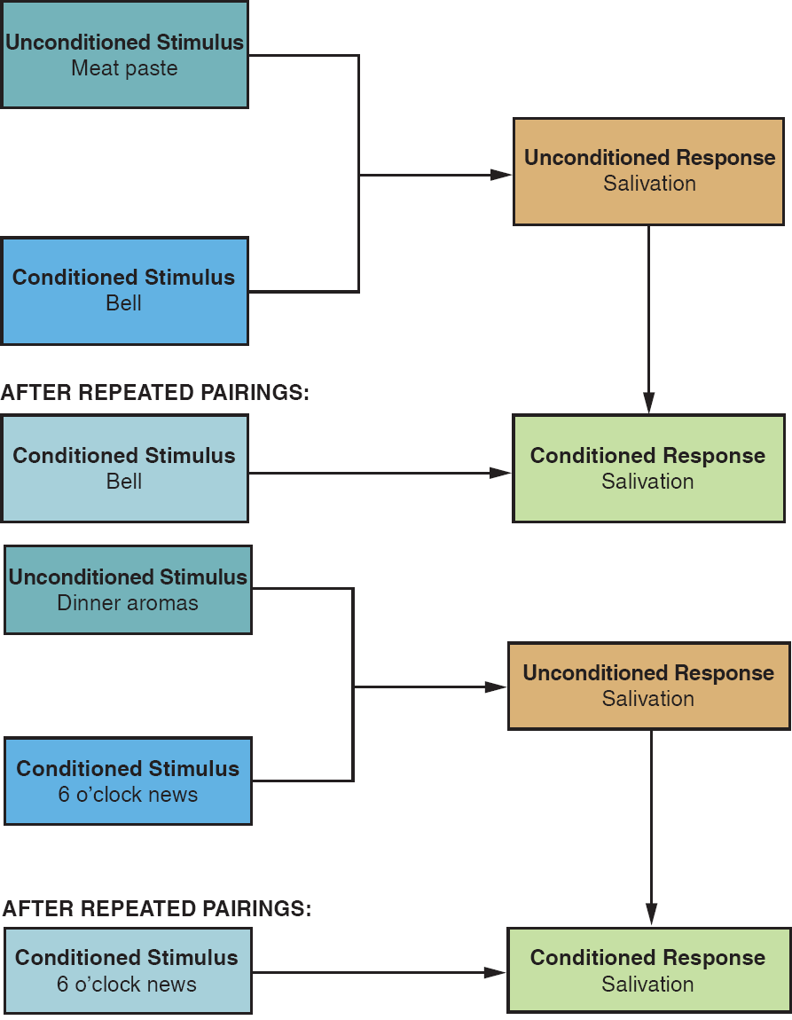
Classical Conditioning
Notes:
Classical conditioning is viewed as a “knee-jerk” (or automatic) response that builds up through repeated exposure and reinforcement. The unconditioned stimulus occurs naturally in response to given circumstances, the conditioned stimulus becomes associated with a particular event or feeling as a result of repetition, and the conditioned response is a response to the conditioned stimulus. The strategic applications of classical conditioning to consumer behavior are associative learning, the need for repetition, stimulus generalization, and stimulus discrimination.

Slide 9
Applications of Classical Conditioning
Associative learning
Need for repetition
  Advertising wear-out
  Three-hit theory
Stimulus generalization
Stimulus discrimination
Notes:
Contemporary behavioral scientists view classical conditioning as learning of associations among events that enable consumers to expect and anticipate events. Repetition is the key to forming associations between brands and fulfillment of needs. Advertising wear-out is the point at which an individual becomes satiated with numerous exposures, and both attention and retention decline. Some marketing scholars believe that just three exposures to an advertisement are needed: one to make consumers aware of the product, a second to show consumers the relevance of the product, and a third to remind them of its benefits. This exposure pattern is called the three-hit theory. Stimulus generalization and stimulus discrimination are explored on the next few slides.

Slide 10
Stimulus Generalization
Product line extensions
Product form extensions
Family branding
Licensing
Source: Procter & Gamble Co.
Notes:
Responding the same way to slightly different stimuli is called stimulus generalization.
Product line extensions are additions of related items to an established brand; these are likely to be adopted because they come under a known and trusted brand name. V8 soups are product line extensions. In learning terms, consumers will apply what they already know about V8 to its new product and probably try the new item.
Offering the same product in a different form but under the same brand is a product form extension.
Family branding consists of marketing different products under the same brand name. The extension of the V8 line to other products is also a form of family branding.
Licensing is contractually allowing a well-known brand name to be affixed to the products of another manufacturer. The names of designers, manufacturers, celebrities, corporations, and even cartoon characters are attached, for a fee (i.e., “rented out”) to a variety of products, enabling
the licensees to achieve instant recognition and implied quality for the licensed products.

Slide 11
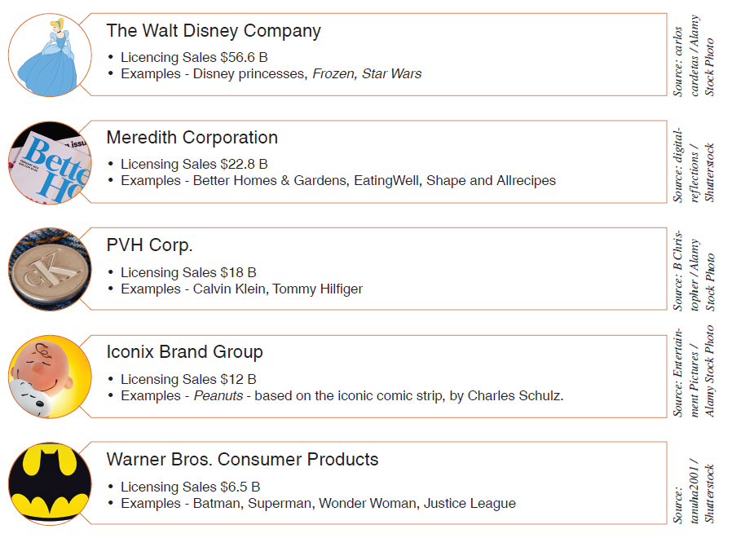
Top Licensing Companies
Notes:
Licensing rents out well-known brand names so they can be associated with another manufacturer’s product.

Slide 12
Stimulus Discrimination
Brand differentiation
Market leaders want consumers to distinguish between products and imitators
Relevant, meaningful, valuable differentiation
Notes:
Stimulus discrimination is the opposite of stimulus generalization. Its purpose is the selection of a specific stimulus from among similar stimuli. The core objective of positioning is to “teach” consumers to discriminate among similar products (i.e., similar stimuli) and form a unique image for a brand in their minds.

Slide 13
Learning Objective 5.3
5.3 To understand instrumental conditioning and the objectives and methods of reinforcement.
Notes:
Instrumental conditioning (or operant conditioning) is based on the notion that learning occurs through a trial-and-error process, with habits formed as a result of rewards received for certain responses or behaviors. Instrumental conditioning requires a link between a stimulus and a response where the stimulus that results in the most rewarded response is the one that is learned.

Slide 14
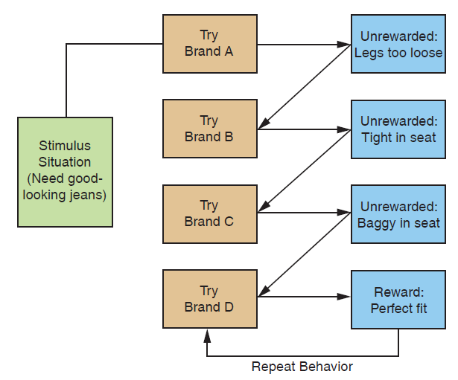
Instrumental Conditioning
Notes:
The consumer who tries several brands and styles of jeans before finding a style that fits her figure (i.e., reinforcement) has engaged in instrumental learning. Presumably, the brand that fits best is the one she will continue to buy.

Slide 15
Discussion Questions
What is the difference between positive reinforcement and negative reinforcement?
What is the difference between negative reinforcement and punishment?
What is the difference between extinction and forgetting?
Notes:
Positive reinforcement rewards a particular behavior and thus strengthens the likelihood of a specific response during the same or similar situation. Negative reinforcement is the removal of an unpleasant stimulus and it strengthens the likelihood of a given response during the same or similar circumstances. On the other hand, punishment is designed to discourage behavior.
Extinction occurs when a learned response is no longer reinforced and the link between the stimulus and the expected reward breaks down. Forgetting is often related to the passage of time, and thus is often called decay.

Slide 16
Incentivized Advertising
Provides consumers with rewards for watching ads
Consumers may try to avoid ads
Notes:
Video game and television ads might have some incentive to get people to view them.

Slide 17
Reinforcement Schedules (1 of 2)
Continuous
Fixed ratio
Variable ratio
Notes:
With continuous reinforcement, a reward is provided after each transaction. A fixed ratio reinforcement schedule provides reinforcement every nth time the product or service is purchased (say, every third time). A variable ratio reinforcement schedule rewards consumers on a random basis. Gambling casinos operate on the basis of variable ratios. Variable ratios tend to engender high rates of desired behavior and are somewhat resistant to extinction.

Slide 18
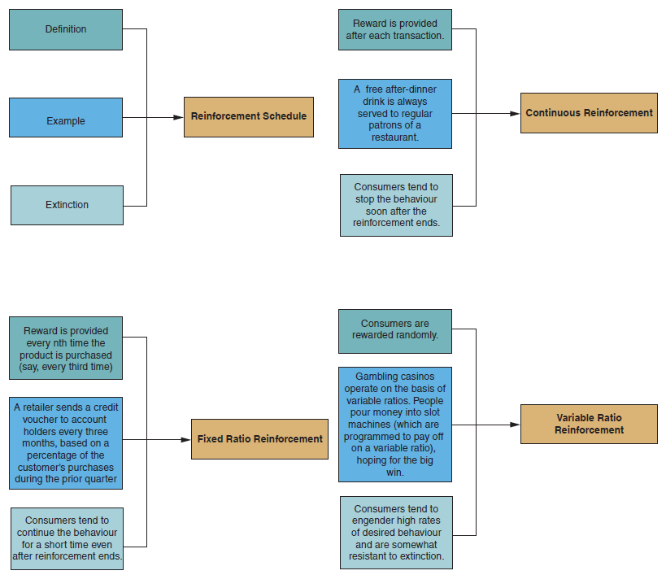
Reinforcement Schedules (2 of 2)
Notes:
The possibility of receiving a reward is the reinforcement and incentive for continued patronage.

Slide 19
Extinction and Forgetting
Defined
Extinction occurs when a learned response is no longer reinforced and the link between the stimulus and the expected reward is eliminated.
Forgetting is the point at which the link between the stimulus and the expected reward ceases to exist.
Notes:
Forgetting is sometimes called decay. It usually occurs because of time.

Slide 20
Customer Satisfaction and Retention
Satisfaction and repeat patronage
Frequent shopper programs
Shaping
Notes:
Savvy marketers consistently provide high quality. Incentives associated with frequent shopper programs are another application of instrumental conditioning.
Shaping increases the likelihood that a desired consumer behavior will occur by performing reinforcement before the desired consumer behavior takes place.

Slide 21
Mass Versus. Distributed Learning
Should a learning schedule be spread out over a period of time?
Should a learning schedule be “bunched up” all at once?
Notes:
Marketers also have the choice between massed versus distributed learning. Should the learning and the exposure to the stimuli happen in a relatively short period of time or be drawn out? Media planners are often faced with this decision when putting together an advertising campaign. when the goal is long-term repeat buying on a regular basis, a distributed schedule is preferable. A distributed schedule, with ads repeated on a regular basis, usually results in more long-term learning that is relatively immune to extinction.

Slide 22
Learning Objective 5.4
5.4 To understand observational learning.
Notes:
Observational learning (or modeling) is the process through which individuals learn behavior by observing the behavior of others and the consequences of such behavior. For this type of learning to occur, reinforcement must take place.

Slide 23
Observational Learning
Defined
Also known as modeling, observational learning occurs when people observe and later imitate observed behaviors
Notes:
Children learn much of their social behavior and consumer behavior by observing their older siblings and their parents. They imitate the behavior of those they see rewarded, expecting to be rewarded similarly if they adopt the same behavior.

Slide 24
Learning Objective 5.5
5.5 To understand how consumers process information.
Notes:
A lot of learning occurs through consumer thinking and problem solving. Sometimes we resolve purchase-related dilemmas instantly. In other situations, we search for information and carefully evaluate what we learned. This kind of learning, called cognitive learning, consists of mental processing of data rather than instinctive responses to stimuli.

Slide 25
Sensory Store
Defined
A location in the brain where the sensory input lasts for just a second or two. If it is not processed immediately, it is lost.
Notes:
Sensory store is a mental space in the human mind.

Slide 26
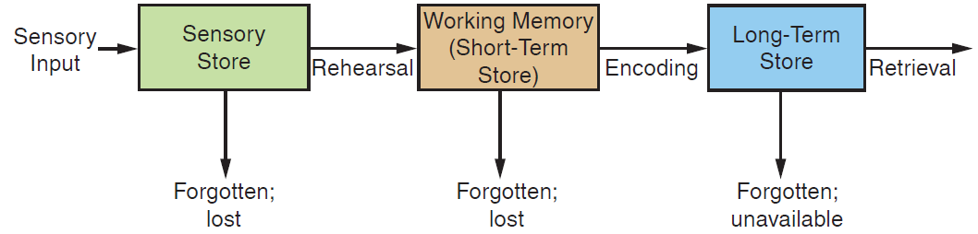
Cognitive Learning (1 of 2)
Notes:
The human mind processes the information it receives. Consumers process product information by attributes, brands, comparisons between brands, or a combination of these factors. The number and complexity of the relevant attributes and available alternatives influence the intensity or degree of information processing. Consumers with higher cognitive abilities acquire more product information and consider more product attributes and alternatives than consumers with lesser ability. Information processing occurs in stages and in three sequential “storehouses” where information is kept: the sensory, short-term, and long-term stores.

Slide 27
Information Processing
Storing information
  Sensory store
  Short-term storage
  Long-term storage
Rehearsal
  Encoding
  Information overload
Retention
  Chunking
  Retrieval
Notes:
The sensory store is the mental “space” in the human mind where sensory input lasts for just a second or two. If it is not processed immediately, it is lost. The short-term store is where information is processed and held for just a brief period. If information in the short-term store undergoes the process known as rehearsal, which is the silent, mental repetition of information, it is then transferred to the long-term store. The transfer process takes from 2 to 10 seconds. If information is not rehearsed and transferred, it is lost in about 30 seconds or less. The amount of information that can be
held in short-term storage is limited to about four or five items. The long-term store is the mental “space” where information is retained for extended periods of time, in contrast to the short-term store, where information lasts only a few seconds. Although it is possible to forget something within a few minutes after the information reaches long-term storage, it is more common for data in long-term storage to last for days, weeks, or even years.
The purpose of rehearsal is to hold information in short-term storage long enough for encoding to take place. Encoding is the process by which we select a word or visual image to represent a perceived object. Processing and remembering a picture takes less time than learning verbal information, but both types of information are important in forming an overall mental image. When consumers receive too much information and then have difficulty encoding and storing it, information overload occurs.
Information does not merely remain in long-term storage waiting to be retrieved. It is constantly organized and reorganized, as new chunks of information are received and new links among those chunks are created. A key component of retention is called chunking, defined as the process during which consumers recode what they have already encoded; this process often results in recalling additional relevant information. Retrieval is the process by which people recover information from the long-term store; it is frequently triggered by external cues.

Slide 28
Information Overload
Defined
A situation that occurs when consumers receive too much information and find it difficult to encode and store it
Notes:
When several strong brands are heavily promoted, consumers can not process information about features of new brands.

Slide 29
Retaining Information
Brand imprinting
Sound symbolism
Linguistic characteristics
Notes:
Brand imprinting suggests messages that convey a brand’s identity can help a consumer learn and retain information about a brand. Similarly, sound symbolism suggests sounds of words convey meaning. In the same way, linguistic characteristics like unusual spelling can affect encoding and retention of a brand name.

Slide 30

Chunking Aids Retrieval
Source: Swedish Tourist Association
Notes:
Chunks are groupings of information, like the phone number in the ad.

Slide 31
Environmental Triggers
Defined
Cues in the environment that remind a person of something, and then she or he talks about it
Notes:
Marketers have a better chance of success when they include something in their advertising, in their product name, or on their packaging that has a trigger in the environment to remind consumers about their brand. Unexpected elements that are relevant to an ad’s message also can improve a consumers’ ad retention.

Slide 32
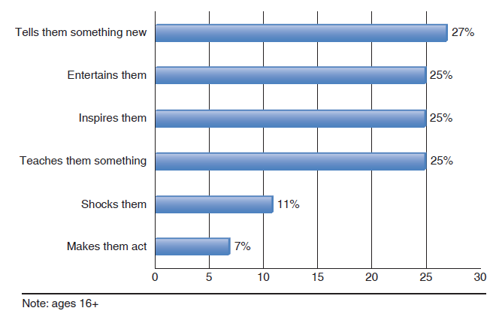
Content That Captivates
Notes:
The chart shows the percentage of respondents that reported each of the attributes helped them remember branded content (Internet users in the U.K.)

Slide 33
Learning Objective 5.6
5.6 To understand cognitive learning as a form of consumer decision-making.
Notes:
Cognitive learning is the systematic evaluation of information and alternatives needed to solve a recognized but unfilled need or unsolved problem. Unlike behavioral learning, which consists of instinctive responses to stimuli, cognitive learning involves deliberate mental processing of information.

Slide 34
Cognitive Learning (2 of 2)
Defined
The premise that learning occurs in the form of sequential, mental processing of information when people face problems they wish to resolve.
Notes:
Cognitive learning occurs when a person has a goal and must search for and process data in order to make a decision or solve a problem. For a long time, consumer researchers believed that all consumers passed through a complex series of mental and behavioral stages in arriving at a purchase decision. These stages ranged from awareness of the purchase options (exposure to information), to evaluation and preferences regarding the alternatives available, to possibly trying one or more versions of the product, and then buying or not buying it (behavior expressed as adoption or rejection).

Slide 35

Discussion Question
How would the ad influence the behavior of an individual who was engaged in a cognitive learning process?
Figure 5 .11 Cognitive Learning: Crest Pro-Health
Notes:
If a consumer was facing a problem with his/her teeth, looked for a solution, read the ad that indicated the benefits of Crest Pro-Health, used the product, and had less problems, the consumer would have been engaged in a cognitive learning process.

Slide 36
Representations of Cognitive Learning (1 of 2)
Generic States of Cognitive Learning
  Knowledge
  Evaluation
  Behavior
Tri-Component Attitude Model
Definition—All attitudes have three components
  Cognitive
  Affective
  Conative
Aida
Definition—Developed to explain how marketing and selling messages engage consumers
  Attention
  Interest and Desire
  Action
Innovation Adoption
Definition—Developed by Everett Rogers to explain how consumers adopt new products and services
  Awareness
  Interest and Evaluation
  Trial and Adoption
Notes:
All of the models follow the generic three stage model in the upper left corner

Slide 37
Representations of Cognitive Learning (2 of 2)
Innovation Decision-Making
Definition—Revised vversion of Everett Rogers’ consumer adoption process
  Knowledge
  Persuasion
  Decision, Implementation, and Confirmation
Consumer Decision-Making
Definition—The stages consumers pass through when making logical decisions
  Need Recognition
  Search and Evaluation
  Purchase and Post-Purchase Evaluation
Simple Consumer Journey
Definition—The nonlinear circular consumer journal includes a post-purchase stage in which a consumer enters into a relationship with a brand that often plays out on social media
  Consider
  Evaluate
  Buy and Post-Purchase Experience— Enjoy, Advocate, and Bond
Expanded Consumer Journey
Definition—nonlinear consumer journey in which consumers backtrack, skip steps, reject, or opt out at any stage
  Need/Want Recognition, Awareness/ Knowledge, Consider/Examine
  Search/Learn, Like/Trust, Sees Value/ Willing to Pay, Commit/Plan
  Consumer, Satisfaction/Dissatisfaction, Loyal/Repeat Buyer, Engage/Interact, Actively Advocate
Notes:
The consumer journey models take into consideration that consumers can skip steps, go backward, reject or opt out of any stage in the process

Slide 38
Learning Objective 5.7
5.7 To understand the impact of involvement and passive learning on purchase decisions.
Notes:
Consumer involvement is the degree of personal relevance that the product or purchase holds for the consumer. High-involvement purchases are very important to the consumer (e.g., in terms of perceived risk) and thus provoke extensive problem solving and information processing. Low-involvement purchases are not very important, hold little relevance, have little perceived risk, and provoke limited information processing. There are different ways to measure involvement. One study discovered that attractive avatar sales agents were effective in selling to consumers with moderate product involvement, whereas expert avatars were more effective sales agent for products with high involvement levels.

Slide 39
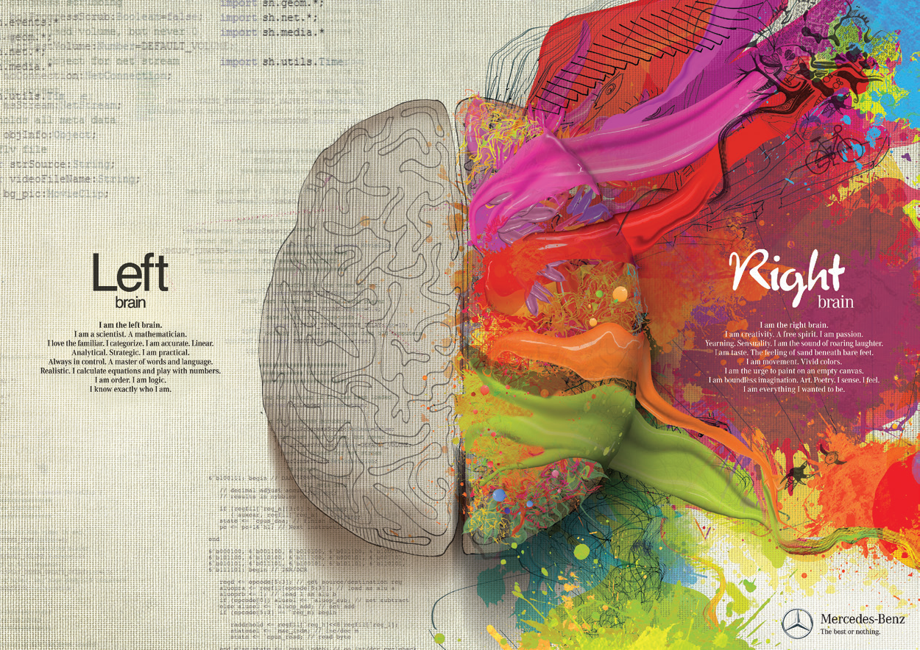
Hemispheric Lateralization
Source: Mercedes-Benz U S A, L L C
Notes:
Hemispheric lateralization (split-brain theory) stems from medical research done in the 1960s; its premise is that the human brain is divided into two distinct cerebral hemispheres that operate together, but “specialize” in processing different types of cognitions. The left hemisphere is the center of human language; it is the linear side of the brain and primarily responsible for reading, speaking, and reasoning. The right hemisphere of the brain is the home of spatial perception and nonverbal concepts; it is nonlinear and the source of imagination and pleasure.
A research suggested that when consumers watch advertising on TV, they “passively” process right brain, pictorial information, but text in print ads were primarily processed using left brain. The researcher considered TV a primarily pictorial medium, and TV viewing as a right brain activity, consisting of passive and holistic processing of images viewed on the screen. He also maintained that TV is a low-involvement medium. Cognitive learning models suggest that behavior follows the cognitive processing of information. Advocates of passive learning maintain that repeated exposure to TV commercials, which is low-involvement information processing, induces purchases prior to consumers’ information processing and the formation of attitudes.

Slide 40
Passive Learning
Defined
A form of learning in which consumers receive information from repeated exposures which is fully processed after a product is purchased
Notes:
Advocates of passive learning suggest low-involvement information processing of things like TV ads can induce purchases prior to consumers’ information processing and the formation of attitudes. The right brain’s passive processing of information is consistent with classical conditioning.

Slide 41
Learning Objective 5.8
5.8 To understand how to measure the outcomes of consumer learning.
Notes:
For marketers, the goals of consumer learning are increased market share and brand-loyal consumers. These goals are interdependent: Brand-loyal customers are the core of a stable and growing market share, and brands with larger market shares have proportionately larger numbers of loyal buyers.

Slide 42
Measures
Aided recall (recognition)
Unaided recall (recall)
How does the Starch Readership Ad Study measure ad effectiveness?
Notes:
Recognition and recall tests measure whether consumers remember seeing an ad and the extent to which they have read it and can recall its content. Recognition tests are based on aided recall, whereas recall tests use unaided recall.
The Starch Readership Ad Study evaluates the effectiveness of magazine advertisements according to three criteria: noticing the ad, associating the ad with the brand advertised, and involvement with the ad (defined as having read most of the ad text). Participants are shown each ad from a magazine issue they read with the brand name concealed—and asked questions that measure recall and recognition of the ad. The study output consists of tagged advertisements, with the tags showing the percentage of readers who have “noticed” each ad, were able to “associate” the ad with the brand advertised, and “read most” of the ad’s copy. Starch also appraises consumers’ intentions to buy and likelihood to engaging in word-of-mouth about the product after reading the ad.

Slide 43
Brand Equity
Defined
The intrinsic value of a brand name. This value stems from the foundations of brand loyalty: the consumer’s perception of the brand’s superiority, the social esteem that using it provides, and the customer’s trust and identification with the brand.
Notes:
The degree of brand loyalty depends on three factors: (1) the consumer’s risk aversion or variety seeking; (2) the brand’s reputation and availability of substitute brands; and (3) social group influences and peers’ recommendations.

