Slide 1
Consumer Behavior
Twelfth Edition, Global Edition
Chapter 2
Market Segmentation and Real-Time Bidding
Copyright © 2019 Pearson Education, Ltd. All Rights Reserved.
Notes:
If this PowerPoint presentation contains mathematical equations, you may need to check that your computer has the following installed:
1) MathType Plugin
2) Math Player (free versions available)
3) NVDA Reader (free versions available)

Slide 2
Learning Objectives
2.1 To understand how to segment markets along demographics, lifestyles, product benefits and usage, and media exposure.
2.2 To understand how to identify, select, and reach target markets.
2.3 To understand real-time bidding as compared with market segmentation.
Notes:
This chapter provides an overview of the interrelationships between market segmentation, targeting and positioning, describes the criteria and bases for identifying and selecting target markets, and concludes with a discussion of real-time bidding, which has implications for market segmentation.

Slide 3
Usage-Occasion Segmentation
Source: Mack’s® is a registered trademark of Mckeon Products, Inc.
Notes:
Marketer’s like Mack’s Earplugs target consumers based on usage occasion. The example is trying to reach beach tourists on spring break.

Slide 4
Learning Objective 2.1
2.1 To understand how to segment markets along demographics, lifestyles, product benefits and usage, and media exposure.
Notes:
Market segmentation is the process of dividing a market into subsets of consumers with common needs or characteristics that are different from those shared by other groups. Targeting consists of selecting the segments that the company views as prospective customers and pursuing them. Positioning is the process by which a company creates a distinct image and identity for its products, services, and brands in consumers’ minds. The image differentiates the company’s offering from competition by communicating to the target audience that the product, service or brand fulfills their needs better than alternatives. This image can be refreshed through product repositioning.

Slide 5
Two Types of Shared Characteristics
Quantitative factors
Consumer-intrinsic
Consumption-based
Cognitive factors
Consumer-intrinsic
Consumption-specific
Notes:
Behavioral data is evidence-based; it can be determined from direct questioning (or observation), categorized using objective and measurable criteria, such as demographics, and consists of:
1. Consumer-intrinsic factors, such as a person’s age, gender, marital status, income, and education.
2. Consumption-based factors, such as the quantity of product purchased, frequency of leisure activities, or frequency of buying a given product.
Cognitive factors are abstracts that “reside” in the consumer’s mind, can be determined only through psychological and attitudinal questioning, and generally have no single, universal definitions. It consists of:
1. Consumer-intrinsic factors, such as personality traits, cultural values, and attitudes towards politics and social issues.
2. Consumption-specific attitudes and preferences, such as the benefits sought in products and attitudes regarding shopping.

Slide 6
Marketers Combine Factors
Demographics determine needs for products
Psychographics explain buyers’ purchase decisions and choices
Notes:
Marketers combine factors that are used to segment audiences. Demographics and psychographics are often used together.

Slide 7
Demographic Segmentation
Age
Gender
Marital Status
Household type and Size
Income and Wealth; Occupation
Geographical location
Notes:
Demographics are the core of almost all segmentation because they are easy and logical. In addition, they are a cost-effective way to reach segments and demographic shifts are easier to identify than other types of shifts. Income, education, and occupation tend to tie together and lead to segmentation based on social class.

Slide 8
Age
Age influences buying priorities
Marketers target age groups
Example: movie studios compete for teens and young adults each summer
Notes:
Consumers of different ages have different needs, so age is important in marketing products and services.

Slide 9
Gender
Gender roles have blurred
Gender less accurate to distinguish among consumers in some product categories than it used to be
Some ads depict mean and women in roles traditionally occupied by the opposite gender
Some products (e.g. skin care and snacks) are marketed differently to men and women
Notes:
Even though firms are increasingly blurring the lines between genders, gender is still used as a way to segment audiences. For example, snacks are packaged differently for women than for men, and men are sold skin care products differently than women.

Slide 10
Households
Family life cycle
Important occasions change consumption patterns
Notes:
Family life cycle blends different things like marital status, the size of the family, age of family members, and employment status of the head of the household into a composite variable. The different target segments across the phases of the family life cycle are discussed more in chapter 10.

Slide 11
Social Standing
Social class
Fluctuations affect marketing
Notes:
Social class divides people into a hierarchy that is related to education, occupation, and income. When there is a recession, it can affect decision making, even among the most affluent consumers.

Slide 12
Ethnicity
Members of the same culture often share the same values, beliefs, and customs.
Marketers may target culturally distinct segments with the same product using different promotional appeals.

Slide 13
Psychographics
Defined
Consumers’ lifestyles, which include consumers’ activities, interests, and opinions
Notes:
Marketers segment consumers based on their lifestyles.

Slide 14
Table 2.1 Psychographic Measures (1 of 2)
Psychographic | Statements
Personal Values* | I have a sense of belonging. I seek fun and enjoyment in life. I am self-fulfilled. Financial security is important to me. My greatest achievements are ahead of me. I am more conventional than experimental. My social status is an important part of my life.
Apparel and Fashion* | I buy clothes I like regardless of current fashion. My friends often ask me for advice on fashion. Men do not notice women who do not dress well.
Notes:
Psychographic variables cover things related to buying habits and ideas about consumption/social issues, leisure activities, and other dimensions.

Slide 15
Table 2.1 Psychographic Measures (2 of 2)
Psychographic | Statements
Gift Giving* | I generally give gifts because people expect me to. I try to give gifts that carry personal messages to recipients. Gifts always communicate love and friendship.
Personal Relationships* | I find it hard to speak in front of a group. When I make friends I always try to make the relationships work. I enjoy making my own decisions. Others usually know what’s best for me.
Buying Online* | It requires too much time to set up accounts with online stores. The look of a website is an important factor in my buying decisions. I tell others about my experiences in buying online.
At Leisure** | Played adult games (e.g., cards or mahjong) Visited art gallery or museum Went hunting or shooting Went to the movies Attended a sporting event
* Responses on a “strongly agree” to “strongly disagree” scale
** Responses indicate the number of times respondents had engaged in the activity during the past 6 months.
Notes:
Psychographics can provide marketers with really descriptive profiles of their target markets. Agreement with statements like the ones on this and the previous slide are used in consumer research.

Slide 16
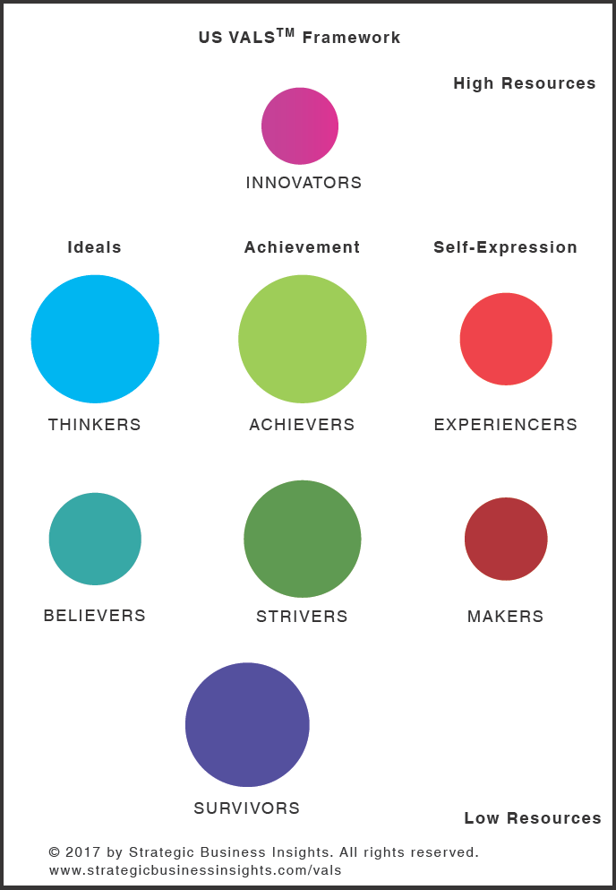
V A L S™
Notes:
VALS™ is a widely used segmentation method. Examining the diagram from left to right, there are three primary motivations: the ideals motivated (these consumer segments are guided by knowledge and principles), the achievement motivated (these consumer segments are looking for products and services that demonstrate success to their peers), and the self-expression motivated (these consumer segments desire social or physical activity, variety, and risk). Furthermore, each of these three major self-motivations represents distinct attitudes, lifestyles, and decision-making styles. Examining the figure from top to bottom, the diagram reveals a kind of continuum in terms of resources and innovation—that is, high resources-high innovation (on the top) to low resources-low innovation (on the bottom). This range of resources/innovation (again, from most to least) includes the range of psychological, physical, demographic, and material means and capacities consumers have to draw upon, including education, income, self-confidence, health, eagerness to buy, and energy level, as well as the consumer’s propensity to try new products.

Slide 17
Geodemographic Segmentation
P R I Z M ®
Location, demographics, and consumer behavior
Lifestage groups
Urbanization and affluence
ConneXions
P $ Y C L E
Notes:
Geodemographic segmentation suggests that where a person lives helps determine his/her consumption behavior.
PRIZM is the geodemographic segmentation system that divides US households into 66 segments using zip codes.
In addition to location, demographics, and consumer behavior, PRIZM examines whether there are children in the household, socioeconomic rank, urbanization, technology adoption, and wealth/income producing assets.

Slide 18
Benefit Segmentation
Benefits sought represent consumer needs
Important for positioning
Source: Campbell Soup Company
Notes:
Benefit segmentation is based on the benefits that consumers seek from products and services. The benefits that consumers look for represent unfilled needs, whereas buyers’ perceptions that a given brand delivers a unique and prominent benefit result in loyalty to that brand. Marketers of personal care products, such as shampoos, soaps, and toothpastes, create different offerings designed to deliver specific benefits.

Slide 19
Expectations of Service Providers
Social Benefits
Recognized/known by staff
Treated in a way that they feel important/friendship
Special Treatment Benefits
Helping when something goes wrong
Receiving priority treatment
Confidence-Related Benefits
Feel confident service will be provided correctly
Clear descriptions of services and what to expect
Notes:
Dentists, hairdressers, travel agents, and financial firms are expected to deliver social benefits, special treatment benefits, and confidence-related benefits.

Slide 20
Product Usage
Usage-rate segmentation (heavy, medium, light)
Lots of competition for heavy users
Notes:
It is generally more profitable to target heavy users, but they can be hard to reach because competitors want to reach them as well.
In addition to usage, marketers also segment consumers based on their awareness, involvement, or usage-occasion.

Slide 21
Learning Objective 2.2
2.2 To understand how to identify, select, and reach target markets.
Notes:
Consumers are different. Differences include needs, wants, desires, backgrounds, education, and experiences.

Slide 22
Airlines Example
Coach
Premium Economy (50% more than coach)
Business Class (2+x Premium Economy)
First Class (3-4x Business)
Notes:
Airlines offer four cabins to segment their target audience based on benefits sought. The features are differentiated for the different alternatives.

Slide 23
Segments Should Be…
Identifiable
Profitable
Reachable
Notes:
Marketers need to be able to distinguish between segments, have enough consumers to target the segment profitably, and be able to communicate with the consumers effectively and economically.
Identifiable - marketers divide consumers into separate segments on the basis of common or shared needs by using demographics, lifestyles, and other factors named “bases for segmentation.” Some segmentation factors (e.g. demographics) are easier to identify than others (e.g. lifestyles).
Reachable – also known as accessible; marketers must be able to communicate with the consumers in the segment effectively and economically.
Profitable – companies must be interested in and have the means to reach the segment(s) they select.

Slide 24
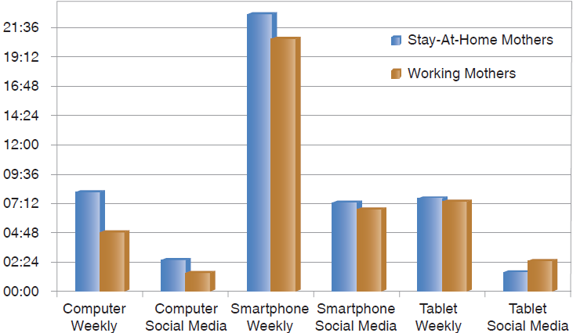
Reachable Market Segments
Notes:
The figure distinguishes between mothers who work outside the home and those who stay at home. Each distinct, reachable segment shows different usage behavior.

Slide 25
Mobile Targeting
Showrooming
Geofencing
Websites are versatile
Notes:
Showrooming is when consumers go to physical retailers to learn about a product but then use their phones to check the price online, and order it for a lower price. Geofencing sends promotions to people who are in the proximity of the location.
Marketers can respond quickly to consumers using online tools.

Slide 26
Learning Objective 2.3
2.3 To understand real-time bidding as compared with market segmentation.
Notes:
Marketers have to persuade their target audiences to choose their products vs. competitive products.

Slide 27
Real-Time Bidding (R T B)
Defined
A technique that allows advertisers to reach the right user in the right place at the right time, which also sets the price advertisers pay per impression or action
Notes:
Impressions are counted when a consumer is reached. Marketers try to customize things to the extent it is possible. A real time bidding operation uses an application programming interface to let people know when an impression is available.

Slide 28
Web Crawlers
Defined
Programs that capture content across the internet and transmit it to the data broker’s servers
Notes:
Web crawlers are used by aggregators, or data brokers.

Slide 29
Predictive Analytics
Defined
Measures that predict consumers’ future purchases on the bases of past buying information and other data, and also evaluate the impact of personalized promotions stemming from the predictions.
Notes:
Predictive analytics focus on noticing change in buying behavior. Behavioral biometrics charts unique patterns in the way people perform different activities. Cookies help websites remember information.

Slide 30
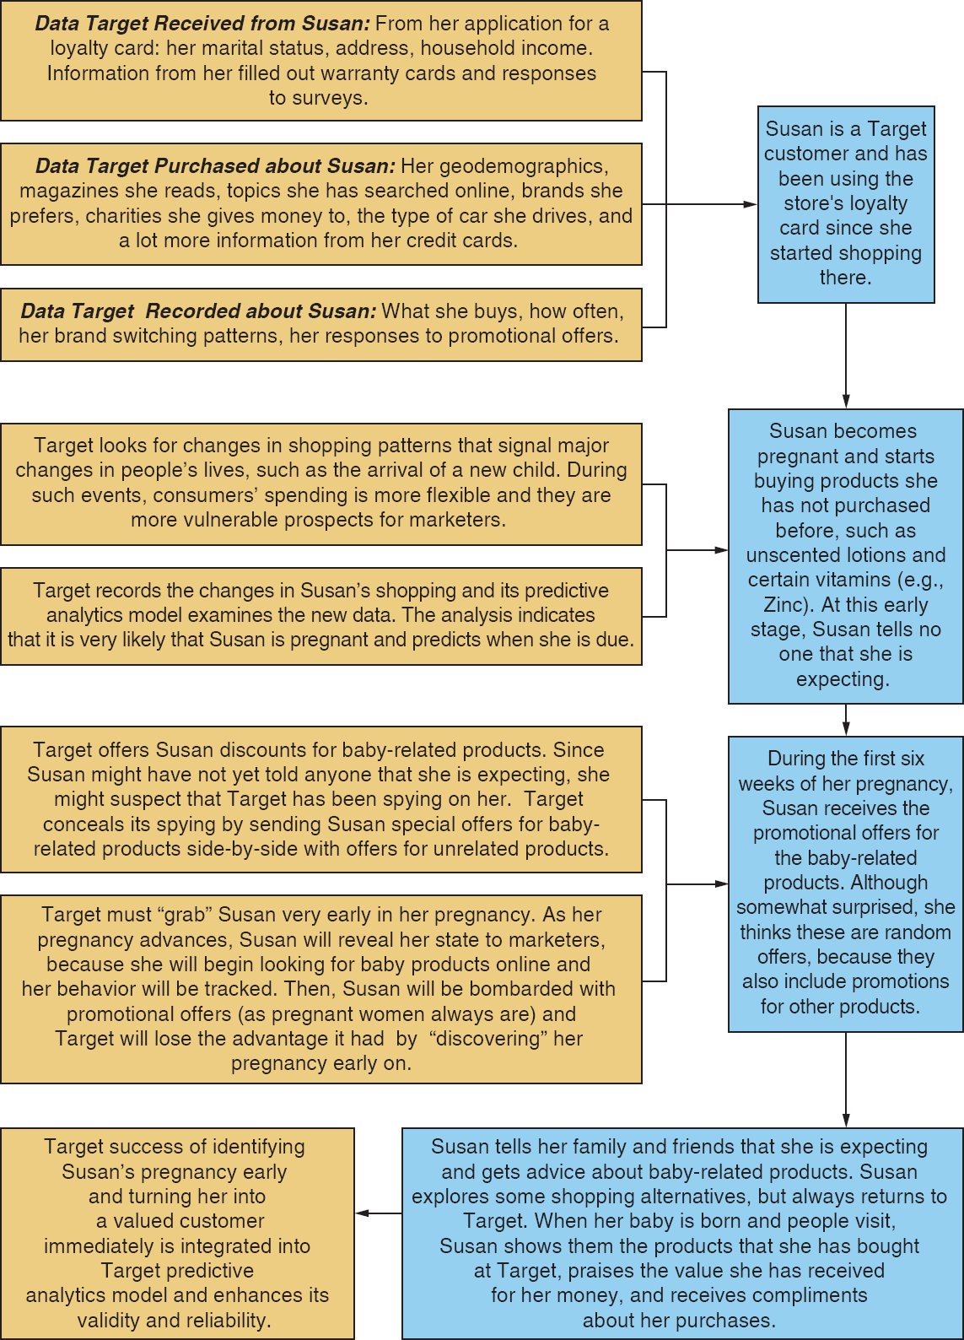
Application: Target
Notes:
Target developed a model that detects changes in women’s buying pattern to identify their pregnancy early on. Figure 2.6 describes how this model was used to market baby-related products to Susan, a hypothetical Target shopper. After Susan started buying several products that she had never bought before, Target’s predictive analytics signaled that these purchases strongly indicate that Susan is expecting a baby. Using this data and a lot of additional information, Target then started sending Susan applicable promotional offers and also took steps to conceal its spying on her.

Slide 31
Ad Exchange
Defined
A big pool of ad impressions – websites – paste their ad impressions into the pool, hoping someone will buy them
Notes:
Outcomes of bidding on ad exchange impressions can be determined in seconds.

