Slide 1
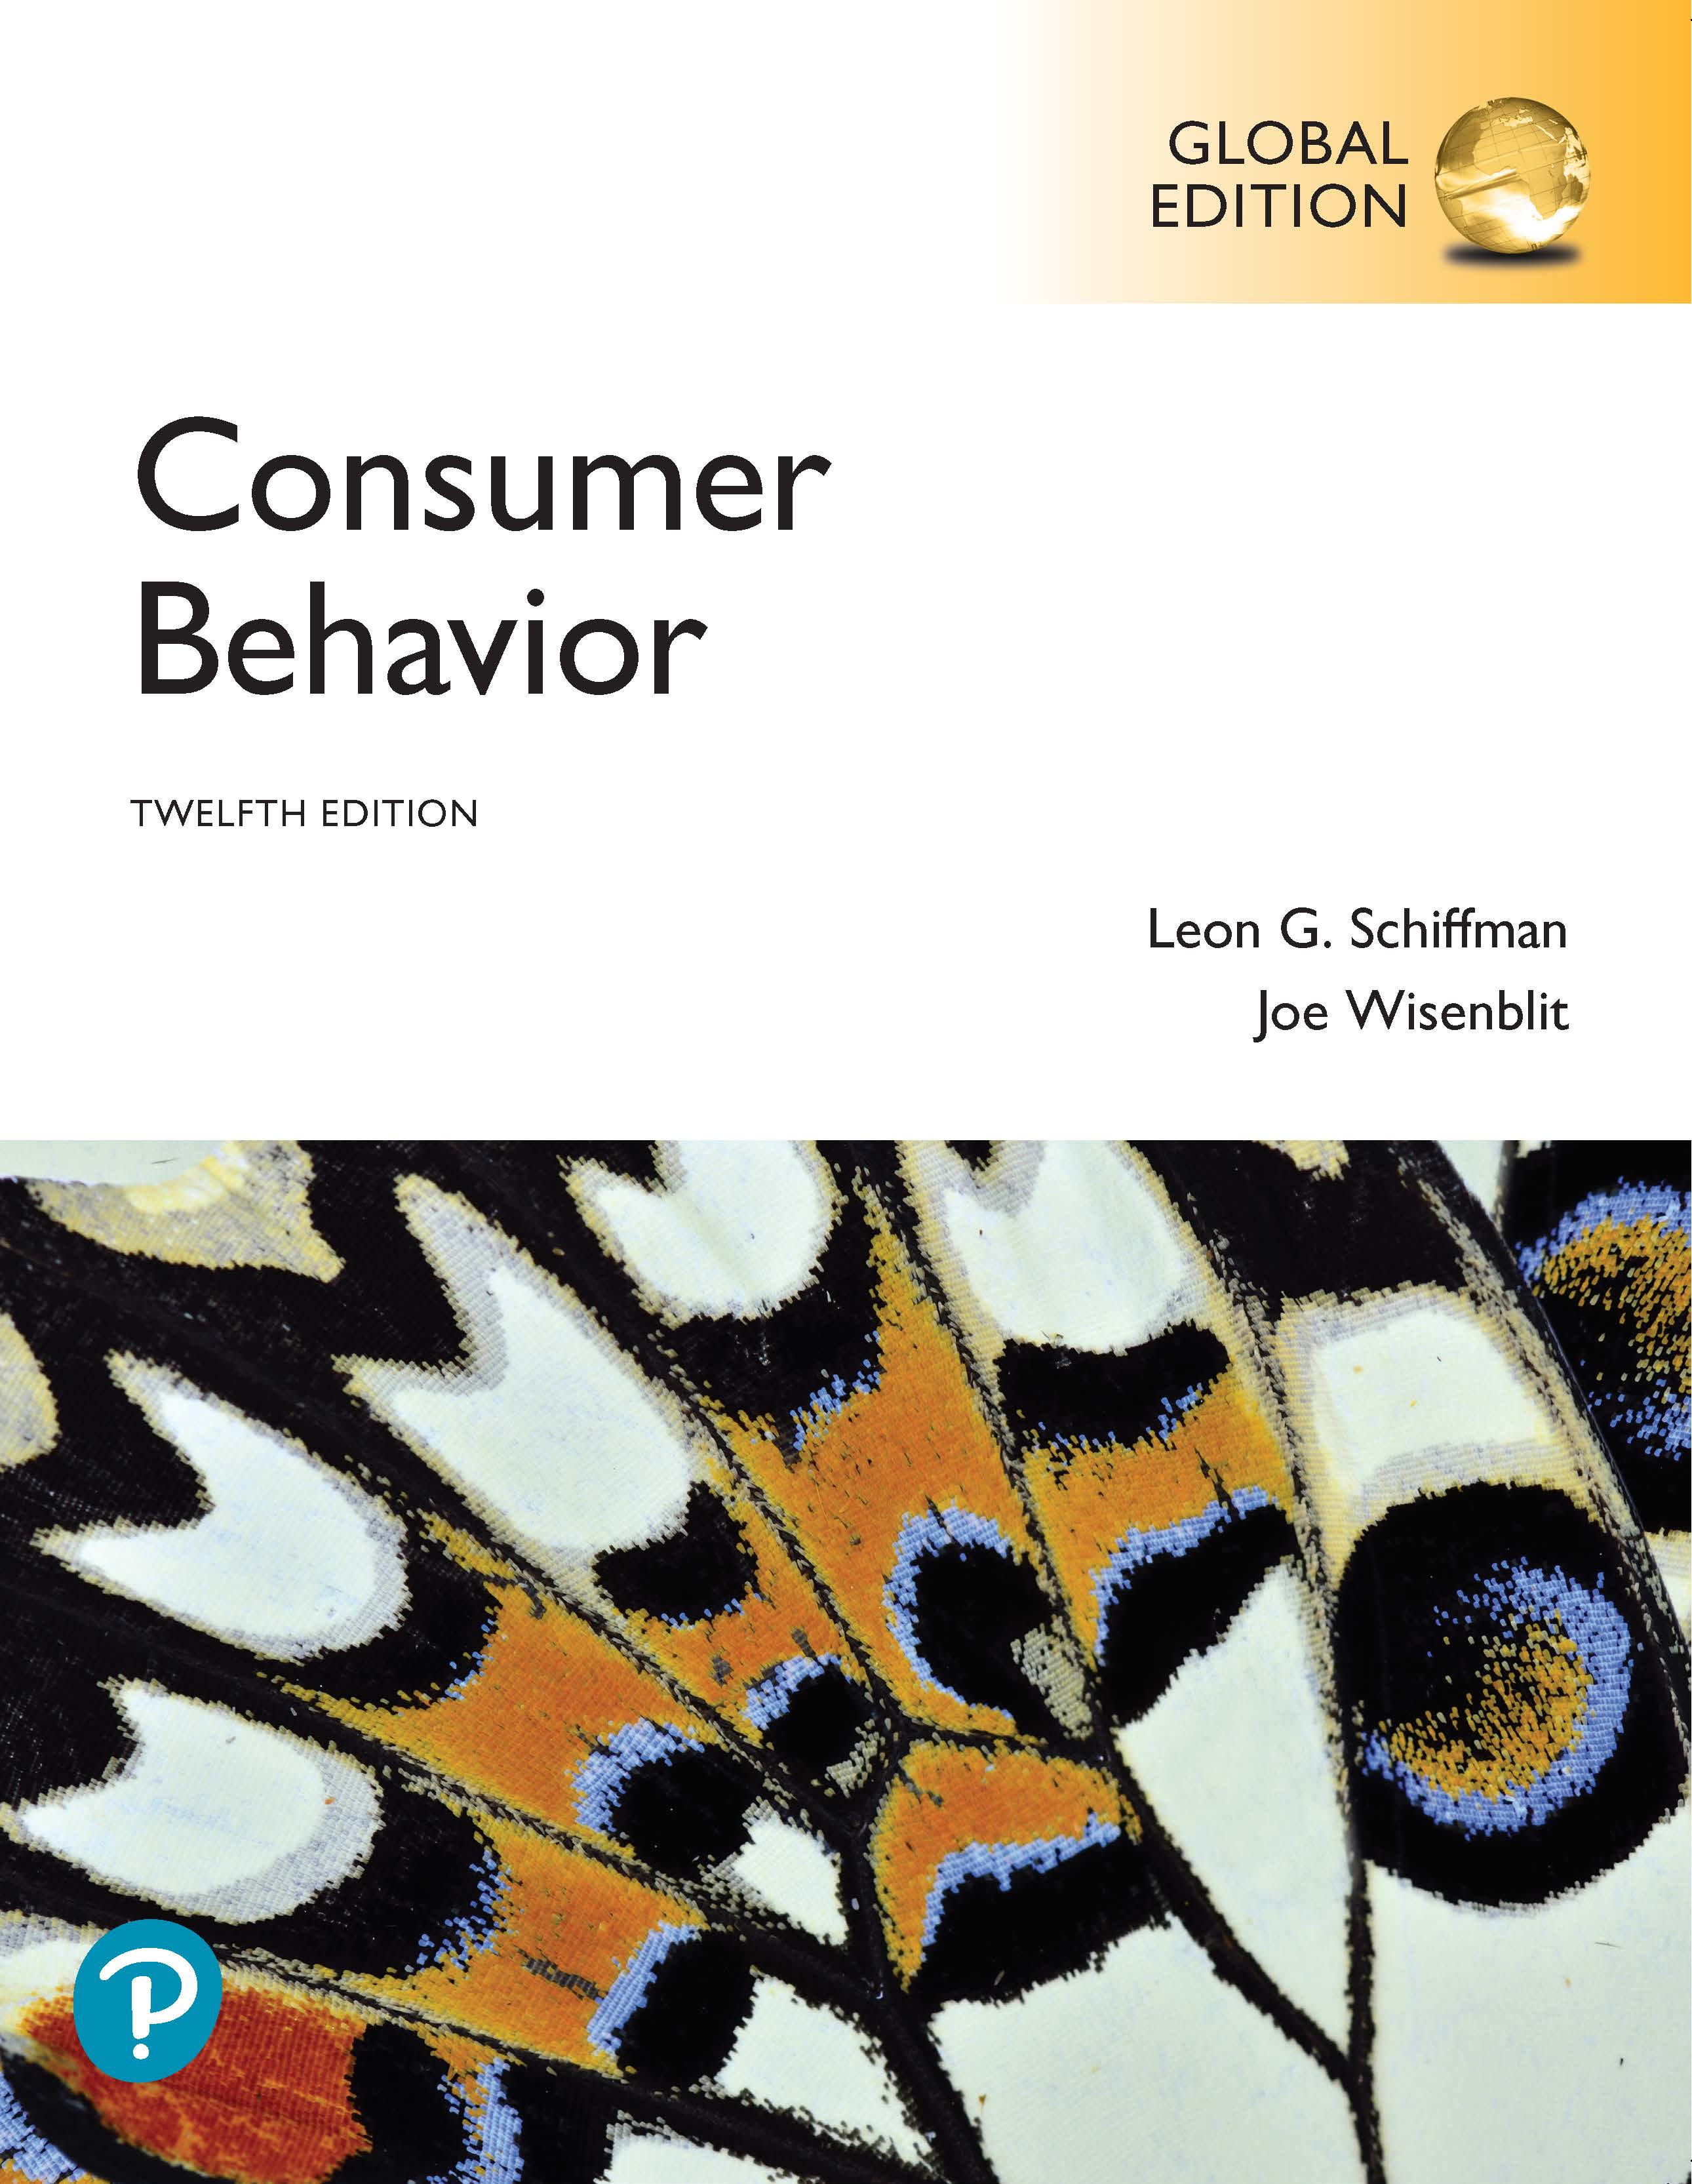
Consumer Behavior
Twelfth Edition, Global Edition
Chapter 1
Consumer Behavior and Technology
Copyright © 2019 Pearson Education, Ltd. All Rights Reserved.
Notes:
If this PowerPoint presentation contains mathematical equations, you may need to check that your computer has the following installed:
1) MathType Plugin
2) Math Player (free versions available)
3) NVDA Reader (free versions available)

Slide 2
Learning Objectives
1.1 To understand the evolution of the marketing concept, what consumer behavior is, and the components of strategic marketing.
1.2 To understand how technology has benefited both marketers and consumers.
1.3 To understand providing value and satisfaction and how technology has enhanced customer loyalty and retention.
1.4 To understand marketers’ social and ethical responsibilities.
1.5 To understand consumer decision-making as the foundation of this book.
1.6 To explain how the knowledge of consumer behavior advances seeking employment after graduation.
Notes:
Chapter 1 describes the evolution of the marketing concept and describes the role of consumer behavior in strategic marketing. It describes technology has benefited marketers and consumers. Afterwards, it explains the interrelationships among customer value and satisfaction and describes how technology can enhance loyalty and retention strategies. It provides an overview of marketers’ social and ethical responsibilities and introduces the consumer decision-making foundation for the rest of the book. Lastly, it explains how knowledge about consumer behavior can benefit individuals who are seeking employment.

Slide 3
Marketing
Defined
Marketing is the activity, set of institutions, and processes for creating, communicating, and delivering offerings that have value for customers, clients, partners, and society.
Notes:
Marketers work to identify unmet or partially satisfied consumer desires so they can create and promote better offerings.

Slide 4
Consumer Behavior
Defined
Consumer behavior is the study of consumers’ choices during searching, evaluating, purchasing, and using products and services that they believe would satisfy their needs.
Notes:
Consumer behavior explains how people spend their money, time, and effort on the offerings from marketers.

Slide 5
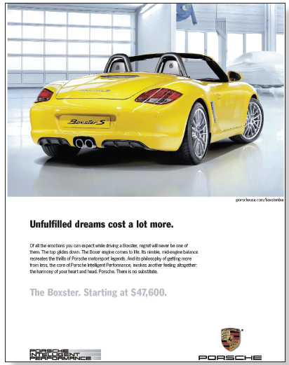
What Can a Car Help Express About its Owner?
Notes:
The car ad shown in Figure 1.1., which appears on the slide above, is used to introduce the idea that although people buy cars because they need personal transportation, the types of cars people choose are determined not by needs alone, but also by how cars express their owners’ characteristics.
The tagline in Porsche’s Boxster ad appeals to prospective owners’ psychology by addressing conflicts about paying for performance, stating that “unfulfilled dreams cost a lot more” and assures them that “of all the emotions you can expect while driving a Boxster, regret will never be one of them.” The ad appeals to unfilled needs and understands what the target audience desires.

Slide 6
Vices and Virtues
Presence of healthy food option “licensed” consumers to eat unhealthy food
Estimated burger calories decreased over 100 calories when accompanied by three celery sticks.
How and why do consumers make decisions based on other factors than facts and rationality?
Notes:
Consumer behavior sometimes defies logic and common sense. The idea that the presence of healthy options justifies unhealthy choices is one example.

Slide 7
Learning Objective 1.1
1.1 To understand the evolution of the marketing concept, what consumer behavior is, and the components of strategic marketing.
Notes:
Consumer behavior is related to the marketing concept. The marketing concept asks marketers to satisfy consumer needs and to focus on offerings consumers are likely to buy.

Slide 8
Marketing Concept
Defined
The premise that marketing consists of satisfying consumers’ needs, creating value, and retaining customers, and that companies must produce only those goods that they have already determined would satisfy consumer needs and meet organizational goals.
Notes:
The marketing concept replaced prior business approaches, including the production concept, the product concept, and the selling concept. It is important to note that marketing is not only concerned with satisfying consumer needs, but also meets organizational goals.

Slide 9
Marketing Concept Application
How does the Vans ad relate to the marketing concept?
Notes:
The ad appeals to couples who want to wear customized shoes that can gratify their desires for affection and uniqueness.

Slide 10
Development of the Marketing Concept
Production Concept
Product Concept
Selling Concept
Marketing Concept
Notes:
The marketing concept was developed over time through three other important business orientations: the production concept, the product concept and the selling concept. Under the production concept, marketers focus on product availability at low prices. The implicit marketing objectives are cheap, efficient production and intensive distribution, not product variations. The product concept assumes that consumers will buy the product that offers them the highest quality, the best performance, and the most features. The focus on the product rather than the needs of the market is known as marketing myopia. The selling concept creates a focus on selling the products that the marketer has decided to produce. The selling concept assumes that consumers are unlikely to buy the product unless they are aggressively persuaded to do so – and the approach does not consider customer satisfaction or customer retention.

Slide 11
Marketing Myopia
Short-sighted approach where companies “look in the mirror instead of out the window”
In other words, managers focus on the product, not the needs it is designed to fulfill
Notes:
An example of myopia was when Apple failed to allow its users to share software. It lost market share to Microsoft, which was more focused on the user experience at the time.

Slide 12
Marketing Concept Requirements
Market Segmentation
Targeting
Positioning
The Marketing Mix (4 Ps)
Product or service
Price
Place
Promotion
Notes:
Humans share common biological needs, but they develop psychological needs through their upbringing, the environment, culture, education, and life experiences. Marketers perform segmentation by looking for groups with common needs. When a marketer chooses the segments that they will pursue, they have chosen a target market. Selection of the correct target market is critical to success of the product since the marketer has assumed that this group of consumers has a similar need with respect to their product or service and they will respond similarly to marketing action. Positioning is how the consumer thinks about a marketer’s product versus the competitor’s product. The marketing mix includes 4 Ps: 1. Product or service: The features, designs, brands, and packaging offered, along with post-purchase benefits such as warranties and return policies. 2. Price: The list price, including discounts, allowances, and payment methods. 3. Place: The distribution of the product or service through stores and other outlets. 4. Promotion: The advertising, sales promotion, public relations, and sales efforts designed to build awareness of and demand for the product or service.

Slide 13
Learning Objective 1.2
1.2 To understand how technology has benefited both marketers and consumers.
Notes:
Marketers provide value to consumers in the form of information, including opportunities to customize products easily and entertainment content. Marketers are investing to improve digital sites, increase social media activity, and they are switching resources from traditional to digital media.

Slide 14
Value Exchange
Technologies create a value exchange
Technology makes it easier to shop and access information, entertainment, and customized products
Consumers pay for content with information about themselves
Notes:
Consumers exchange information about themselves for value gained from technology, including efficient shopping, quicker access to information, and the ability to buy customized products.

Slide 15
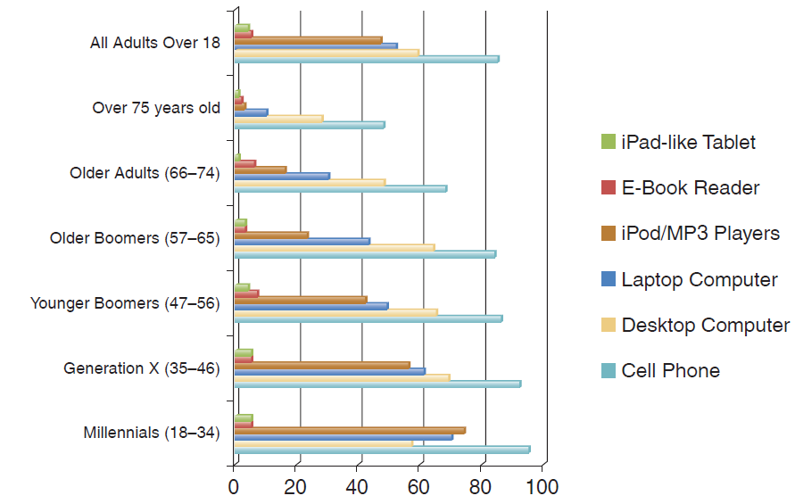
Consumers Have Embraced Technology
Notes:
Figure 1.3 illustrates that across age groups, most Americans own technological gadgets.

Slide 16
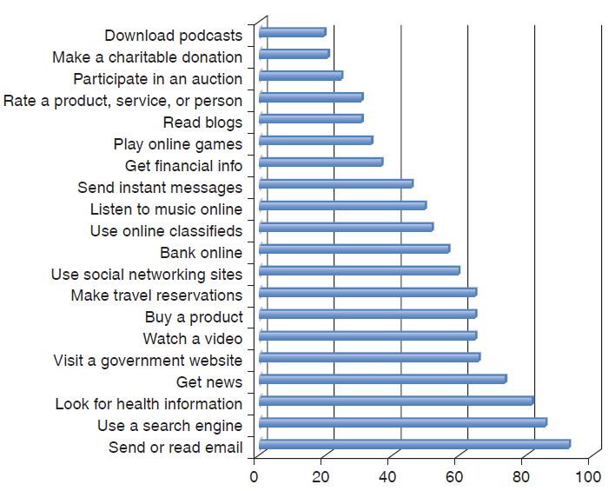
Most Prominent Online Activities
Notes:
Figure 1.4 shows the popularity of different online activities.

Slide 17
More Precise Targeting
Cookies
Global Positioning Systems (G P S)
Selfies
Interactive communications
Notes:
Websites track who is interested in what through “cookies” (invisible bits of code stored on Web pages). Marketers also use GPS and selfies to learn about consumer habits. Consumers also have access to better information, and can compare products. Marketers try to reach the right customer with the right message at the right time using individualized targeting.

Slide 18
Cross-Screen Marketing
Defined
A promotional strategy that consists of tracking and targeting users across their computers, mobile phones, and tablets, and sending them personalized ads based on their interests, as observed by marketers.
Notes:
Advertisers can “push” ads to mobile phones based on the interests that people expressed while surfing online. It is important to use multiple channels to reach the consumer because they are often dividing their attention across more than one type of media at the same time.

Slide 19
Discussion Question
How does technology affect the Marketing Mix?
Provide examples
Interactive and novel communication channels
Customizing products and promotional messages
Better prices and distribution
Notes:
Electronic communications enable a two-way interactive exchange in which consumers instantly react to marketers’ messages. Consumers are designing ads and advertisers are using product placements since consumers can skip or avoid ads. Marketers are also attempting to use cross-screen marketing, which consists of tracking and targeting users across their computers, mobile phones, and tablets.
Companies use technology to customize products. Product customization requires that customers clearly understand their preferences and express them, and “high involvement” products (i.e., infrequently purchased and pricey items) represent the best prospects for customization. Companies can also customize promotional messages based on past purchases and/or search behavior.
The Internet allows consumers to compare prices more efficiently, improves distribution and customer service.

Slide 20
Learning Objective 1.3
1.3 To understand providing value and satisfaction and how technology has enhanced customer loyalty and retention.
Notes:
Consumers see the value of the benefits associated with the product exceed the cost of the product – the cost in terms of money, time, and opportunity costs.
If a product delivers value, the company is likely to have a high level of customer satisfaction. They will tell others about the product and speak highly of it when asked or when reviewing the product online. A company with strong customer relationships will be able to achieve a high level of customer retention – their customers will not defect to the competitor or stop using their product. They will retain these customer over time and will be more profitable due to these valuable loyal customers.

Slide 21
Successful Relationships (1 of 3)
Value, Satisfaction, and Retention
Customer Value
Customer Satisfaction
Customer Retention
Defined as the ratio between the customer’s perceived benefits and the resources used to obtain those benefits
Perceived value is relative and subjective
Developing a value proposition is critical
Notes:
It is best to think of value as the consumers’ perception of what they gained vs. what they gave up to purchase a product or use a service. Marketers are developing value propositions which are statements of the value their product offers to consumers. If the value propositions are clear and applicable to the consumer, they will understand the strength of the product benefits.

Slide 22
Discussion Questions
How does McDonald’s create value for the consumer?
How do they communicate this value?
Notes:
They create bundled meals and dollar menus to create value for price-conscious consumers. In addition, they create value to the health-conscious consumer by offering salads, fruit, and healthy options for Happy Meals.
They communicate this value through television ads, in-store signage, and their website.

Slide 23
Successful Relationships (2 of 3)
Value, Satisfaction, and Retention
Customer Value
Customer Satisfaction
Customer Retention
The individual's perception of the performance of the product or service in relation to his or her expectations.
Customer groups based on loyalty include loyalists, apostles, defectors, terrorists, hostages, and mercenaries
Notes:
It is important to understand the role of customer expectations in customer satisfaction. If you fall below the consumer's expectations, then the consumer is not satisfied, but if you exceed expectations then you can create “customer delight.”
When customers are highly satisfied, they can become loyalists who continue to purchase or apostles, who provide very positive word-of-mouth. When customers are disappointed, they can become defectors and move to the competition or terrorists, who spread negative word-of-mouth. Some dissatisfied customers become hostages and stay with the company but are very unhappy. Mercenaries are satisfied but are not really considered loyal and will move from company to company.

Slide 24
Successful Relationships (3 of 3)
Value, Satisfaction, and Retention
Customer Value
Customer Satisfaction
Customer Retention
The objective of providing value is to retain highly satisfied customers.
Loyal customers are key
They buy more products
They are less price sensitive
Servicing them is cheaper
They spread positive word of mouth
Notes:
Customer retention is an important strategy to all marketers. The goal is to make customers stay with your company and generate positive word of mouth about your service and products. The Internet and cell phones have helped marketers maintain closer relations with their consumers and have opened easier channels for the customer to contact the company if they have questions, problems, or suggestions.
Loyal customers buy more products and constitute a ready-made market for new models of existing products as well as new ones, and also represent an opportunity for cross-selling.
Long-term customers who are thoroughly familiar with the company’s products are an important asset when new products and services are developed and tested.
Loyal customers are less price-sensitive and pay less attention to competitors’ advertising. Thus, they make it harder for competitors to enter markets.
Servicing existing customers, who are familiar with the firm’s offerings and processes, is cheaper. It is expensive to “train” new customers and get them acquainted with a seller’s processes and policies. The cost of acquisition occurs only at the beginning of a relationship, so the longer the relationship, the lower the amortized cost.
Loyal customers spread positive word-of-mouth and refer other customers.
Marketing efforts aimed at attracting new customers are expensive; indeed, in saturated markets, it may be impossible to find new customers. Low customer turnover is correlated with higher profits.
Increased customer retention and loyalty make the employees’ jobs easier and more satisfying. In turn, happy employees feed back into higher customer satisfaction by providing good service and customer support systems.

Slide 25
Customer Relationships
For Discussion:
Provide two examples where brands used technology to engage consumers/enhance customer relationships.
Provide two examples where technology was used to add value to the consumer.
Notes:
Marketers try to engage consumers using technology. One example is Apple’s iTunes, which has a large software selection for editing and posting content online. Marketers also engage with consumers using social media.

Slide 26
Forms of Engagement
Emotional Bonds
Personal commitment and attachment
Social media attempts to get consumers to engage emotionally with products and brands
Transactional Bonds
Mechanics and structures that facilitate exchanges between consumers and sellers
Factors like assortment and transaction ease could shape the relationship
Notes:
Because emotional bonds represent a customer’s high level of personal commitment and attachment to the company, savvy marketers seek emotional bonds with consumers. Transactional bonds are the mechanics and structures that facilitate exchanges between consumers and sellers.

Slide 27
Determinants of Site Satisfaction
Adaptation
Interactivity
Nurturing
Commitment
Network
Assortment
Transaction ease
Engagement
Loyalty
Inertia
Trust
Notes:
Adaptation measures whether purchase recommendations match customer’s needs; the ability to order tailor-made products; personalized advertisements and promotions; and whether the consumer feels unique and valued. Interactivity measures whether the consumer can view merchandise offerings from different perspectives; use a search tool to locate products; make comparisons easy; and gain useful information. Nurturing measures whether the consumer receives reminders about making purchases; provides relevant information for purchases; acknowledges appreciation; makes an effort to increase business with the customer; and cultivates a relationship with the customer. Commitment measures whether the company delivers goods on time; responds to complaints; has customer-friendly return policies; and takes good care of customers. Network measures whether customers can share experiences about their product purchases on the merchant’s website; whether the network is useful for sharing experiences; and whether shoppers benefit from the community of prospects and customers sponsored by the merchant. Assortment measures depth and breadth of offerings, or whether the merchant has a wide assortment/selection.
Transaction ease measures the intuitiveness of navigation; the ability to make a purchase for the first time without help; and whether the site enables quick transactions. Engagement measures whether the site design is attractive and whether shopping is enjoyable at the site. It also reflects whether the site is inviting and whether the consumer feels comfortable shopping at the site. Loyalty measures switching consideration; whether the consumer clicks on merchant’s site whenever needing to make a purchase; whether the consumer likes to navigate the site; and whether the site is from the favorite merchant with which to do business. Inertia measures whether changing to a new merchant would not be worth the bother unless the consumer is really dissatisfied; whether the consumer finds it difficult to stop shopping at the site; and whether the consumer feels that the cost in time, money, and effort to change merchants are high. Finally, trust measures whether the consumer feels s/he can count on the merchant to complete purchase transactions successfully; whether the consumer trusts the site’s performance; and whether the consumer believes that the merchant is reliable and honest.

Slide 28
Profitability-Focused Segmentation
Miles Travelled Annually and Matching Revenues
Airplane’s Class and Matching Revenues per Mile | At least 250,000 Miles | At least 150,000 miles | At least 100,000 miles
First Class ($ 4 per mile) | $ 1,000,000 DIAMOND | $ 600,000 EMERALD | $ 400,000 EMERALD
Business Class ($ 2 per mile) | $ 500,000 EMERALD | $ 300,000 SAPPHIRE | $ 200,000 SAPPHIRE
Premium Economy ($ 0.6 per mile) | $ 150,000 ELITE | $ 90,000 SELECT | $ 60,000 SELECT
Economy ($ 0.3 per mile) | $ 75,000 SELECT | $ 45,000 | $ 30,000
Notes:
The figures in the right column show how much money the airline makes per mile in each of its four service classes. The top row represents the number of miles travelled by a given customer. The twelve cells represent the airline’s revenue from a given customer based on the amount of miles the customer travelled and the class in which he or she travelled.

Slide 29
Measures of Customer Retention
Customer valuation
Retention rates
Analyzing defections
Notes:
Customer valuation categorizes customers according to their financial and strategic worth so that the company can decide where to invest for deeper relationships and determine which relationships should be served differently or even terminated.
Retention rates examine the percentage of customers at the beginning of the year who are still customers by the end of the year. Companies can use this ratio to make comparisons between products, between market segments, and over time.
Analyzing defections should look for the root causes, not mere symptoms.

Slide 30
Review Question
What is the difference between emotional and transactional bonds?
Identify and describe four of the eleven determinants of customer satisfaction with online merchants. Characterize each selected determinant as primarily driven by emotion or stemming from the mechanics of the transaction.
Notes:
Emotional bonds represent a customer’s high level of personal commitment and attachment to the company. Transactional bonds are the mechanics and structures that facilitate exchanges between consumers and sellers.
The eleven determinants are:
1. Adaptation: The merchant’s purchase recommendations match one’s needs; one is enabled to order products that are tailor-made; personalized advertisements and promotions; feeling like a unique and valued customer. (emotional)
2. Interactivity: Ability to view merchandise offerings from different perspectives; search tool that enables one to quickly locate products; having tools that make comparisons easy; useful information. (transactional)
3. Nurturing: Receiving reminders about making purchases; providing relevant information for one’s purchases; acknowledgment of appreciating one’s business; making an effort to increase business with the customer; cultivating a relationship with the customer. (emotional)
4. Commitment: Delivering goods on time; responding to problems encountered; customer friendly return policies; taking good care of customers. (emotional and transactional)
5. Network: Customers sharing experiences about their product purchases on the merchant’s website; useful network for sharing experiences; shoppers benefit from the community of prospects and customers sponsored by the merchant. (emotional)
6. Assortment: Merchant provides “one-stop shopping” for most online purchases; site satisfies shopping needs; merchant carries wide assortment and selection of products. (transactional)
7. Transaction ease: Merchant’s website can be navigated intuitively; a first-time buyer is able to make a purchase without much help; site is user-friendly and enables quick transactions. (transactional)
8. Engagement: The merchant’s site design is attractive; enjoyable shopping at the site; feel that the site is inviting; feel comfortable shopping at the site. (emotional)
9. Loyalty: Seldom consider switching to another merchant; usually click on the merchant’s site whenever needing to make a purchase; like to navigate the site; one’s favorite merchant to do business with. (emotional and transactional)
10. Inertia: Unless becoming very dissatisfied, changing to a new merchant would not be worth the bother; finding it difficult to stop shopping at the site; feeling that the cost in time, money, and effort to change merchants is high. (transactional)
11. Trust: Counting on the merchant to complete purchase transactions successfully; trusting the site’s performance; feeling that the merchant is reliable and honest. (emotional)

Slide 31
Learning Objective 1.4
1.4 To understand marketers social and ethical responsibilities.
Notes:
Because almost all companies prosper when society prospers, marketers would be better off if they integrated social responsibility into their marketing strategies.

Slide 32
Social Responsibility
Companies incorporate social goals into their mission statements
Marketing ethics and social responsibility can shape organizational effectiveness
Socially responsible activities improve image among stakeholders
Notes:
In addition to companies trying to do the right thing, regulatory agencies and not-for-profit advocacy groups work to advance causes that are ethically and morally right.

Slide 33
Learning Objective 1.5
1.5 To understand consumer decision-making as the foundation for this book.
Notes:
Consumer behavior stems from four disciplines. Psychology is the study of the human mind and the mental factors that affect behavior (i.e., needs, personality traits, perception, learned experiences, and attitudes). Sociology is the study of the development, structure, functioning, and problems of human society (the most prominent social groups are family, peers, and social class). Anthropology compares human societies’ culture and development (e.g., cultural values and subcultures). Communication is the process of imparting or exchanging information (including media and persuasive strategies).

Slide 34
Consumer Decision Making (1 of 2)
Inputs
Firm marketing efforts
Sociocultural influences
Process
Psychological factors
Need Recognition, Decision Type, Prepurchase Search, Evaluation of Alternatives
Learning
Outputs
Purchase
Post-purchase evaluation
Notes:
The input stage of consumer decision-making includes two influencing factors: the firm’s marketing efforts (i.e., the product, its price and promotion, and where it is sold) and sociocultural influences (i.e., family, friends, neighbors, social class, and cultural and subcultural entities).
The process stage focuses on how consumers make decisions. The psychological factors (i.e., motivation, perception, learning, personality, and attitudes) affect how the external inputs from the input stage influence the consumer’s recognition of a need, prepurchase search for information, and
evaluation of alternatives. The experience gained through evaluation of alternatives, in turn, affects the consumer’s existing psychological attributes.
The output stage consists of two post-decision activities: purchase behavior and post-purchase evaluation.

Slide 35
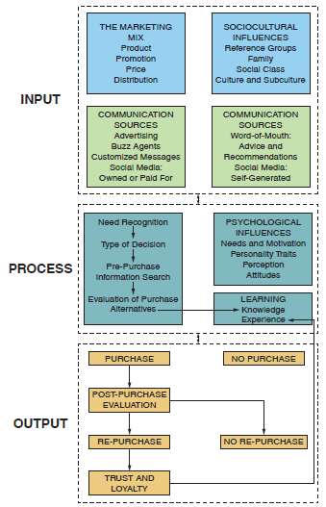
Consumer Decision Making (2 of 2)
Notes:
The diagram summarizes the process of consumer decision making, which includes three components: the input, process, and output stages of decision-making

Slide 36
Learning Objective 1.6
1.6 To explain how knowledge of consumer behavior advances seeking employment after graduation.

Slide 37
Employment Opportunities
Brand management
Advertising
Consumer research
Notes:
Brand management is the process of maintaining, improving, and upholding a brand so that it is clearly differentiated from other offerings in the same product category. Studying consumer behavior prepares students for becoming copy writers, planning and implementing advertising strategies, measuring the effectiveness of advertising campaigns and, if necessary, redesign promotional message to make them more persuasive. Consumer research refers to the process and tools used to study consumer behavior

