Slide 1
Laboratory Safety
The Responsibility is YOURS!

Slide 2
What are Hazardous Chemicals?
Hazardous chemicals are any products or materials that present any physical or health hazards when used.
any chemicals (including a tape water) should be considered as a hazardous chemical and you must wear gloves and lab coat at all times.

Slide 3
Personal Safety
Clothing
Wear:
Gloves
Long lab coat
Goggles/safety glasses
Closed-toed shoes
Tie back long hair
Do NOT Wear:
Sandals
Jewelry
Loose or
Baggy clothing
Contact lenses

Slide 4
Types of Gloves
Vinyl Gloves
Latex Gloves
Used with diluted solutions of acids and bases, can be used with Acetone but not with most organic components.
Not to be used with chemicals or flame, used only to handle food and house hold.

Slide 5
Types of gloves
Butyl gloves
Neoprene gloves
Best to deal with alcohol, acids and Acetonitrile but not with solvents that has Chlore
It has a very high endurance, fit to deal with oxidizing substances, resistant to leakage and water vapor

Slide 6
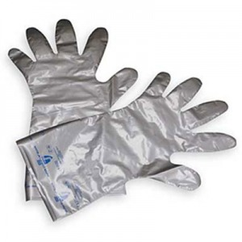
Types of gloves
Nitrite gloves
Silver shield gloves
Used for most chemicals especially DMSO but it does not fit with aldehydes, nitro compounds, and Isocyanates.
The best types of gloves, suitable for the prevention of most types of chemicals and general risks

Slide 7
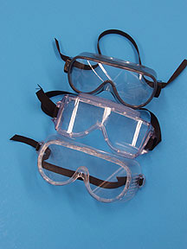
Lab Safety Equipment
Safety Goggles
Eye Wash
Eyelids must be forcibly kept open and washed for a minimum of 20 minutes

Slide 8
Lab Safety Equipment
Fire
Extinguisher
Fire Blanket

Slide 9
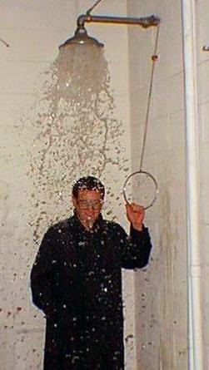
Safety Shower
The safety shower is used primarily when large amounts of chemicals have been splashed onto the skin or clothing.
The safety shower may be used in the case of a body on fire, but a fire blanket should be used if possible.
IF the safety shower should ever be used, the person affected will need to remove all clothing including shoes and jewellery. As such, all other persons should evacuate the room – to get help, and to allow for privacy.

Slide 10
Lab Safety Symbols
Glassware
Heat
Eye and Face
Sharps
Electrical
Animal
Chemical
Fire

Slide 11
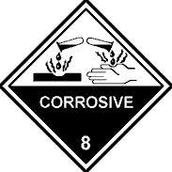
Other Chemical Hazards and Symbols
Flammable
Explosive
Toxic/Poison
Irritant
Corrosive
Environmental

Slide 12
Chemical Hazard Symbols and Definitions
Flammable – Any substance that will burn if exposed to an open flame.
Explosive – A substance that may explode if exposed to heat or flame.

Slide 13
Chemical Hazard Symbols and Definitions
Toxic/Poison – A substance that can lead to death if inhaled, ingested, or absorbed by the skin.
Corrosive – A substance that can destroy or burn living tissue and can eat away at other materials.

Slide 14
Chemical Hazard Symbols and Definitions
Irritant - A substance that causes inflammation upon contact with skin or mucous membranes.
Environmental - Substances that are harmful to the environment. They must be disposed of properly, not washed down the drain.

Slide 15
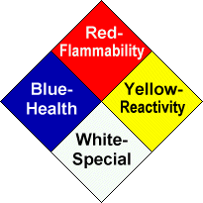
Hazardous Materials Identification System NFPA 704 (Fire Diamond)
NFPA 704 is a standard maintained by the U.S.-based National Fire Protection Association. It defines the colloquial "fire diamond" used by emergency personnel to quickly and easily identify the risks posed by nearby hazardous materials. This is necessary to help determine what, if any, special equipment should be used, procedures followed, or precautions taken during the first moments of an emergency response.

Slide 16
The diamond is broken into four sections.
Numbers in the three colored sections range
from 0 (least severe hazard) to 4 (most severe
hazard).
The fourth (white) section is left blank
and is used only to denote special fire fighting
measures/hazards.

Slide 17
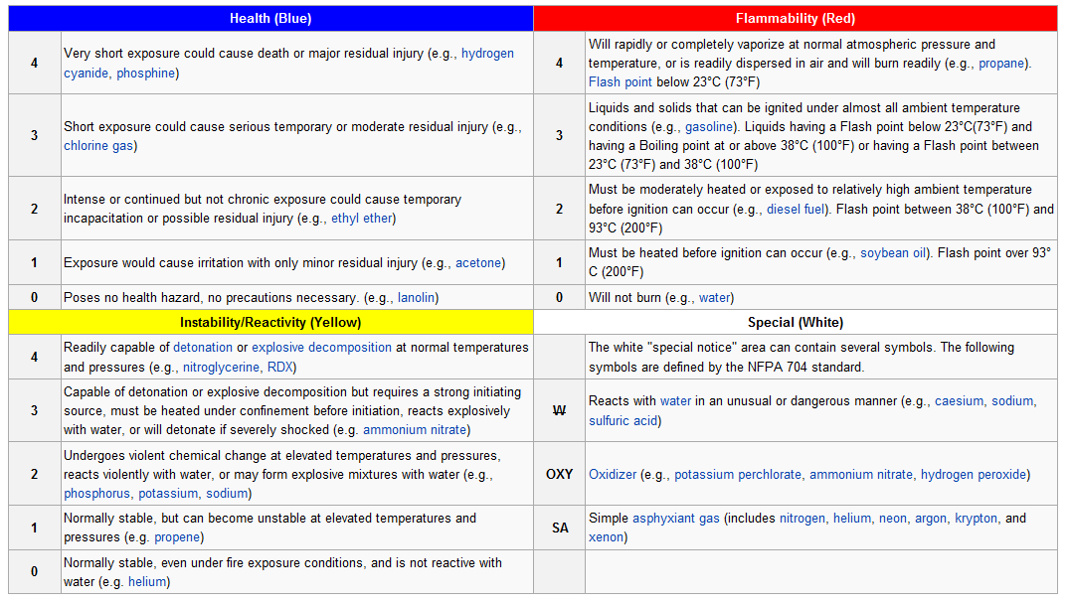
Hazardous Materials Identification System (Fire Diamond)

Slide 18
Hazardous Materials Identification System (Fire Diamond)

Slide 19
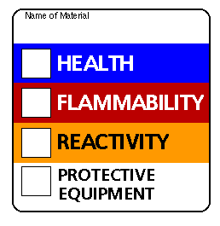
Hazardous Materials Identification System (Color Bar)

Slide 20
Waste Disposal
First ask your teacher where/how to dispose of waste.
Never pour anything down the drain unless you are told to do so.
A waste bottle will be supplied for substance that cannot go down the drain

Slide 21
Reasons for proper waste disposal
- Hazardous chemicals down the drain can lead to pollution of ground water, lakes, rivers, etc.
- Plants and animals will die if they are exposed to hazardous chemical waste.
- Serious health problems will become present in people if hazardous waste finds its way into drinking water.

Slide 22
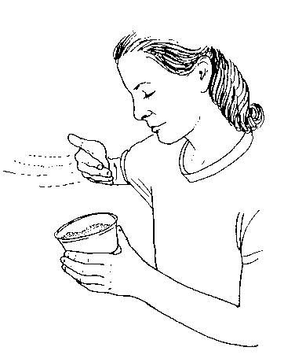
Teachers & Students should protect their:
Nose by smelling substances by wafting
Eyes with goggles
Hands with gloves
Feet with closed shoes

Slide 23
Thank you

