Slide 1
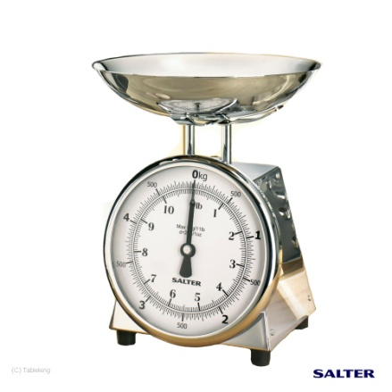
Revision
Calculate the porosity and the oil saturation
5cm
4cm
3cm
Dry sample= 20gm
Oil = 50 °API
Oil wet Wt = 24gm
Water= 10 °API
Weight = 27gm
Oil = 50 °API
Weight = 27gm

