Slide 1
Representing Boolean Functions
Sum-of-products Expansions

Slide 2
Literal & Minterm
DEFINITION 1

Slide 3
EXAMPLE 2
Find a minterm that equals 1
if x₁=x₃=0 and x₂=x₄=x₅=1, and equals 0 otherwise
Solution:

Slide 4
Sum-of-products Expansions
The sum of minterms that represents the function is called the sum-of-products expansion or the disjunctive normal form of the Boolean function.

Slide 5
EXAMPLE 3
Solution:

Slide 6
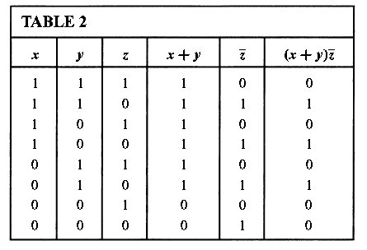
Second, we can construct the sum-of-products expansion by determining the values of F for all possible values of the variables x, y, and z. These values are found in Table 2.
The sum-of products expansion of F is the Boolean sum of three minterms corresponding to the three rows of this table that give the value 1 for the function. This gives

Slide 7
Functional Completeness
Every Boolean function can be expressed as a Boolean sum of minterms.
Each minterm is the Boolean product of Boolean variables or their complements.
This shows that every Boolean function can be represented using the Boolean operators . , +, and -.
Because every Boolean function can be represented using these operators we say that the set { . , +, - } is functionally complete.
We can eliminate all Boolean sums using the identity
Similarly, we could eliminate all Boolean products using the identity

Slide 8
Homework
Page 760
1(b,c)
2(a,d)
3(a,d)
7(c)
12(a,c)

