Slide 1
8.1 Relations and Their Properties

Slide 2
The Binary Relation
DEFINITION 1
Let A and B be sets. A binary relation from A to B is a subset of AxB.
In other words, a binary relation from A to B is a set R of ordered pairs where the first element of each ordered pair comes from A and the second element comes from B.
We use the notation a R b to denote that (a, b)ϵR and a R b to denote that (a, b)ɇR.
Moreover, when (a, b)belongs to R, a is said to be related to b by R.

Slide 3
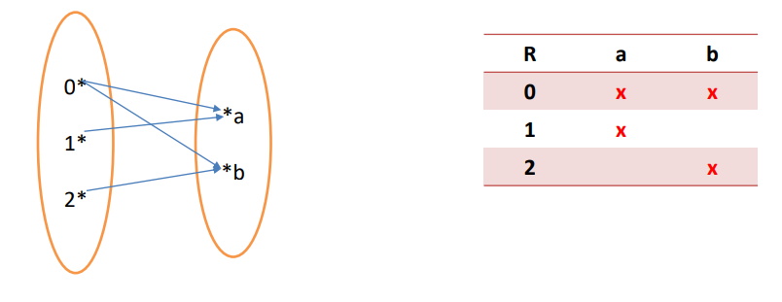
EXAMPLE 1:
Let A = {0,1 , 2} and B = {𝑎, 𝑏} .
Then {(0, 𝑎), (0, 𝑏), (1, 𝑎), (2, 𝑏)} is a relation from A to B .
This means, for instance, that 0Ra , but that 1Rb.

Slide 4
Example 2 :
Let A={1,2,3} and B={4,5,6}
Define R to be a relation from A to B such that:
aRb ↔ a\b.
Write the R as a set of ordered pairs then Find the domain and the range.
Solution:

Slide 5
Functions as Relations
Recall that a function f from a set A to a set B assigns exactly one element of B to each element of A .
• The graph of f is the set of ordered pairs (a , b) such that b = f(a).
• Because the graph of f is a subset of A x B, it is a relation from A to B. Recall that the graph of the function f from A to B is the set of ordered pairs
(a, f (a)) for 𝑎 ∈ 𝐴

Slide 6
Relations on a Set
DEFINITION 2
A relation on the set A is a relation from A to A .
In other words, a relation on a set A i s a subset o f A x A .

Slide 7
EXAMPLE 3
Let A be the set {1,2,3,4}. Which ordered pairs are in the relation R = {(a , b) | a divides b}?
Solution:

Slide 8
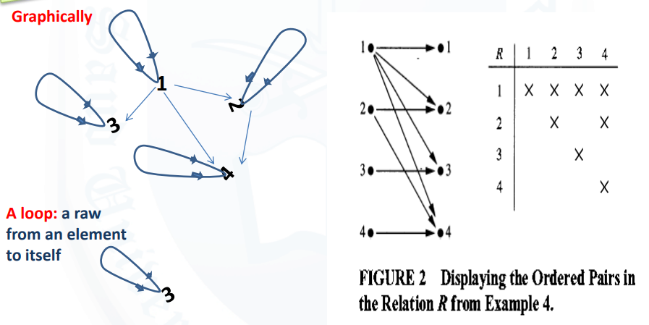
R = {(1,1), (1,2), (1,3), (1,4), (2,2), (2,4), (3,3), (4,4) } .

Slide 9
Properties of Relations

Slide 10
Reflexive Relation
DEFINITION 3
A relation R on a set A is called reflexive if (a,a)ϵR for every element aϵA.

Slide 11
Symmetric and Antisymmetric
DEFINITION 4
A relation R on a set A is called symmetric if (b,a) ϵ R whenever (a,b) ϵ R, for all a,bϵA .
A relation R is called asymmetric if (a, b) ∈ R implies that (b, a) ∉R.
A relation R on a set A such that for all a,bϵA , if (a,b) ϵ R and (b,a) ϵ R, then a=b is called antisymmetric.

Slide 12
Remark:
• we see that the relation R on the set A is symmetric if
∀a ∀b((a, b) ∈ R → (b, a) ∈ R).
• the relation R on the set A is asymmetric if
∀a ∀b((a, b) ∈ R → (b, a) ∉ R).
• Similarly, the relation R on the set A is antisymmetric if
∀a ∀b (((a, b) ∈ R ∧ (b, a) ∈ R) → (a = b)).

Slide 13
Transitive
DEFINITION 5
A relation R on a set A is called transitive if whenever (a,b)ϵR and (b,c)ϵ R , then (a,c) ϵ R , for all a,b,c ϵA.

Slide 14
Example 5
Consider the following relations on {1,2,3,4} :
R₁= {(1,1), (1,2), (2,1), (2,2), (3,4), (4,1) , (4,4)} ,
R₂ = {(1,1), (1,2), (2,1) } ,
R₃ = { (1,1) , (1,2) , (1,4), (2,1), (2,2),(3,3) ,(4,1) ,(4,4)},
R₄ = {(2,1), (3,1) , (3,2), (4,1) , (4,2), (4,3)} ,
R₅ = {(1,1) ,(1 ,2), (1,3), (1,4), (2,2), (2,3), (2,4), (3,3), (3,4), (4,4)} ,
R ₆ = {(3,4)} .
Which of these relations are reflexive, symmetric and transitive?

Slide 15
Remark:
The relation R is connected if for each 𝑎, 𝑏𝜖𝐴, where 𝑎 ≠ 𝑏, either a R b or b R a.
• R is connected if and only if:
∀a ,b ∈ A : a ≠ b ⟹( a , b )∈R ∨ (b , a)∈R
(for example, the relation< )
• Inverse relation: The inverse relation from B to A, denoted by $R^{−1}$ , is the set of ordered pairs
{(𝑏, 𝑎) | (𝑎, 𝑏) ∈ 𝑅}.
• Complementary relation: The complementary relation R is the set of ordered pairs {(𝑎, 𝑏) | (𝑎, 𝑏) ∉ 𝑅}.

Slide 16
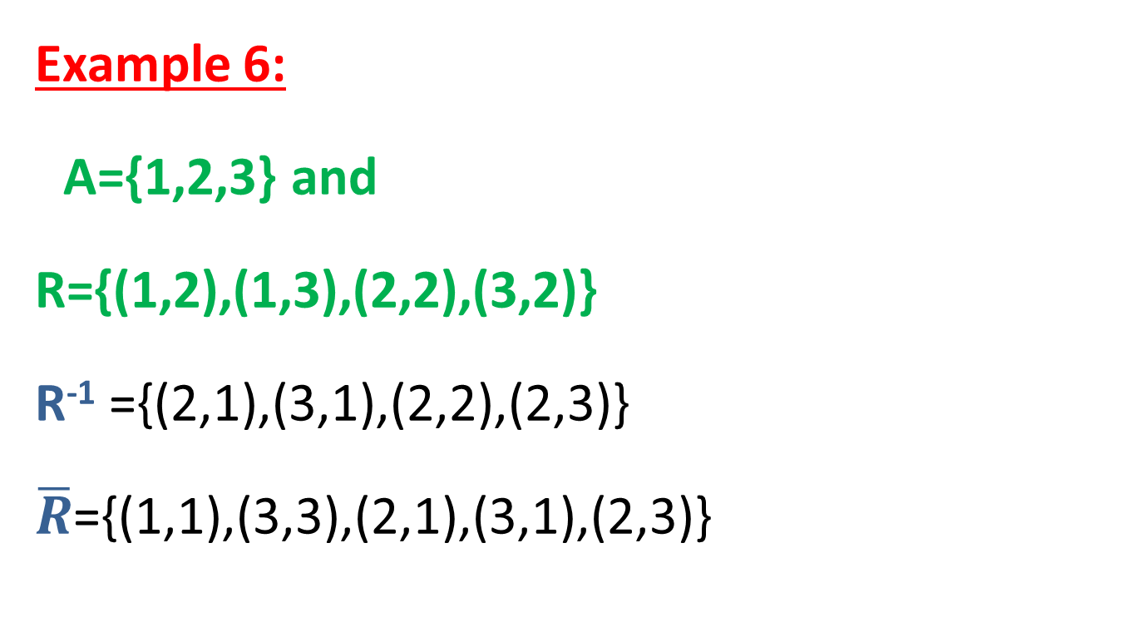
Example 6:
A={1,2,3} and
R={(1,2),(1,3),(2,2),(3,2)}
R⁻¹ ={(2,1),(3,1),(2,2),(2,3)}
$\overline{R}$={(1,1),(3,3),(2,1),(3,1),(2,3)}

Slide 17
Combining Relations
Because relations from A to B are subsets of A x B, two relations from A to B can be combined in any way, two sets can be combined.
EXAMPLE 10
Let A = {1,2,3} and B = {1,2,3,4} . The relations $R_{1}$= {(1,1), (2,2), (3,3)} and $R_{2}$ ={(1,1), (1,2), (1,3), (1,4)}. can be combined to obtain:
$R_{1}$U $R_{2}$ = {(1,1) , (1,2), (1,3), (1,4) , (2,2), (3,3)} , $R_{1}$∩ $R_{2}$ = {(1,1)} ,
$R_{1}$ - $R_{2}$ = {(2,2), (3,3) } ,
$R_{2}$ - $R_{1}$ = { (1,2) , (1,3), (1,4)} .

Slide 18
The composition of two relations
Let R be a relation from a set A to a set B and S a relation from B to a set C. The composite of
R and S is the relation consisting of ordered pairs (a,c), where aϵA, cϵC , and for which there exists an element bϵB such that (a,b)ϵR and (b,c) ϵ S. We denote the composite of R and S by S◦R.

Slide 19
EXAMPLE 7
What is the composite of the relations R and S, where R is the relation from {1,2,3} to {1,2,3,4}
with R = {(1,1) , (1,4), (2,3), (3,1) , (3,4)} and S is the relation from {1,2,3,4} to {0,1,2}
with S = {(1,0), (2,0), (3,1 ) ,(3,2), (4,1)}?
Solution:

Slide 20
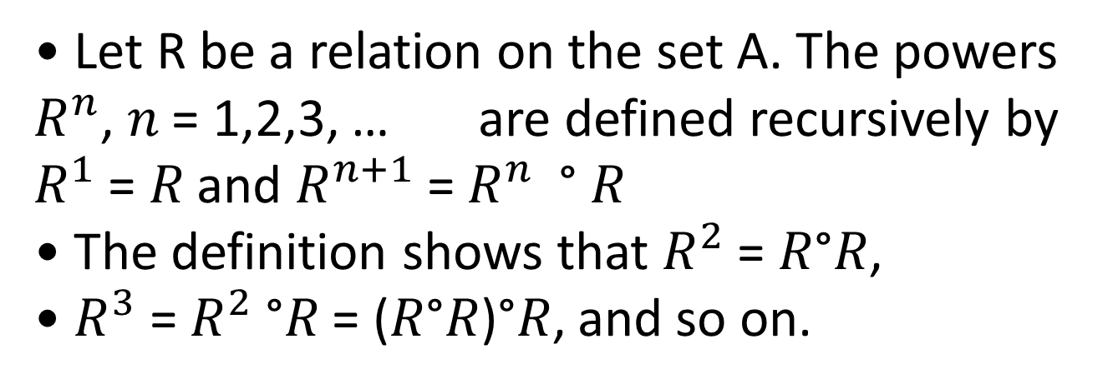
DEFINITION
• Let R be a relation on the set A. The powers $R^{n}$, 𝑛 = 1,2,3, … are defined recursively by $R^{1}$ = 𝑅 and $R^{n+1}$= $R^{n}$ ° 𝑅
• The definition shows that $R^{2}$ = 𝑅°𝑅,
• $R^{3}$ = $R^{2}$ °𝑅 = (𝑅°𝑅)°𝑅, and so on.

Slide 21
Example 8:
• Let 𝑅 = {(𝐼, 1), (2, 1 ), (3 , 2), (4, 3)}. Find the powers $R^{2} , R^{3}$ .
• Solution:

Slide 22
Theorem 1:

Slide 23
Homework
Page 581\582\583
1 (a,b,c,d,e,f)
3 (a,b,c,d,e,f)
7(a,f)
26
27
30
32
56(a,b)

