Slide 1
Re-designing the Health Care Environment
Abdulrahman Al-Muammar, MD
CEO, King Saud University Medical City
International Patient Experience Conference - 2015
Princess Nourah bint Abdulrahman University

Slide 2
Introduction
Enhancing patient safety and quality of heath care are the main areas of interest for leaders in health care management
Evidence based clinical practice
Required organizational practices
Plans, initiatives, KPI…

Slide 3
Introduction
Is it enough from patient perspective?
You may decrease the waiting time in ER
Increase compliance with hand hygiene
Decrease medication error
Patient may not appreciate the quality of care you have provided

Slide 4
Introduction
Patient safety and quality of care is priority
But
Other factors have to be taken into consideration
Patient outcomes such as
Pain, sleep, stress, depression, length of stay, spatial orientation, privacy, communication, social support, and overall patient satisfaction
Staff outcomes such as
Injuries, stress, work effectiveness, and satisfaction

Slide 5
Introduction
Role of health care environment in addressing
Patient safety and quality
Patient outcomes
Staff outcomes

Slide 6
Introduction
The more attractive the environment, the higher the perceived quality of medical care, the higher reported reduction of anxiety, and the more positive the reported interaction with staff
Patients in more attractive physical environments perceived shorter waiting times than patients in less attractive environment
Becker et al. Healthcare Design, 2006;6

Slide 7
Evidence –Based Environmental Design
Private patient rooms
Adequate space for families
Noise-reducing materials
Larger patient bathrooms with double door
Access to natural light
Ceiling mounted patients lifts
Decentralized nursing station
Clear effective way finding systems

Slide 8
KSUMC- Survey
As part of our enhancing patient experience initiatives
Survey was conducted to assess our patient perception for specific environmental design
Reaching the Hospital
Access to the Hospital
Moving Around
Experience at the department
Primary Sample size: 292 collectively (KKUK and KAUH)
Survey methodology
To identify the probability ($p$) of each patients Overall Evaluation based on the given factors, Logistic Regression model was used
Notes:
*Questions included response categories of yes, no, I don’t know. Every section had a final question asking patients to rate areas they consider most important.
Included parking facilities, disability accommodation, signage
Wheelchair access, help desk staff, guiding signs, cleanliness etc.
Overall appeal, adequacy of communal and seating facilities, management of cleaning staff, limited mobility facilities
Attractive and comfort of the waiting areas and clinics and seating adequacy in the clinics

Slide 9
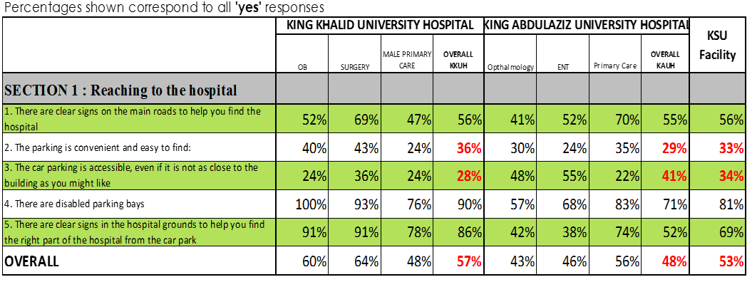
1. Reaching the Hospital
Notes:
Questions that revolved around parking infrastructure and facility were rated lower in both hospitals and hence are important areas to consider.

Slide 10
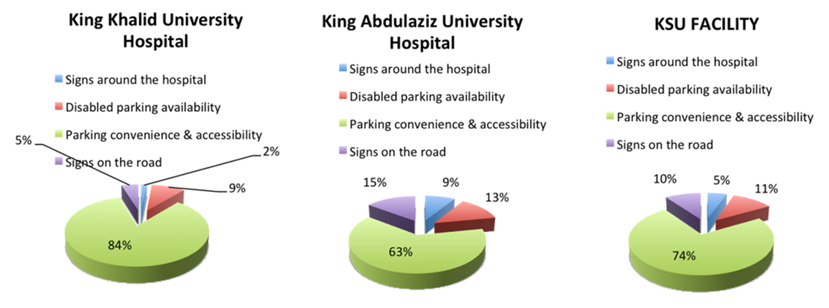
Reaching the Hospital Most Important Area of Improvement

Slide 11
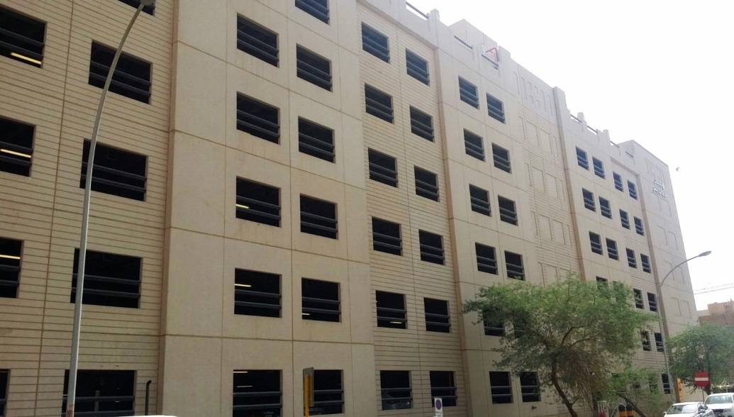
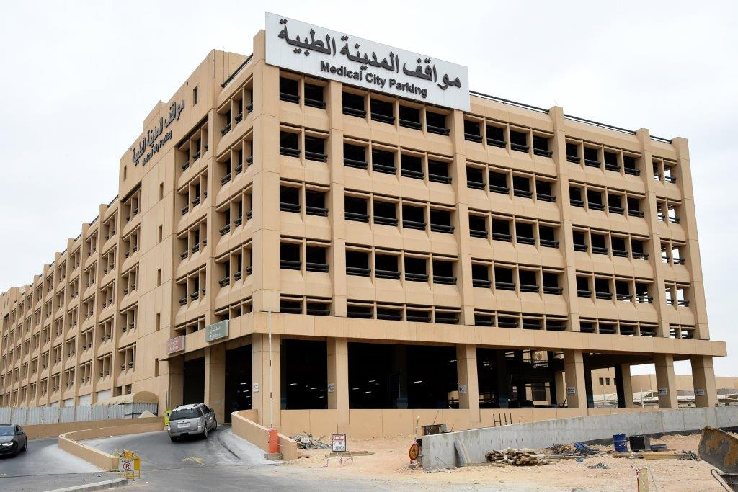
1. Reaching the Hospital
Clear signs on the road – 56%
Parking Convenience – 33%
Parking Accessibility – 34%
Disabled parking bays – 81%
Clear signs around the hospital to guide to parking – 69%

Slide 12
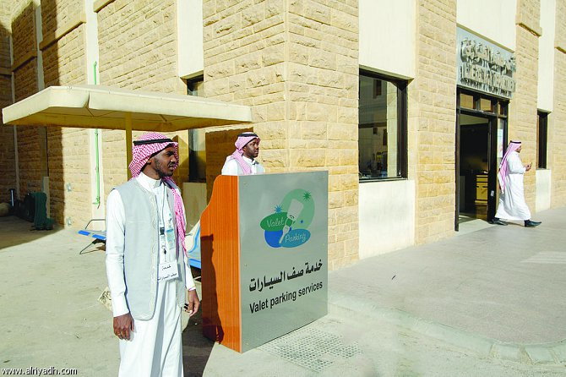
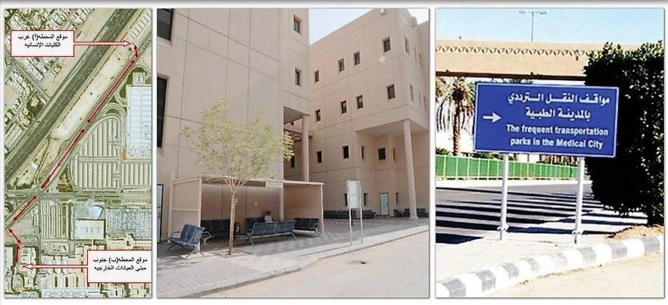
Valet Parking & Shuttle Service

Slide 13
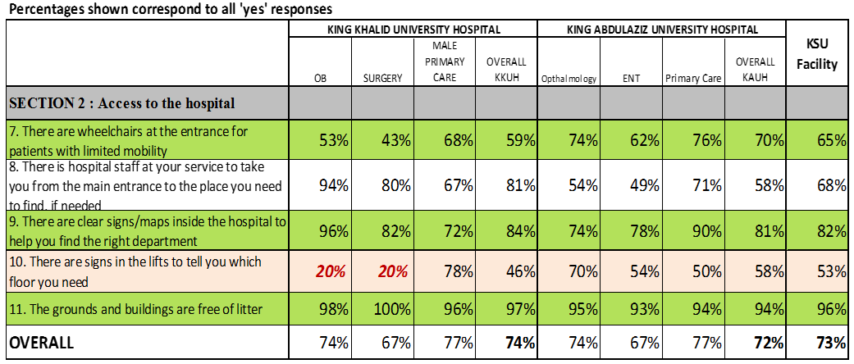
2. Access to the Hospital
Notes:
Presence of wheelchairs at the entrance is an area of improvement. In KKUH, the presence of signages was a very important factor that reduced that overall satisfaction score.
Cleanliness was found to be our strength which we aim to maintain.

Slide 14
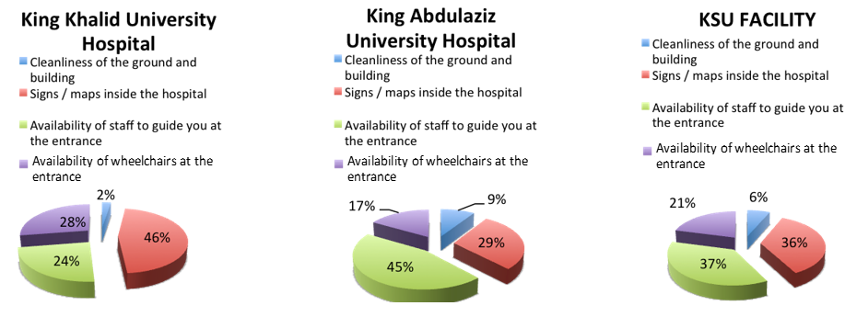
Access to the Hospital Most Important Areas of Improvement
Notes:
Area most important to the responders was the availability to help desk staff to guide them at the entrance, presence of signs inside the hospital. However, at KKUH, the presence of wheelchair at the entrance was deemed more important than the presence of staff.

Slide 15
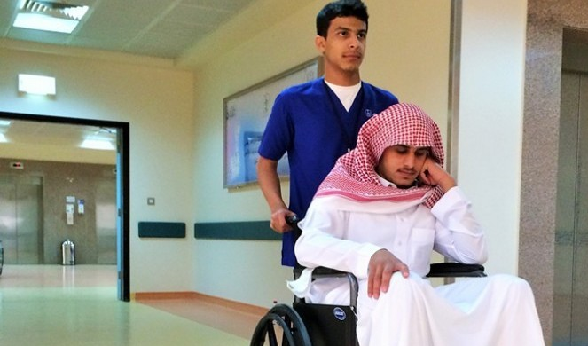
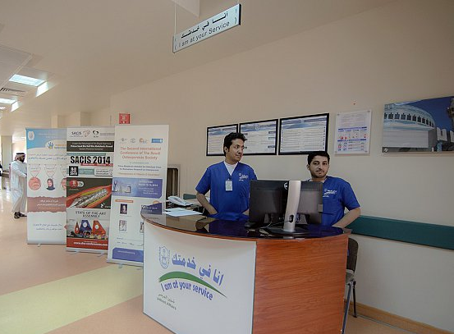
2. Access to the Hospital
Notes:
Presence of wheelchairs at the entrance is an area of improvement. In KKUH, the presence of signages was a very important factor that reduced that overall satisfaction score.
Cleanliness was found to be our strength which we aim to maintain.

Slide 16
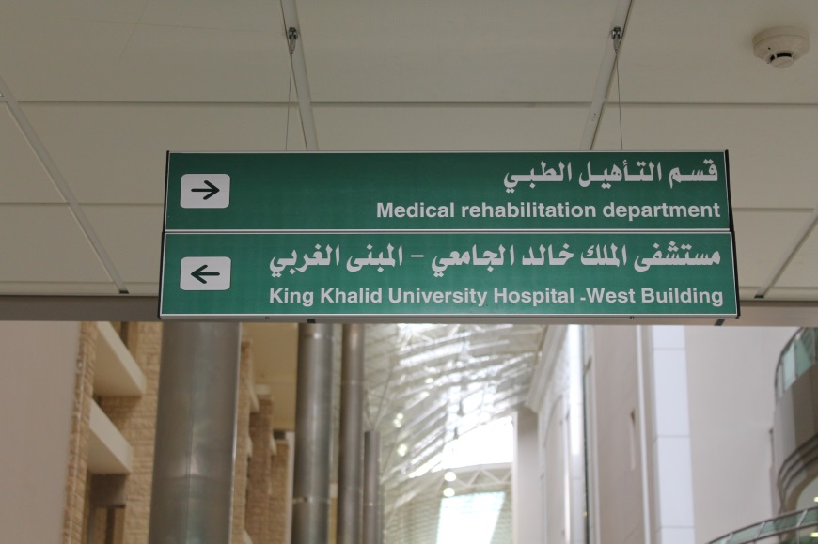
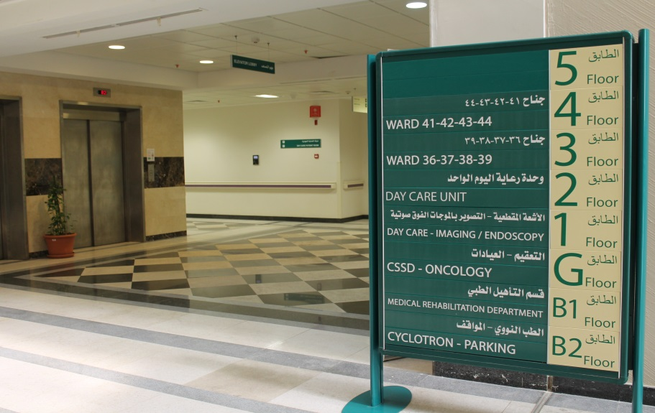

Slide 17
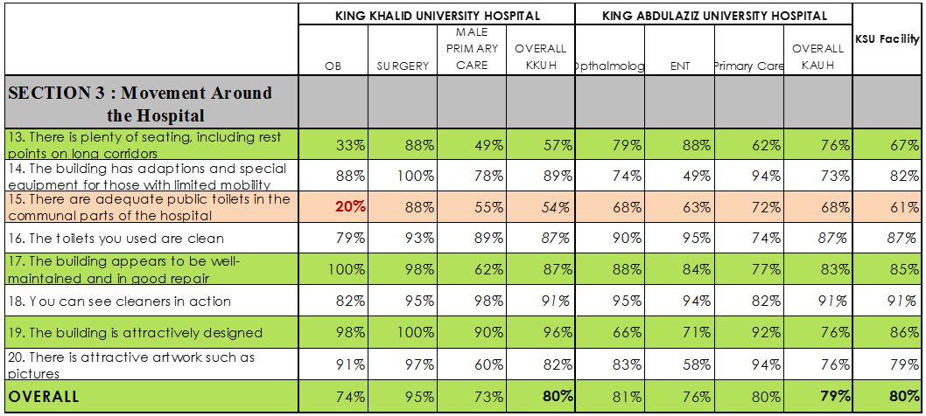
3. Movement around the Hospital
Notes:
Hospital cleanliness again was given the highest ranking.

Slide 18
Movement around the Hospital Most Important Area of Improvement

Slide 19
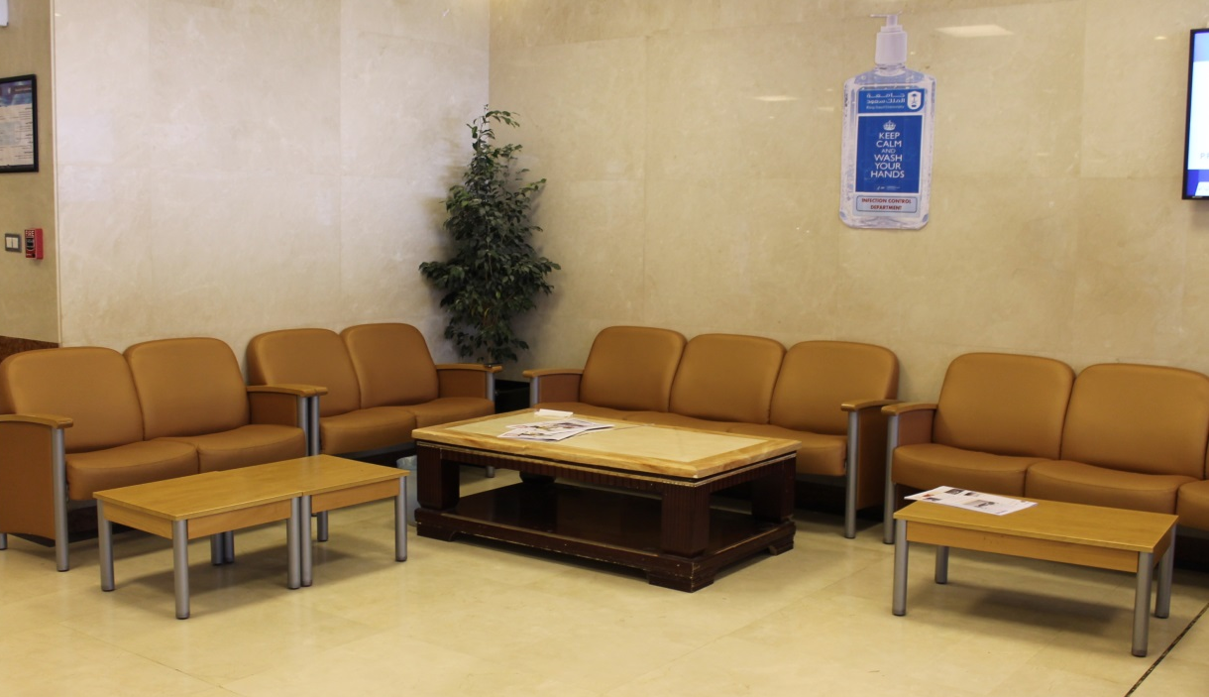
3. Movement around the Hospital

Slide 20
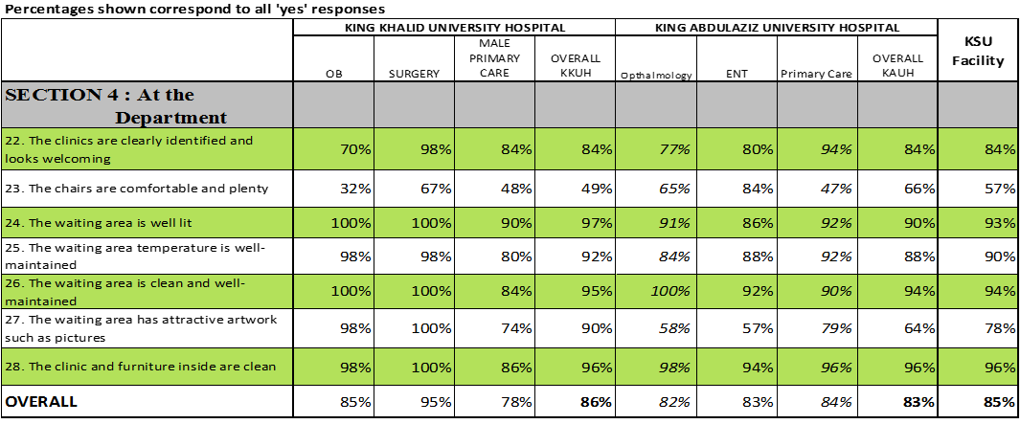
4. At the Department
Notes:
Areas regarding ambience, lighting, temperature and cleanliness were rated the highest.
Lower rates were given to the availability of adequate and comfortable chairs.

Slide 21
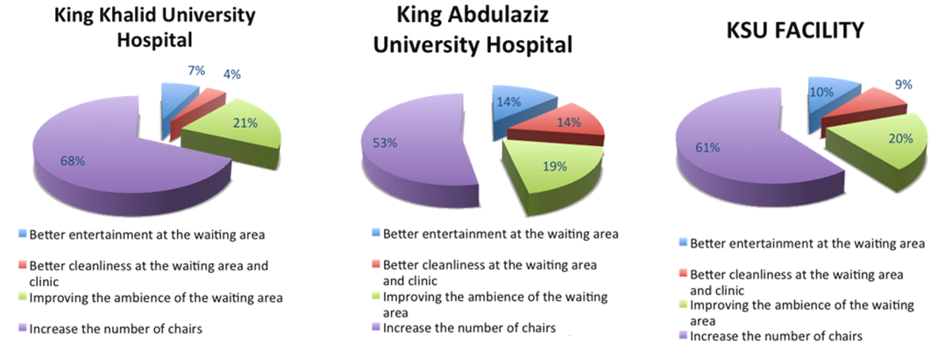
At the Department Most Important Areas of Improvement
Notes:
At the level of the departments, each hospital was scored high for the need of seating areas.

Slide 22
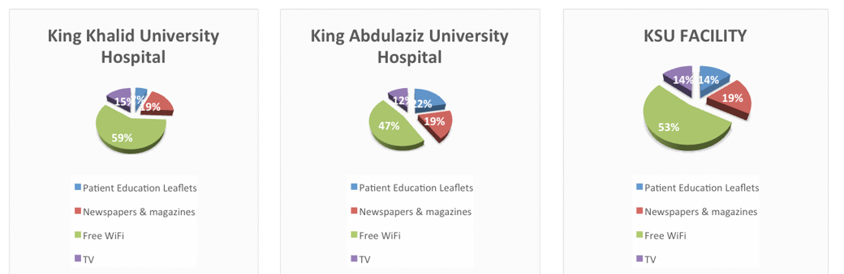
At the Department Spending Time in the Waiting Area - Preferences
Notes:
Wifi access clearly was the need of all patients for spending time in the waiting areas.

Slide 23
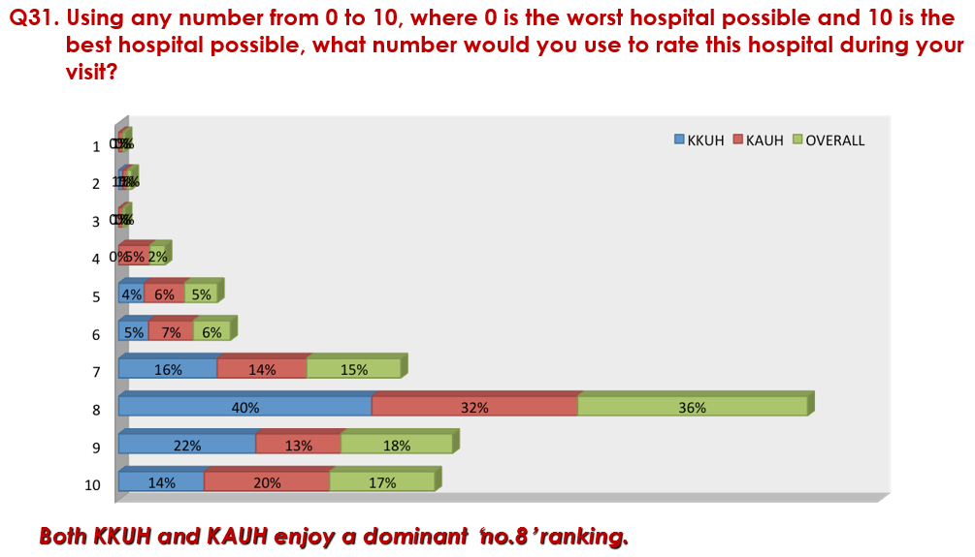
Overall, 71% of the respondents rated the KSUMC facilities at 8 – 1
Notes:
This shows that overall the hospital is rated favorably among patients, with 36% rating it at 8 and a collective 71%, between 8 – 10.

Slide 24
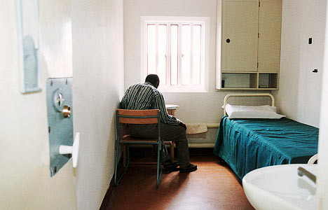
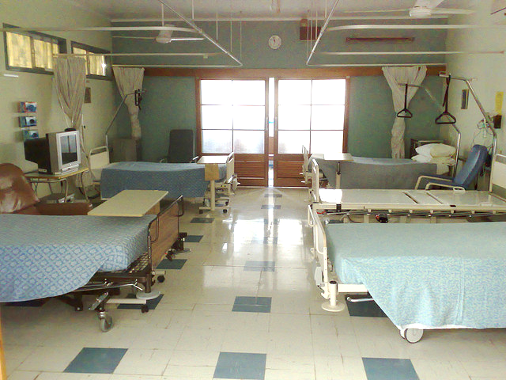
WHY
“ I sometimes feel that I have come in for interrogation rather than consultation”
Comment by a patient during Leadership Walk

Slide 25
CONCLUSION
Adopting evidence- based environmental design becomes major tool to:
Enhance safety and quality
Increase overall patient and staff satisfaction
Facilitate obtaining accreditation from different organization
Developing national standard for hospital design may help to:
Minimize the variation in the way patient perceive quality of care
Help in decreasing the cost
Ensure standardization in the design which can enhance safety
Notes:
* Key Areas: These were the most important areas of improvement that were identified at both hospitals.

Slide 26
Thank you
Notes:
* Key Areas: These were the most important areas of improvement that were identified at both hospitals.

