Slide 1
Merge of pictures

Slide 2
merge of pictures is the most beautiful properties Alffucob it is possible making Merged images with ease and there are several ways to integrate the images we'll talk about the simplest way to integrate photograph

Slide 3
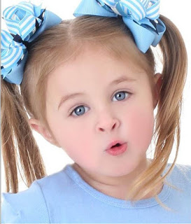

To merge of pictures by Easier way :
(1)Open the two images to be merged program photoshop

Slide 4
(2) Make a copy of the first image by
Ctrl+A
Then
CTrl+C

Slide 5

(3) determine a place in the second image that I want to megre it by choosing Eliptical Marquee tool From the toolbar and select where on this photo

Slide 6
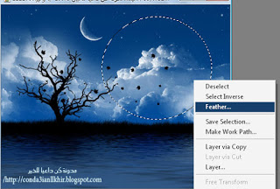
Then work right click inside the circle and choose the Feather
and determine a value of
Feather =45

Slide 7
when increases the value of 45 ,increases the degree of transparency of the edges of the image

Slide 8
Finaly
selected first picture within the region defined by Shift+Ctrl+V

Slide 9

Result

