Slide 1
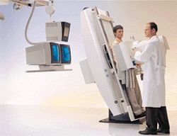
RAD 322

Slide 2
1st Lecture: Ba swallow.
2nd Lecture: Ba meal.
3rd Lecture: Small Bowel Procedures.
4th Lecture: Ba Enema.
5th Lecture: Gall Bladder and Biliary system procedures
6th Lecture: Sialography.
7th Lecture: Hysterosalpingography.
8th Lecture: Urography Procedures .
9th Lecture: Arthrogram.

Slide 3
Ba Swallow
- Definition.
- Normal esophagus appearance.
- Contrast media.
- Routine positions.
-Abnormalities.

Slide 4
Ba Meal
- Definition
- Anatomy
- Contrast Media.
- Patient preparation
- Positions

Slide 5
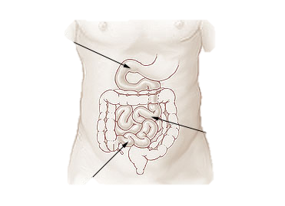
Small Bowel Procedures
1- Definition
2- Anatomy
3- Contrast media
4- Patient preparation
5- Methods

Slide 6
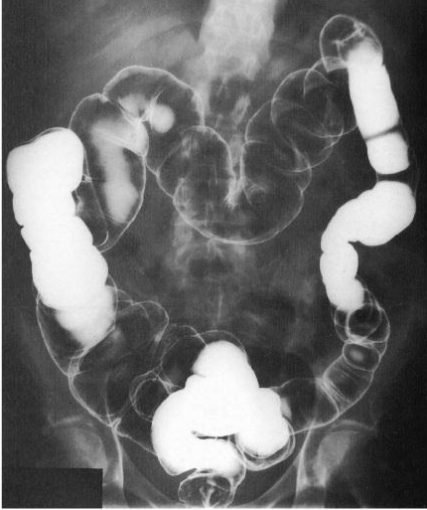
Ba Enema
1- Definition
2- Anatomy
3- Contrast media
4- Patient preparation
5- Methods

Slide 7
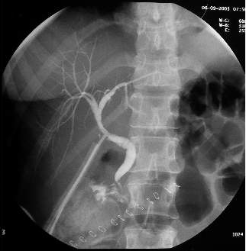
Gall Bladder and Biliary System Procedures
- Definition.
- Anatomy
- Operative (Immediate) Cholangiogram
- Post Operative (T-Tube) Cholangiography
- ERCP

Slide 8
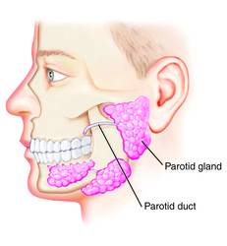
Sialography
1- Definition
2- Anatomy
3- Contrast media
4- Position

Slide 9
Hysterosalpingography
1- Definition
2- Anatomy

Slide 10
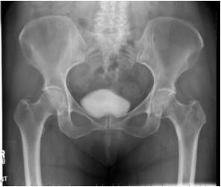
Urography Procedures
Anatomy
Retrograde Cystography (Cystogram)
MCUG

Slide 11
Knee Arthrography
1- Definition
2- Anatomy
3- Indications
4- patient preparation

