Slide 1
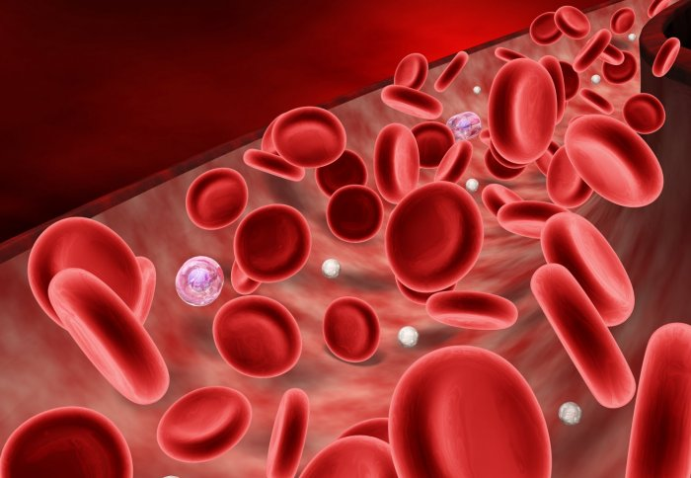
Quantitative determination of serum iron, unsaturated iron binding capacity (UIBC), and total iron binding capacity (TIBC)

Slide 2
Objectives
To determine the normal level of serum iron.
To determine the use of this test in diagnosis of anemia (iron deficiency).

Slide 3
Iron in the body
Iron is the metal component of haemoglobin, myoglobin, cytochromes and some proteins of the electron transport chain.
The total iron of an adult male is 4-5g and of a female is 3-4g.

Slide 4
Iron transport-Trasferrin
Transferrin
Iron is carried in Fe3+ state bound to a specific iron transport protein known as transferrin.
transferrin are iron-binding blood plasma glycoproteins that control the level of free iron in biological fluids
It contains two specific high-affinity Fe(III) binding sites.
largely synthesized by the liver
Transferrin distributes iron to those tissues which have a demand for its utilization.
The transferrin–iron complex enters the cell through specific receptors and the iron ions are released for metabolic functions
receptor

Slide 5
Iron transport-Trasferrin
When iron stores become low, transferrin levels will increase. When there is too much iron, transferrin levels are low
Individuals who lack transferrin show severe hypochromic anemia and are also susceptible to bacterial and viral infections

Slide 6
Iron level in blood
It is important to measure iron and iron-binding capacity to detect iron deficiency or overload.
*Serum iron on its own provides no complete information on iron level.
What tests are used ?
Serum Iron
Total iron-binding capacity
TIBC or UIBC may be ordered along with serum iron when it appears that a person has iron deficiency or overload. These tests may be ordered when there are signs of anemia, especially when a CBC is performed and shows red blood cells that are microcytic and hypochromic and the hemoglobin and hematocrit levels are low

Slide 7
Total iron-binding capacity
It is a medical laboratory test that measures the blood's capacity to bind iron with transferrin.
It is measuring the maximum amount of iron that it can carry, which indirectly measures transferrin
It is calculated by adding serum iron and unsaturated iron binding capacity (UIBC)
It is most frequently used along with a serum iron test to evaluate people suspected of having either iron deficiency anemia or iron overload (hemochromatosis)

Slide 8
Serum Iron, TIBC, UIBC
Total iron-binding capacity
Blood
Unsaturated serum iron binding capacity
Serum Iron

Slide 9
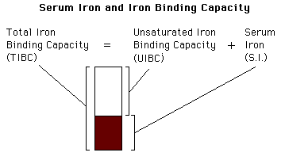

Slide 10
principle
Serum iron: The iron dissociated from its Fe-III-transferrin complex by addition of acidic buffer containing hydroxylamine which reduces the Fe(III) to Fe(II) .
Then the chromogenic agent (PDTS) form a highly colored Fe(II) complex that is measured spectrophotometrically at 565nm .
UIBC: Determined by adding Fe(II) to serum so that it binds to unsaturated iron binding site on transferrin . The excess Fe(II) react with PDTS to form color complex which is measured spectrophotometrically at 565nm. The difference between the amount of Fe(II) added and the amount of Fe(II) measured represent the UIBC
TIBC: is determined by adding serum iron to UIBC value.

Slide 11
principle
Serum Iron:
Fe-III-transferrin complex Fe(II)
UIBC:
Unsaturated iron binding site on transferrin
TIBC: is determined by adding serum iron to UIBC value.
acidic buffer
PDTS
Colored Fe(II) complex
Adding excess Fe(II) to serum
Fe-III-transferrin complex
+
The excess Fe(II)
PDTS
Colored Fe(II) complex

Slide 12
Method
 | Serum Iron
 | Blank | Standard | Test
Iron buffer (pH 4.5) | 2.5 ml | 2.5 ml | 2.5 ml
Iron Standard | ------- | 0.2 ml | -------
Sample | -------- | -------- | 0.2 ml
Water | 0.2 ml | -------- | ------
 | UIBC
 | Blank | Standard | Test
UIBC buffer | 2 ml | 2 ml | 2 ml
Iron Standard | ------- | 0.2 ml | 0.2 ml
Sample | -------- | -------- | 0.2 ml
Water | 0.4 ml | 0.2 ml | ------

Slide 13
Method

Slide 14
Calculations

Slide 15
Normal ranges
Serum iron (50 -160 μg/dl)
TIBC (250 - 450 μg/dl)
Transferrin saturation (20 – 55 %)

Slide 16
Defect in Serum iron
Serum iron is low in iron deficiency anaemia whether due to insufficient intake, malabsorbtion, blood loss or inability to retrieve storage iron. •
Serum iron concentration is high when marrow cannot utilize iron, hemolysis, increased absorption or defects in storage capabilities. High values are also found in severe hepatitis due to release from liver cells.
Defect in Total iron binding capacity (TIBC)
Increase in iron deficiency anemia
Decrease in hemochromatosis, malignant or rheumatic fever.

