Slide 1
Pump Basics2 Cavitation and NPSH Dr. Basharat Salim

Slide 2
Learning Objectives
After successfully completing this lesson, you will be familiar with:
Head-Flow Curves
Power-Flow Curves
Net Positive Suction
Head
Cavitation; and how to prevent it

Slide 3
Pump Performance
The performance of a pump is show by its characteristic curve, where the flow capacity (Q) is plotted against the delivery pressure or developed head (H).
Head is measured in metres.

Slide 4
Static and Dynamic Head
The static Head is the difference between Suction Head and Delivered Head.
As the Suction Head changes the Static Head changes.
When the pump is operating the liquid will be moving within the pipe wok and so a loss due to friction will occur.
Dynamic Head

Slide 5
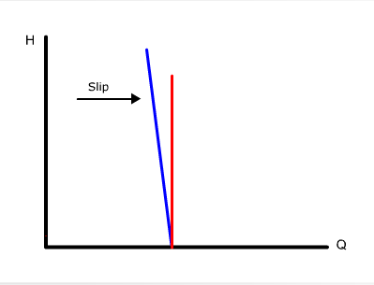
Slip
For a positive displacement pump,running at constant speed,the flow is constant and so the Head to Flow(H-Q) curve should be like the red line.
However ,the actual H-Q curve will look like the blue line.
The small change is known as Slip and is due to the compressibility of the fluid and leakage.
This curve indicates that even small
restrictions in the designed flow rate
can cause very high pressures to be deliverde.

Slide 6
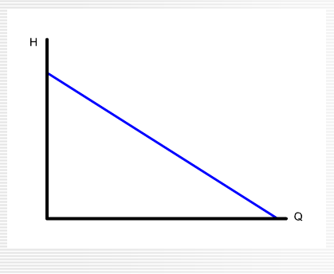
Centrifugal Pump Performance Curve
A centrifugal pump uses the conservation of energy principle .It changes velocity energy into pressure energy .
As the differential head (H) increases ,the flow rate (Q)decreases .The performance curve looks like this .

Slide 7
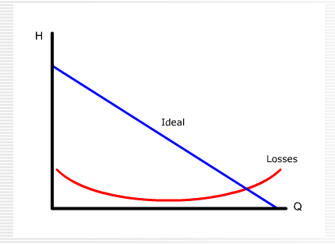
Losses due to Friction
A centrifugal pump incurs head losses due to friction.
The friction is caused by the fluid changing direction when travelling through the pump and by clearances within the pump .These losses vary with both head and flow.

Slide 8
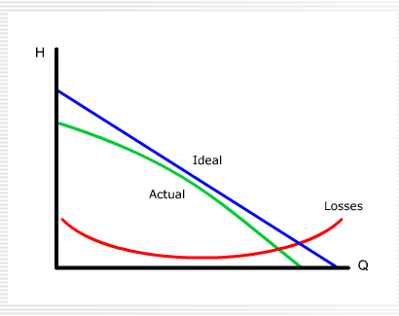
Actual performance curve
Subtracting the losses from the ideal gives the actual performance curve for the pump.
Ideal Head –Losses =Actual Head
It is possible to determine the useful power of a pump by the formula

Slide 9
Actual performance curve
Power = ρ*Q*g*H
For a give system the density of the liquid and gravity are constant:
γ = ρ*g, so
Useful Power = γ * Q *H
For a positive displacement pump the flow (O) can be considered constant ,so we can plot a graph of useful power against pressure.

Slide 10
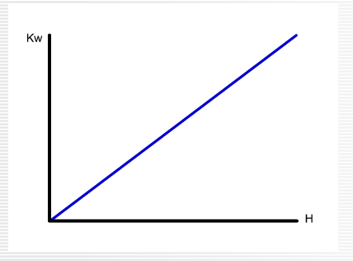
Losses in a positive displacement pump
This graph shows that the developed pressure of a positive displacement pump is dependent upon the power of the motor driiving the pump as
Supplied Power =Useful power +Losses
Losses in a positive displacement pump are mainly mechanical with the exception of a small loss due to leakage.

Slide 11
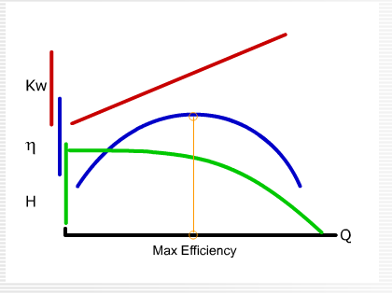
Losses in a centrifugal pump
For a centrifugal pump, as previously mentioned ,losses vary with pump flow and developed head.This means that the useful power varies.
A more useful curve is obtained from plotting Efficiency-Flow.

Slide 12
Losses in a centrifugal pump
Efficiency=Useful Power/Supplied Power
The system should be designed to give the normal operating flow rate at the point of maximum efficiency.

Slide 13
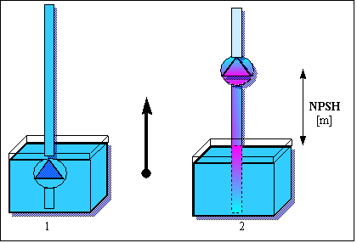
NPSH
If you start a pump, submerged in water like the sketch indicates, the pump will have a specific capacity at a specific delivery head.
If you gradually lift the pump, the pump will, at a specific height, have a perceptible reduction in the capacity.
When this occurs, the height of the pump above liquid level is called Net Positive Suction Head or NPSH.
The pump suction capabilities are measured by NPSH

Slide 14
Friction Head & NPSHA
Net Positive Suction Head Available is by NPSHA in short.
The static suction head (H) can be positive if the suction is above the pump.
The friction head (Hf) varies with the rate of liquid flow.
NPSHA is determined by the pump work conditions.

Slide 15
NPSHR & NPSHA
Net positive suction head requirement is NPSHR in short
For a given rate of flow a pump will have a NPSHR, which is determined by the manufacture.
NPSHR varies with liquid flow.

Slide 16
Cavitation
If the pump operates to the right of point A, then the required suction head is greater than the available suction head. This means that vapour bubbles will occur in the suction pipe.
As the vapour bubbles move through the pump, the pressure will increase and the bubble will collapse.
This process is called Cavitation and can cause severe damage to the pump.
Operation to the left of point A means that vapour bubbles will not form, and so Cavitation will not be a problem.

Slide 17
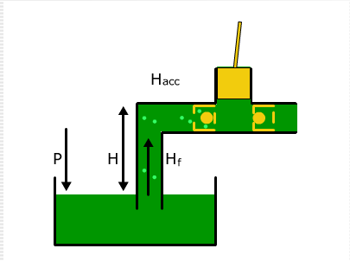
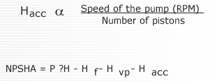
Reciprocating Pumps
Finally,when considering reciprocating pumps ,a further adjustment of Net Positive Suction Head is required due to the inertia of the suction pulses.

Slide 18
Question
If the NPSHA is less than the NPSHP then?
A) The pump will not draw the liquid
B) The pump will overheat
C) The pump will suffer damage
D) The pump needs to run faster

Slide 19
Question
A pump is to be used to pump fresh water at 25 degree C.The vapour pressure of water at 25 degree C=3kN/m2
If the atmospheric pressure is 105 kN/m2,the maximum suction lift is 6.7m, and the pipeline losses on the suction side are equivalent to a head of 3.2m.what will the pump NPSH available be?
A) 1.1m
B) 0.7m
C) 0.5m
D) 0.3m

