Slide 1
Project Procurement Management

Slide 2
Importance of Project Procurement Management
Procurement means acquiring or purchasing products, systems, tools, applications, and/or services from an outside/external source
Experts predict that global spending on computer software and services will continue to grow.
India is the leading country for U.S. offshore outsourcing.

Slide 3
1. Planning Purchases and Acquisitions
The key goal of this process is to determine which project needs may best be met by sellers or vendors outside of the project team. It includes deciding:
  whether to procure or not
  how to procure
  what to procure
  how much to procure
  when to procure
Techniques:
  1.1. Subject Matter Experts both internal and external, can provide valuable inputs in procurement decisions
  1.2. Make-or-buy analysis determine whether it makes more sense to perform the activities within the project team or to contract with a seller.

Slide 4
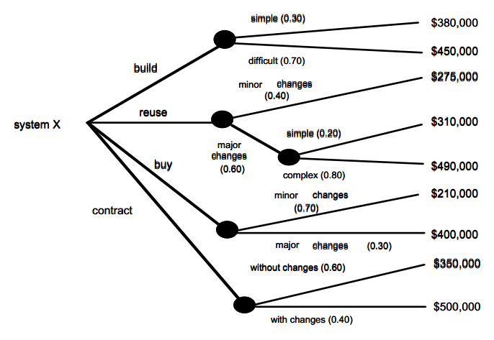
1.2. Planning Purchases and Acquisitions:
Decisions Trees (Make-Buy-Reuse-Contract)

Slide 5
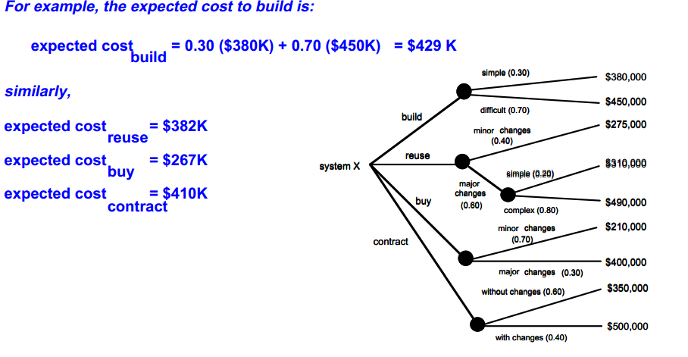
1.2. Planning Purchases and Acquisitions:
Decisions Trees (Make-Buy-Reuse-Contract)

Slide 6
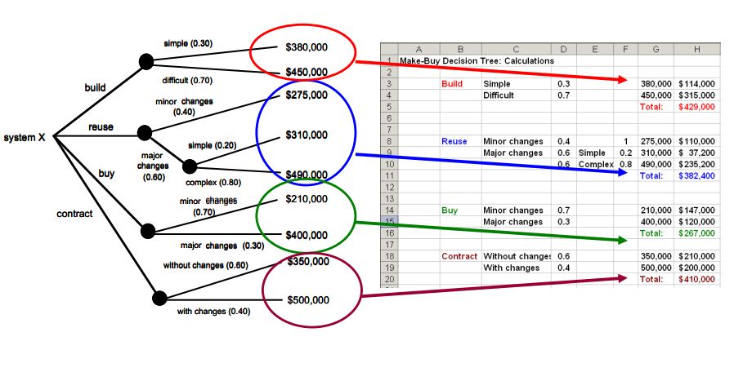

Slide 7
Make-or-Buy Example
Assume you can lease an item you need for a project for $800/day. To purchase the item, the cost is $12,000 plus a daily operational cost of $400/day.
How long will it take for the purchase cost to be the same as the lease cost?

Slide 8
Make-or Buy Solution
Set up an equation so both options, purchase and lease, are equal.
In this example, use the following equation. Let d be the number of days to use the item:
  $12,000 + $400d = $800d
  Subtracting $400d from both sides, you get:
  $12,000 = $400d
  Dividing both sides by $400, you get:
  d = 30
If you need the item for more than 30 days, it is more economical to purchase it.

Slide 9
Make-or-Buy Decision Tree: Issues to be Discussed
Labor costs : internal cost of human resources
 Human resource knowledge : if required knowledge is not present training will be needed
 Cost to prepare and maintain all product artifacts (progress reports, testing, schedules, etc.)
 Rework costs : costs of changes, bugs On-going support costs day-to-day maintenance and updates after product/service is implemented
 Opportunity costs while working on this project, other items are not getting done
 Cost associated with the procurement process itself
 Cost to manage the relationship
 Initial purchase cost along with on-going support costs
 Other Risks (associated with the vendor itself)
Make-or-Buy Decision: MAKE option
Make-or-Buy Decision:
BUY option

Slide 10
(Before Contracts): Statement of Work
Statement of Work (SOW) is a “contract” between the Software Development/IT staff and the customer regarding deliverables and time estimates for a software system/IT system development project.
 SOW is a document which describes the procurement item in sufficient detail to allow prospective sellers to determine if they are capable of providing the item and potentially at what cost
 SOW is a document which describes 100% of the work or services required to be completed under contract by the seller

Slide 11
Figure 12-2. Statement of Work (SOW) Template

Slide 12
Contracts
Contracts : The seller/buyer relationship is based on a signed contract = a mutually binding agreement entered into by two or more parties enforceable in a court of law.
 It obligates the seller (provider, developer) to provide the specified products, services, or results. It also, obligates the buyer (customer) to provide in most cases monetary compensation
Contracts generally fall into one of three broad categories:
  Type 1: Fixed-price or lump-sum
  Type 2: Cost-reimbursable
  Type 3: Time and material

Slide 13
  Type 1: Fixed-price or lump-sum
Contract that provides for a price which normally is not subject to any adjustment unless certain provisions (such as contract change, economic pricing, or defective pricing) are included in the agreement. These contracts are negotiated usually where reasonably definite specifications are available, and costs can be estimated with reasonable accuracy.
A fixed price contract places minimum administrative burden on the contracting parties, but subjects the contractor to the maximum risk arising from full responsibility for all cost escalations. Also called firm price contract.
 A fixed-price or lump-sum contract is appropriate when the Statement of Work (SOW) is sufficiently detailed and stable such that the seller can prepare an accurate fixed price for completing the work
 The seller is obligated to complete 100% of the work at the negotiated (fixed-price) contract value
 Unfortunately, this method presents risks for both
buyer and seller. Why?

Slide 14
  Type 2: Cost-reimbursable
This category involves the reimbursement (payment) of the seller’s actual costs, plus a fee typically representing the seller’s profit.
 Cost-reimbursable contracts include incentive (motive, stimuli) clauses based on the seller meeting certain project objectives such as schedule targets or cost targets
  2.1. Cost-plus-fee or cost-plus percentage of cost
  2.2. Cost-plus-fixed fee
  2.3. Cost-plus-incentive fee (stimulus)

Slide 15
Type 2: Cost-reimbursable
Cost plus percentage of costs (CPPC): The buyer pays the supplier for allowable performance costs plus a predetermined percentage based on total costs.
Cost plus fixed fee (CPFF): The buyer pays the supplier for allowable performance costs plus a fixed fee payment usually based on a percentage of estimated costs.
Cost plus incentive fee (CPIF): The buyer pays the supplier for allowable performance costs plus a predetermined fee and an incentive bonus.

Slide 16
CPFF
For example:
  a project that was originally estimated to cost $50,000 was also given a fixed fee of $10,000.
  If the project was completed by the Seller at greater cost (for example, at a cost of $60,000), then they would only receive $60K + $10K + ($50K - $60K) = $60,000 or $ 0.0 profit
  If the project was completed by the Seller at lower cost (for example, at a cost of $45,000), then they would receive $45,000 + $10,000 = $55,000 or $ 10K profit

Slide 17
CPIF
Example # 1:
   Sharing Formula 85/15, 85% by buyer and 15% by seller
   Allowable cost $50,000
   Target Fee $3,750
   Maximum Fee $6,750
   Minimum Fee $1,500
 Project Result:
  Seller completes the project at cost of $45,000
  Seller is paid $45,000 + ($50,000 – $45,000) * .15 + $3750 = $49,500
  Seller profit = $49.500 - $45,000 = $4,500

Slide 18
Example # 2
   Sharing Formula 85/15
   Allowable cost $50,000
   Target Fee $3,750
   Maximum Fee $6,750
   Minimum Fee $1,500
 Project Result:
  • Seller completes the project at cost of $55,000
  • Seller is paid: $55,000 + $1,500 = $56,500
  • Seller profit = $1,500

Slide 19
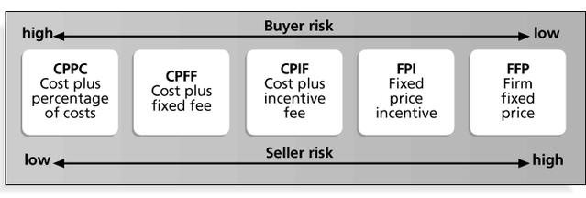
Figure 12-2. Contract Types Versus Risk

Slide 20
Project Procurement Management Processes
Requesting seller responses: Obtaining information, quotes, bids, offers, or proposals from sellers, as appropriate.
Selecting sellers: Choosing from among potential suppliers through a process of evaluating potential sellers and negotiating the contract.
Administering the contract: Managing the relationship with the selected seller.
Closing the contract: Completing and settling each contract, including resolving any open items.

Slide 21
Planning Contracting
Involves preparing several documents needed for potential sellers to prepare their responses and determining the evaluation criteria for the contract award.
  Request for Proposals: Used to solicit proposals from prospective sellers.
    A proposal is a document prepared by a seller when there are different approaches for meeting buyer needs.
  Requests for Quotes: Used to solicit quotes or bids from prospective suppliers.
    A bid, also called a tender or quote (short for quotation), is a document prepared by sellers providing pricing for standard items that have been clearly defined by the buyer.

Slide 22
Selecting Sellers
Also called source selection.
Involves:
  Evaluating proposals or bids from sellers.
  Choosing the best one.
  Negotiating the contract.
  Awarding the contract.

Slide 23
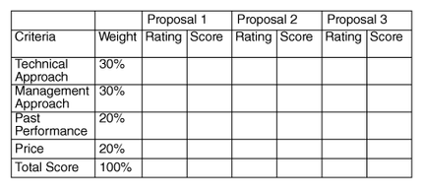
Figure 12-4. Sample Proposal Evaluation Sheet

