Slide 1
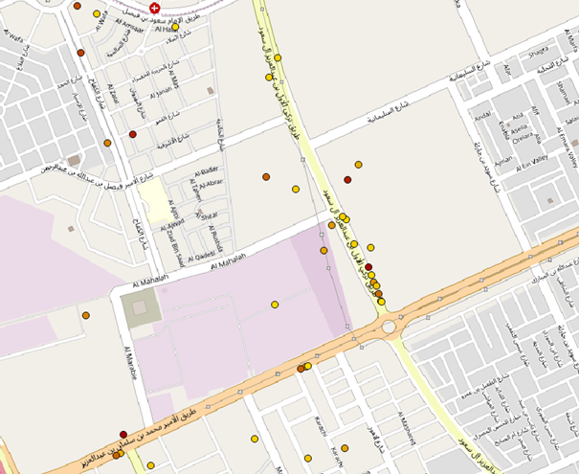
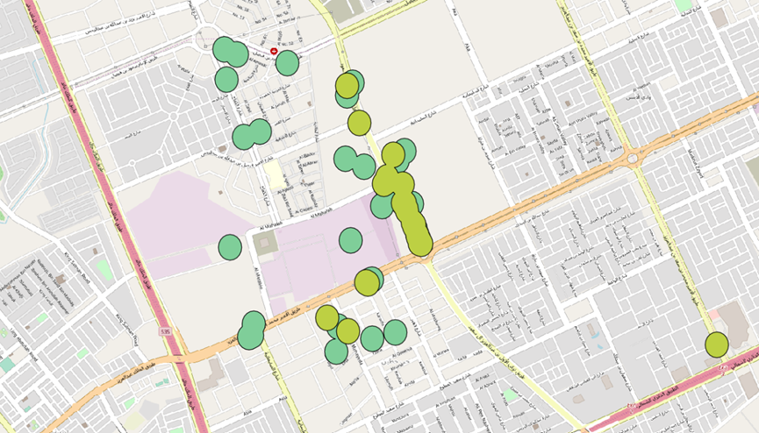
Problem description:
FOOD TRUCKS IN RIYADH
Data descriptions:
We want to know the exact location for each food trucks and analyze the environment surrounded to each food truck.
Food trucks are a new subject or service that are being considered in public places in Saudi Arabia so a lot of people does not have enough information about them.
There may be some parties interested in the distribution of the food trucks and the information gathered.
Rating map
we gather the locations of food trucks using google maps and searching for other informations using the internet.
we download the Riyadh map using free source (OpenStreetMaps).
we used vector data type and for each point we gathered its coordinates represented by two values longitude and latitude, we sorted the data collected on a table using excel Microsoft and add the file in Qgis to represent points on the map.
5
4
3
2
Analysis:
1
Using the buffer analysis to give a view of the distribution of food trucks locations to make it easy knowing the best environment for placing a new food truck.
Because there is a lot of food trucks next to each other in the same spot, we classify the points based on the rating for the food trucks to give an idea about the current trucks for people to know.
Conclusion:
Buffer analysis
We noticed that the distribution of the food trucks are usually clustered in one region.
Our distribution of the food trucks may not be very accurate because of the possibility of them moving to a different location in the future.
Most of the food trucks do not serve a walking facilities, parks, small playgrounds, …etc.
R
C
Mohammad Alnowibet 436104364
Fahad Alotaibi 436100822
Abdulaziz Alasmari 436102165

