Slide 1

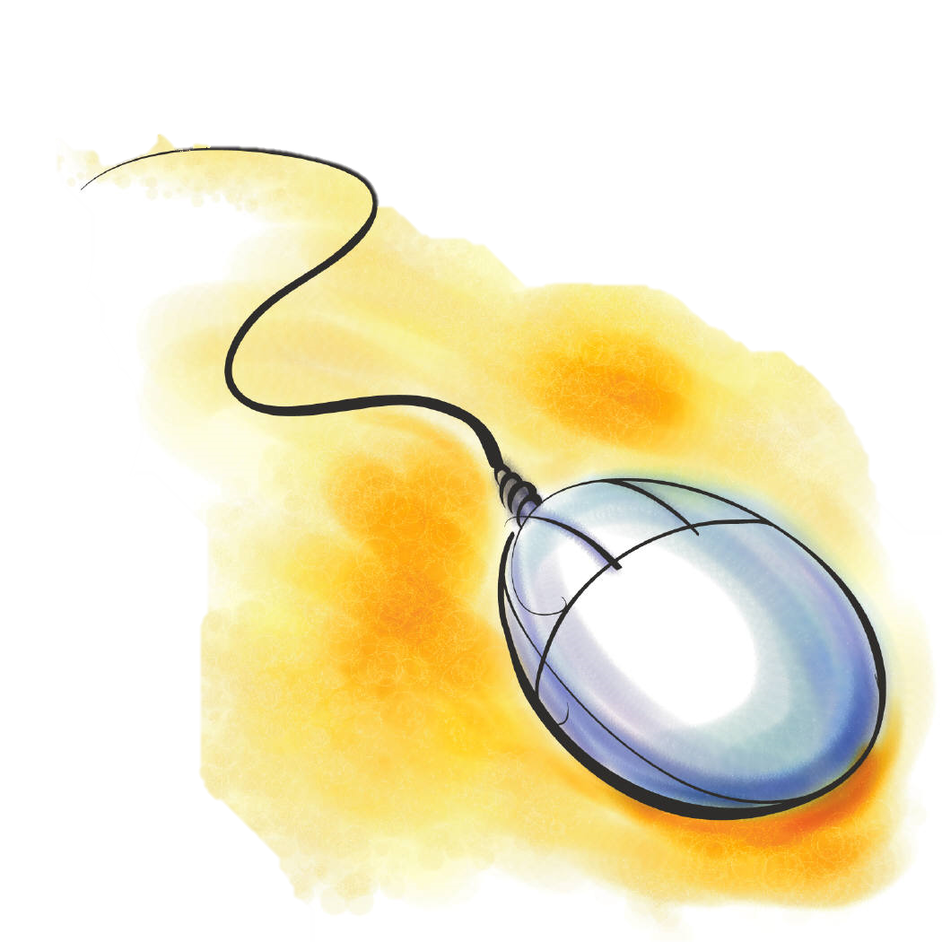



1st King Abdullah Ear Specialist Center Research Day
18th of October 2014
(24 Dhu Al HIjjah 1435)
Riyadh, Kingdom of Saudi Arabia

Slide 2

Program
7:30 – 8:00 | Registration + Opening of the Research Day.
8:00 - 8:10 | Introduction Dr. Fida Al-Muhawas
8 :10 – 8:30 | Inspirational Talk Honored Guests (Dr. Al-Moammar)
8:30 - 8:50 | Basic in Research (Arabic Presentation) Dr. Mohammed Al Garni
Note ..

Slide 3

Program
8:50 – 9:10 | Why Do We Do Research? Prof. Ayman Abdo
9:10 – 9:30 | Ethics in Medical Research Dr. Fahad Al Saab
9:30 – 9:50 | Where to Publish: Scientific and Practical Consideration? Dr. Saleh Al_Mohsen
9:50 – 10:00 | BREAK ..
Note ..

Slide 4
Program
10:00 – 10:20 | The Structure and Process of IRB Dr. Murad Momani / Mr. Taher
10:20 -10:40 | Research Methodology Prof. Hussein Rabee
10:40 – 11:30 | Grant Writing Prof. Ahmed BaHamman
11:30 – 11:50 | Plagiarism Prof. Hussein Rabee
Note ..

Slide 5

Program
11:50 – 1:00 | Prayer + Lunch ..
1:00 –1:20 | End Note in Medical Fields Dr. Mohammed Al-Essa
1:20 – 1:40 | ISI Journal Citation Report Dr. Tamer Al-Musallam
1:40-2:10 | My Carrier in Research Prof. Abu El-Asrar
Note ..

Slide 6
Program
2:10 – 3:10 | Statistics Mr. Nasser Al-Maflehi
3:10 – 3:20 | BREAK ..
3:20 – 3:40 | Vancouver Style Prof. Abdulrahman Hagr
3:40 – 4:00 | How to be an Inventor? (Arabic Presentation) Prof. Khalid Al-Ghamdi
Note ..

Slide 7
Program
4:00 – 4:20 | Manuscript Path Prof. Ibrahim Al Orainy
4:20 – 4:40 | Scientific Papers: The Classification and Publication Requirements Mr. Adnan Mahmood
4:40 – 5:00 | Developing a Publication -The Example of HOXA1 and Deafness Prof. Thomas Bosley / Dr. Fida
5:00 on words | Discussion and Closing Remarks
Note ..

Slide 8



