Slide 1
IE 214: Operations Management
Lecture
1
Operations and Productivity
KAMAL

Slide 2
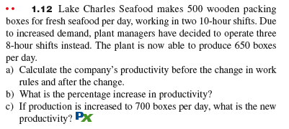

Slide 3
EXERCISE 1.12
Given:
* Output old = 500 boxes / day
* Input old = 20 hrs/ day
*Output new = 650 boxes / day
* Input new = 24 hrs / day
Productivity = ـــــــــــــــــــــــ
Output
Input

Slide 4
Productivity = ـــــــــــــــــــــــ
Output
EXERCISE 1.12
Input
Solution:
a) Old Productivity = 500 / 20 = 25 boxes / hrs
New Productivity = 650 / 24 = 27.08 boxes / hrs
b) % increase in productivity
= [(27.08 - 25)/ 25]*100% = 8.3 %
c) Productivity (if output = 700) = 700 / 24 = 29.17 boxes

Slide 5
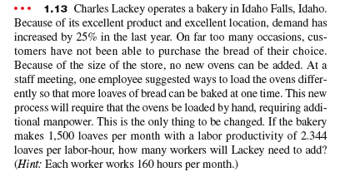

Slide 6
EXERCISE 1.13
Given:
Current output = 1500 loaves / month
Input = n labors * 160 hrs / month
Labor productivity = 2.344 loaves / hrs
Demand has increased by 25 %
Labor Productivity = ــــــــــــــــــــــــــــــــــــ
Output
Input in labor hrs

Slide 7
EXERCISE 1.13
Solution:
New Output = 1.25 * 1500 = 1875 Loaves
Labor Productivity = Output/Input = 2.344
= 1875 / (n * 160) = 2.344
n = 1875 / 375 = 4.99 ≈ 5 Labors

Slide 8
HW # 1
1.14
1.15
1.16

