Slide 1
Probe-Based Microbial Detection and Identification

Slide 2
Probe-Based Microbial Detection and Identification
The principle
Applications
The Target
rRNA
tmRNA
mRNA
Notes:
The principle: the intrinsic ability of single-stranded DNA or RNA to anneal specifically to a complementary sequence and form a double-stranded hybrid
Applications: Nucleic acid probe-based microbial identiﬁcation is widely used in clinical laboratories. The probes can be used for identiﬁcation of microorganism directly from the specimen, from culture, or on formalin-ﬁxed and parafﬁn-embedded tissue.
The Target: Ribosomes are highly conserved and essential organelles responsible for protein synthesis.
tmRNA, a RNA molecule of 363 nucleotides that combines properties of tRNA and mRNA, has been successfully used for bacterial identiﬁcation
mRNA has also been used as target for in situ hybridization

Slide 3
Ribosomes
rRNA
A good marker for bacterial identiﬁcation
The quantity
Well conserved within a species
The 16S and 23S rRNA molecules - variable sequence motifs
Notes:
The quantity: As the backbone of the ribosome, rRNAs are found in all known living cells. In growing bacterial cell, as many as 104 to 105 copies of 5S, 16S, and 23S rRNAs can be found in the cell
In contrast DNA target, which usually has one or a few copies per cell
quite variable between most different species of microorganisms, making rRNA an ideal target for species identiﬁcation for medically important organisms.

Slide 4
Probes
Short DNA
Between15 – 25 nucleotides
Can be labeled
Enzymatically linked reporter molecules
Tyramid Signal Ampliﬁcation (TSA) detection kit
Fluorescent microscope
Notes:
The oligonucleotide probes used to identify bacteria are DNA
The shorter the probe, the lower the probe can tolerate mismatches.
the probe can be labeled with a variety of compounds(chemiluminescence,ﬂuorescencedye,peroxidase,lectin,etc.)and be used in combination with corresponding detection methods.
The most common probe labeling involves enzymatically linked reporter molecules like digoxigenin, alkaline phosphatase,or horseradish peroxidase
These probes need an additional step after the hybridization procedure with ﬂuorescent anti-DIG or use tyramid signal ampliﬁcation(TSA)detection kit.TheTSAkit consists of a ﬂuorescent tyramide which would beradicalized by horseradish peroxidase and then bind intracellularly to arominatic amino acids (tyrosine, phenylalanine, and tryptophan). The signal intensity may be increased10-to20-fold by using the TSA kit

Slide 5
Hybridization Formats
Solution hybridization
Solid-support hybridization
In situ hybridization
Notes:
Nucleic acid hybridization can be performed in a few formats: in liquid, with both probe and target free to interact (solution hybridization) or with the probe free and the target nucleic acid bound to a solid surface (solid-support hybridization), and in situ hybridization, in which intact cells or tissue sections are ﬁxed onto glass slides and the target nucleic acid is detected directly in cells.

Slide 6
Matrix-Assisted Laser Desorption Ionization (MALDI) Time of Flight (TOF) Mass Spectrometry

Slide 7
The principle
Advantages:
High sensitivity and specificity (~95%–100%) in comparison with phenotypic detection methods
Directly used for clinical specimens, such as blood culture and urine samples
As a first-line epidemiological tool
A powerful, quick, and cost-effective method
Disadvantages:
Requires a growth step in order to obtain sufficient material for acquisition of mass spectra
Not able to identify all pathogens in mixed cultures.
Manual interpretation is not possible
https://www.youtube.com/watch?v=8R1Oyqx5KfE
Notes:
MS detects the mass-to-charge ratio
High sensitivity (~95%–100%) and specificity (~95%–100%) in comparison with phenotypic detection methods without false-positive or false-negative results
Dis:
whereas MALDI-TOF MS can detect production of carbapenemases and carbapenemase activity, it cannot differentiate specific carbapenemase types and is consequently less informative for molecular studies

Slide 8
Steps of MALDI-TOF operation
Fresh bacterial culture
Suspended in a buffer and centrifuged
Resuspend Pellet in a reaction buffer containing the β-lactam molecule
after incubation at 35 °C for 1 to 3 h
The reaction mixture is centrifuged
The supernatant is mixed with an appropriate matrix
Measured by MALDI- TOF MS
Notes:
A MALDI-TOF MS assay for detection of carbapenemases was published in 2011 by Hrabak et al. [74]. This method allows for detection of resistance to carbapenems in Enterobacteriaceae carbapenemase-mediated hydrolysis, without false-positive results.

Slide 9
Technical consideration
Purity:
Sources of contamination • Ionic compounds (salts) • Water • Buffers, detergents • Separate purification may be necessary
Matrix Type:
Matrix advantages/disadvantages • Ease of crystallization • Ease of ionization • Tolerance to impurities • Analytical sensitivity
Solvent:
• Solubility is important • Protein samples: H20/CH3CN, 0.1% TFA

Slide 10
application
An efficient and reliable alternative method for bacterial identification, replacing the traditional biochemical techniques.
High interlaboratory reproducibility

Slide 11
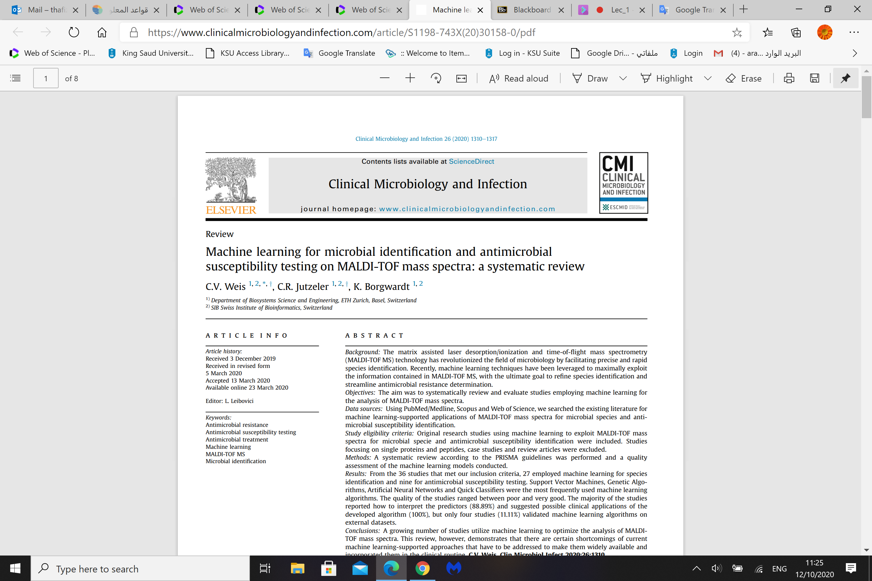
Latest publication
https://www.clinicalmicrobiologyandinfection.com/article/S1198-743X(20)30158-0/pdf

