Slide 1
Primary Survey
Mashael Alsufyani
M.S.N ,community Health Nursing
Nursing lecturer, King Saud University.

Slide 2
Learning Objectives
After completion of this practical lecture,
you will be able to:
Know how to do primary survey.
Know how to assess a victim consciousness
Check Disability AVPU

Slide 3
Assess the situation and make own safety first

Slide 4
Assess a victim consciousness by:
Asking question
Shaking.

Slide 5
If she respond:
Treat her & call 997

Slide 6
If she not respond:
Shout for help
Open the airway (head tilt – chin lift)
Assess her breathing by looking, listen and feel / cervical
spine stabilization.

Slide 7
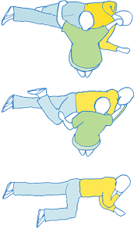
If she breath:
Turn her into recovery position, and call 997.

Slide 8
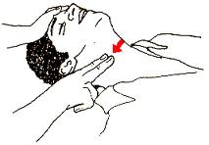
:If she not breath
Assess her circulation by checking carotid pulse.
No pulse = conduct CPR

Slide 9
Pulse is present :
Continue primary survey
Check Disability AVPU
Note initial level of responsiveness on AVPU scale
A Alert
V Responds to voice
P Responds to painful stimulus
U Unresponsive

Slide 10
Expose and Examine

Slide 11
Summary
In this practical lecture we have discuss the following:

Slide 12
Video
Primary survey
http://www.youtube.com/watch?v=ueXMyxPKEm0
http://www.youtube.com/watch?v=AGznNGtT4xw&list=PL1D4A3553A070F702

