Slide 1
Precipitation
Double immunodiffusion
Radial immunodiffusion

Slide 2
Precipitation
Is a secondary serological test where Ag is soluble not a particulate cell.
A precipitation line appears at optimal proportions of Ag and Ab not equal proportions.
This is explained by Lattice theory
This test was first done in a test tube, now it is done as a diffusion method.

Slide 3
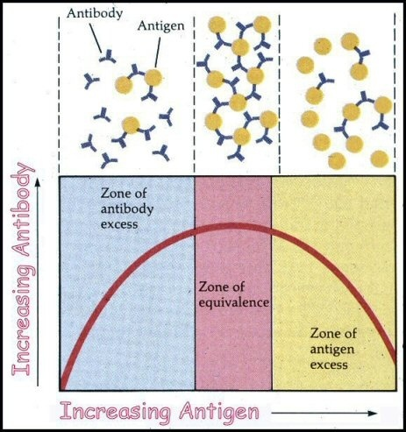
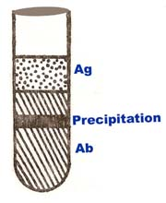
Precipitin reactions
The result of the reaction between soluble antigen and soluble antibody to form a lattice until the complex is large enough to become insoluble and form visible precipitate .This occurs at the Zone of Equivalence

Slide 4
Precipitation
Reactions in Gel
A-Eelectrophoresis
1- Serum Protein
electrophoresis
2- Countercurrent
Immunoelectro-
phoresis
3- (Rocket)
Technique
4- Electro-
immunodiffusion
5- Immunoelectro-
phoresis
6- Immunoblotting
B-Immunodiffusion
1-Single Diffusion
RID
2-Double diffusion

Slide 5
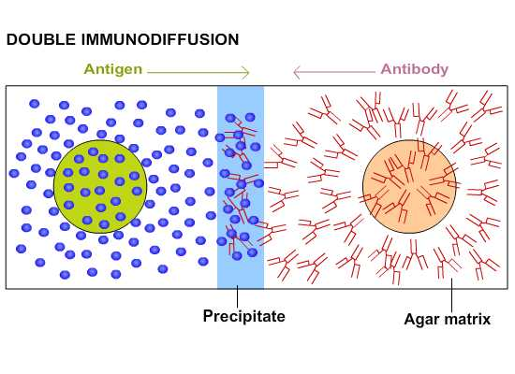
Double Immunodiffusion
Diffusion of antibody and antigen towards each other in an Agarose gel.
A line of precipitate will form if the antibody binds to antigen.
Used to determine if an antigen or antibody is present

Slide 6
Ouchterlony double immunodiffusion test
Ab is delivered into the central well and different patient samples are delivered into the surrounding wells, the plate is then incubated 24 to 48 hours. A line of precipitation appears at optimal proportions of Ag and Ab. This test is qualitative.
This test is used to:
1. Diagnose fungal Ags in body fluids.
2. Determine relationship between Ags.

Slide 7
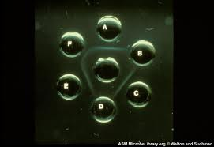

Double immunodiffusion

Slide 8
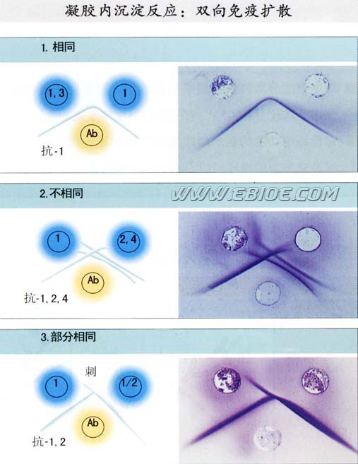
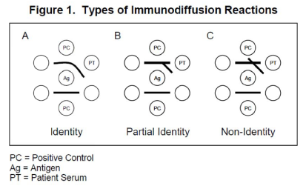
Double immunodiffusion

Slide 9
Single Radial Immunodiffusion
Immunoglobulin G (IgG) is the Major antibody in human serum
It accounts for approximately 75% of the total immunoglobulin pool
Its concentration is 1200 mg/dl
IgG will react with anti Human IgG antibody to form Ag-Ab complex
In Single Radial Diffusion: one component is fixed
(e.g. Ab :in this case it is anti-IgG)
Precipitation Reaction: When the Antigen and Antibody are in soluble form, the interaction between them causes precipitation.

Slide 10
Mancini
In radial immunodiffusion Antibody (anti-IgG antibody) is incorporated into the agar gel as it is poured
Different dilutions of the serum are placed in holes punched into the agar.
As the IgG diffuses into the gel it reacts with the antibody anti -IgG and when the equivalence point is reached a ring of precipitation is formed
The diameter of the ring is proportional to the concentration of IgG since the amount of antibody is constant.

Slide 11
Thus, this is a quantitative test.
This test is commonly used in the clinical laboratory for the determination of immunoglobulin levels( IgG, IgM, IgA, IgE, IgD) in patient samples. Also to determine complement components C3,C4 concentration.
Thus, by running different concentrations of a standards one can generate a standard curve from which one can quantitate the amount of an antibody in an unknown sample.

Slide 12
Radial Immunodiffusion (Mancini)
Method
Ab incorporated in gel (anti-IgG)
Ag in a well(IgG, IgM)
Ab in gel
Ag
Ag
Ag
Ag
Interpretation
Diameter of ring is proportional to the concentration
Quantitative
Ig levels ,C3,C4 conc.
Diameter²
Ag Concentration

Slide 13
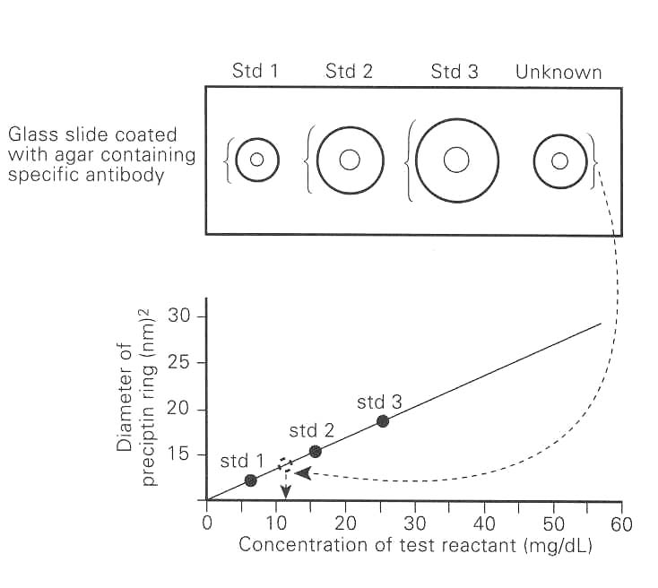
RID
After plotting the curve from standard, the concentration of test sample is determined from diameter of precipitin ring

Slide 14
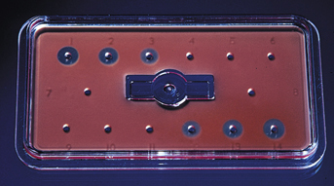
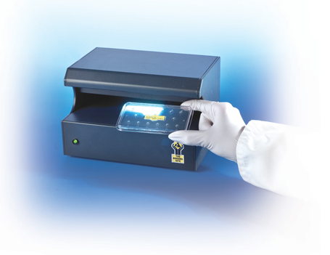
RID

Slide 15
Precipitation
Reactions in Gel
A-Eelectrophoresis
1- Serum Protein
electrophoresis
2- Countercurrent
Immunoelectro-
phoresis
3- (Rocket)
Technique
4- Electro-
immunodiffusion
5- Immunoelectro-
phoresis
6- Immunoblotting
B-Immunodiffusion
1-Single Diffusion
RID
2-Double diffusion

Slide 16
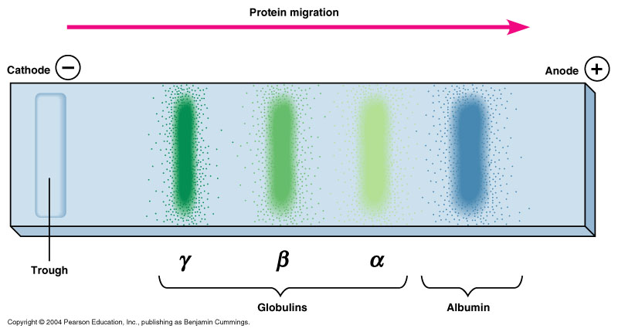
Electrophoresis of Serum Proteins

Slide 17
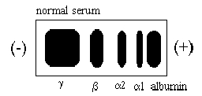
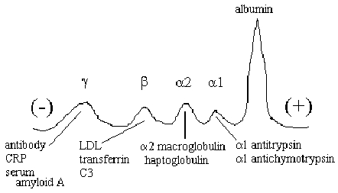

Slide 18
Normal Pattern
Monoclonal gammopathy
Polyclonal gammopathy
Chronic inflammation
Cirrhosis

Slide 19
Immunoelectrophoresis
Method
Ags are separated by electrophoresis
Ab is placed in trough cut in the agar
+
-
Ag
Ag
Ab
Ag
Ab
Interpretation
Precipitin arcs represent individual antigens

Slide 20
Countercurrent electrophoresis
Method
The same principle as double immunodiffusion test but Ag and Ab migrate toward each other by electrophoresis.
Used only when Ag and Ab have opposite charges
Qualitative
Rapid

Slide 21
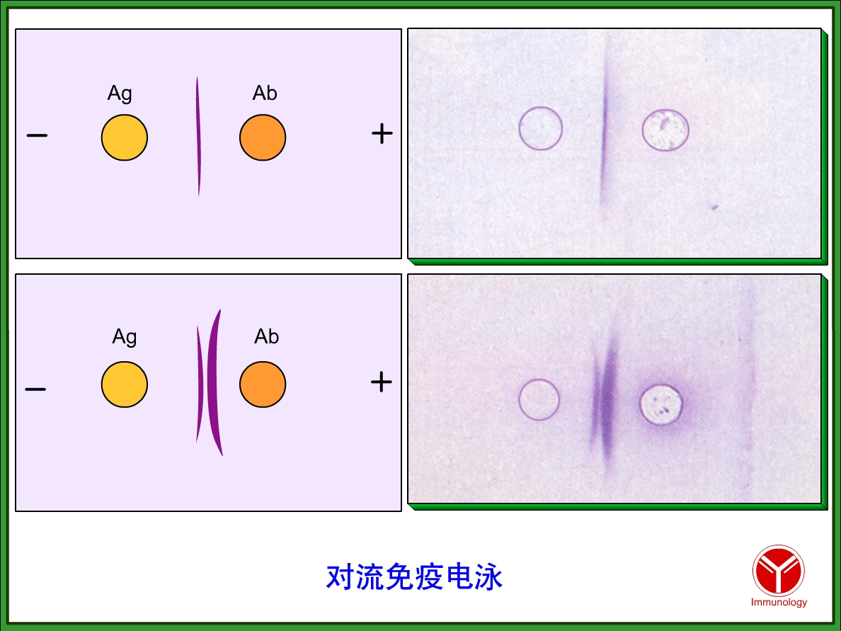
CIEP

Slide 22
Agglutination vs. Precipitation
Agglutination
Insoluble or particulate Ag or Ab
Ag must have at least two determinants
Ag excess results in Postzone reaction
Ab excess results in Prozone reactions
Reaction time: minutes to hours
Test results: qualitative or semi-quantitative
Precipitation
Soluble Ag & Ab
Ag must have at least two determinants
Ag excess results in Postzone reaction
Ab excess results in Prozone reactions
Reaction time: hours to days
Test results: qualitative, semi quantitative or quantitative

