Slide 1
Qualitative test of protein

Slide 2
Protein precipitation
Is widely used in downstream processing of biological products in order to concentrate proteins and purify them from various contaminants.
The solubility of proteins is affected by pH, temperature, salts, heavy metal salts ..etc
Proteins will get denatured while using some factors that lead to precipitation.

Slide 3
Denaturation of Proteins
Denaturation is a process in which the proteins losing its quaternary structure, tertiary structure and secondary structure, by application of some external factor or compound such as a strong acid or base, a conc. inorganic salt, an organic solvent (e.g., alcohol or chloroform), or heat.
Denatured proteins can exhibit a wide range of characteristics, from loss of solubility to aggregation.

Slide 4
Today, you will deal with two proteins that are extracted from the white of egg, Albumin and globulin,,
Albumin and globulin are separated by centrifugation at 3000 rpm for 20 min.
Albumin will be in the
supernatant because it
has smaller molecular weight,
globulin will be in the precipitate
Albumin
globulin

Slide 5
1- Biuret test
To detect the presence of peptide bonds or proteins in the sample
2-Protein precipitate
Effect of salt concentration on the protein solubility
Acid precipitation of proteins
Precipitation of protein by salts of heavy metals
Protein denaturation by Heat

Slide 6
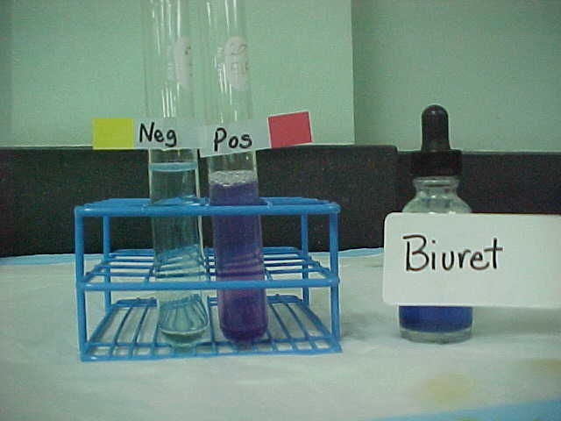
Biuret test
Objective:
-To detect the presence of a protein or peptides.
Positive result(purple color) will given if the substance have two or more peptide bonds (three or more amino acids)
Despite its name, the reagent does not in fact contain biuret ((H2N-CO-)2NH). The test is so named because it also gives a positive reaction to the peptide-like bonds in the biuret molecule.

Slide 7
Principle:
In this reaction, proteins form a pink-purple colored complex with CuSO4 in a strongly alkaline solution.
When proteins and peptides (i.e peptide bonds) treated with an alkaline solution of dilute copper sulfate a violet color is formed . A positive test is indicated by the formation of a violet color.

Slide 9
Method:
1- add 3ml of protein Albumin
2- Add 1 ml of 10M NaoH
3- Add 0.5 ml of CuSO4 and mix well.
Comment | Observation | protein
 |  | Albumin

Slide 10
Precipitation of the protein:
A-By salt “Salting out”(NH4SO4)
B- By strong acids(HNO3,TCA)
C-by salts of heavy metals(Hg+2, Pb+2, Ag+1 Tl+1, Cd+2)

Slide 11
Experiment (2): Effect of salt concentration on the protein solubility :
Objective:
to investigate the effect of different salt concentration on protein solubility.
When low concentrations of salt is added to a protein solution the solubility increases (This is called salting in)
At some point, solubility begins to decrease as salt increases-"salting out”
Each protein can be precipitated at specific salt concentration.

Slide 12
To precepitate proteins using salt you should consider:
The molecular weight (Mwt.)of protein , the high Mwt. will need less salt concentration to precipitate .
(there is inverse relationship between the Mwt of protein and the concentration of salt)
High Mwt need low concentration salt ( low percentage of saturation)
Low Mwt need high conc. of salt ( High percentage of saturation)
It is Reverse process, the protein can again become soluble when we add water

Slide 13
Principle: Salting In
Low concentrations of salt the solubility increases. This could be explained by the following:
Salt molecules stabilize protein molecules by :
Decreasing the electrostatic energy between the protein molecules which increase the solubility of proteins.
-
H2O
H2O
+
NaCl
H2O
H2O
+
+
H2O
H2O
-

Slide 14
Principle: Salting out
High concentration of salts the solubility decreases, and protein precipitates.
This could be explained by the following:
because the excess ions (not bound to the protein) compete with proteins for the solvent. The decrease in solvation allows the proteins to aggregate and precipitate.
-
-
-
+
H2O
+
H2O
H2O
+
H2O
More NaCl
+
+
+
-
+
H2O
-
+
-
-
-
H2O
-
+
H2O
+
+
-

Slide 15
Method:
T4 | T3 | T2 | T1
Take your T3 tube | Take 2 ml of your albumin sample | Take 2ml of T1 | Take your globulin sample
Add a few amount of 100% solid (NH4)2SO4 | Slightly add of 50% saturated (NH4)2SO4 solution | Slightly add of 50% saturated (NH4)2SO4 solution | Add 4 ml of NaCl solution to your globulin tube
Shake it well and write your observation | Concentrate your vision on the tube while adding | Concentrate your vision on the tube while adding Shake gently | Shake it well and write your observation
Compare between T3 and T4 (before and after addition of salt) | record your observation . Compare between T2 and T3( albumin and globulin) | record your observation | Now put your tube side for next test T2

Slide 16
Results:
Comment | Observation | Tube
 |  | Globulin + NaCl
 |  | (Globulin + NaCl) +50% saturated (NH4)2SO4
 |  | Albumin+50% saturated (NH4)2SO4
 |  | (Albumin+50% saturated (NH4)2SO4 ) + 100%saturated (NH4)2SO4
Discusses each result and Compare between them what and why you obtain it …

Slide 17
Experiment(3):Acid precipitation of proteins
Objective:
To investigate the effects of strong acids on the protein solubility.
Applications:
-Separation and purification
-Detection of small amount of protein in urea sample
- Stop the enzyme reaction

Slide 18
Principle:
This test depend on affecting solubility of the protein as a function of changes in pH in highly acidic media, the protein will be positively changed, which is attracted to the acid anions that cause them to precipitate.

Slide 19
Method
B | A
Put 3 ml of the albumin solution | In a test tube, put 3ml of conc. nitric acid carefully
add 5-7 drops of T.C.A solution carefully | Using a dropper add to (albumin) on the inner wall of the tube to form a layer up the acid
Record your observation | Record your observation

Slide 20
Results:
Comment | Observation | Tube
 |  | Conc. HNO3 + Albumin
 |  | Albumin + TCA
Discusses each result
what and why you
obtain it …

Slide 21
Experiment(4):precipitation of proteins by salts of heavy metals:
Heavy metal salts usually contain Hg+2, Pb+2, Ag+1 Tl+1, Cd+2 and other metals with high atomic weights. Since salts are ionic they disrupt salt bridges in proteins. The reaction of a heavy metal salt with a protein usually leads to an insoluble metal protein salt.
Objective:
to identify the effect of heavy metal salt on protein

Slide 22
Principle
Heavy metal salt will neutralize the protein .
By the negative charge of protein will bind with positive charge of metal ion . Then the protein will precipitate as insoluble metal protein salt .
Application::
To eliminate the poisoning by palladium Pb++ ,......mercury salts Hg++

Slide 23
Method
B | A
In a test tube, put 1 ml of Albumin sample | In a test tube, put 1 ml of Albumin sample
Using a dropper add to (albumin) few drops of HgCl2 | Using a dropper add to (albumin) few drops of AgNO3
Record your observation | Record your observation

Slide 24
Results:
Comment | Observation | Tube
 |  | Albumin + AgNO3
Discusses each result
what and why you
obtain it …

Slide 25
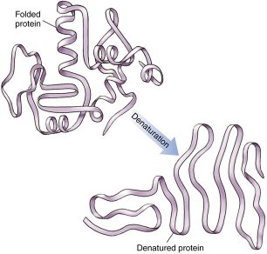
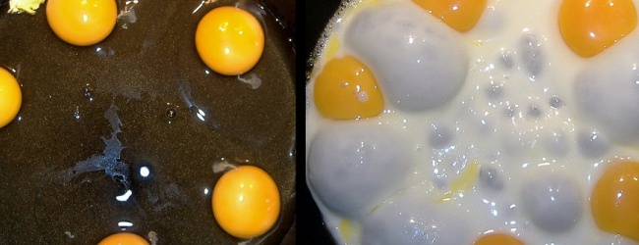
Experiment(5):proteins denaturation by heating
Non-covalent bond can be broken by heating, leading to protein denaturation and the precepitation

Slide 26
Method:
1- Take 1 ml of protein Albumin and drops of acetic acid
2- Place it in a boiling water bath for 5-10 minutes
3-Remove aside to cool to room temperature.
4-Note the change
Result:
Comment | Observation | protein
 |  | Albumin

Slide 27
