Slide 1
Pragmatics Part I
Feb 3, 2014

Slide 2
Today’s outline
1- Pragmatics(what does it mean?)
2- Context
3- Deixis

Slide 3
As you may have studied, the term linguistics may cover :
Phonetics , Phonology, Morphology , Syntax , Semantics and Pragmatics.
Pragmatics is a field of linguistics that deals with the meaning .
So , what is the difference between semantics and pragmatics ?

Slide 5
Example1

Slide 6
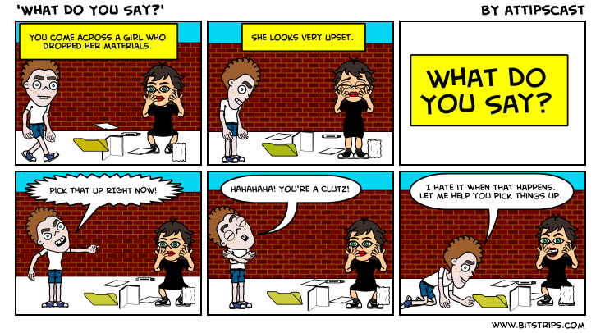

Slide 7
What is pragmatics?
Pragmatics is…
…the study of speaker’s meaning.
… the study of contextual meaning.
…the study of how more gets communicated than is said.
… the invisible meaning
Notes:
The invisible meaning

Slide 8
Advantage: one can talk about people's intended meanings, their assumptions, their purposes or goals, and the kinds of actions (for example, requests) that they are performing when they speak.
Disadvantage: difficult to analyze consistently.

Slide 9
Example:
Two friends having a conversation may imply some things and infer some others without providing any clear linguistic evidence that we can point to as the explicit source of 'the meaning' of what was communicated.
Her: So – did you?
Him: Hey – who wouldn’t?

Slide 11
Context
There are two kinds:
Linguistic context: the set of other words used in the same phrase or sentence.
Physical context: our mental representation of those aspects of what is physically out there that we use in arriving at an interpretation. Most importantly, the time and place in which we encounter linguistic expressions.

Slide 12
Deixis
Deixis are words in our language that cant be interpreted at all if we don’t know the context, especially the physical context of the speaker.
Example:
You’ll have to bring it back tomorrow because she isn’t here today.

Slide 13
Deixis
We can only understand deictic expressions, or indexicals, in terms of the speaker’s intended meaning.
Deixis means ‘pointing’ via language.

Slide 14
Three kinds of deixis:
Person deixis: to point to things and people… such as: it, this…
Spatial deixis: to point to a location… such as: here, there
Temporal deixis: to point to a time… such as: now, then

Slide 15
Deixis
We also make a distinction between what is “close” to the speaker and what is “distant” depending on the speaker’s deictic center or location.
Proximal: ‘near the speaker’…
such as: …
Distal: ‘away from the speaker’…
such as: …

