Slide 1
MKCL’s Quasi Online Examination - Practice Exam System
User Guide for Learner

Slide 2
REFERENCE VIDEO IN ARABIC
CLICK THE BELOW LINK TO VIEW THE REFERENCE VIDEO IN ARABIC.
https://shasha.ksu.edu.sa/video/practice-running-procedure

Slide 3
Pre-Requisites
Practice Exam Software will work only in Internet Explorer Browser
The Computer should have English version of Windows 7 and MS Office 2010.
Good and continuous Internet connectivity should be present.

Slide 4
Pre-Requisites
Follow the given path and refer the image given to Change User Account Control settings to “Never Notify”
Go to Control Panel >> User Accounts >> Change User Account Control settings
Drag the slider to the bottom to indicate “Never Notify”

Slide 5
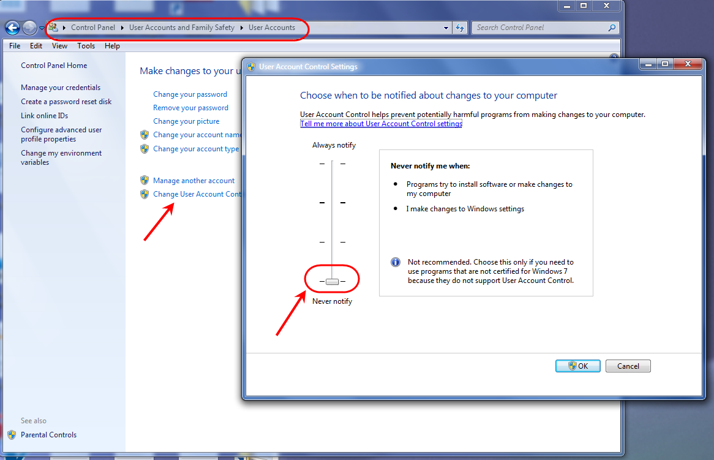
Pre-Requisites
Refer the image given to Change User Account Control settings to “Never Notify”

Slide 6
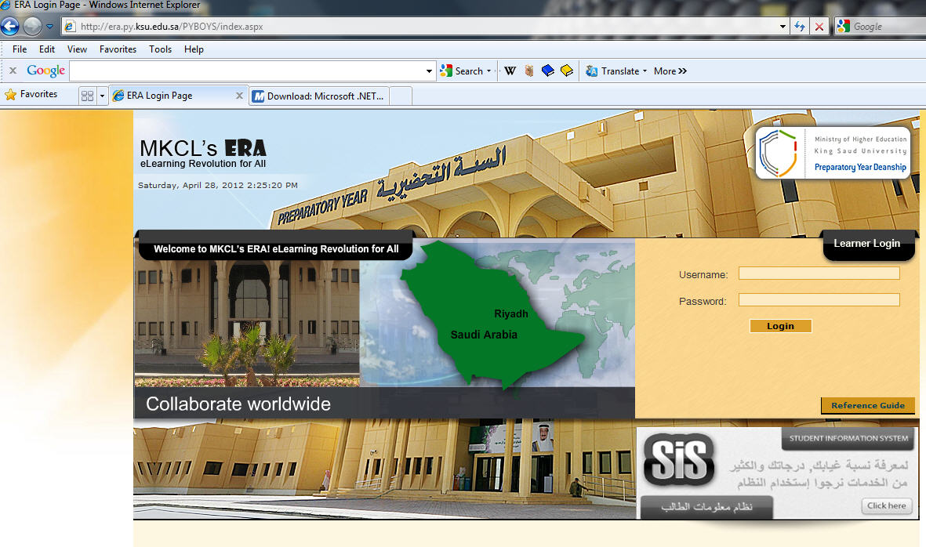
LEARNER ERA LOGIN PAGE
LOGIN TO YOUR ERA HOMEPAGE WITH YOUR STUDENT ID & PASSWORD

Slide 7
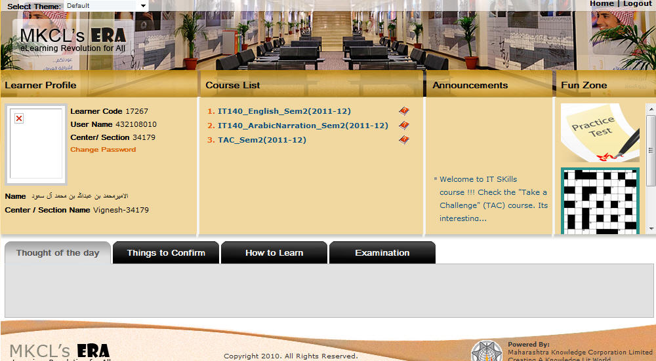
ERA HOMEPAGE
CLICK ON THE PRACTICE TEST
CLICK HERE TO TAKE THE PRACTICE TEST

Slide 8
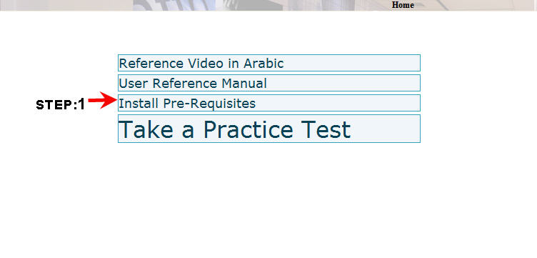
STEPS FOR PRACTICE TEST SOFTWARE INSTALLATION
STEP1 : Click the “Install Pre-requisites” which will install Microsoft .NET framework 4.0 & change the Regional Language Settings to English.

Slide 9
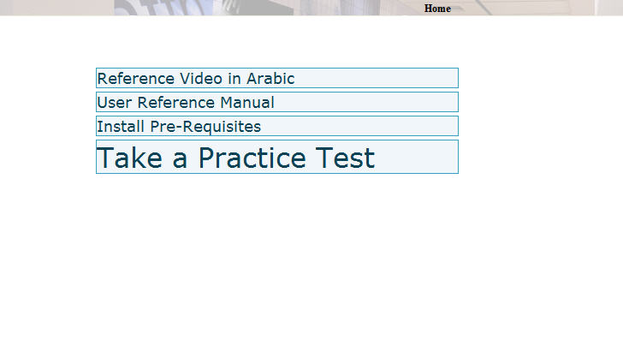
START PRACTICE TEST
Click the “Take a Practice Test” to install the exam software

Slide 10
LOADING OF EXAM SOFTWARE
Exam software application will be copied to your local machine

Slide 11
Exam Server Name
Enter 212.57.192.57,51113

Slide 12
Exam Server configuration
After successful configuration of Exam Server, you need to restart the application.

Slide 13
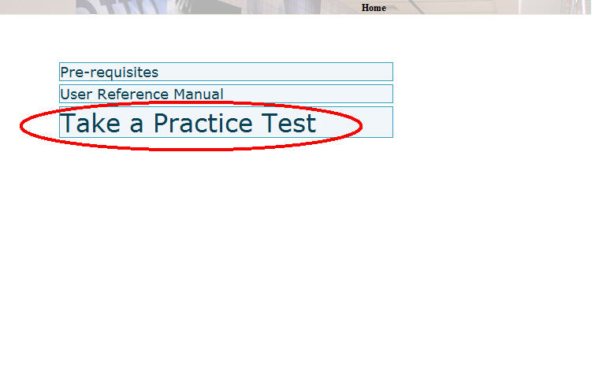
CLICK PRACTICE TEST
AFTER DOWNLOADING EXAM SOFTWARE CLICK THE LINK AGAIN to Take Practice Test

Slide 14
Start Practice Test
Click this button to start the Practice Test

Slide 15
Practice Test selection
Click on NEXT after selecting Exam
Select a Practice Test name and click Next

Slide 16
Practice Exam Learner Information
Leaner information for Practice Exam will be displayed. Click Next to continue

Slide 17
Exam Instructions
Read the instructions carefully and start the text.

Slide 18
Examination Window
Time and Exam status
Objective Questions
Practical Questions

Slide 19
Objective Questions
1) Choose the correct option
2) Click “SUBMIT ANSWER” button for every attempted question

Slide 20
Practical Questions
Click this button to start the Practical Question

Slide 21
Practical Question Window
Click the “Submit” link for submitting your answer
Practical Question can be read from here.

Slide 22
Practical Question Window – Increasing Font of Question Text
Select the required Font Size from here.

Slide 23
Practical Question Window – Expanding window size
Question window size can be expanded from here. This will help you to view the question without scrolling

Slide 24
End Test
Upon clicking “END TEST” button, you will get the summary information of how many questions are attempted, and how many are remaining.
If you want to end the test, you can click on “END TEST” button. Make sure that you really want to end the test

Slide 25
End Test - Confirmation
END TEST – Confirmation 1

Slide 26
End Test - Confirmation
END TEST – Confirmation 2

Slide 27
RESULT
Mark Details will be displayed here
Take another test
Click this button to view the Exam Attempt Details

Slide 28
Exam Attempt Details
Details of each question will be displayed here

Slide 29
Repeated Practice Tests
Take another test to practice yourself.
Practice ,Practice , Practice !!!

Slide 30
All the Best

