Slide 1
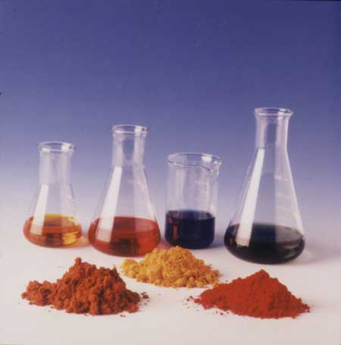
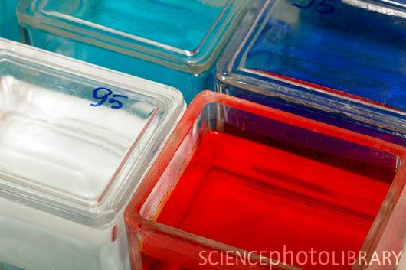
Practical-7 Mayer’s Hematoxylin & Eosin
by:
Khadija Rashed

Slide 2
It is a general purpose stain or micro-anatomical stain.
Mayer's hematoxylin is used because it eliminates the necessity for differentiation and bluing of the section. It can be considered a progressive stain which produces a stained section with clearly defined nuclei while the background is completely colorless.
Stain Solutions:
Mayer's Hematoxylin
Eosin Solutions

Slide 3
MAYER`S ALUM HAEMATOXYLIN & EOSIN METHOD
PROCEDURE:
1. Deep slide | Xylene | 3mins.
2. Deep Slide | 100% alcohol | 2min
3. Deep slide | 95% alcohol | 1min.
4. Deep slide | 70% alcohol | 1min.
5. Rinse section to | Tap water
6. Apply | Mayer`s haematoxylin | 10mins.
7. Rinse in | tap water again | 2mins.
8. Blue in | Ammonia water | 1min.
9. Apply | Eosin | 3mins.
10. Apply | 70% alcohol | 30seconds
11. Apply | 95% alcohol | 10seconds
12. Dehydrate | 100% alcohol | 10seconds
13. Dehydrate | 100% alcohol | 15seconds
14.Clear in 2 changes | Xylene | 2mins
15. Mount in | DPX-cover slipping

Slide 4
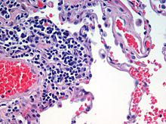
RESULT:
Cell Nuclei __________________________ blue
RBCs ______________________________ red
Connective tissue & cell cytoplasm______ shade of pink

