Slide 1
Pointer Data Type and Pointer Variables II
By:Nouf Aljaffan
Edited by : Nouf Almunyif

Slide 2
Classes, Structs, and Pointer Variables
by default, all members of a class are private.
studentType student;
studentType *studentPtr;
studentPtr= & student;
Class studentType
{
char name[26];
double GPA;
int sID;
char grade;
};
private

Slide 3
Member access operator (.)
Consider the expression *studentPtr.gpa.
Because. (dot) has a higher precedence than *, the expression studentPtr.gpa evaluates first.
The expression studentPtr.gpa would result in a syntax error, as studentPtr is not a struct variable, so it has no such component as GPA.
The following statement stores 3.9 in the component GPA of the object student:
(*studentPtr).gpa = 3.9;

Slide 4
Member access operator (->)
C++ provides another operator called the member access operator arrow, ->.

Slide 5
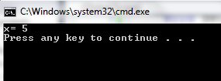
Example
#include <iostream>
using namespace std;
///////////////////////////////////
class classexample{
private :
int x;
public :
void setX(int a ) {x=a;}
void print(){cout<<"x= " <<x<<endl;}
};
///////////////////////////////////
void main (){
classexample ob;
classexample *obpointer;
obpointer = &ob;
obpointer->setX(5);
obpointer->print();
}
ob
obpointer
X
ob
obpointer
X
5

Slide 6
Initializing Pointer Variables
C++ does not automatically initialize variables
pointer variables must be initialized if you do not want them to point to anything.
Pointer variables are initialized using the following two statements :
p = NULL;
p = 0 ;
The number 0 is the only number that can be directly assigned to a pointer variable.

Slide 7
Operations on Pointer Variables
The value of one pointer variable can be assigned to another pointer variable of the same type.
Two pointer variables of the same type can be compared for equality, and so on.
Integer values can be added and subtracted from a pointer variable.
The value of one pointer variable can be subtracted from another pointer variable.

Slide 8
copies the value of q into p. After this statement executes, both p and q point to the same memory location.
Any changes made to *p automatically change the value of *q, and vice versa.

Slide 9
Comparison
The expression:
p == q
evaluates to true if p and q have the same value—that is, if they point to the same
memory location. Similarly, the expression:
p != q
evaluates to true if p and q point to different memory locations.

Slide 10
Decrement and increment
++ increments the value of a pointer variable by the size of the memory to which it is pointing.
Similarly, -- the value of a pointer variable by the size of the memory to which it is pointing.
Recall that the size of the memory allocated for an
int variable is 4 bytes
a double variable is 8 bytes
a char variable is 1 byte.
studentType is 39 bytes.

Slide 11
to explain the increment and decrement operations on pointer variables:
The statement:
p++; or p = p + 1;
increments the value of p by 4 bytes because p is a pointer of type int.
Similarly, the statements:
q++;
chPtr++;
increment the value of q by 8 bytes and the value of chPtr by 1 byte, respectively.
The statement:
stdPtr++;
increments the value of stdPtr by 39 bytes.

Slide 12
Cont.
Moreover, the statement:
p = p + 2;
increments the value of p by 8 bytes.
Thus, when an integer is added to a pointer variable, the value of the pointer variable is incremented by the integer times the size of the memory that the pointer is pointing to.
Similarly, when an integer is subtracted from a pointer variable, the value of the pointer variable is decremented by the integer times the size of the memory to which the pointer is pointing.

Slide 13
Notes
Pointer arithmetic can be very dangerous.
The program can accidentally access the memory locations of other variables and change their content without warning. leaving the programmer trying to find out what went wrong.

Slide 14
Functions and Pointers
A pointer variable can be passed as a parameter to a function either by value or by reference.
In the function pointerParameters, both p and q are pointers. The parameter p is a reference parameter; the parameter q is a value parameter.
Furthermore, the function pointerParameters can change the value of *q, but not the value of q. However, the function pointerParameters can change the value of both p and *p.

Slide 15
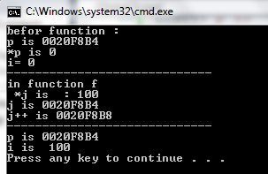
Example
#include <iostream>
using namespace std; // assume &i =0020F8B4
void f(int *j)
{*j = 100; // var pointed to by j is assigned 100
cout <<"-----------------------------"<<endl;
cout <<"in function f \n "<<"*j is : "<< *j<<endl;
cout<<"j is " <<j <<endl;
j++;
cout<<"j++ is " <<j <<endl;
cout <<"-----------------------------"<<endl;
}
int main()
{int i =0 ;
int *p;
p = &i; // p now points to i
cout << "befor function :"<<endl;
cout<<"p is " <<p<<endl;
cout<<"*p is " << *p<<endl
<< "i= " << i <<endl;
f(p);
cout<<"p is " <<p<<endl;
cout << "i is " << i << endl;
return 0;
}

Slide 16
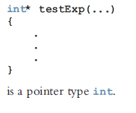
Pointers and Function Return Values
In C++, the return type of a function can be a pointer. For example, the return type of the function:

Slide 17
Example
#include <iostream>
using namespace std;
double * GetSalary()
{
double salary = 10.5; // assume &salary=0041FD14
double *HourlySalary = &salary;
return HourlySalary;
}
Void main()
{
double hours = 5.0;
cout << "Weekly Hours: " << hours << endl;
cout << "Hourly Salary: " << GetSalary() << endl;
cout << "Hourly Salary: " << *GetSalary() << endl;
double salary = *GetSalary();
double WeeklySalary = hours * salary;
cout << "Weekly Salary: " << WeeklySalary << endl;
}

Slide 18
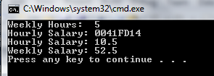

Slide 19
Dynamic Variables
Variables that are created during program execution are called dynamic variables.
new and delete operators used to create and destroy dynamic variables, respectively.
When a program requires a new variable, the operator new is used.
When a program no longer needs a dynamic variable, the operator delete is used.
In C++, new and delete are reserved words.

Slide 20
Operator new
The operator New has two forms:
New ALLOCATES memory (a variable) of the designated type and RETURNS a pointer to it—that is, the address of this allocated memory.
Moreover, the allocated memory is uninitialized.

Slide 21
Operator new
Consider the following declaration:
int *p;
int x;
The statement:
p = &x;
Similarly, the statement:
Char *q;
q = new char[16];
creates an array of 16 components of type char and stores the base address of the array in q.
stores the address of x in p. However, no new memory is allocated.
On the other hand, consider the following statement:
p = new int;
This statement creates a variable during program execution somewhere in memory and stores the address of the allocated memory in p.

Slide 22
int *p;
p=new int;
*p =10;
string *str;
str=new string;
*str="hello";

Slide 23
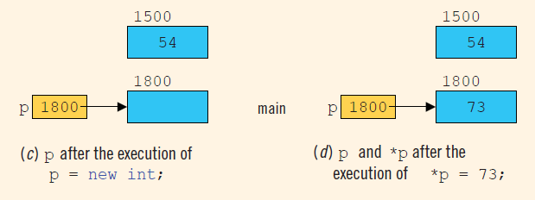

Slide 24
Operator delete
Example
only marks the memory spaces that these pointer variables point to as deallocated.

Slide 25
Dynamic Arrays
limitations of a static array is that
every time you execute the program, the size of the array is fixed.
Using the same data type.
It is ERROR to do int t=5;
int p[t];
Two approaches are used if you cannot even guess the array size.
to declare an array that is large enough to process a variety of data sets.
during program execution, you could prompt the user to enter the size of the array and then create an array of the appropriate size.
Pointers help in creating arrays during program execution and process.
An array created during the execution of a program is called a dynamic Array.

Slide 26
Dynamic Array
To create a dynamic array, we use the second form of the new operator.
allocates 10 contiguous memory locations, each of type int, and stores the address of the first memory location into p.
the statement:
*p = 25;
stores 25 into the first memory location, and the statements:
p++; //p points to the next array component
*p = 35;
store 35 into the second memory location.

Slide 27
Of course, after performing a few increment operations, it is possible to lose track of the first array component.
C++ allows us to use array notation to access these memory locations. For example, the statements:
p[0] = 25;
p[1] = 35;
p[0] refers to the first array component, p[1] refers to the second array component

Slide 28
p[i] refers to the (i)th array component. After the preceding statements execute, p still points to the first array component.
the following for loop initializes each array component to 0:
When the array notation is used to process the array pointed to by p, p stays fixed at the first memory location. Moreover, p is a dynamic array created during program execution.

Slide 29
The following program segment illustrates how to obtain a user’s response to get the array size and create a dynamic array during program execution.

Slide 30
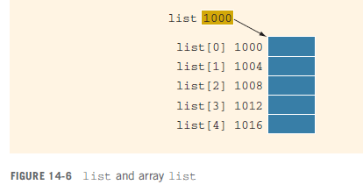
List itself is a variable, and the value stored in list is the base address of the array—that is, the address of the first array component. Suppose the address of the first array component is
1000.

Slide 31
Because the value of list, which is 1000, is a memory address, list is a pointer variable.
However, the value stored in list, which is 1000, cannot be altered during program execution. That is, the value of list is constant.
Therefore, the increment and decrement operations cannot be applied to list.
In fact, any attempt to use the increment or decrement operations on list results in a compile-time error.

Slide 32
copies the value of list, which is 1000, the base address of the array, into p.
We are allowed to perform increment and decrement operations on p.
An array name is a constant pointer.

