Slide 1
Chapter 1:
Introduction to Project Management
Modified by: Asma AlOsaimi& Safa’aAlBassam

Slide 2
Learning Objectives
Understand the growing need for better Project Management (PM), especially for Information Technology (IT) projects
Explain what a project is, provide examples of information technology projects,
List various attributes of projects, and describe the triple constraint of projects
Describe PM and discuss key elements of the PM framework, including: project stakeholders, PM knowledge areas, common tools and techniques, and project success
Describe the PM profession, and the advancement of project management software

Slide 3
Introduction
Many organizations today have a new or renewed interest in project management, why?
  Computer hardware, software, networks, and the use of interdisciplinary and global work teams have radically changed the work environment
  The world as a whole spends nearly $10 trillion of its $40.7 trillion gross product on projects of all kinds
More than 16 million people regard project management as their profession

Slide 4
Project Management Statistics
Total global spending on technology goods, services, and staff was projected to reach $2.4 trillion in 2008
In the U.S. the size of the IT workforce topped 4 million workers for the first time in 2008
In 2007 the total compensation for the average senior project manager in U.S. dollars was $104,776 per year in the United States, $111,412 in Australia, and $120,364 in the United Kingdom
The number of people earning their Project Management Professional (PMP) certification continues to increase

Slide 5
What went wrong?
IT Projects have a terrible track record (Project failure)
In 1995 Standish Group study (CHAOS) found that only 16.2% of IT projects were successful in meeting scope, time, and cost goals; over 31% of IT projects were canceled before completion.
A PricewaterhouseCoopers study found that overall, half of all projects fail and only 2.5% of corporations consistently meet their targets for scope, time, and cost goals for all types of project.
These facts motivate for studying project management formally

Slide 6
What Is a Project?
A project :
“a temporary endeavor undertaken to create a unique product, service, or result” (PMBOK® Guide, Fourth Edition, 2008, p. 5)
  Projects end when their objectives have been reached or the project has been terminated
  Projects can be large or small and can take a short or long time to complete
Operations is work done to support the business

Slide 7
Project Example 1
manufacturing cell phone cases:
  A cell phone company is interested in manufacturing a special cell phone case for their newest model. This cell phone case is part of a promotion to sell the phone. They begin four months from today. Only 1200 of these special cases will be manufactured for distribution during the promotion. After the promotion, no further cases will be manufactured or distributed.
    is it temporary? ✓
    is it unique? ✓
    will the end of the project reach the project objectives? ✓

Slide 8
Project Example 2
manufacturing cell phone cases:
  The cell phone company has so much success with their promotional cell phone cases that customer demand has convinced them to integrate this case as part of their regular product offering. It will now be manufactured along with the other five cases that are currently offered. The cases will be manufactured until the customer demands for the phone drops.
    is it temporary? ✗
    is it unique? ✗
    will the end of the project reach the project objectives? ✗
  It is not a project , it is an operation work.

Slide 9
Examples of IT Projects
A small software development team adds a new feature to an internal software application for the finance department
A college campus upgrades its technology infrastructure to provide wireless Internet access across the whole campus
A company decides what Voice-over-Internet-Protocol (VoIP*) system to purchase and how it will be implemented
(* A protocol for transmitting the human voice in digital form over the Internet or other networks as an audio stream, instead of using traditional telephone lines. VoIP uses the Internet Protocol (IP), but is not limited to communication by computer—even phone-to-phone communication can be conducted using this technology.

Slide 10
Project Attributes
A project:
  Has a unique purpose
  Is temporary
  Is developed using progressive elaboration
  Requires resources, often from various areas
  Should have a primary customer or sponsor
    The project sponsor usually provides the direction and funding for the project
  Involves uncertainty

Slide 11
The Triple Constraint
Every project is constrained in different ways by its
  scope, time and cost goals. The limitations are sometimes called the triple constraints.
  Scope goals: What is the project trying to accomplish? What unique product or service does the customer or sponsor expect from the project ?
  Time goals: How long should it take to complete the project? What is the project schedule ?
  Cost goals: What should it cost to complete the project?
It is the project manager’s duty to balance these three often competing goals

Slide 12
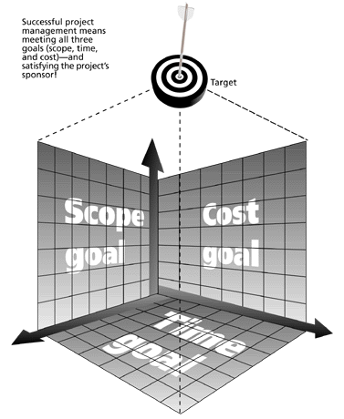
The Triple Constraint of Project Management
Successful project management means meeting all three goals (scope, time, and cost) – and satisfying the project’s sponsor!

Slide 13
Triple Constraint
Managing the triple constraint involves making compromises between scope, time and cost goals for a project. e.g. increasing the budget for a project in order to meet scope and time goals. Or, reducing the scope of a project in order to meet time and cost goals.

Slide 14
Quadruple Constraint
Triple constraints describes the basic elements of a project. There are also some elements that play significant roles. These are
  Quality
  Customer or Sponsor satisfaction
  Some people believe that quality considerations, including customer satisfaction must be inherent in setting the scope, time and cost goals of a project.
  Thus , a good project management meets not only the triple constraint (scope, time and cost) but also the quality and customer satisfaction.

Slide 15
What is Project Management?
Project management is “the application of knowledge, skills, tools and techniques to project activities to meet project requirements”
Project managers strive to meet the triple constraint by balancing project scope, time, and cost goals

Slide 16
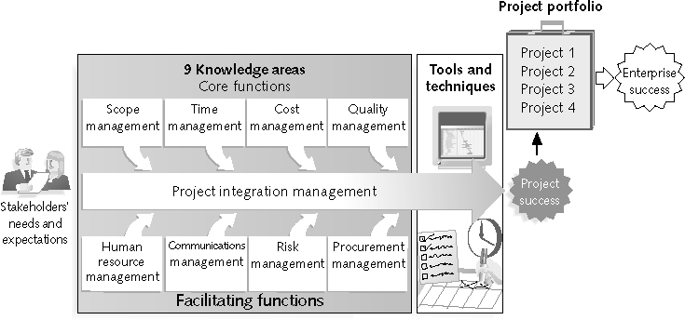
Project Management Framework

Slide 17
Key elements of the Frame work
Project stakeholders.
Project management knowledge areas.
Project management tools and techniques.

Slide 18
1:Project Stakeholders
Stakeholders are the people involved in or affected by project activities
Stakeholders include:
  The project sponsor
  The project manager
  The project team
  Support staff
  Customers
  Users
  Suppliers
  Opponents to the project
The stakeholders often have very different needs and expectations, which are important throughout the life of a project.
Successful Project Mangers develop good relationships with project stakeholders to understand and meet their needs and expectations.

Slide 19
2: 9 Project Management Knowledge Areas
Knowledge areas describe the key skills and qualifications that project managers must develop
  4 core knowledge areas (scope, time, cost, and quality) lead to specific project objectives
  4 facilitating knowledge areas (human resources, communication, risk, and procurement management) are the means through which the project objectives are achieved
  1 knowledge area (project integration management) affects and is affected by all of the other knowledge areas
  All knowledge areas are important!

Slide 20
3: Project Management Tools and Techniques
Project management tools and techniques assist project managers and their teams in various aspects of project management
Some specific ones include:
  Project charter, scope statement, and WBS (scope)
  Gantt charts, network diagrams, critical path analysis, critical chain scheduling (time)
  Cost estimates and earned value management (cost)
  See Table 1-1 in the book for many more

Slide 23
Advantages of Using Formal Project Management
Better control of financial, physical, and human resources
Improved customer relations
Shorter development times
Lower costs
Higher quality and increased reliability
Improved productivity
Better internal coordination
Higher worker morale

Slide 24
What Went Right?
  The Standish Group’s CHAOS studies show improvements in IT projects success in the past decade
  The number of successful IT projects has more than doubled, from 16% in 1994 to 35% in 2006
  The number of failed projects decreased from 31% in 1994 to19% in 2006
  The United States spent more money on IT projects in 2006 than 1994 ($346 billion and $250 billion, respectively), but the amount of money wasted on challenged and failed projects was down to $53 billion in 2006 compared to $140 billion in 1994

Slide 25
Project Success Criteria
There are several ways to define project success:
  The project met scope, time, and cost goals
  The project satisfied the customer/sponsor
  The results of the project met its main objectives, such as making or saving a certain amount of money, providing a good return on investment, or simply making the sponsors happy

Slide 26
Project and Program Managers
Project managers work with project sponsors, the project team, and other people involved in a project to meet project goals
Program: group of related projects managed in a coordinated way to obtain benefits and control not available from managing them individually
Program managers oversee programs; often act as bosses for project managers

Slide 27
Program and Project Portfolio Management
A program manager provides leadership and direction for the project managers heading the projects within the program
Examples of common programs in the IT field include infrastructure, applications development, and user support

Slide 28
Project Portfolio Management
Portfolio: A group of investments
As part of project portfolio management, organizations group and manage projects and programs as a portfolio of investments that contribute to the entire enterprise’s success
Portfolio managers help their organizations make wise investment decisions by helping to select and analyze projects from a strategic perspective

Slide 29
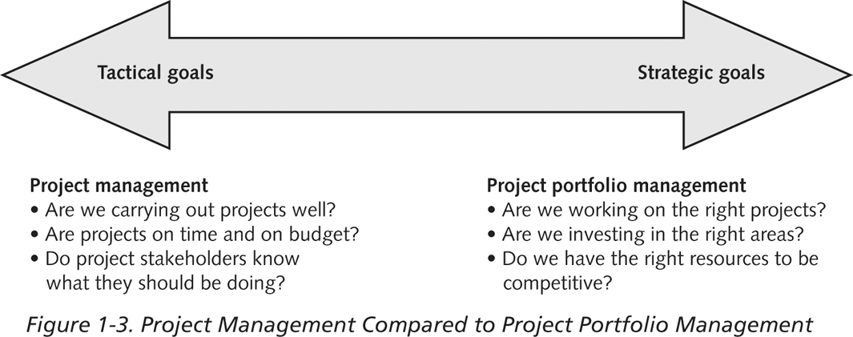
Project Management Compared to Project Portfolio Management

Slide 30
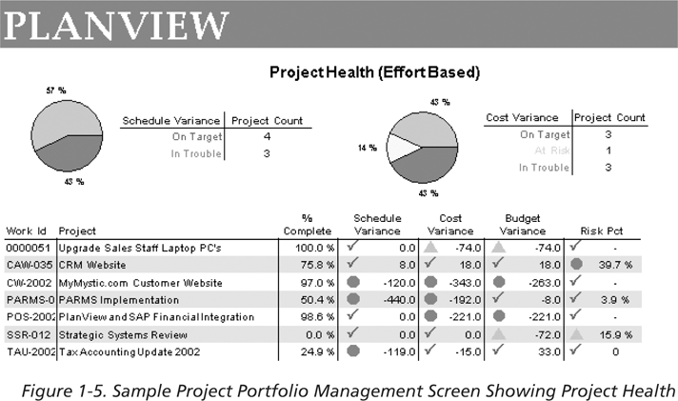
Sample Project Portfolio Management SW Screen Showing Project Health

Slide 31
The Role of the Project Manager
Job descriptions vary, but most include responsibilities like planning, scheduling, coordinating, and working with people to achieve project goals
Remember that 97% of successful projects were led by experienced project managers, who can often help influence success factors

Slide 32
Suggested Skills for Project Managers
Project managers need a wide variety of skills
Project managers need both “hard” and “soft” skills.
  Hard skills include product knowledge and knowing how to use various project management tools and techniques.
  soft skills include being able to work with various types of people

Slide 33
Suggested Skills for a Project Manager
    Communication skills: listening, persuading
    Organizational skills: planning, goal-setting, analyzing and achieving project goals
    Team Building skills: empathy, motivate different types of people effectively, develop esprit de corps within the project team and the stake holders.
    Leadership skills: set examples of appropriate and effective behaviour, be energetic, have vision (big picture), delegate, be positive
    Coping skills: flexibility, creativity, patience, persistence
    Technological skills: experience, product and project knowledge

Slide 34
Most Significant Characteristics of Effective and Ineffective Project Managers
Effective Project Managers Ineffective Project Managers
Lead by example
Are visionaries
Are technically competent
Are decisive
Are good communicator
Are good motivators
Stand up to upper management when necessary
Support team members
Encourage new ideas
Set bad examples
Are not self-assured
Lack technical expertise
Are poor communicators
Are poor motivators

Slide 35
Careers for IT Project Managers
In a 2006 survey, IT executives ranked the skills that would be the most in demand in the next two to five years
Project/program management topped the list!

Slide 36
Table 1-4. Top IT Skills (partial list)
SKILL PERCENTAGE OF RESPONDENTS
Project/program management 60%
Business process management 55%
Business analysis 53%
Application development 52%
Database management 49%
Security 42%
Enterprise architect 41%
Strategist/internal consultant 40%

Slide 37
The Project Management Profession
The profession of project management is growing at a very rapid pace
It is helpful to understand the role of professional societies like the Project Management Institute (PMI), and the growth in project management software
  The Project Management Institute (PMI) is an international professional society for project managers founded in 1969
PMI has continued to attract and retain members, reporting 277,221 members worldwide by August 31, 2008
PMI provides certification as a Project Management Professional (PMP)
The number of people earning PMP certification is increasing quickly

Slide 38
Figure 1-8. Growth in PMP Certification, 1993-2008

Slide 39
Project Management Software
There are hundreds of different SW products to assist in performing project management
Three main categories of SW tools:
  Low-end tools: handle single or smaller projects well, cost under $200 per user
  Midrange tools: handle multiple projects and users, cost $200-600 per user, Project 2007 most popular
  High-end tools: also called enterprise project management software, often licensed on a per-user basis, like VPMi Enterprise Online (www.vcsonline.com)
See the Project Management Center Web site or Top Ten Reviews for links to many companies that provide project management software

Slide 40
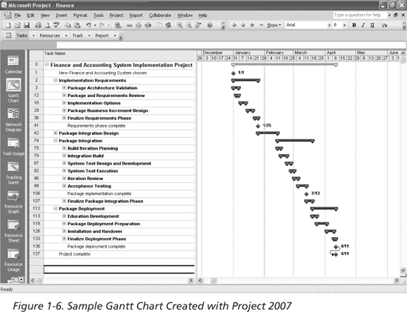
Sample Gantt Chart Created with Project 2007

Slide 41
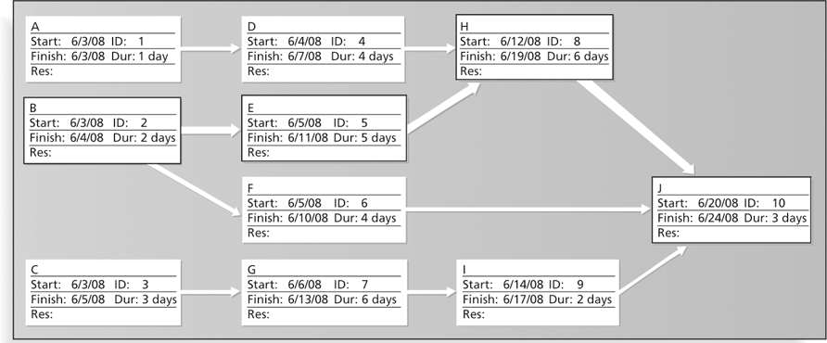
Sample Network Diagram in Microsoft Project

Slide 42
Projects Cannot Be Run in Isolation
Projects must operate in a broad organizational environment
Project manager need to consider projects within the organization context
Project managers need to use systems thinking:
  A system is a set of interacting components working with an environment to fulfill some purpose
  Taking a holistic view of carrying out projects within the context of the organization
Senior managers must make sure that projects continue to support current business needs

Slide 43
Chapter Summary
A project is a temporary endeavor undertaken to create a unique product, service, or result
Project management is the application of knowledge, skills, tools, and techniques to project activities to meet project requirements
A program is a group of related projects managed in a coordinated way
Project portfolio management involves organizing and managing projects and programs as a portfolio of investments
Project managers play a key role in helping projects and organizations succeed
The project management profession continues to grow and mature

