Slide 1
Chapter#8:Project Risk Management Planning

Slide 2
Objectives
Define and recognize risk
Define the contents of a risk management plan
Conduct a risk identification and prioritization process
Define the correct risk response strategy for the organization

Slide 3
The Importance of Project Risk Management
Every IT project regardless of size, complexity, location, or organization contains some measure of risk
Aid the project team in assessing the impact a negative event will have on the project and how likely (generally expressed as a percentage or qualitative term) is the event to occur
The PM’s objective: is not the removal of all risk, this simply can’t be done, but to identify and manage risks to the benefit of the project
Risks on a project can be a good thing if managed appropriately
The main objectives of risk management are to increase the probability and impact of positive outcomes and decrease the probability and impact of negative outcomes

Slide 4
The Importance of Project Risk Management
Crisis management is the opposite of good risk management – organizations find themselves trying to figure out what to do about a problem after it has occurred instead of planning for issues in advance
This is also referred to “fire fighting”

Slide 5
What Is Risk?
A Function of the {likelihood, and impact}
An event if it occurs will have a negative impact on one or more of: project scope, time, cost, quality, or resources

Slide 6
Risk Utility
An organization’s approach to risk management is driven by their risk utility or tolerance for risk
Risk utility or risk tolerance is the amount of satisfaction or pleasure received from a potential payoff
  Utility rises at a decreasing rate for a person who is risk-averse
  Those who are risk-seeking have a higher tolerance for risk and their satisfaction increases when more payoff is at stake
  The risk-neutral approach achieves a balance between risk and potential payoff

Slide 7
Risk Utility Function and Risk Preference

Slide 8
Risk Management Planning Processes
  Risk management planning: deciding how to approach and plan the risk management activities for the project
  Risk identification: determining which risks are likely to affect a project and documenting their characteristics
  Qualitative risk analysis: characterizing and analyzing risks and prioritizing their effects on project objectives
  Quantitative risk analysis: measuring the probability and consequences of risks
  Risk response planning: taking steps to enhance opportunities and reduce threats to meeting project objectives

Slide 9
Risk Management Planning
The main deliverable of risk management planning is the risk management plan!
The risk management plan is created early in the planning phase of the project and updated throughout the life of the project

Slide 10
Risk Identification
The first step is to identify as many risks as possible for the upcoming project with the knowledge that you can never see them all
Risk identification is not a one time process; but should be a continuous process of team members and stakeholders looking for new issues that may affect the success of the project Broad Organizational Categories
  Analogy
  Brainstorming
  Interviews
  Delphi Technique
  SWOT Analysis

Slide 11
Where to Look for Risks?

Slide 12
Broad Categories of Risk
People (human resources)
Technology (changes)
Quality and performance issues
Customers
Vendors
Management
Funding
Political Issues or Legal Issues
Market Forces

Slide 13
Risk Identification methods
Analogy
  Uses information from past similar projects or the experience of team members to look for risks
  Previous projects must be up to date!
  Delphi Technique
  Using this technique the participants are unknown to each other so ideas can be generated without fear of ridicule
Brainstorming
  It is a non-structured or semi-structured method of eliciting ideas from a group with the goal of generating a complete list of ideas

Slide 14
Risk Identification methods
Post-it note
  During a short time interval such as five minutes, have each participant write down on post-it notes as many ideas as they can think of putting one idea per post-it
  Participants then hand their notes to the moderators who stick them on a chalk or white board. duplicate ideas are stuck on top of each other to reduce the number of entries. A list of ideas is then quickly generated and the team discusses the merits of each
  Ideas which have close to zero probability of occurring or zero impact to the project are removed from the board

Slide 15
Post-it Notes
The ideas that remain must then be rated for likelihood and impact. A large matrix is drawn on the board similar to the probability and impact matrix (Figure 8-2). The post-it notes can then be moved around inside the matrix until the team agrees on each placement
Finally, generate the start of the risk register (figure 8-1) from the remaining post-it notes

Slide 16
Interviewing
The project leader and other key members of the team with interview skills, conduct personal one-on-one discussions with key stakeholders
The crucial aspect to successful interviewing is to make sure the stakeholders feel comfortable sharing ideas with the interviewer
The success of this technique is heavily dependent on the skills of the interviewer

Slide 17
Risk Register

Slide 18
Risk Register Contents
Risk – name of the risk along with short description. Some like to include a numbering scheme to make it easier to reference
Trigger event – explanation of the event or events that signal to the person monitoring that this risk is about to happen or has happened; looking at the root cause of the risk
Responsible – name of the person (preferred) or group/department responsible for monitoring the risk and executing mitigation activities

Slide 19
Risk Register Contents
Consequence – explanation of the impact to the project if the risk occurs
Probability – an estimation of the likelihood the risk will materialize and affect the project. The probability is often a qualitative rating (low, medium, high) or could be a more quantitative number
Mitigation – explanation of the strategy being used to lesson the chances the risk will occur

Slide 20
Qualitative Risk Analysis
Subjective methods for qualifying each risk for impact and probability of occurrence
This usually involves a method which can be done quickly in a short period of time with little resources
Risk qualitative tools and techniques include
  Interviews with Subject Matter Experts
  Probability/Impact matrix

Slide 21
Probability/Impact Matrix
The probability and impact matrix aids the project team in prioritizing which risks need more attention based on either their probability of occurring or the size of the impact to the project or both

Slide 22
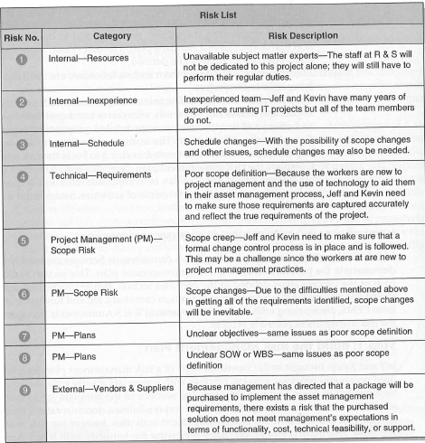

Slide 23
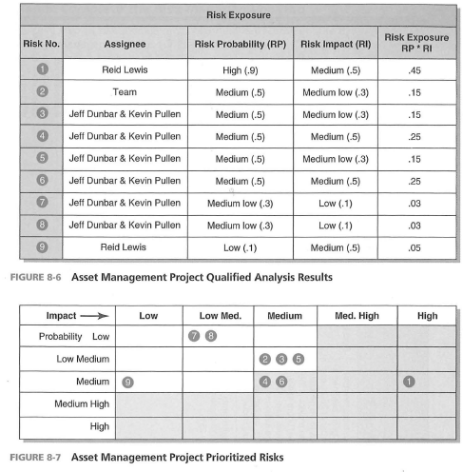

Slide 24
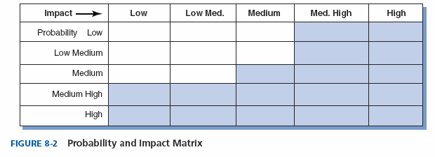
Probability and Impact Matrix

Slide 25
Probability/Impact Matrix
The columns represent the degree of impact to the project’s scope, time, cost, and quality goals
This example using a five level scale: zero to low impact, low to medium, medium, medium to high, and high impact. The scores are determined by subject matter experts and historical data
The next step determine the probability that a risk will materialize again using expert judgment and historical data

Slide 26
Risk Rating Scores

Slide 27
Quantitative Risk Analysis
Much like qualitative risk analysis, quantitative risk analysis attempts to estimate the impact a risk may have on a project as well as the probability
The key difference between the two is that quantitative analysis is based on mathematical or statistical techniques to model the behavior of a particular risk

Slide 28
Quantitative Risk Analysis Techniques
Decision trees with expected monetary value analysis
Simulation (Monte Carlo)

Slide 29
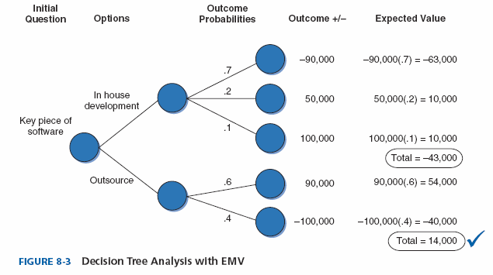
Decision Trees and Expected Monetary Value (EMV)
The EMV analysis technique is a statistical concept that calculates the average outcome when dealing with unknown future scenarios

Slide 30
Risk Response Planning
After identifying and quantifying risk, you must decide how to respond to them
Four main strategies:
  Risk avoidance: eliminating a specific threat or risk, usually by eliminating its causes
  Risk acceptance: accepting the consequences should a risk occur without trying to control it
  Risk transference: shifting the consequence of a risk and responsibility for its management to a third party internal or external to the organization
  Risk mitigation: reducing the impact of a risk event by reducing the probability of its occurrence

Slide 31
Mitigation Strategies
The final step after the risk response has been chosen; update the risk register with the mitigation strategy: fallback plans, contingency plans, and contingency reserves.
  Fallback plans
  Contingency plans.
  Contingency reserves
Contingency plans use the contingency reserves to meet project objectives
Notes:
Fallback plans are used if the project can not be completed as originally planned
Contingency plans are put in place to allow for fluctuations that will allow the project to finish as originally planned.
Contingency reserves are excess amounts of time, dollars, and resources etc. used if necessary in order for the project to finish as originally planned.

Slide 32
Risk Management Process Steps
Build/choose the risk management plan format
Identify risks
Risk assessment
Complete the risk register
Complete the risk management plan (budget, schedule of activities, any specific tools needed)

