Slide 1
Project Quality and Communications Planning
Chapter#7

Slide 2
Objectives
Part 1: Quality Management
   Understand the definition of quality and the different methodologies to provide quality
   Know quality management plan components
Part 2: Communications Management
   Understand the importance of possessing excellent communication skills
   Know how to build a communication management plan

Slide 3
Poor Quality Examples
Therac-25 was a radiation therapy machine produced by Atomic Energy of Canada Limited and CGR MeV of France. It was involved with at least six known accidents between 1985 and 1987, in which patients were given massive overdoses of radiation. At least five patients died of the overdoses due to a software bug
In the U.S. software bugs cost organizations nearly $60 billion per year, according to the Commerce Department’s National Institute of Standards and Technology (NIST). According to NIST, one-third of these costs could be eliminated with improved testing methods especially early in the development cycle

Slide 4
Outcomes
NO Quality Management at all or minimal attention to Quality – one of main reasons of software project failure.
Total Software Quality Management (TSQM), Software Quality Management (SQM), Software Quality Assurance (SQA) – are CRITICAL areas in software development industry these days
Not just Quality Management in general (as business folks understand it), but specifically Software Quality Management – based on deep knowledge of software engineering, development and testing processes.
These days, every global company has quality-related strategy and Vice-President on Quality, Total Quality Management, invests millions of dollars into quality, etc

Slide 5
What Is Project Quality Management?
International Organization for Standardization (ISO) definition: the totality of features and characteristics of a product or service that bears on its ability to satisfy stated or implied needs
The American Society for Quality and the PMBOK define quality as “the degree to which a set of inherent characteristics fulfill requirements.”
Text: the degree to which the product satisfies both stated and implied requirements
Can be inflated for more quality or deflated for less quality.

Slide 6
ISO Quality Management Principles
Customer Focus
Provide Leadership
Involvement of People
Use a Process Approach
Take a Systems Approach
Encourage Continual
Factual Approach to Decision Making
Mutually beneficial supplier relationships
Notes:
Customer Focus – Because Organizations rely on their customers, they must understand customer needs, they must meet customer requirements, and they must exceed customer expectations.
Provide Leadership - Leaders must establish a unity of purpose and set the direction the organization should take using a unified mission and vision. They must create an environment that encourages people to achieve the organization's objectives.
Involvement of People – The organization must involve people from all levels to promote ownership and support.
Use a Process Approach – Each and every activity within the organization must be managed as a process leading to a more predictable outcome lowering costs and cycle time.

Slide 7
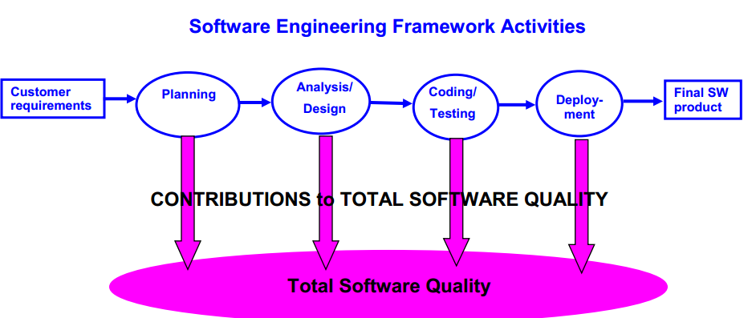
Software Quality: Overall Picture
Software quality can be defined as:
  An effective process applied in a manner that creates a useful software product that provides measurable value for those who produce it and those who use it.

Slide 8
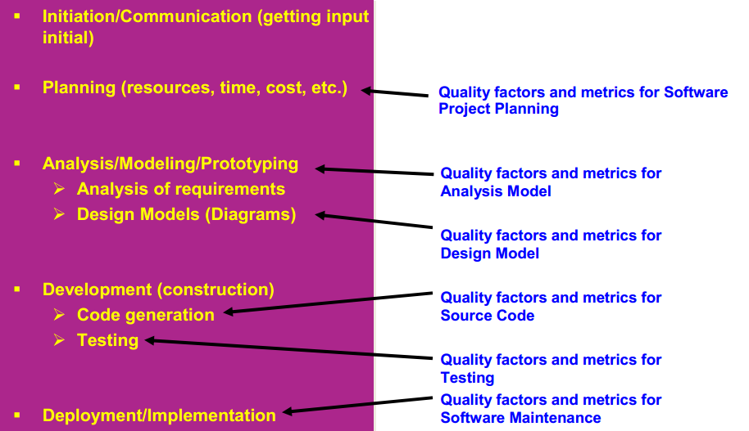
Software Quality Factors and Metrics: Innovative Approach
“Not just Quality Management in general but Software Quality Management”

Slide 9
Quality Management Planning Process
Quality planning: identifying which quality standards are relevant to the project and organization and determining the activities necessary to meet the established standards in order to deliver the product fit for customer use

Slide 10
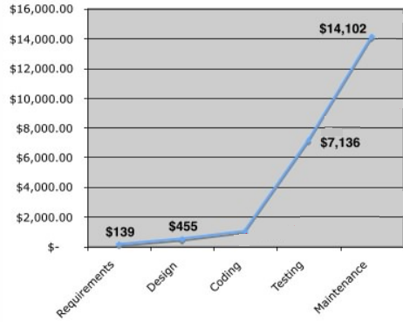
The bottom line: Software System’s Costs (an example)
The relative costs to find and repair a software defect (bug, flaw) increase dramatically as we go from prevention to detection to internal failure to external failure costs.
External failure costs are
The costs associated with deficiencies found after product is received by the customer.
  complaint resolution
  product return and replacement
  help line support
  warranty work
 Internal failure The costs of deficiencies discovered before delivery.
  Rework
  Repair
  failure mode analysis
 Prevention costs i The costs incurred to keep failure and appraisal costs to a minimum.
  quality planning
  formal technical reviews (FTRs)
  test procedures and equipment
  Training
Appraisal Costs.
  determine the degree of conformance to quality requirements
  Ex: inspection costs
$977

Slide 11
ISO 9000
Based in Geneva Switzerland, consortium of approx. 100 world’s industrial nations. The American National Standards Institute (ANSI) represents the U. S.
 Quality system standard applicable to any product, service, or process anywhere in the world
ISO:9000 – defines the key terms and acts as a road map for the other standards
 ISO:9001 – defines the model for a quality system when a contractor demonstrates the capability to design, produce, and install products or services
 ISO:9002 – quality system model for quality assurance in production and installation
 ISO:9003 – quality system model for quality assurance in final inspection and testing
 ISO:9004 – quality management guidelines

Slide 12
ISO 9126 Six Key Groups of
Software Quality Factors (Groups of Metrics)
Functionality :
  Degree to which software complies with requirements specifications.
    Suitability
    Accuracy
    Interoperability
    Security
Reliability :Amount of time the software is available and functioning as expected.
  Maturity
  Fault Tolerance
  Recoverability

Slide 13
ISO 9126 Six Key Groups of
Software Quality Factors (Groups of Metrics)
Usability: indicates how easy it is to learn and use the software. Includes sub attributes Learn ability, Operability, accessibility.
Efficiency: Extent to which software efficiently uses available system resources. Includes sub attributes memory, CPU, disk space and extern devices.
Maintainability.
  Indicates how easy is it to fix defects or enhance or add new functionality to the software. Includes sub attributes analyzability, changeability, testability.
Portability.
  Indicates how easy is it to port or migrate the software to a different hardware or Operating system. Includes sub attributes install ability, adaptability and replace ability.

Slide 14
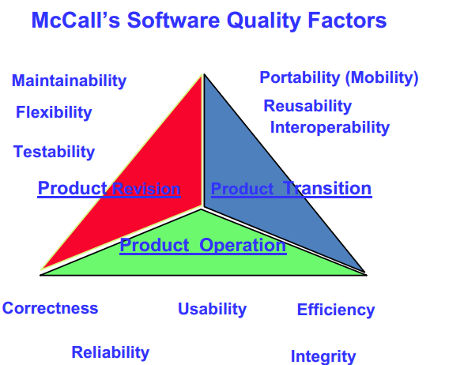
McCall’s Software Quality Factors
They have tight relationship with ISO 9126 SW Quality Factors

Slide 15
Software Quality Factors
Correctness extent to which a program satisfies its specification and fulfills the customer's mission objectives
Reliability extent to which a program can be expected to perform its intended function with required precision
Efficiency amount of computing resources and code required by a program to perform its function
Usability effort required to learn, operate, prepare input for, and interpret output of a program
Reusability extent to which a program [or parts of a program] can be reused in other applications
Testability effort required to test a program to ensure that it performs its intended function
Integrity extent to which access to software or data by unauthorized persons can be controlled
Maintainability effort required to locate and fix an error in a program
Flexibility effort required to modify an operational program
Portability effort required to transfer the program from one hardware and/or software system environment to another
Interoperability effort required to couple one system to another

Slide 16
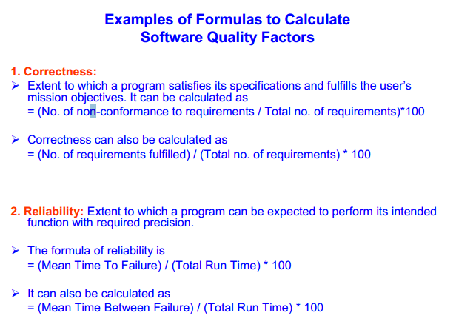

Slide 17
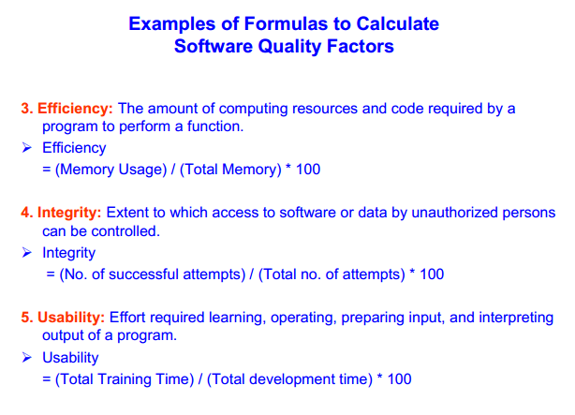

Slide 18
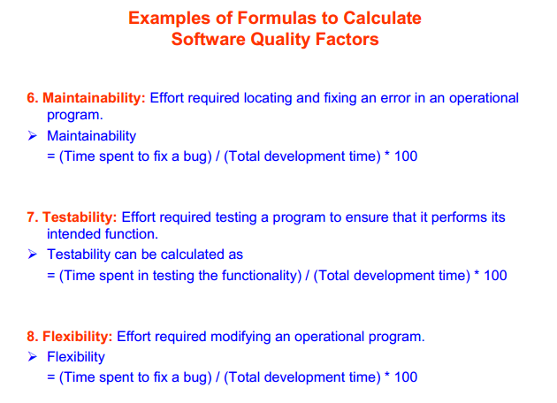

Slide 19
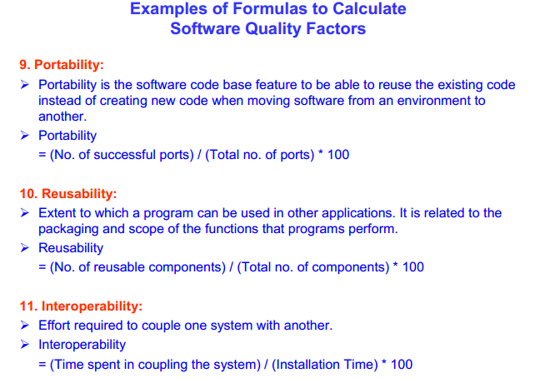

Slide 20
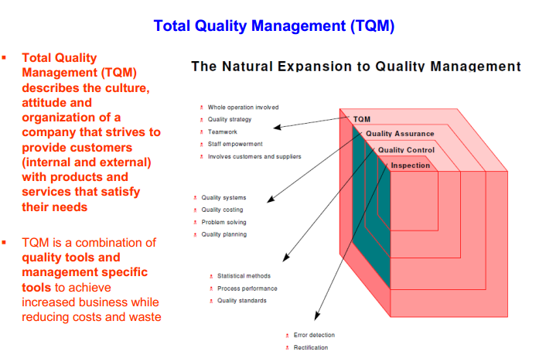

Slide 21
Communications Planning
Importance of Good Communications:
  The greatest threat to many projects is a
“failure to communicate”
  Effective project communications is paramount to success on all projects and especially on IT projects due largely to the language gap that occurs on many projects
  Strong verbal skills are a key factor in career advancement for IT professionals
  It has been estimated that as much as 90% of a project manager’s time is spent in some form of communication
Notes:
http://www.americanrhetoric.com/MovieSpeeches/moviespeechcoolhandluke2.html is the link for failure to communicate
A link to the movie where this quote came from “failure to communicate” Cool Hand Luke

Slide 22
Communications Planning
Every project should include some type of communications management plan, a document that guides project - written and oral communications (timing, detail)
Much of the information contained in the communications management plan is taken from the stakeholder analysis already completed in an earlier process

Slide 23
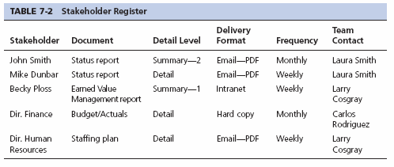
How to Communicate with Each Stakeholder

Slide 24
The Communications Plan Must Answer the Following Questions:
Who are the stakeholders?
What information do the stakeholders need, when do they want it, at what level of detail do they need, and in what form?
Who on the project team is responsible for collecting data, creating the reports, and disseminating the reports?
Who on the project team is the first contact for stakeholders with questions and issues?
Who on the project team is the first contact for external vendors with questions and issues?

Slide 25
Steps to Conducting the Quality Planning Process
Obtain commitment and shared understanding from stakeholders on the quality standards to be used on this specific project.
Conduct training for all on the Organization’s quality initiative (Six Sigma, TQM, CMMI)
Define the quality standards which consist of metrics (goals) to be measured and the acceptable result parameters
Determine how each metric result will be collected and who is responsible for collecting each data item.

Slide 26
Steps to Conducting the Quality Planning Process
Conduct Project Team training on the chosen metrics and the defined process for control and monitoring.
Build checklists to aid the project team in collecting and monitoring quality standards
Define and report the current baseline of metrics for the organization
Build process improvement plans, disseminate and execute
Finally, accumulate information from previous steps and build the Quality Management plan

Slide 27
Steps to Conducting the Communication Planning Process
Review the stakeholder analysis and add information if necessary pertaining to communications management and complete the stakeholder communications matrix.
Define content for status reports and timing
Establish who on the project team is responsible for collecting data for status reports
Establish who on the project team is responsible for creating the reports and disseminating the reports
Establish key project team contacts for each stakeholder to serve as first contact references
Finally, accumulate information from previous steps and build the Communications Management plan

Slide 28
